Slide 1


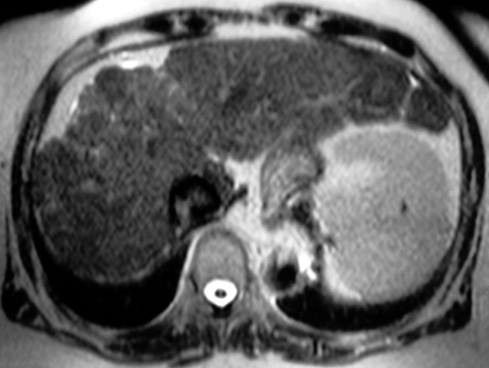
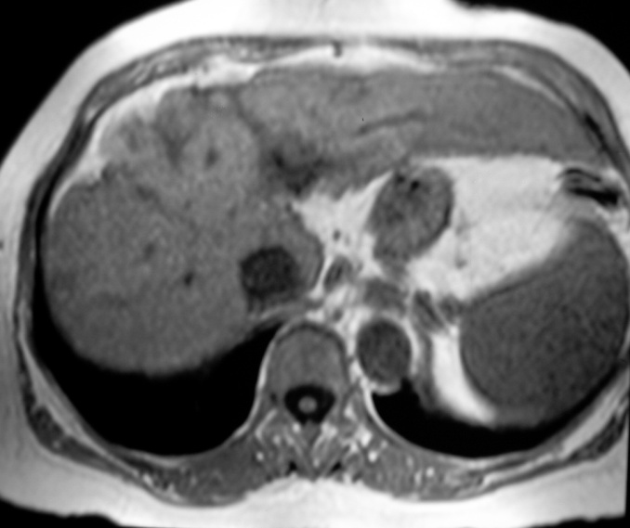
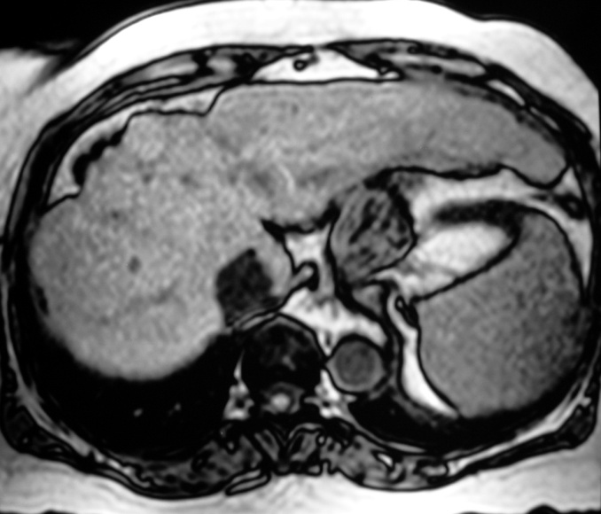
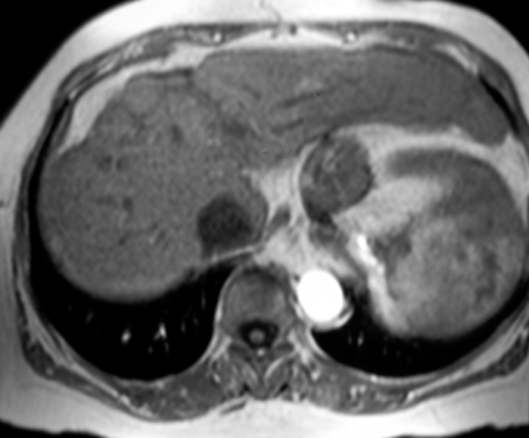
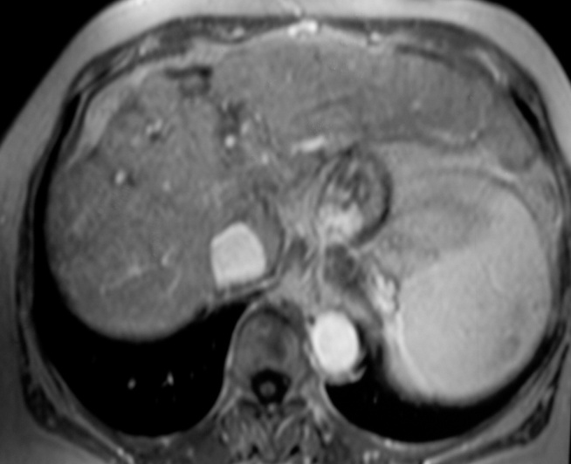
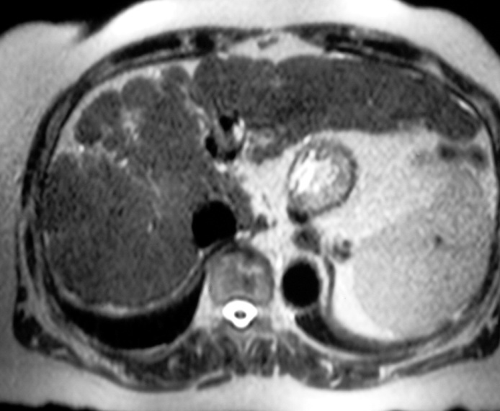
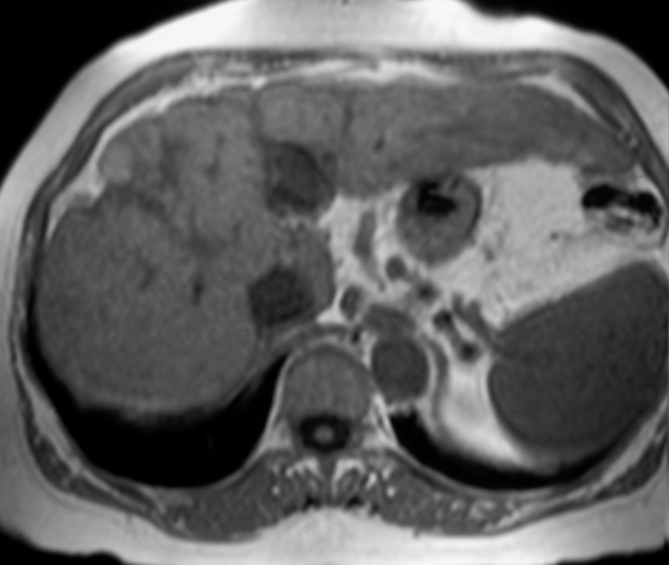
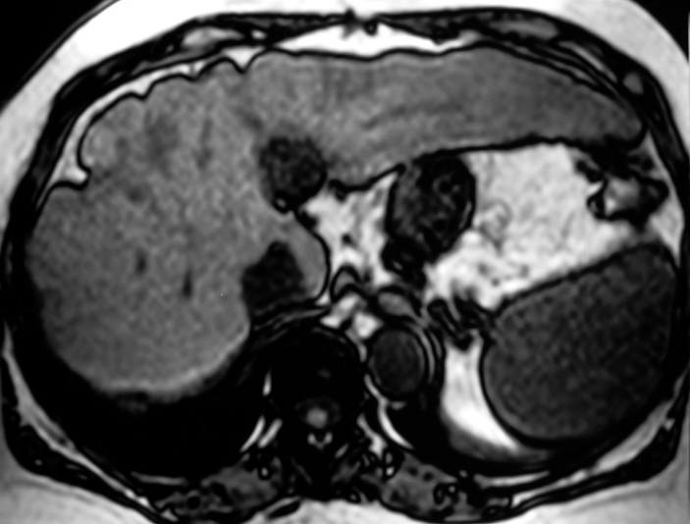
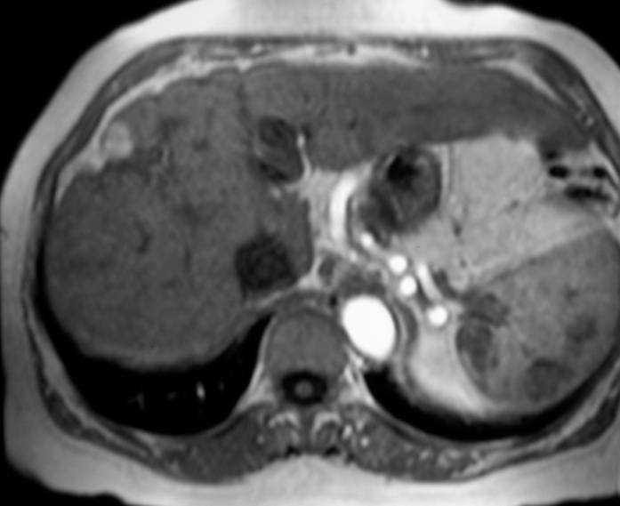
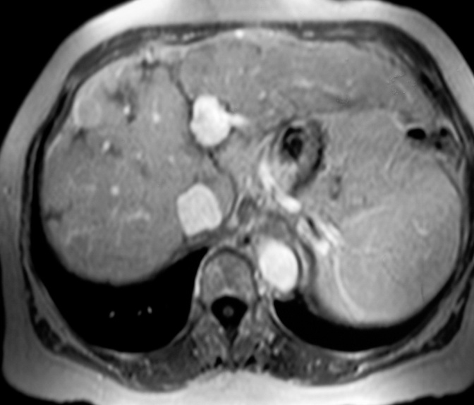
MRI: “wash in” e “wash out”
Enhancement neoangiogenesi HCC
Notes:
1
This vascular criteria is daily used with CT or MR also. In this example on T2……

Slide 2
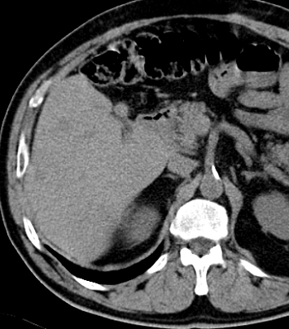
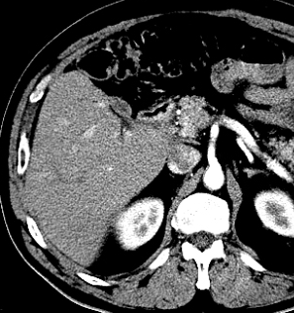
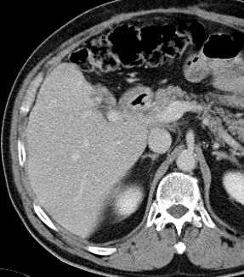
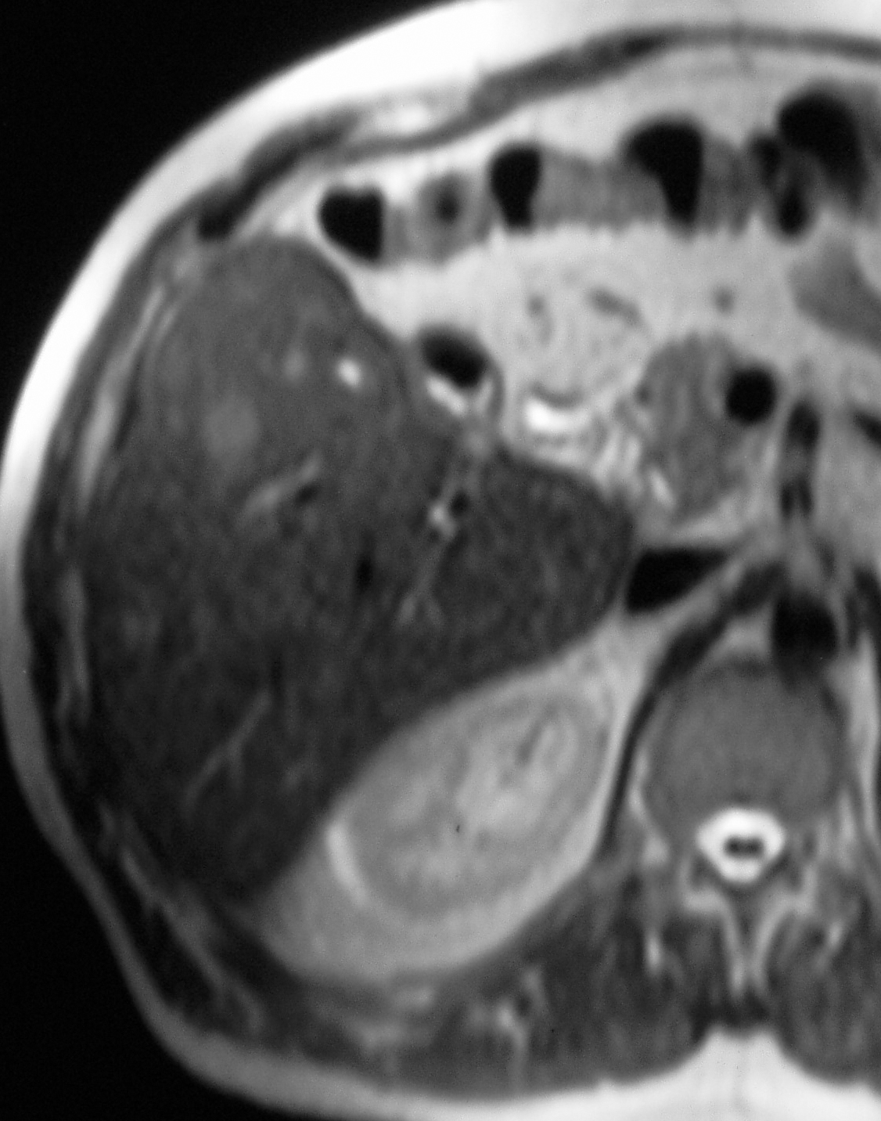
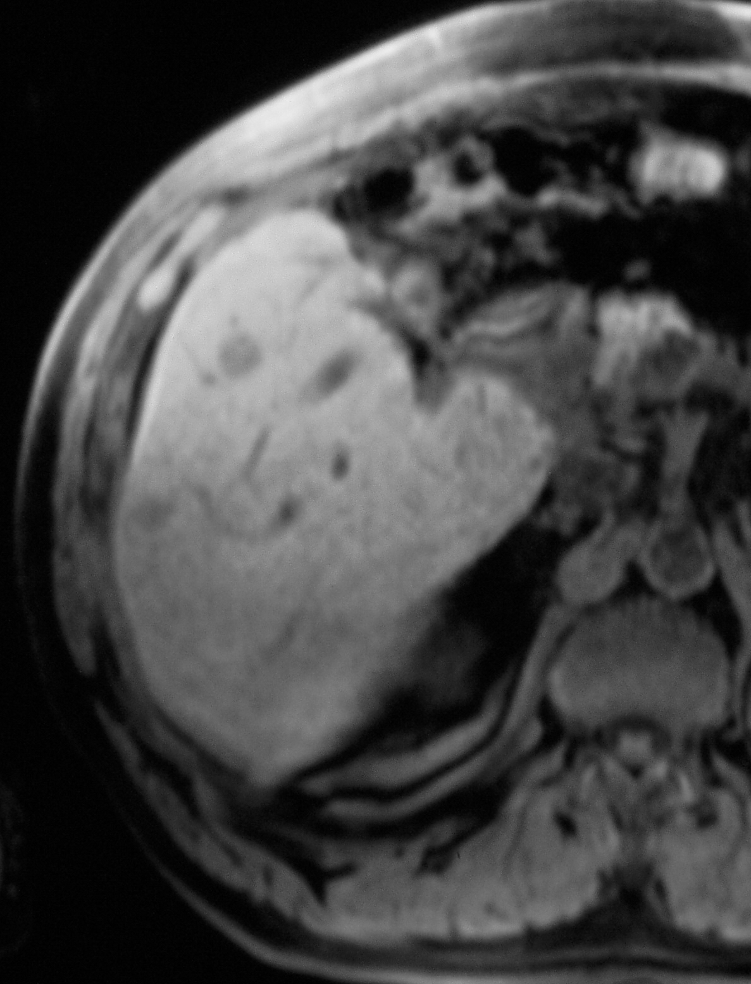
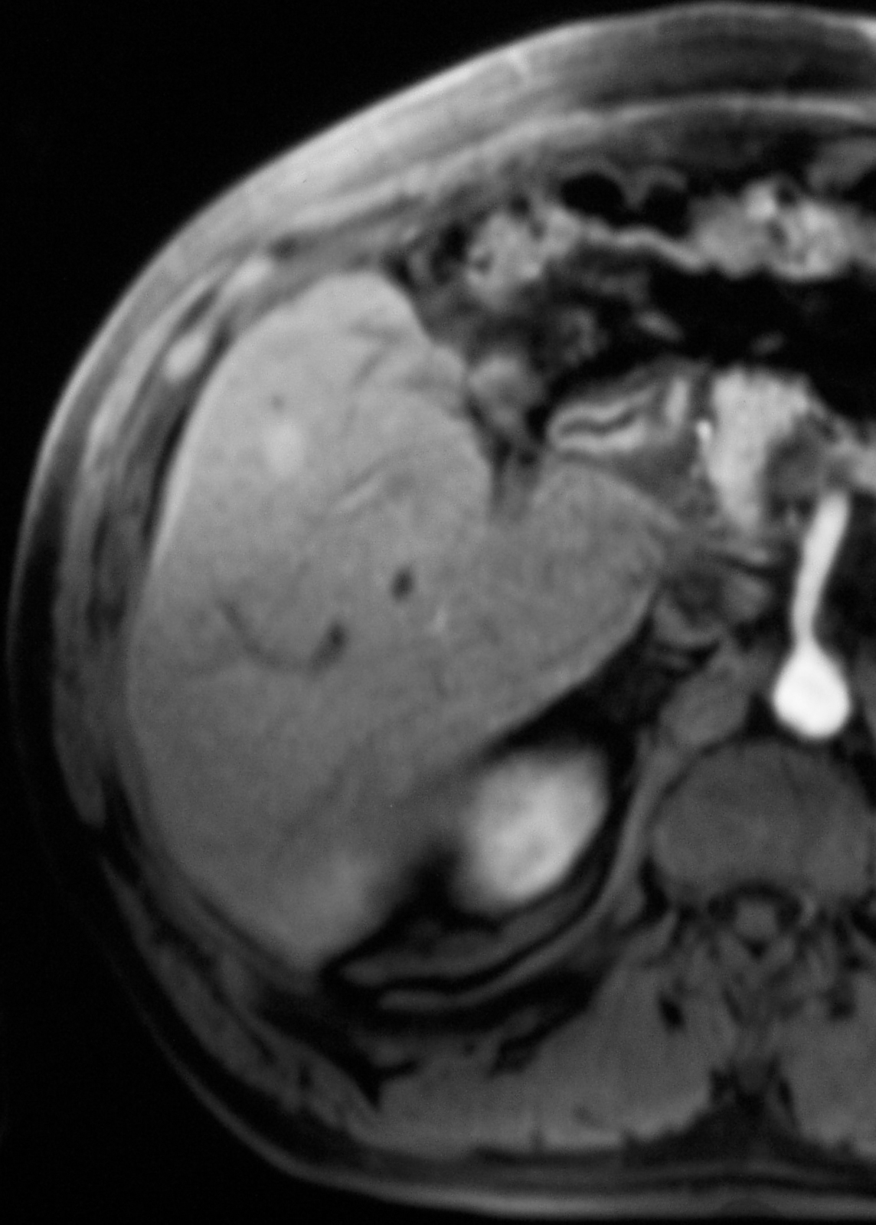
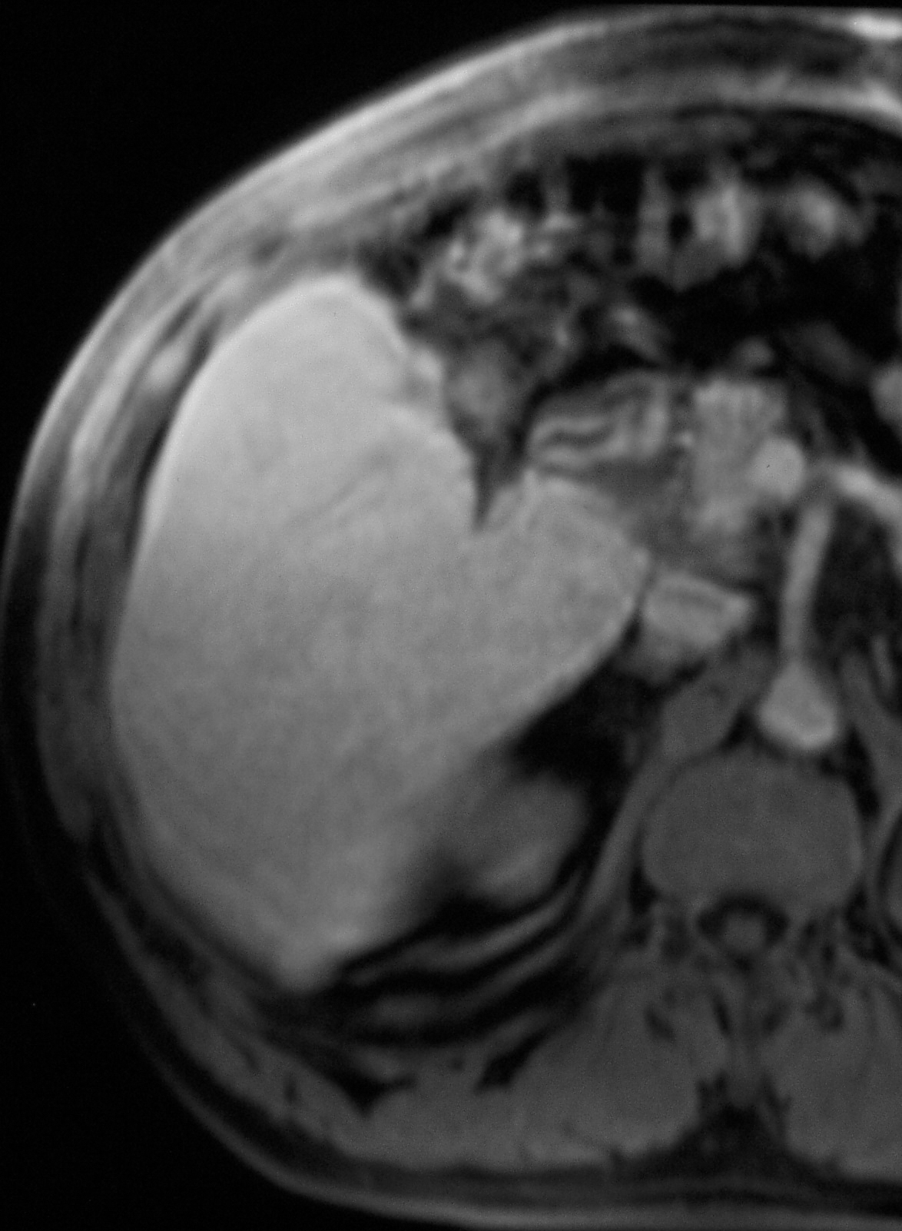
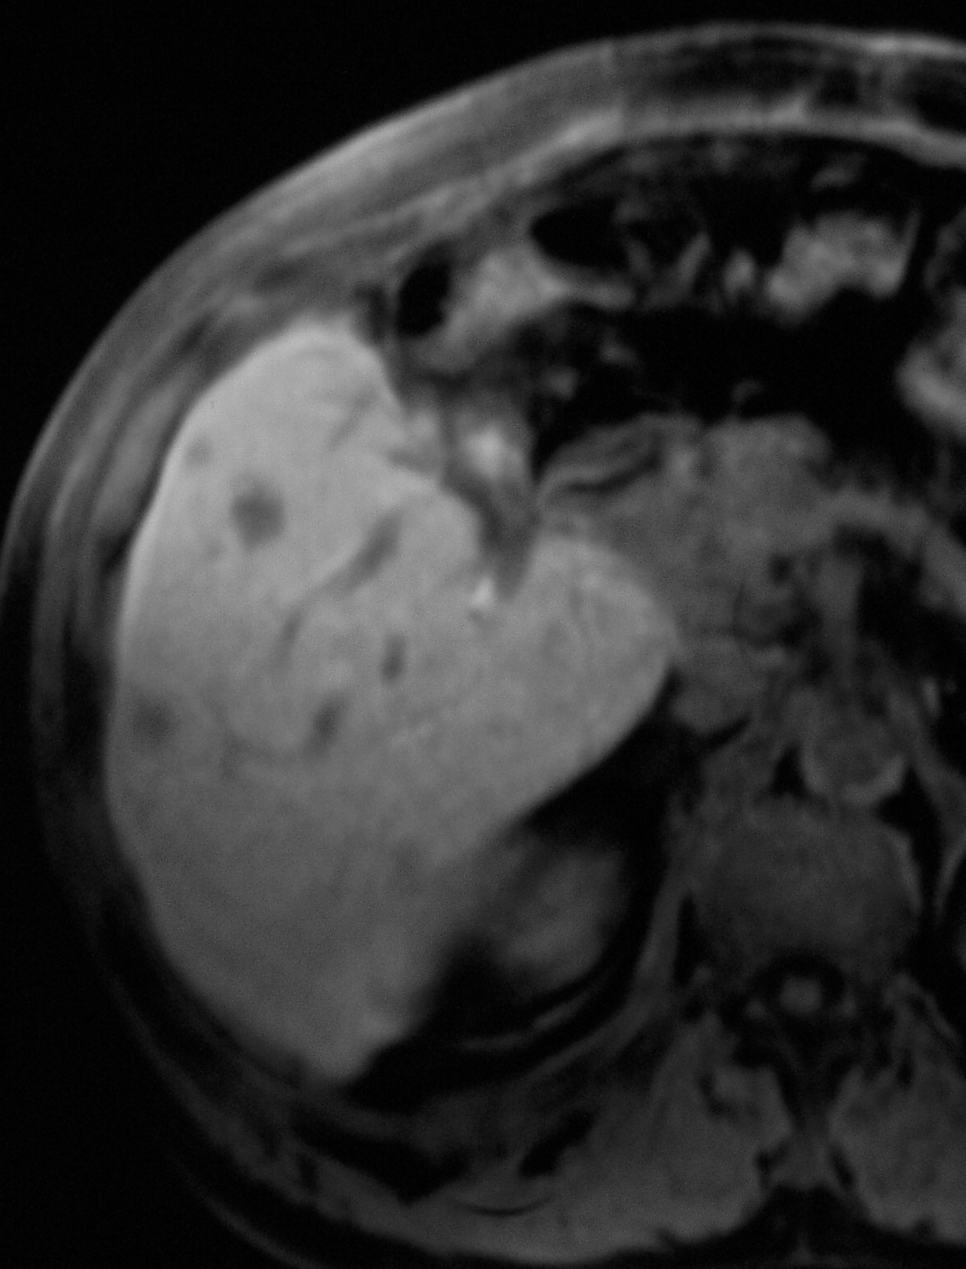
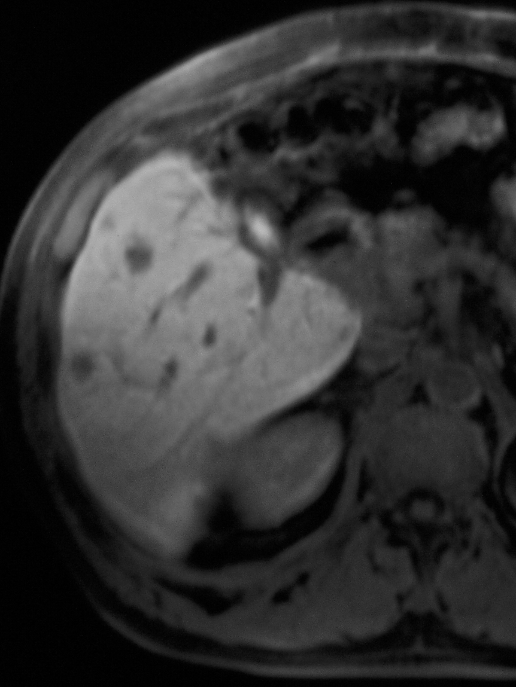
Oltre il criterio vascolare …
Pre-c
Art
PVP
TSE T2w
Studio dinamico con Gd-EOB-DTPA
10’
20’

Slide 3
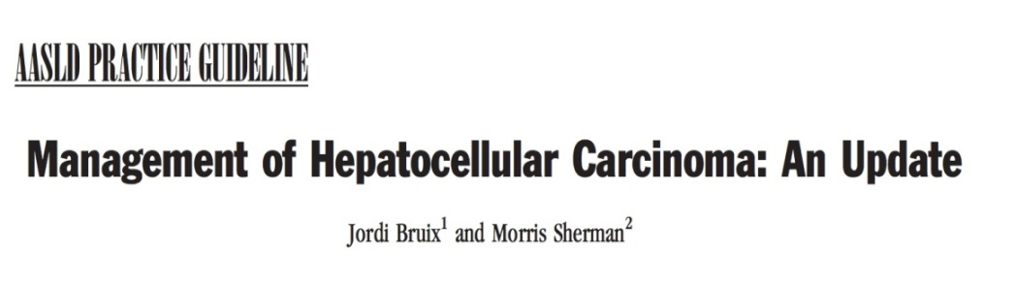
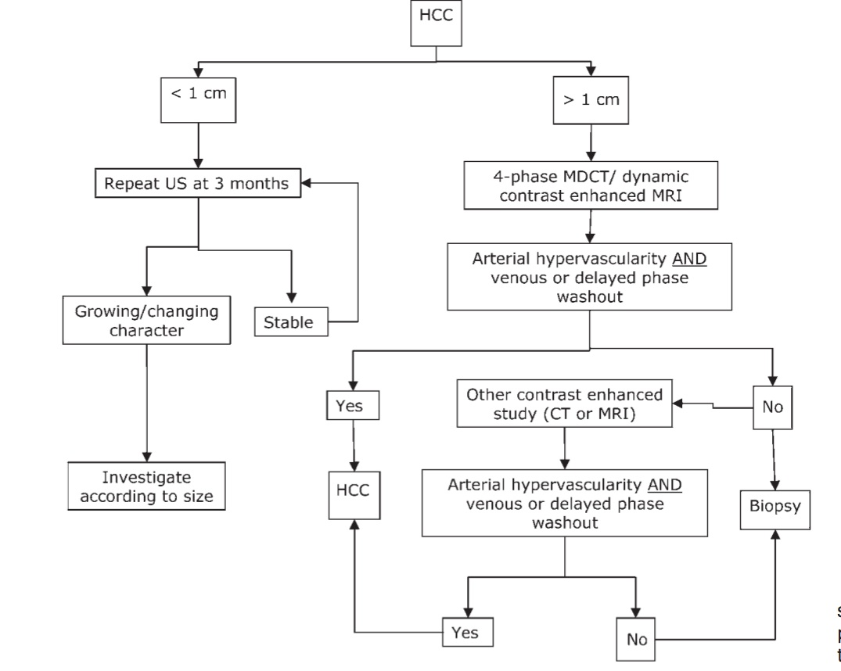
AASLD practice guidelines (2010)

Slide 4


HCC Guidelines and recommendation 2012
Diagnostic algorithm
Mass/nodule on US
<1cm
1-2cm
>2cm
Repeat US at 4 mo
4-phase CT/Dynamic
Contrast enhanced MRI
4-phase CT or Dynamic
Contrast enhanced MRI
1 or 2 positive techniques*:
HCC radiological Hallmarks**
1 positive technique:
HCC radiological Hallmarks**
Growing/Changing
Character
Stable
Investigate
according to size
Yes
No
Yes
No
HCC
Biopsy
HCC
Biopsy
Inconclusive
Diagnostic algorithm and recall policy.*One imaging technique only recommended in centers of excellence with high-end radiological equipment.**HCC radiological hallmark: arterial hypervascularity and venous/late phase washout
EASL–EORTC Clinical Practice Guidelines: Management of hepatocellular carcinoma Journal of Hepatology 2012 vol. 56 j 908–943
Available on: http://www.easl.eu/assets/application/files/d38c7689f123edf_file.pdf
Notes:
4
4

