Slide 1
Protocolli di terapia cellulare sperimentali di fase I/II
Paolo Rebulla
Cell Factory “Franco Calori”
Centro di Medicina Trasfusionale, Terapia Cellulare e Criobiologia
Dipartmento di Medicina Rigenerativa
Fondazione Ca’ Granda Ospedale Maggiore Policlinico, Milano
Notes:
1

Slide 2
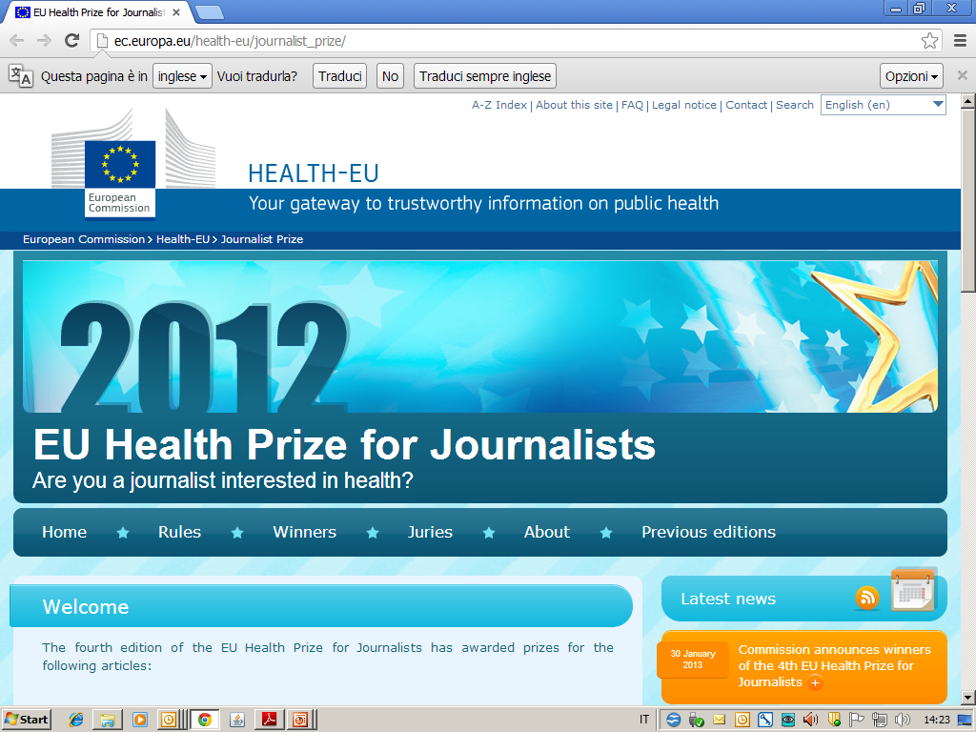

 | 3rd prize Daniela Cipolloni: “All those lies spread by private umbilical-cord blood banks (26 KB) ” (Oggi Scienza magazine, Italy) This article contributes to the debate on umbilical-cord blood banks and the use of stem cells, which is especially valuable as this area is subject to different approaches and divergent views across the EU.

Slide 3
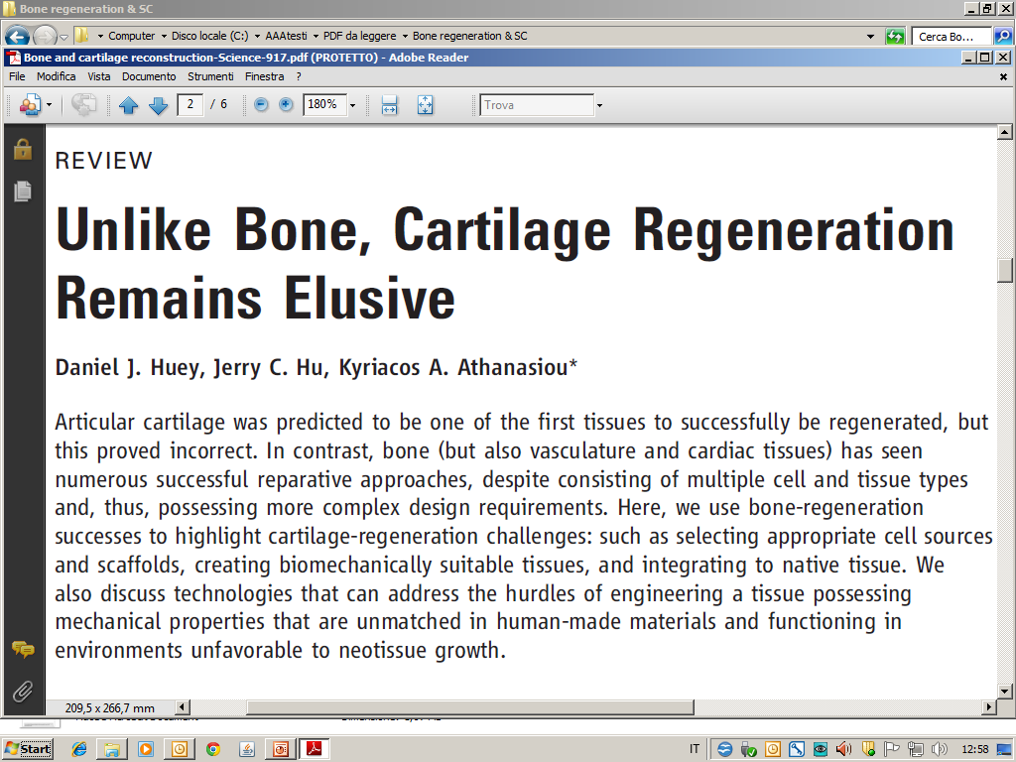
A recent review ...
SCIENCE 2012; 338: 917
Promising vs challenging developments
16 November 2012

Slide 4
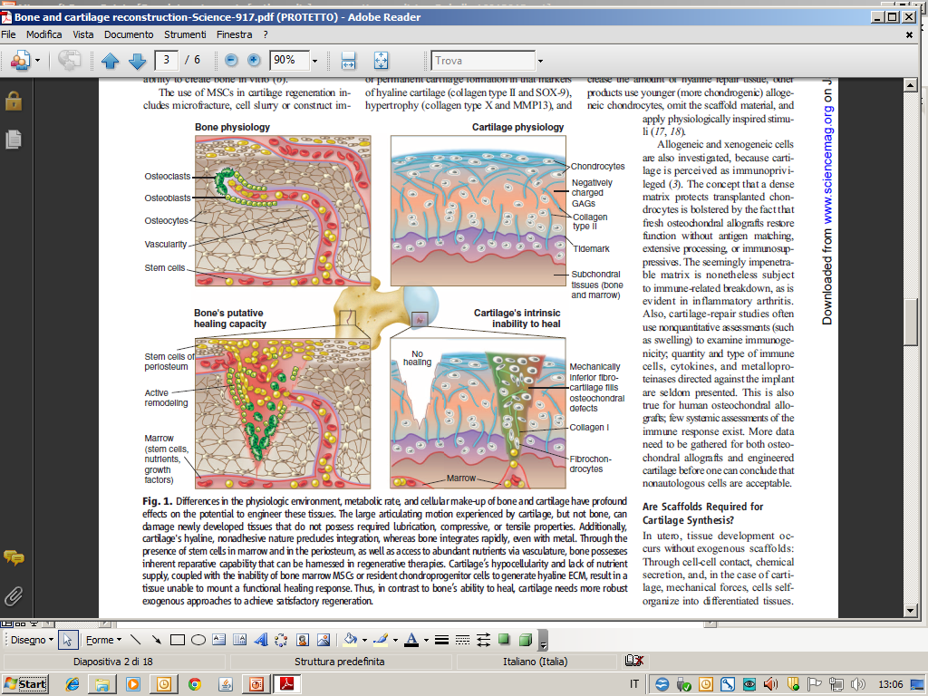
SCIENCE 2012; 338: 917

Slide 5
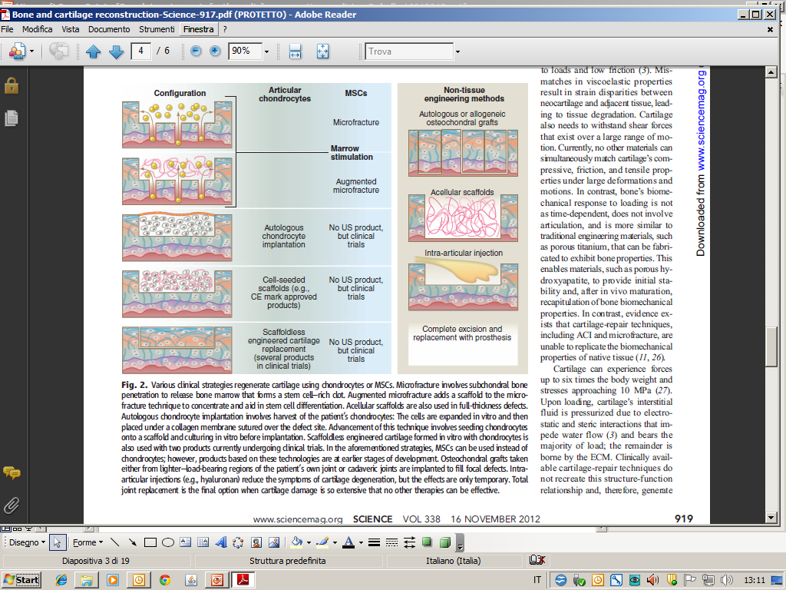
SCIENCE 2012; 338: 917

Slide 6
New scaffolds

Slide 7
Reflection paper on stem cell-based medicinal products.
EMA/CAT/571134/2009 (16 March 2010)
Committee for Advanced Therapies (CAT)
References
Regulation EC (No) 1394/2007 on advanced therapy medicinal products and amending Directive 2001/83/EC and Regulation (EC) No 726/2004
Directive 2001/83/EC of the European Parliament and the Council of 6 November 2001 on the Community code relating to medicinal products for human use Dir 2001/83/EC and amendments
Guideline on human cell-based medicinal products (EMEA/CHMP/410969/2006)
Draft guideline on the quality, preclinical and clinical aspects of medicinal products containing genetically modified cells (EMEA/CHMP/GTWP/671639/2010)
Guideline on strategies to identify and mitigate risks for first-in-human clinical trials with investigational medicinal products (EMEA/CHMP/SWP/28367/07)
Guideline on the safety and efficacy follow-up – risk management of advanced therapy medicinal products (EMEA/149995/2008)
Notes:
7

Slide 8


Slide 10
Product contains recombinant nucleic acid sequence of biological origin?
Effect DIRECTLY related to rec nucl acid seq?
Effect DIRECTLY related to PRODUCT of rec nucl acid seq?
… combined?

Slide 11
Product contains cells?
… substantially manipulated?
… genetically modified?
… non-homologous use?
… combined?

Slide 12
Esempi di alcuni prodotti (dermatologia e ortopedia) e della loro classificazione da parte del CAT (2009-2012)
Autologous, non-manipulated lipoaspirate containing adipocytes and stromal vascular fraction | No medical or therapeutic claims pursued. Autologous lipofiller | Not an advanced therapy medicinal product | 31/05/2012
Autologous cells of stromal vascular fraction (SVF) of adipose tissue | Not medical or therapeutic claims pursued. Cosmetic lipofilling in combination with fresh lipoaspirate | Not an advanced therapy medicinal product | 31/05/2012
Autologous collagen (AC) derived from human adipose tissue | No medical or therapeutic claims pursued. Cosmetic dermal filling | Not an advanced therapy medicinal product | 31/05/2012
Allogeneic bone-marrow derived osteoblastic cells | Intended for the treatment of non-union, delayed union or other bone fractures | Tissue-engineered product - not combined | 01/07/2011
Allogeneic human fibroblasts cultured onto a biodegradable matrix | Dermatology | Tissue engineered product - combined | 04/04/2011
Autologous osteoprogenitor cells, isolated from bone marrow and expanded in vitro, incorporated, as an integral part, with 3D biodegradable scaffold | Intended for repairing and regenerating and replacing bone defects in odontostomatology and maxillofacial surgery | Tissue engineered product - combined | 26/01/2010
Autologous cultured chondrocytes integrated in a scaffold | Intended for repair of symptomatic cartilage defects in joints such as the knee and ankle | Tissue engineered medicinal product - combined | 15/01/2010
Fresh and freeze - dried thrombocytes isolated from autologous or allogeneic blood | Intended for wound healing in orthopedic and dental surgery | Not an advanced therapy medicinal product | 13/11/2009

Slide 13
Norme italiane

Slide 14




Slide 15
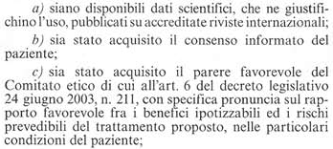

Slide 16
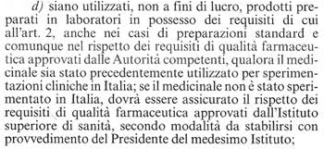

Slide 18
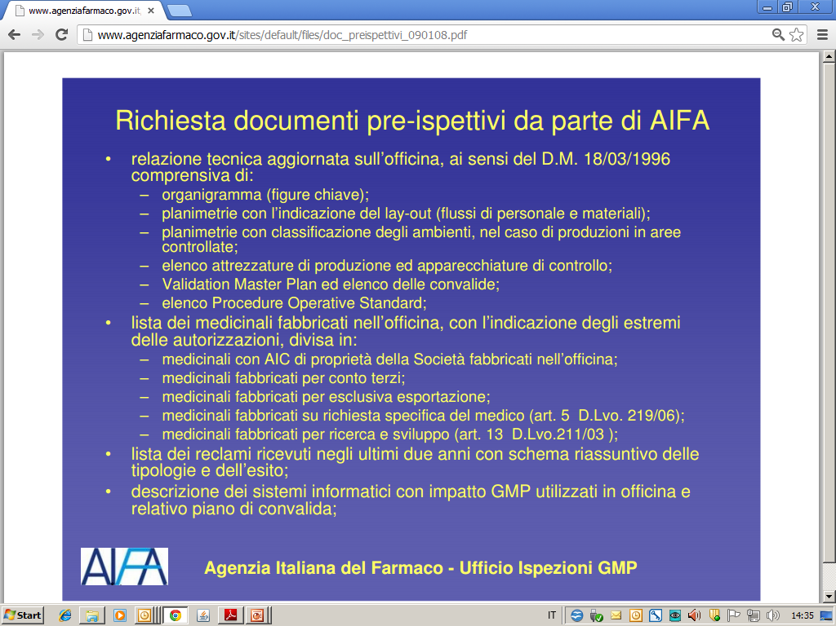

Slide 19
Ringraziamenti
Ettore Biagi (Monza)
Martino Introna (Bergamo)
Rosaria Giordano (MI-Policlinico)
Simona Frigerio (MI-Besta)

Slide 20
MONZA

Slide 21






Le stromali mesenchimali come farmaci “from bench to bed-site”: quando un’azienda ospedaliera si dota di una “Cell Factory”
Dr. Ettore Biagi, MD, PhD,
Pediatra Ricercatore Universitario,
Direttore Tecnico (Qualified Person)
Officina di Terapia Cellulare e Genica
“Stefano Verri”,
Azienda Ospedaliera San Gerardo di Monza
Notes:
21

Slide 22

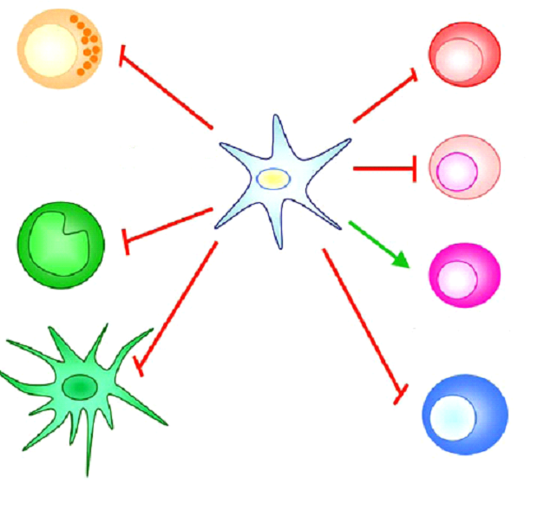
Le cellule MSC come
FARMACI IMMUNOSOPPRESSORI:
l’esempio della Graft vs Host Disease (GvHD)
Effector T cells
NK cells
Cytotoxic T cells
Macrophages
Mesenchymal Stem Cells
(MSC)
Regulatory T cells
Activation
Dendritic Cells
Inhibition
B lymphocytes

Slide 23
MSC - GvHD: phase I-II study
Bicentric, prospective, non randomized, phase I study
Ospedale San Gerardo Monza and Ospedali Riuniti Bergamo
Inclusion criteria:
Acute or chronic steroid resistant or dependant grade II - IV GvHD
Primary objectives
Feasibility and toxicity
Secondary objectives:
Efficacy of MSC infusion in steroid resistant GVHD grade II-IV.
Rate of GVHD recurrence in MSCs infused patients.
Relapse rate of hematological malignancies
OS
MSCs infusion:
At least 3 iv infusions of PL expanded MSCs aiming at 1 ± 0.5 x 10⁶/kg dose with 5-7 interval days, from third party donors.
Enrolled patients: 40 pts enrolled from Sep 2009

Slide 24
Results
Overall response 70% (Complete 30%).
MSCs allow for IS tapering and, in responder patients, they guarantee a free window from GvHD especially when used early after HSCT.
Acute GvHD (SKIN and GUT) seems to respond better than chronic GvHD.
A prompt use (second line) and repeated infusions (at least 3 in 3 weeks) seem to guarantee good results, likely enough the dosage of 1 million cells/kg for each infusion. Likely not necessary to go above 1 million/kg.
No side effects.
Easy to administer thanks to a third party MSC banking.

