Slide 1

4° Corso sul Farmaco
“TERAPIA FARMACOLOGICA NELL’ANZIANO:
ADERENZA, SICUREZZA E RISK MANAGEMENT.”
09/05/2013
La terapia farmacologica dell’anziano: alcuni esempi pratici
La terapia con FANS
Renzo Rozzini

Slide 2
La terapia con FANS
Nonsteroidal anti-inflammatory drugs, usually abbreviated to NSAIDs are a class of drugs that provide analgesic and antipyretic effects, and, in higher doses, anti-inflammatory effects.
The term "nonsteroidal" distinguishes these drugs from steroids, which, among a broad range of other effects, have a similar eicosanoid-depressing, anti-inflammatory action. As analgesics, NSAIDs are unusual in that they are non-narcotic.
The most prominent members of this group of drugs are aspirin, ibuprofen (ad es., Brufen, Antalgil) , and naproxen (ad es., Naprosyn, Synflex), all of which are available over the counter in most countries.

Slide 3
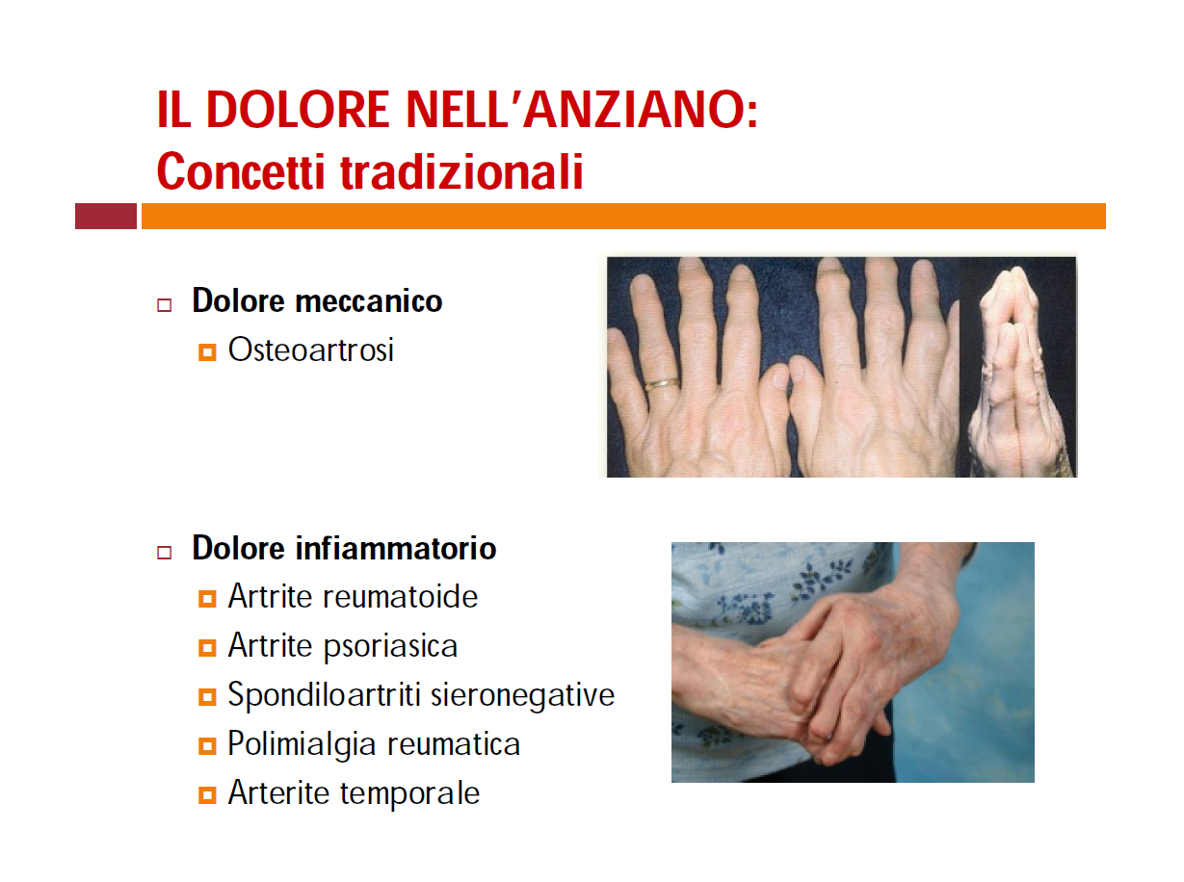

Slide 4
NSAIDs are usually indicated for the treatment of acute or chronic conditions where pain and inflammation are present. Research continues into their potential for prevention of colorectal cancer, and treatment of other conditions, such as cancer and cardiovascular disease.
NSAIDs are generally indicated for the symptomatic relief of the following conditions:
Rheumatoid arthritis
Osteoarthritis
Inflammatory arthropathies (e.g. ankylosing spondylitis, psoriatic arthritis, Reiter's syndrome)
Acute gout
Dysmenorrhoea (menstrual pain)
Metastatic bone pain
Headache and migraine
Postoperative pain
Mild-to-moderate pain due to inflammation and tissue injury
Muscle stiffness and pain due to Parkinson's disease
Pyrexia (fever)
Renal colic
Aspirin, the only NSAID able to irreversibly inhibit COX-1, is also indicated for inhibition of platelet aggregation. This is useful in the management of arterial thrombosis and prevention of adverse cardiovascular events. Aspirin inhibits platelet aggregation by inhibiting the action of thromboxane A2.
In 2001, NSAIDs accounted for 70,000,000 prescriptions and 30 billion over-the-counter doses sold annually in the United States.
Medical uses

Slide 5
The widespread use of NSAIDs has meant that the adverse effects of these drugs have become increasingly prevalent. The main adverse drug reactions (ADRs) associated with NSAIDs relate to the cardiovascular (CV), gastrointestinal (GI), and renal effects of NSAIDs.
These effects are dose-dependent, and in many cases severe enough to pose the risk of ulcer perforation, upper gastrointestinal bleeding, and death, limiting the use of NSAID therapy.
An estimated 10-20% of NSAID patients experience dyspepsia, and NSAID-associated upper gastrointestinal adverse events are estimated to result in 103,000 hospitalizations and 16,500 deaths per year in the United States, and represent 43% of drug-related emergency visits.
Many of these events are avoidable; a review of physician visits and prescriptions estimated that unnecessary prescriptions for NSAIDs were written in 42% of visits.
NSAIDs, like all drugs, may interact with other medications.
For example, concurrent use of NSAIDs and quinolones may increase the risk of quinolones' adverse central nervous system effects, including seizure
Adverse effects

Slide 6
If a COX-2 inhibitor is taken, one should not use a traditional NSAID (prescription or over-the-counter) concomitantly. In addition, people on daily aspirin therapy (e.g., for reducing cardiovascular risk) must be careful if they also use other NSAIDs, as the latter may block the cardioprotective effects of aspirin.
Combinational risk

Slide 7
NSAIDs aside from aspirin, both newer selective COX-2 inhibitors and traditional anti-inflammatories, increase the risk of myocardial infarction and stroke. They are not recommended in those who have had a previous heart attack as they increase the risk of death and / or recurrent MI. Naproxen seems least harmful.
NSAIDs aside from (low-dose) aspirin are associated with a doubled risk of symptomatic heart failure in patients without a history of cardiac disease.
In patients with such a history, however, use of NSAIDs (aside from low-dose aspirin) was associated with a more than 10-fold increase in heart failure.
If this link is proven causal, researchers estimate that NSAIDs would be responsible for up to 20 percent of hospital admissions for congestive heart failure.
In people with heart failure, NSAIDs increase mortality risk by approximately 1.2-1.3 for naproxen and ibuprofen, 1.7 for rofecoxib and celecoxib, and 2.1 for diclofenac.
Cardiovascular

Slide 8
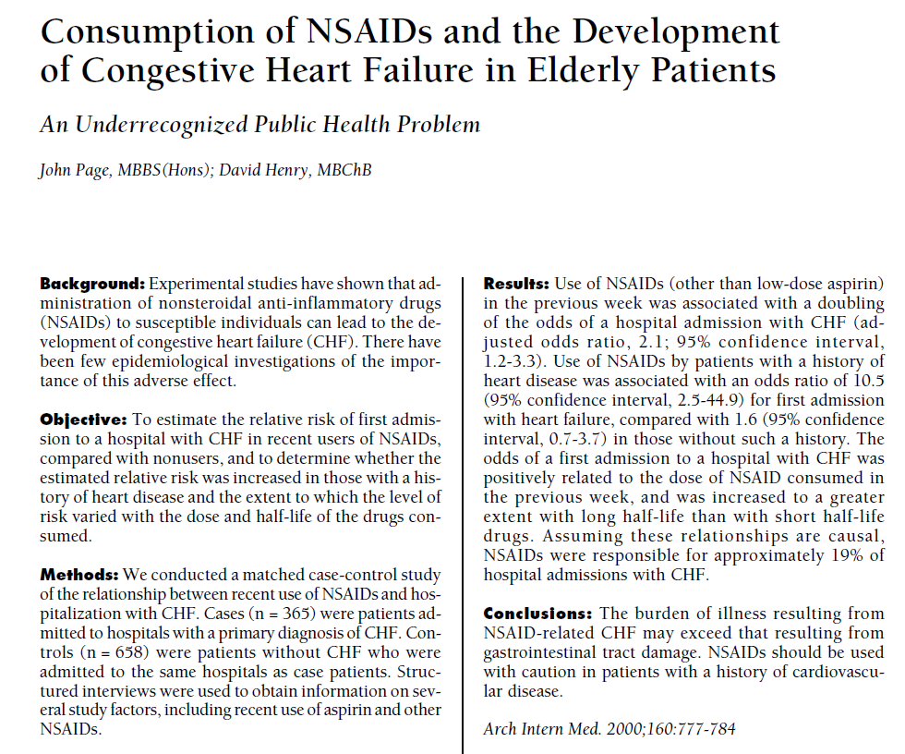

Slide 9
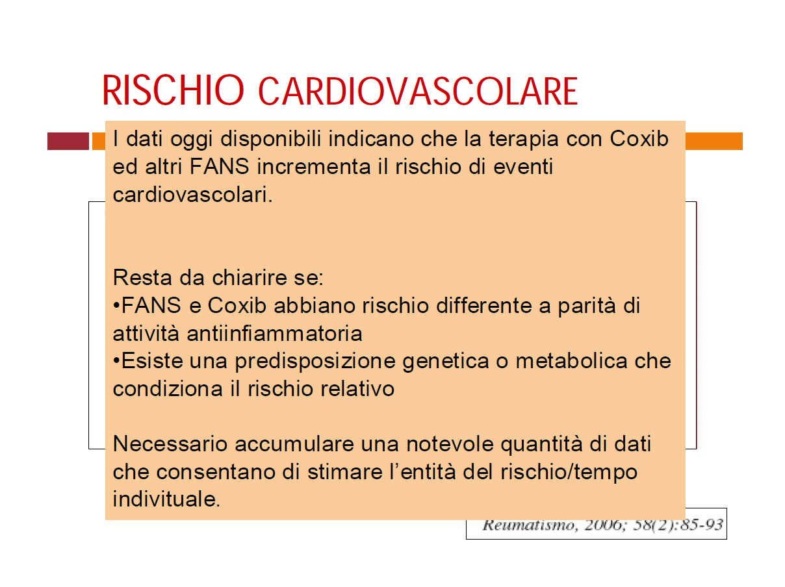

Slide 10
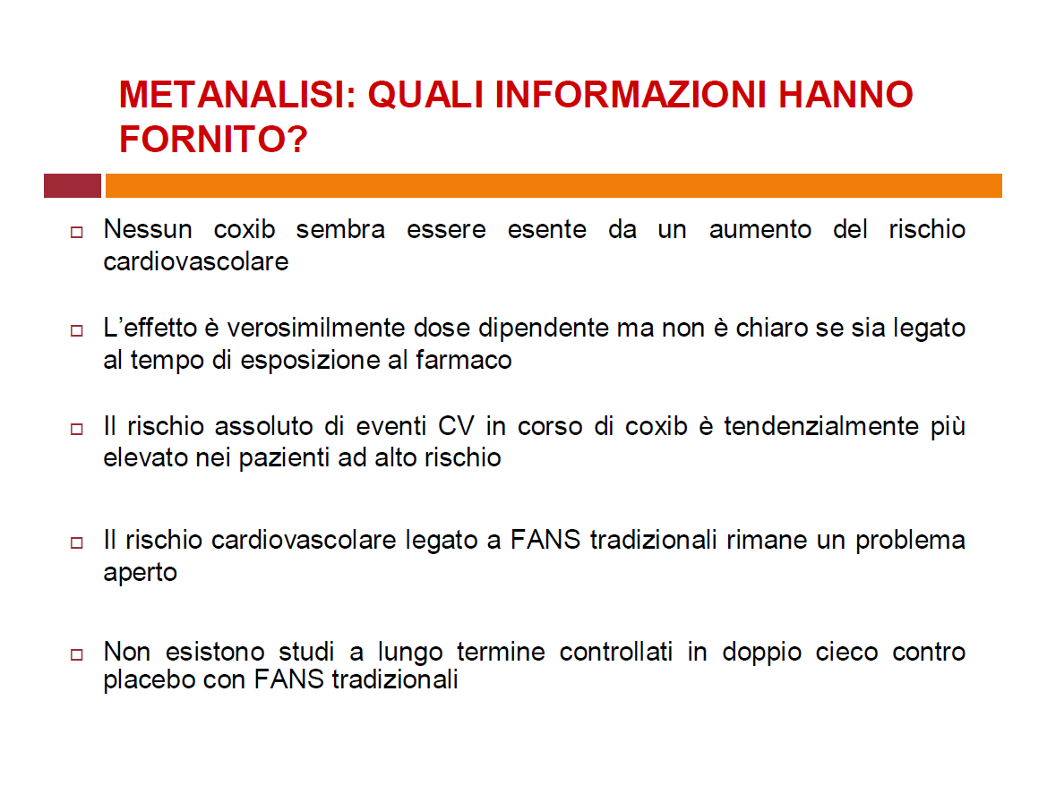

Slide 11
A 2005 study linked long term (over 3 months) use of NSAIDs, including ibuprofen, with a 1.4 times increased risk of erectile dysfunction The report by Kaiser Permanente and published in the Journal of Urology, considered that "regular non-steroidal anti-inflammatory drug use is associated with erectile dysfunction beyond what would be expected due to age and other condition”.
The director of research for Kaiser Permanente added that "There are many proven benefits of non steroidals in preventing heart disease and for other conditions. People shouldn't stop taking them based on this observational study. However, if a man is taking this class of drugs and has ED, it's worth a discussion with his doctor"
Erectile dysfunction risk

Slide 12
The main adverse drug reactions (ADRs) associated with NSAID use relate to direct and indirect irritation of the gastrointestinal (GI) tract.
NSAIDs cause a dual assault on the GI tract: the acidic molecules directly irritate the gastric mucosa, and inhibition of COX-1 and COX-2 reduces the levels of protective prostaglandins. Inhibition of prostaglandin synthesis in the GI tract causes increased gastric acid secretion, diminished bicarbonate secretion, diminished mucus secretion and diminished trophic effects on epithelial mucosa.
Common gastrointestinal ADRs include:
Nausea/Vomiting
Dyspepsia
Gastric ulceration/bleeding.
Diarrhea
Clinical NSAID ulcers are related to the systemic effects of NSAID administration. Such damage occurs irrespective of the route of administration of the NSAID (e.g., oral, rectal, or parenteral) and can occur even in patients with achlorhydria.
Ulceration risk increases with therapy duration, and with higher doses. To minimise GI ADRs, it is prudent to use the lowest effective dose for the shortest period of time—a practice that studies show is often not followed. Recent studies show that over 50% of patients that take NSAIDs have sustained some mucosal damage to their small intestine.
Gastrointestinal

Slide 13
There are also some differences in the propensity of individual agents to cause gastrointestinal ADRs. Indomethacin, ketoprofen (ad es., Orudis) and piroxicam (ad es., Feldene) appear to have the highest prevalence of gastric ADRs, while ibuprofen (lower doses) and diclofenac (ad es., Voltaren) appear to have lower rates.
Certain NSAIDs, such as aspirin, have been marketed in enteric-coated formulations that manufacturers claim reduce the incidence of gastrointestinal ADRs.
Similarly, some believe that rectal formulations may reduce gastrointestinal ADRs.
However, considering the mechanism of such ADRs, and in clinical practice, these formulations have not demonstrated a reduced risk of GI ulceration.
Commonly, gastric (but not necessarily intestinal) adverse effects can be reduced through suppressing acid production, by concomitant use of a proton pump inhibitor, e.g. omeprazole, esomeprazole; or the prostaglandin analogue misoprostol.
Misoprostol is itself associated with a high incidence of gastrointestinal ADRs (diarrhea).
While these techniques may be effective, they are expensive for maintenance therapy.
Gastrointestinal

Slide 14
NSAIDs should be used with caution in individuals with inflammatory bowel disease (e.g., Crohn's disease or ulcerative colitis) due to their tendency to cause gastric bleeding and form ulceration in the gastric lining.
Pain relievers such as paracetamol (also known as acetaminophen) or drugs containing codeine (which slows down bowel activity) are safer medications for pain relief in IBD.
Inflammatory bowel disease

Slide 15
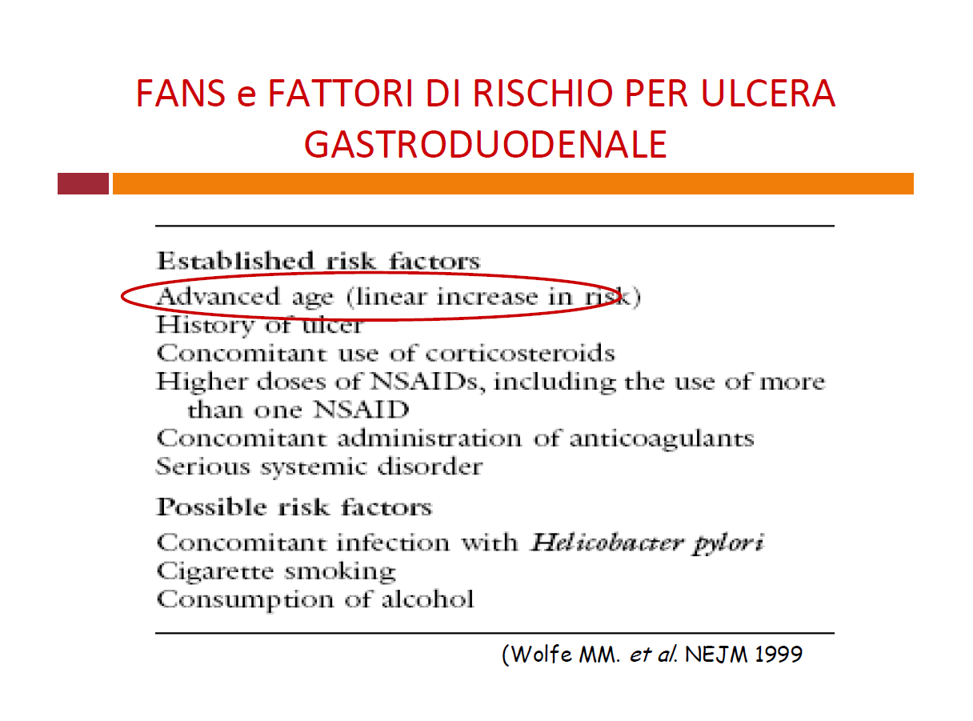

Slide 16
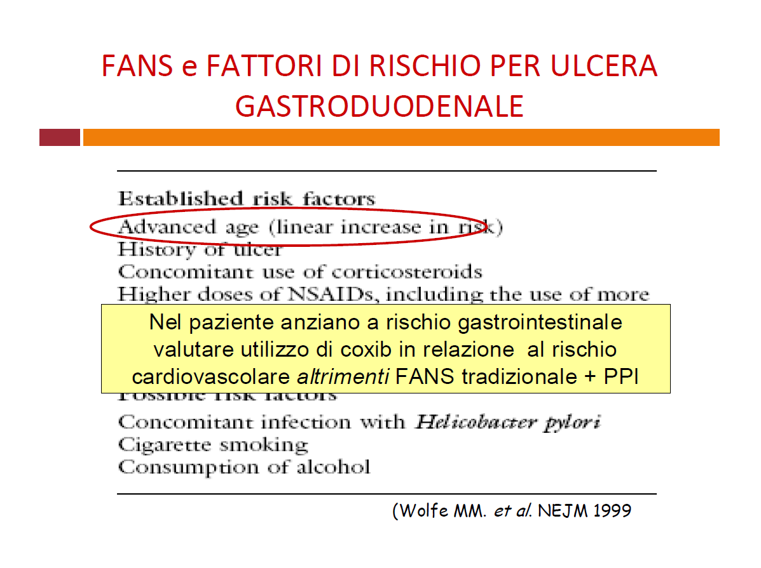

Slide 18
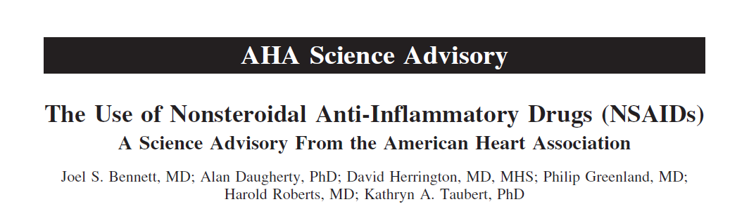
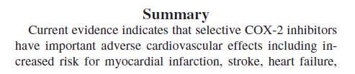
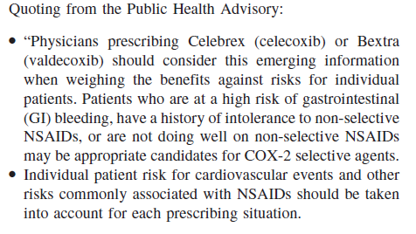
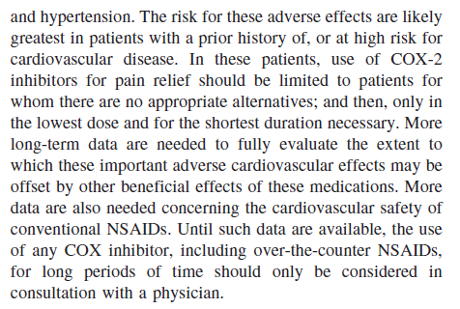
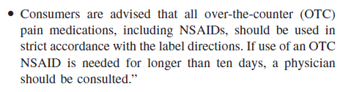


Slide 19
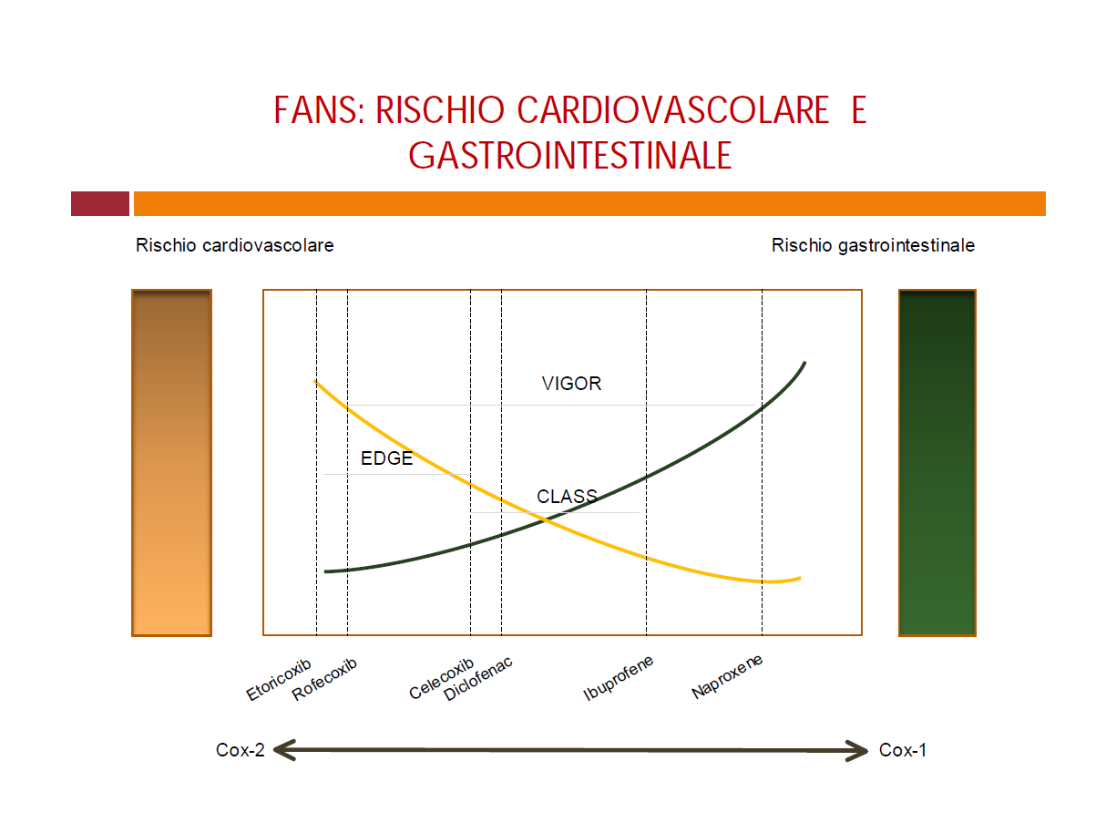

Slide 20
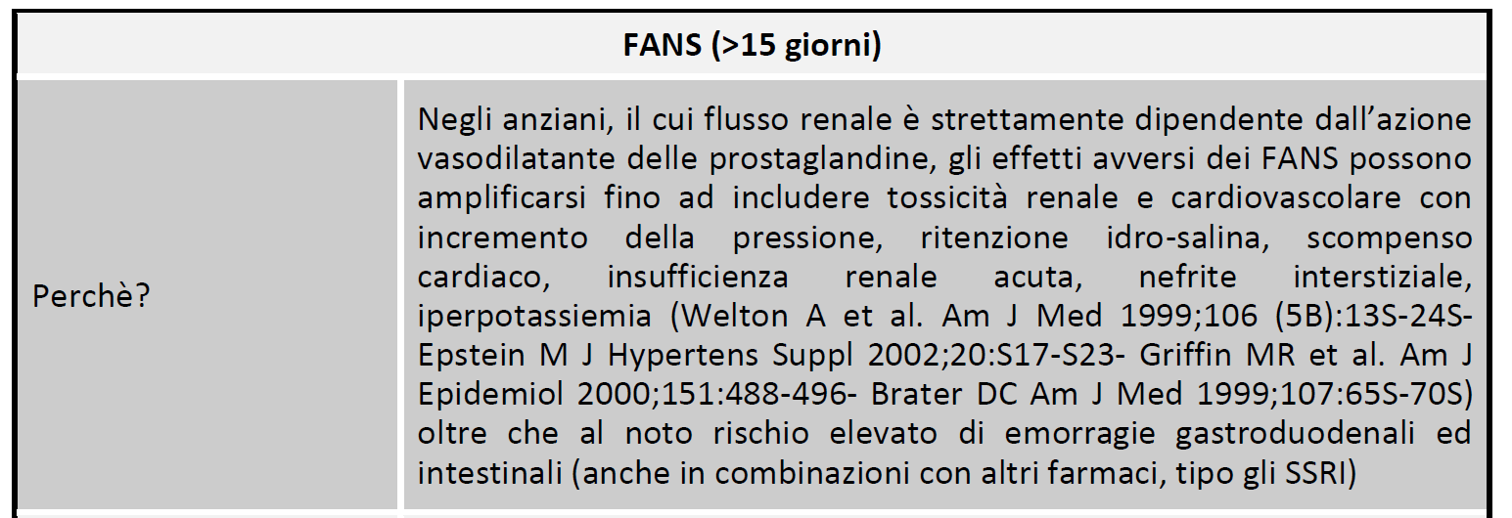
Anti-infiammatori

Slide 21
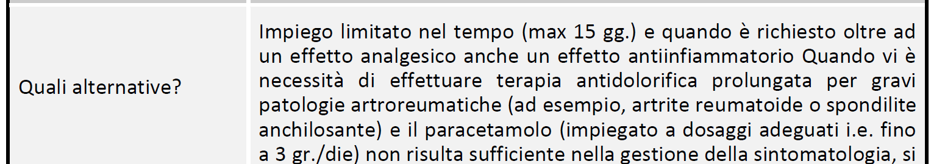
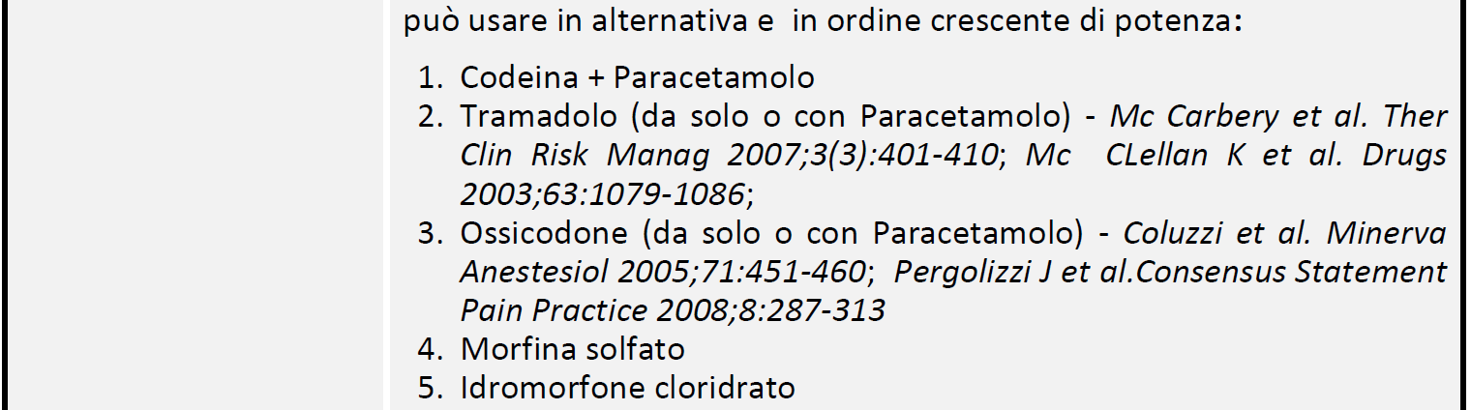

Slide 22
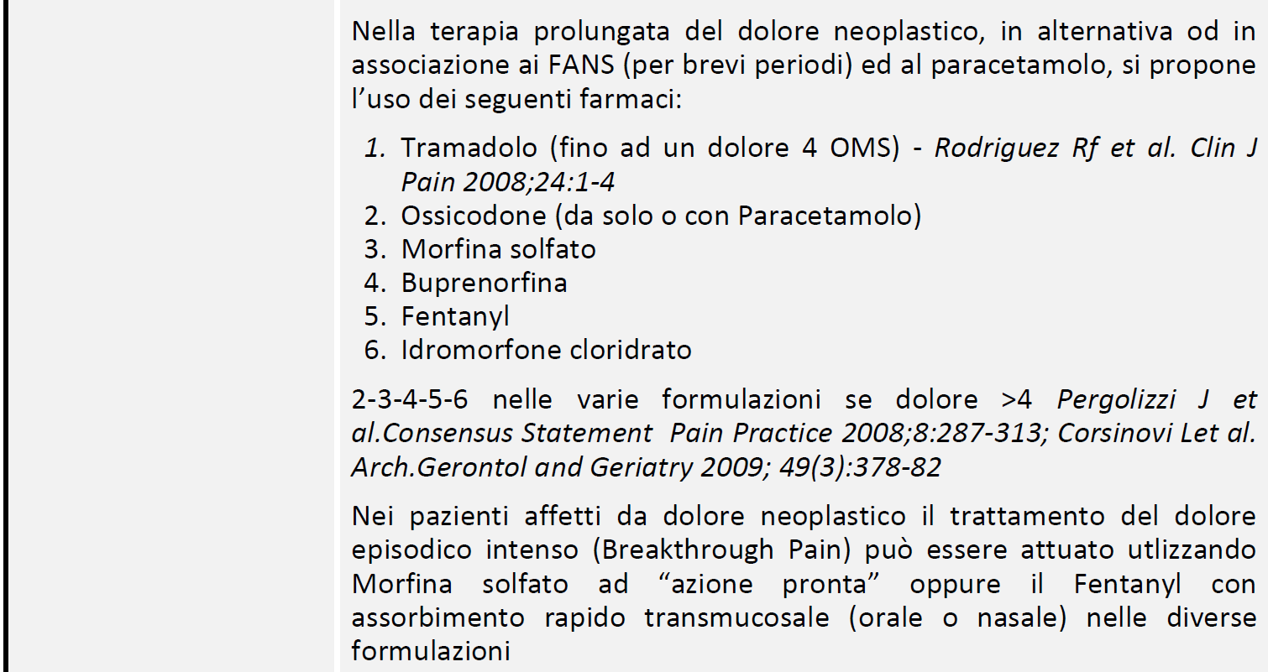

Slide 23
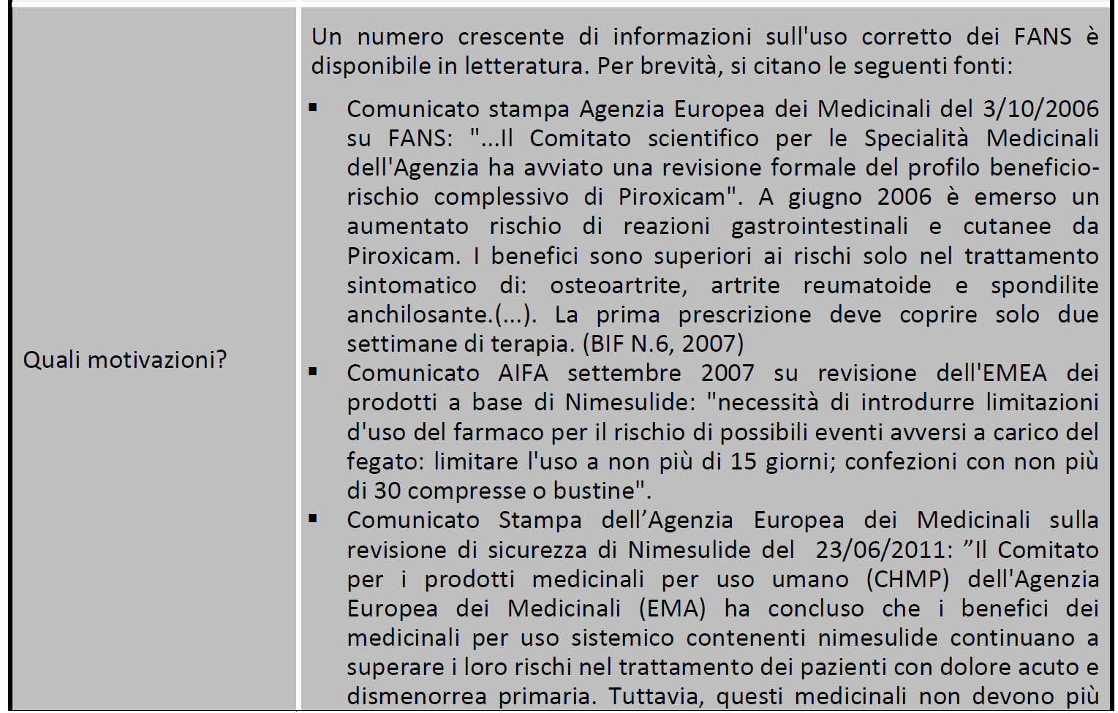

Slide 24
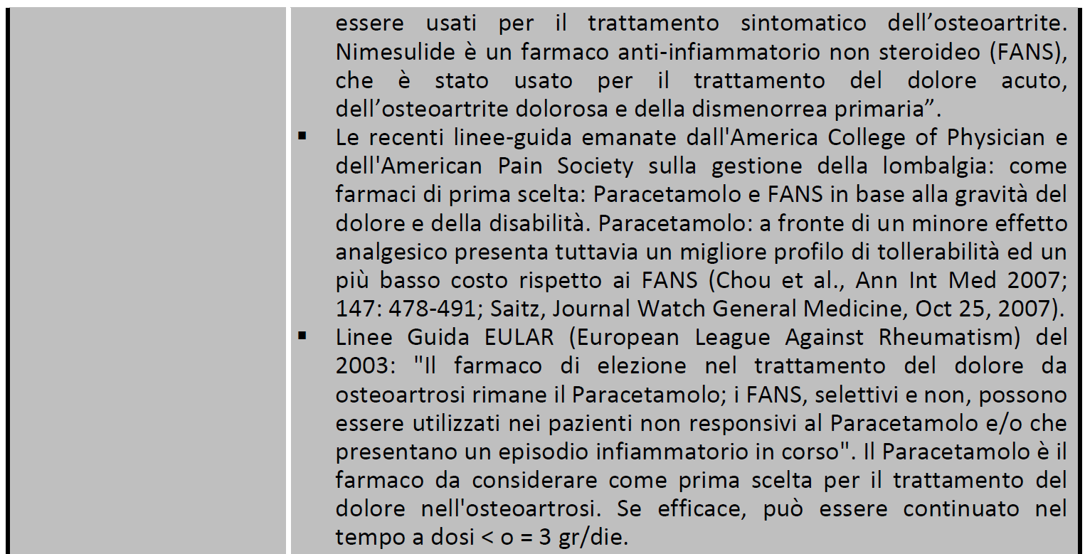

Slide 25
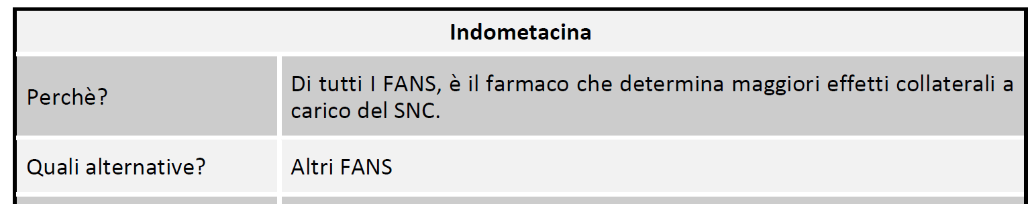

Slide 26
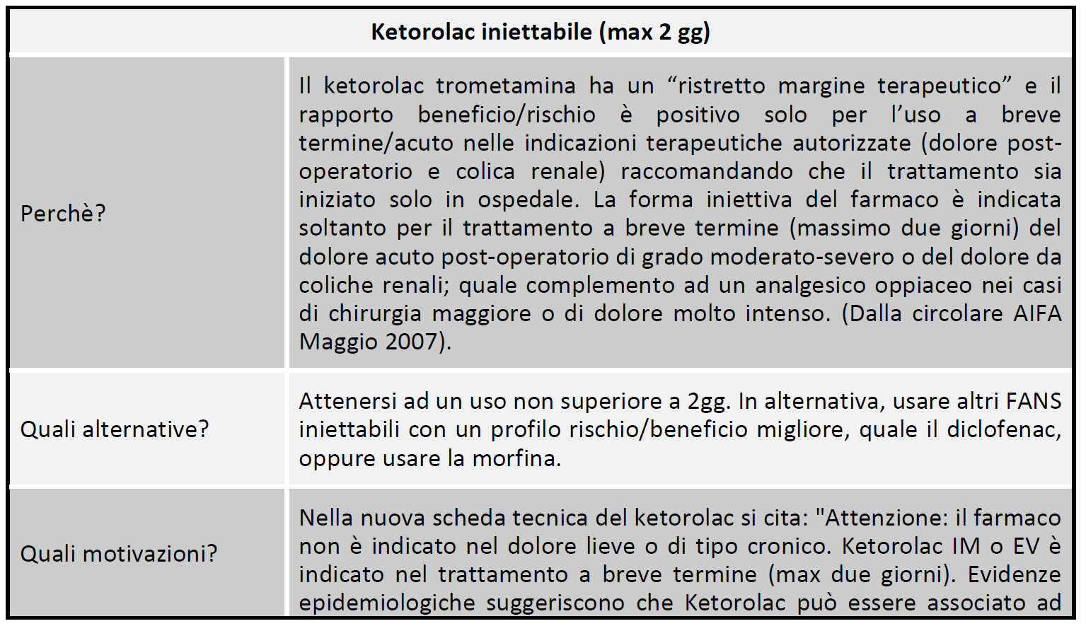

Slide 27
NSAIDs are also associated with a relatively high incidence of renal adverse drug reactions (ADRs). The mechanism of these renal ADRs is due to changes in renal haemodynamics (kidney blood flow), ordinarily mediated by prostaglandins, which are affected by NSAIDs. Prostaglandins normally cause vasodilation of the afferent arterioles of the glomeruli. This helps maintain normal glomerular perfusion and glomerular filtration rate (GFR), an indicator of renal function. This is particularly important in renal failure where the kidney is trying to maintain renal perfusion pressure by elevated angiotensin II levels. At these elevated levels, angiotensin II also constricts the afferent arteriole into the glomerulus in addition to the efferent arteriole it normally constricts. Prostaglandins serve to dilate the afferent arteriole; by blocking this prostaglandin-mediated effect, particularly in renal failure, NSAIDs cause unopposed constriction of the afferent arteriole and decreased renal perfusion pressure.
Common ADRs associated with altered renal function include
Salt and fluid retention
Hypertension (high blood pressure)
Renal

Slide 28
These agents may also cause renal impairment, especially in combination with other nephrotoxic agents. Renal failure is especially a risk if the patient is also concomitantly taking an ACE inhibitor (which removes angiotensin II's vasoconstriction of the efferent arteriole) and a diuretic (which drops plasma volume, and thereby RPF) - the so-called "triple whammy" effect.
In rarer instances NSAIDs may also cause more severe renal conditions:
Interstitial nephritis
Nephrotic syndrome
Acute renal failure
Acute tubular necrosis
NSAIDs in combination with excessive use of phenacetin and/or paracetamol (acetaminophen) may lead to analgesic nephropathy.
Renal

Slide 29
Photosensitivity is a commonly overlooked adverse effect of many of the NSAIDs.
The 2-arylpropionic acids are the most likely to produce photosensitivity reactions, but other NSAIDs have also been implicated including piroxicam and diclofenac.
Benoxaprofen, since withdrawn due to its hepatotoxicity, was the most photoactive NSAID observed. The mechanism of photosensitivity, responsible for the high photoactivity of the 2-arylpropionic acids, is the ready decarboxylation of the carboxylic acid moiety. The specific absorbance characteristics of the different chromophoric 2-aryl substituents, affects the decarboxylation mechanism. While ibuprofen has weak absorption, it has been reported as a weak photosensitising agent
Photosensitivity

Slide 30
NSAIDs are not recommended during pregnancy, particularly during the third trimester. While NSAIDs as a class are not direct teratogens, they may cause premature closure of the fetal ductus arteriosus and renal ADRs in the fetus. Additionally, they are linked with premature birth and miscarriage. Aspirin, however, is used together with heparin in pregnant women with antiphospholipid antibodies. Additionally, Indomethacin is used in pregnancy to treat polyhydramnios by reducing fetal urine production via inhibiting fetal renal blood flow.
In contrast, paracetamol (acetaminophen) is regarded as being safe and well-tolerated during pregnancy, but Leffers et al. released a study in 2010 indicating that there may be associated male infertility in the unborn. Doses should be taken as prescribed, due to risk of hepatotoxicity with overdoses.
In France, the country's health agency contraindicates the use of NSAIDs, including aspirin, after the sixth month of pregnancy.
During pregnancy

Slide 31
Common adverse drug reactions (ADR), other than listed above, include: raised liver enzymes, headache, dizziness. Uncommon ADRs include: hyperkalaemia, confusion, bronchospasm, rash. Rapid and severe swelling of the face and/or body. Ibuprofen may also rarely cause irritable bowel syndrome symptoms. NSAIDs are also implicated in some cases of Stevens–Johnson syndrome.
Most NSAIDs penetrate poorly into the central nervous system (CNS). However, the COX enzymes are expressed constitutively in some areas of the CNS, meaning that even limited penetration may cause adverse effects such as somnolence and dizziness.
In very rare cases, ibuprofen can cause aseptic meningitis.
As with other drugs, allergies to NSAIDs might exist. While many allergies are specific to one NSAID, up to 1 in 5 people may have unpredictable cross-reactive allergic responses to other NSAIDs as well.
Other

Slide 32
NSAIDs reduce renal blood flow and thereby decrease the efficacy of diuretics, and inhibit the elimination of lithium and methotrexate.
NSAIDs cause hypocoagulability, which may be serious when combined with other drugs that also decrease blood clotting, such as warfarin.
NSAIDs may aggravate hypertension (high blood pressure) and thereby antagonize the effect of antihypertensives, such as ACE Inhibitors.
NSAIDs may interfere and reduce efficiency of SSRI antidepressants
Drug interactions

Slide 33
Most NSAIDs act as nonselective inhibitors of the enzyme cyclooxygenase (COX), inhibiting both the cyclooxygenase-1 (COX-1) and cyclooxygenase-2 (COX-2) isoenzymes. This inhibition is competitively reversible (albeit at varying degrees of reversibility), as opposed to the mechanism of aspirin, which is irreversible inhibition. COX catalyzes the formation of prostaglandins and thromboxane from arachidonic acid (itself derived from the cellular phospholipid bilayer by phospholipase A2). Prostaglandins act (among other things) as messenger molecules in the process of inflammation. This mechanism of action was elucidated by John Vane (1927–2004), who received a Nobel Prize for his work.
COX-1 is a constitutively expressed enzyme with a "house-keeping" role in regulating many normal physiological processes. One of these is in the stomach lining, where prostaglandins serve a protective role, preventing the stomach mucosa from being eroded by its own acid. COX-2 was discovered in 1991 by Daniel L. Simmons at Brigham Young University. COX-2 is an enzyme facultatively expressed in inflammation, and it is inhibition of COX-2 that produces the desirable effects of NSAIDs.
When nonselective COX-1/COX-2 inhibitors (such as aspirin, ibuprofen, and naproxen) lower stomach prostaglandin levels, ulcers of the stomach or duodenum internal bleeding can result.
NSAIDs have been studied in various assays to understand how they affect each of these enzymes. While the assays reveal differences, unfortunately different assays provide differing ratios.
Mechanism of action

Slide 34
The discovery of COX-2 led to research to development of selective COX-2 inhibiting drugs that do not cause gastric problems characteristic of older NSAIDs.
Acetaminophen is not considered an NSAID because it has little anti-inflammatory activity. It treats pain mainly by blocking COX-2 mostly in the central nervous system, but not much in the rest of the body.
However, many aspects of the mechanism of action of NSAIDs remain unexplained, for this reason further COX pathways are hypothesized. The COX-3 pathway was believed to fill some of this gap but recent findings make it appear unlikely that it plays any significant role in humans and alternative explanation models are proposed.
NSAIDs are also used in the acute pain caused by gout because they inhibit urate crystal phagocytosis besides inhibition of prostaglandin synthase.
Mechanism of action

Slide 35
NSAIDS have antipyretic activity and can be used to treat fever. Fever is caused by elevated levels of prostaglandin E2, which alters the firing rate of neurons within the hypothalamus that control thermoregulation. Antipyretics work by inhibiting the enzyme COX, which causes the general inhibition of prostanoid biosynthesis (PGE2) within the hypothalamus.PGE2 signals to the hypothalamus to increase the body's thermal set point. Ibuprofen has been shown more effective as an antipyretic than acetaminophen (paracetamol). Arachidonic acid is the precursor substrate for cyclooxygenase leading to the production of prostaglandins F, D & E.
Antipyretic activity

Slide 36
Salicylates
Aspirin (acetylsalicylic acid)
Diflunisal
Salsalate
Propionic acid derivatives
Ibuprofen
Dexibuprofen
Naproxen
Fenoprofen
Ketoprofen
Dexketoprofen
Flurbiprofen
Oxaprozin
Loxoprofen
Acetic acid derivatives
Indomethacin
Tolmetin
Sulindac
Etodolac
Ketorolac
Diclofenac (Safety alert by FDA)
Nabumetone (drug itself is non-acidic but the active, principal metabolite has a carboxylic acid group)
Classification. NSAIDs can be classified based on their chemical structure or mechanism of action. Older NSAIDs were known long before their mechanism of action was elucidated and were for this reason classified by chemical structure or origin. Newer substances are more often classified by mechanism of action.
Enolic acid (Oxicam) derivatives
Piroxicam
Meloxicam
Tenoxicam
Droxicam
Lornoxicam
Isoxicam
Fenamic acid derivatives (Fenamates )
Mefenamic acid
Meclofenamic acid
Flufenamic acid
Tolfenamic acid
Selective COX-2 inhibitors (Coxibs)
Celecoxib (FDA alert[49])
Rofecoxib (withdrawn from market[50])
Valdecoxib (withdrawn from market[51])
Parecoxib FDA withdrawn, licenced in the EU
Lumiracoxib TGA cancelled registration
Etoricoxib not FDA approved, licenced in the EU
Firocoxib used in dogs and horses
Sulphonanilides
Nimesulide (systemic preparations are banned by several countries for the potential risk of hepatotoxicity)

Slide 37
NSAIDs within a group tend to have similar characteristics and tolerability. There is little difference in clinical efficacy among the NSAIDs when used at equivalent doses. Rather, differences among compounds usually relate to dosing regimens (related to the compound's elimination half-life), route of administration, and tolerability profile.
Regarding adverse effects, selective COX-2 inhibitors have lower risk of gastrointestinal bleeding, but a substantially more increased risk of myocardial infarction than the increased risk from nonselective inhibitors. The nonselective naproxen appears risk-neutral with regard to cardiovascular events.
A consumer report noted that ibuprofen and naproxen are less expensive than other NSAIDs, and essentially as effective and safe when used appropriately to treat osteoarthritis and pain.
Main practical differences

Slide 38
Most nonsteroidal anti-inflammatory drugs are weak acids. They are absorbed well from the stomach and intestinal mucosa. They are highly protein-bound in plasma (typically >95%), usually to albumin, so that their volume of distribution typically approximates to plasma volume. Most NSAIDs are metabolised in the liver by oxidation and conjugation to inactive metabolites that typically are excreted in the urine, though some drugs are partially excreted in bile. Metabolism may be abnormal in certain disease states, and accumulation may occur even with normal dosage.
Ibuprofen and diclofenac have short half-lives (2–3 hours). Some NSAIDs (typically oxicams) have very long half-lives (e.g. 20–60 hours).
Pharmacokinetics

Slide 39
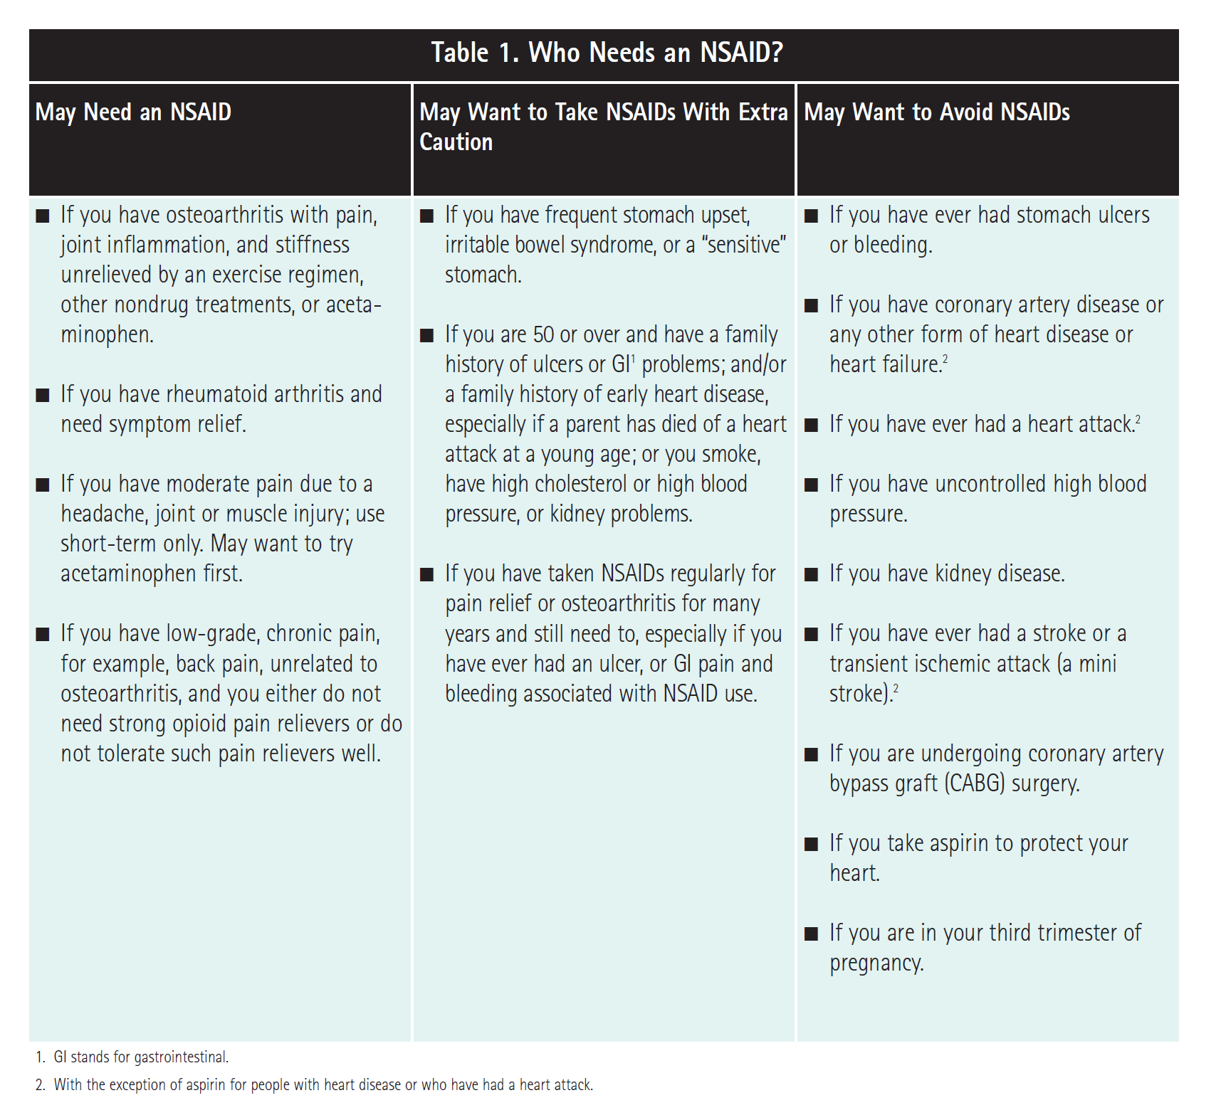
Per i pazienti

Slide 40
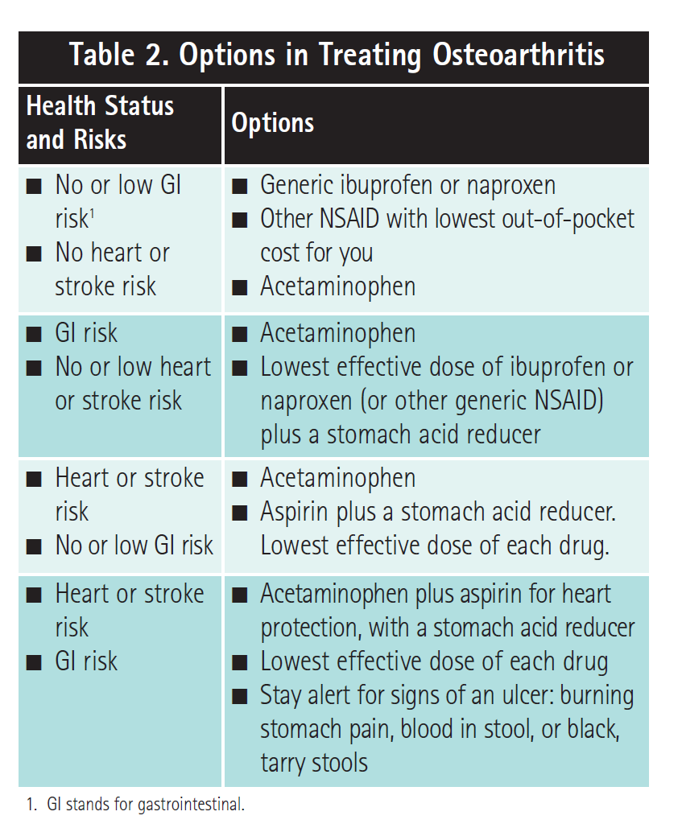

Slide 41
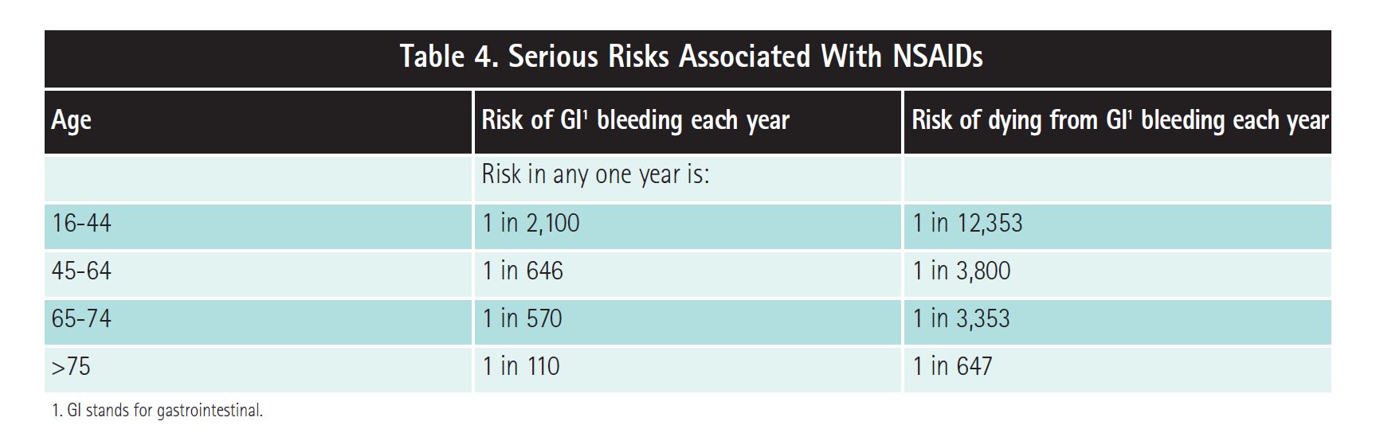

Slide 42
Manifestazioni di dolore nell’anziano in presenza di compromissione cognitiva
Espressioni facciali
-Mimica sofferente
Cambiamento di umore
-Lamentosità
-Pianto
-Ansia
-Irrequietezza ed irritabilità
-Isolamento, riduzione comunicazione
-Insonnia
Confusione mentale
-Disorientamento
-Inattenzione
Peggioramento funzionale
-Rigidità muscolare
-Rifiuto del movimento
-Permanenza a letto
Cambiamento alimentare
-Inappetenza
Turbe neurovegetative
-Pallore cutaneo
-Sudorazione
-Nausea, vomito

Slide 43
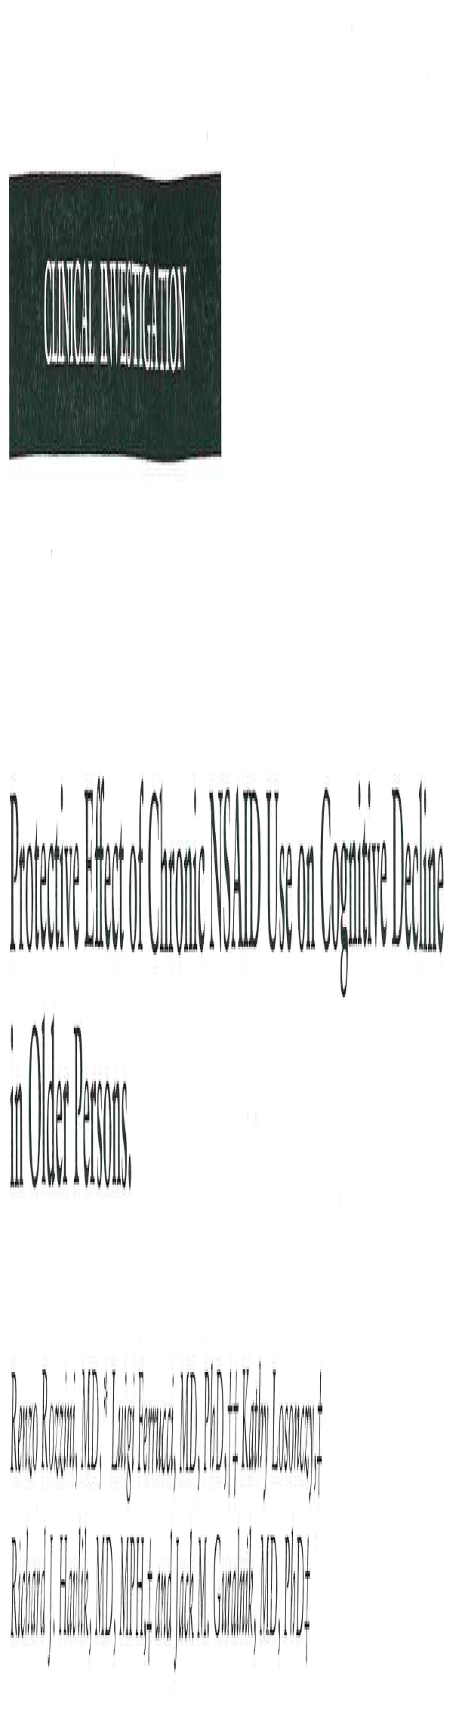
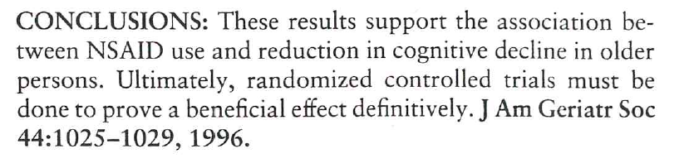

Slide 44
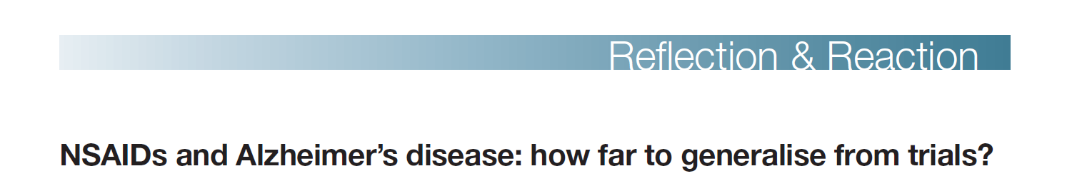
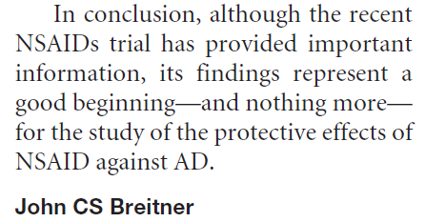

Slide 45
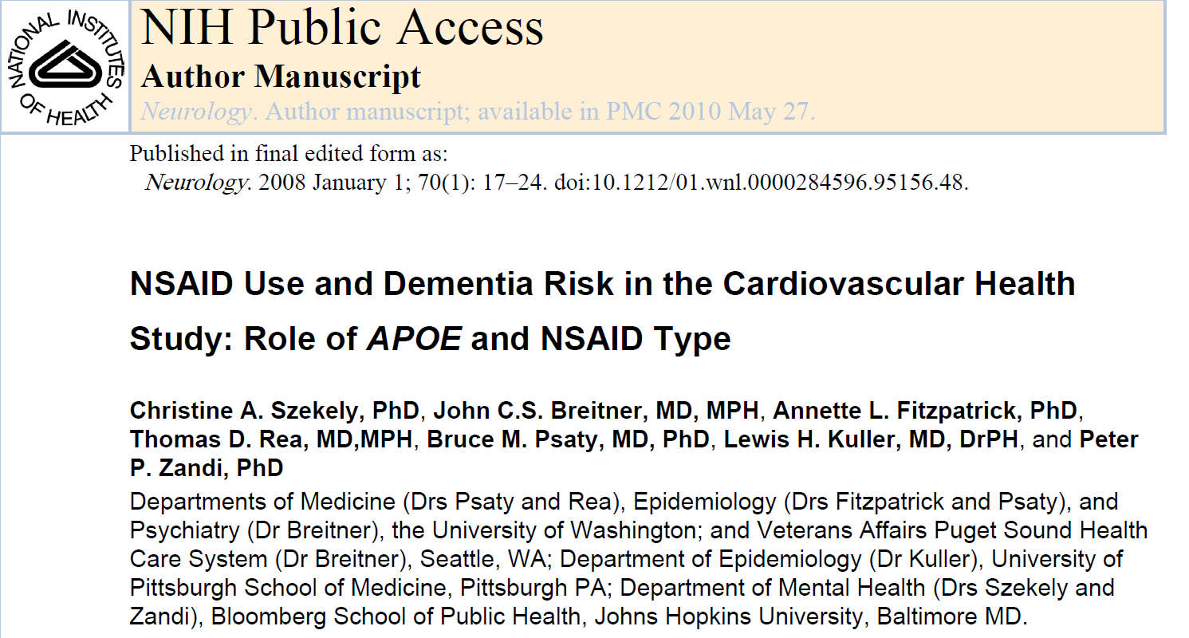
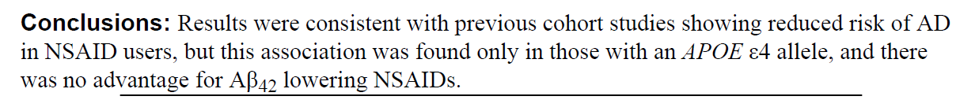

Slide 46
