Slide 1
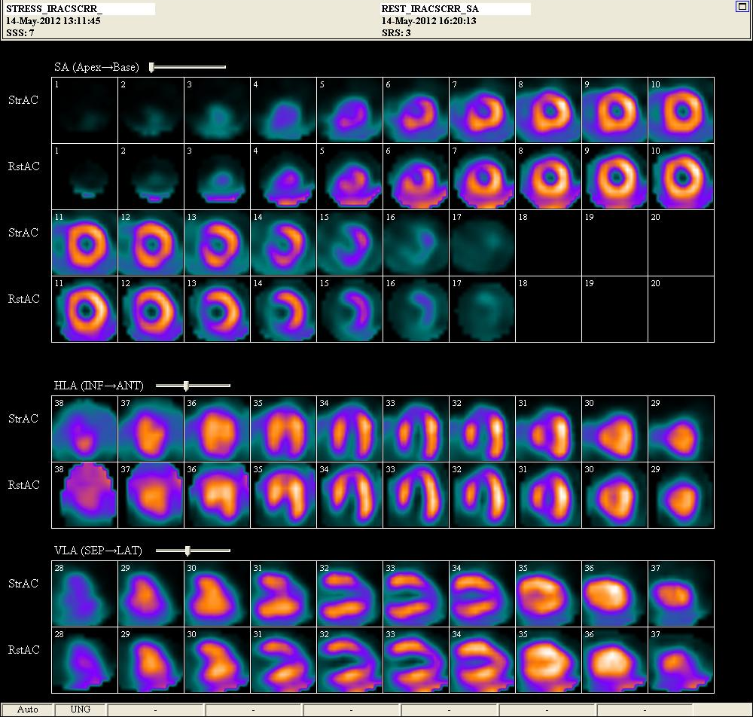

Slide 2
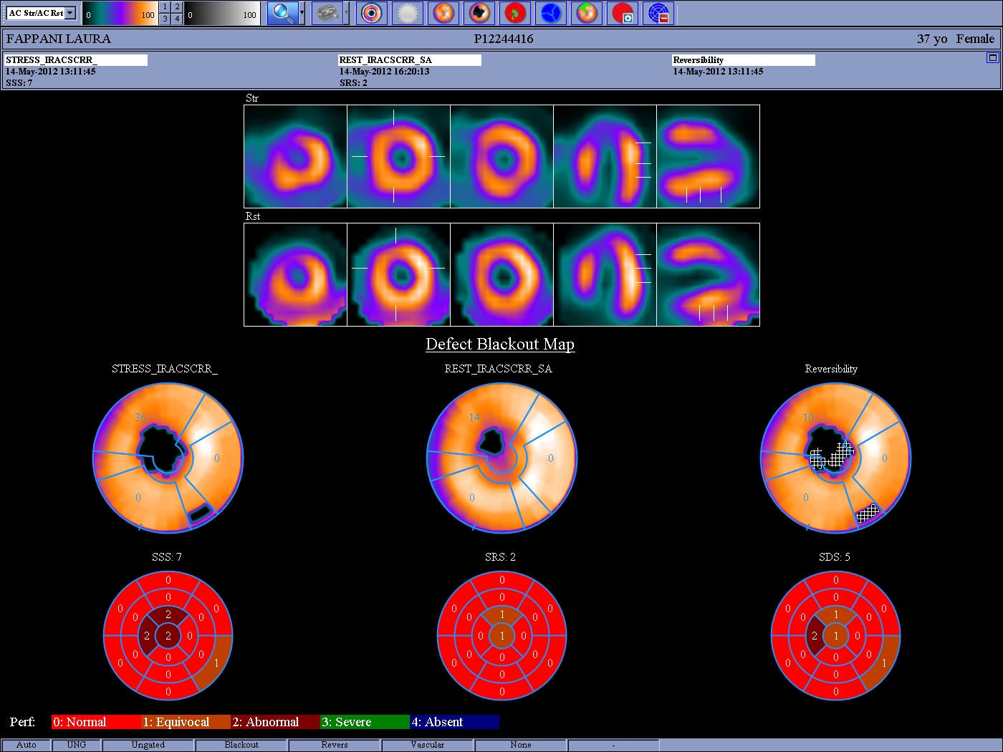

Slide 3
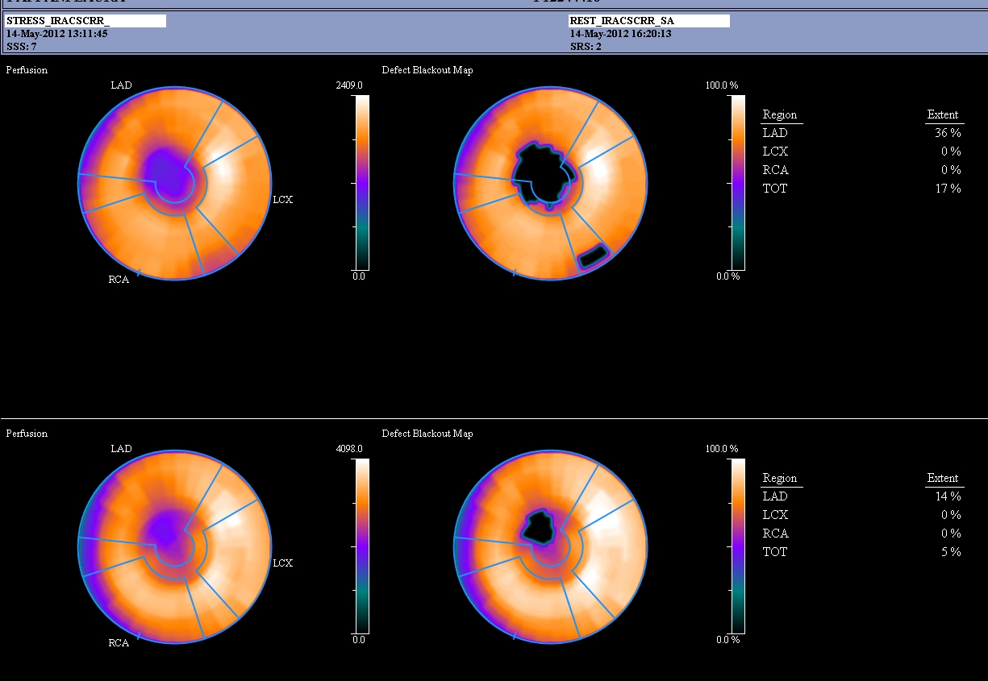

Slide 4
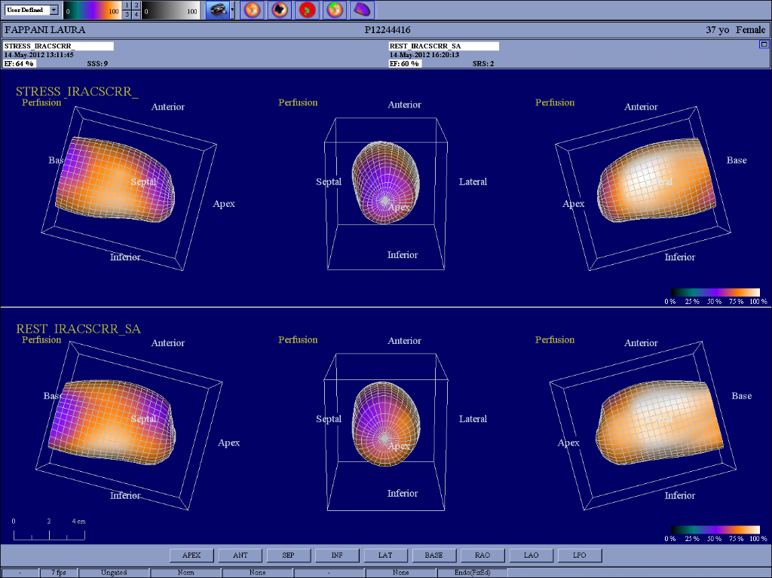

Slide 5
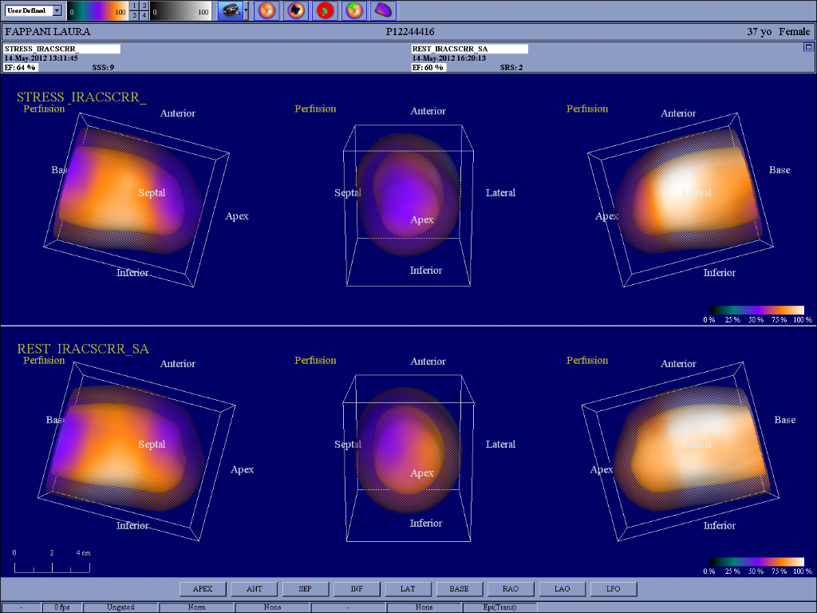

Slide 6
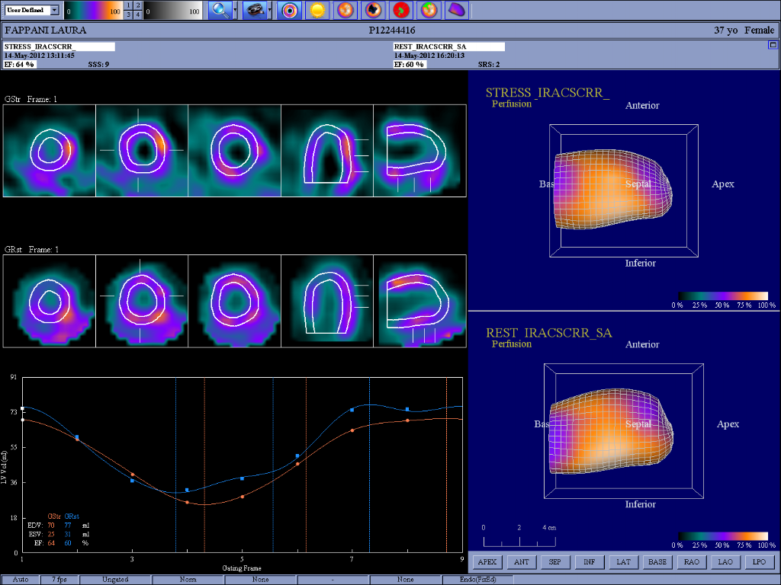

Slide 7
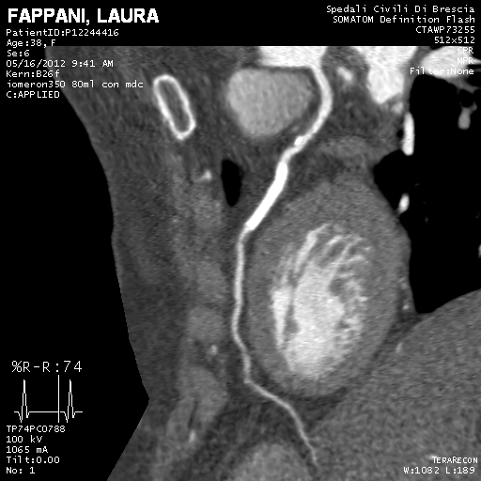

Slide 8
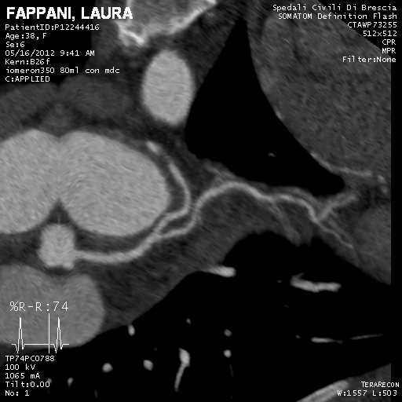

Slide 9
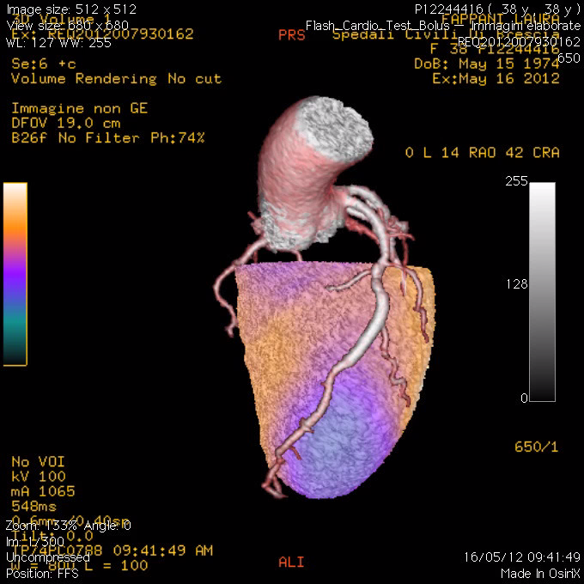

Slide 10
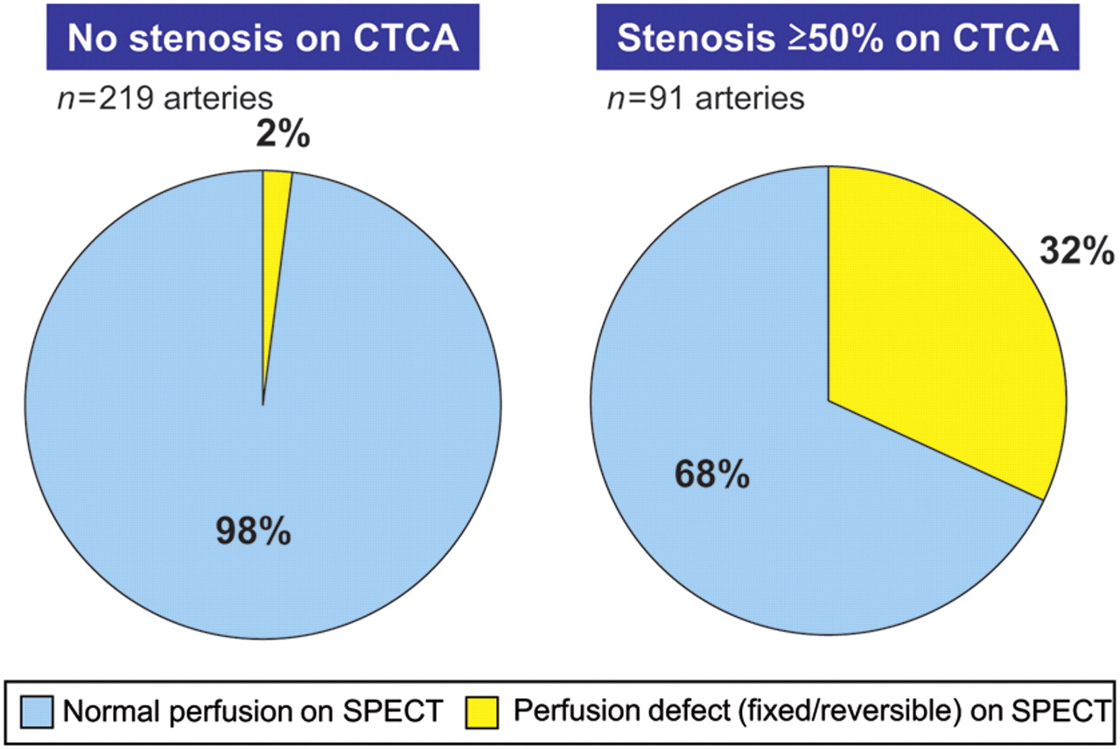
Functionally relevant coronary artery disease: comparison of 64-slice computed tomography coronary angiography with myocardial perfusion single photon emission computed tomography.
Gaemperli O et al. Eur Heart J 2011;32:2100-2108
Gaemperli O et al. Radiology 2008;248:414-423.
Notes:
Functionally relevant coronary artery disease: comparison of 64-slice computed tomography coronary angiography with myocardial perfusion single photon emission computed tomography. While almost all coronary arteries without obstructive lesions were associated with a normal perfusion (left pie chart), only 32% of significant coronary stenoses (≥50%) induced a perfusion defect on single photon emission computed tomography (right pie chart). Adapted from Gaemperli et al.7

Slide 11
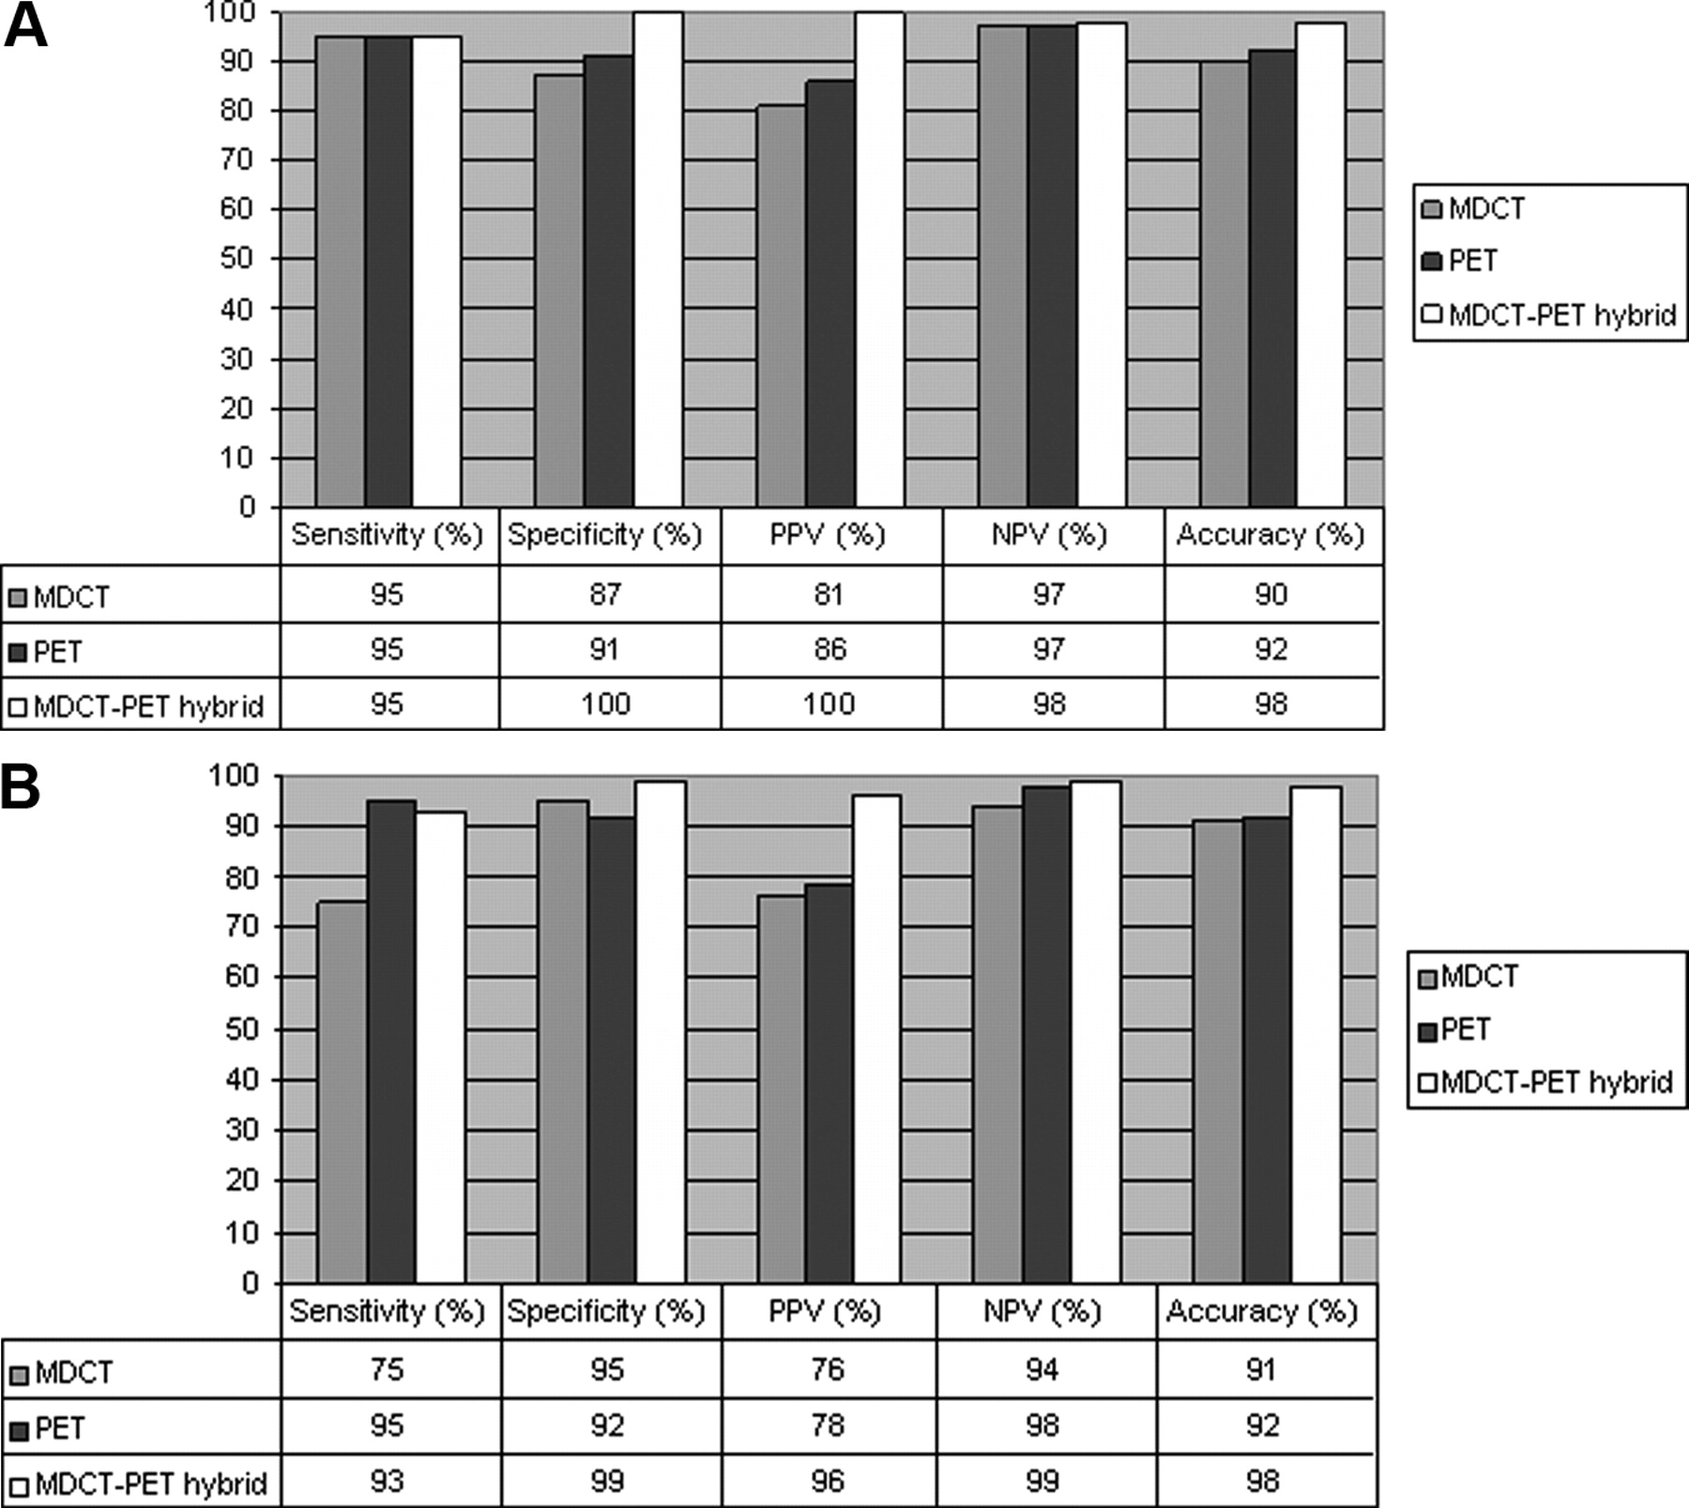
Figure 2. Sensitivity, specificity, PPV, NPV, and accuracy of stand-alone CT and PET and hybrid imaging against combined ICA and FFR. A, Analysis per patient.
Kajander S et al. Circulation 2010;122:603-613
Notes:
Figure 2. Sensitivity, specificity, PPV, NPV, and accuracy of stand-alone CT and PET and hybrid imaging against combined ICA and FFR. A, Analysis per patient. Hybrid imaging was more accurate than either CTA alone (P=0.0039) or PET alone (P=0.014). The difference between CTA and PET was not significant (P=0.32). B, Analysis per vessel. Hybrid imaging was more accurate than either CTA (P<0.0001) or PET (P<0.0001). The difference between CTA and PET was not significant (P=0.08).

