Slide 1
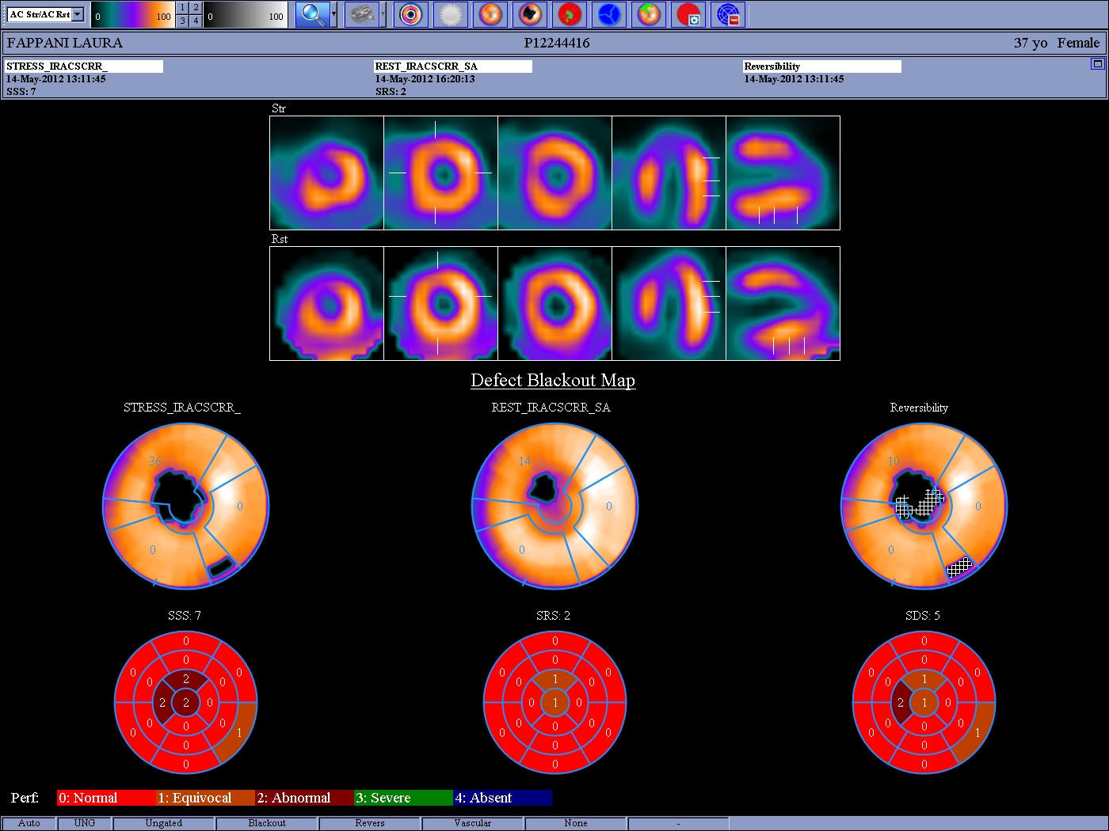

Slide 2
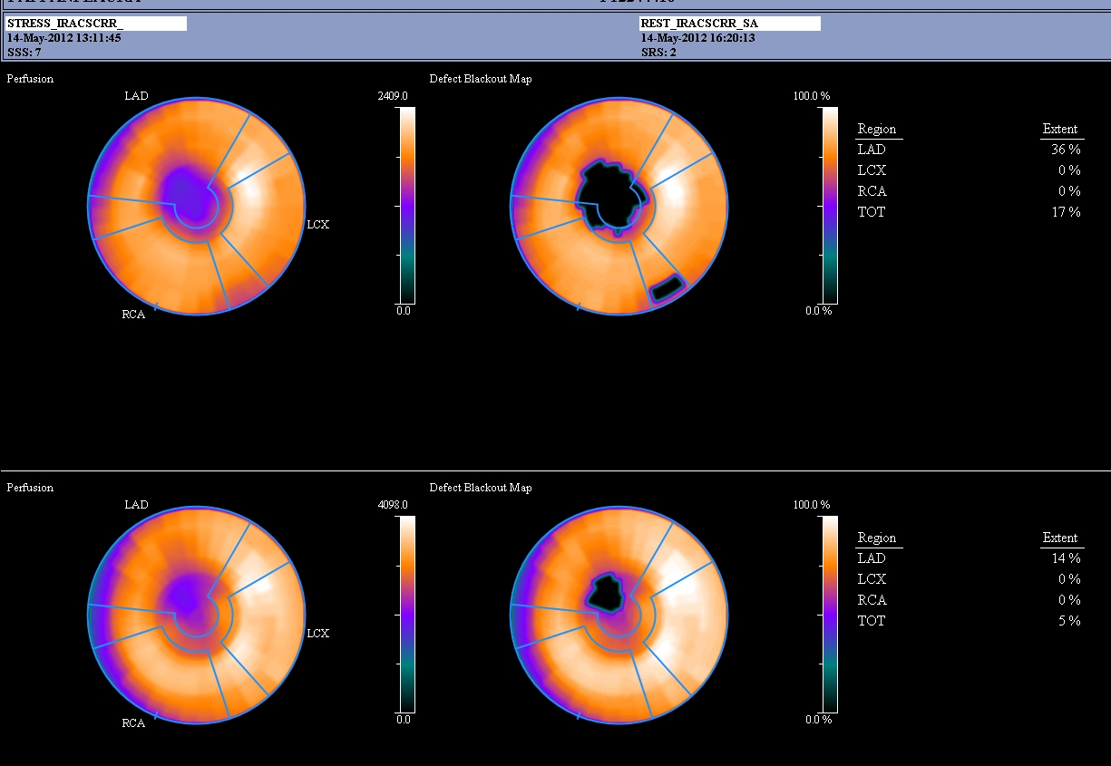

Slide 3
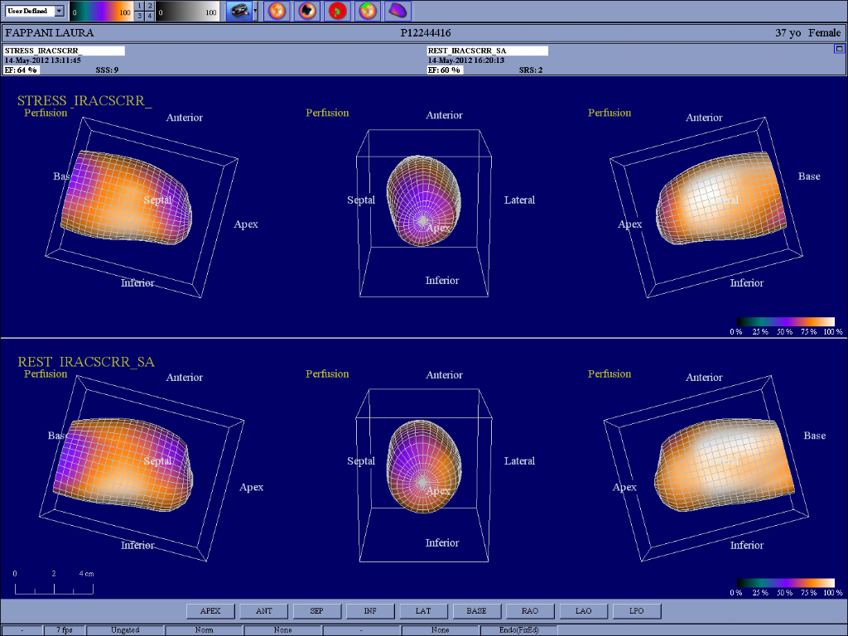

Slide 4
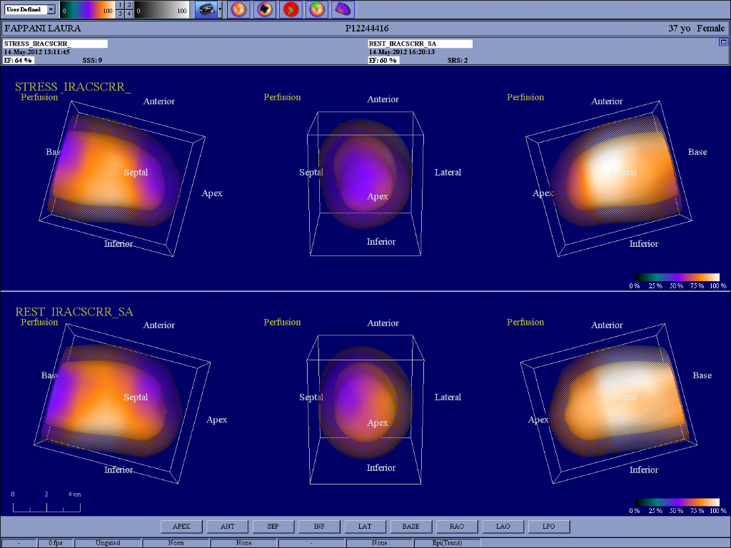

Slide 5
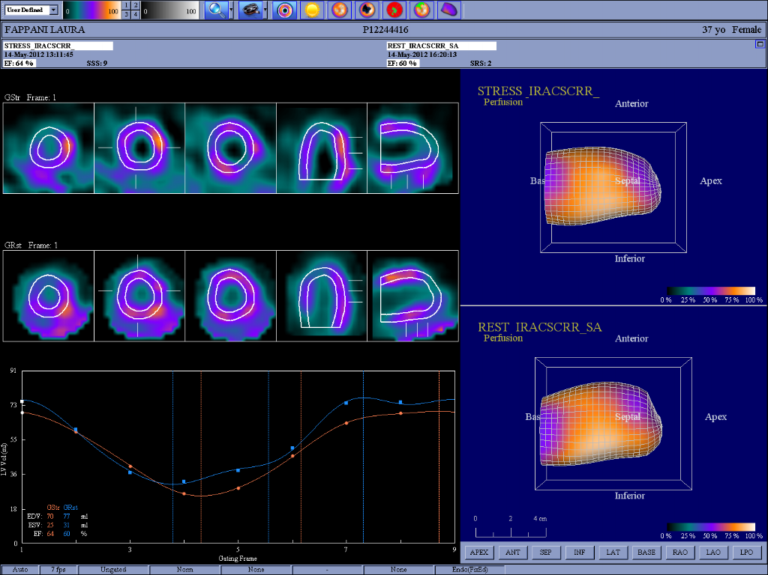

Slide 6
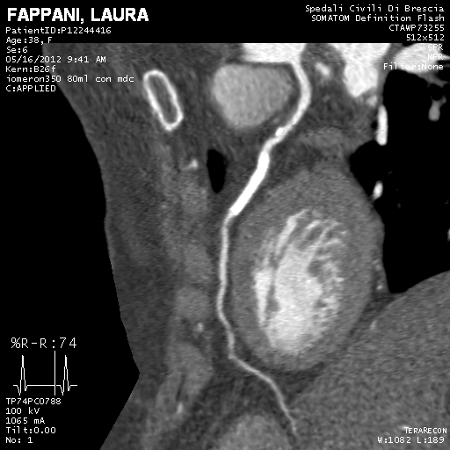

Slide 7
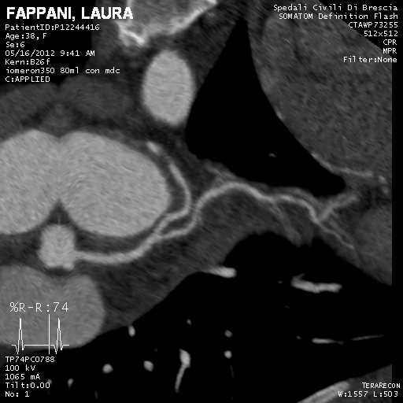

Slide 8
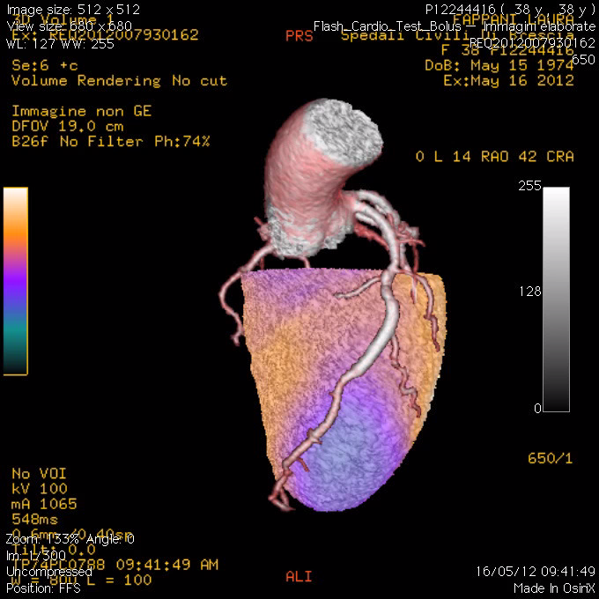

Slide 9
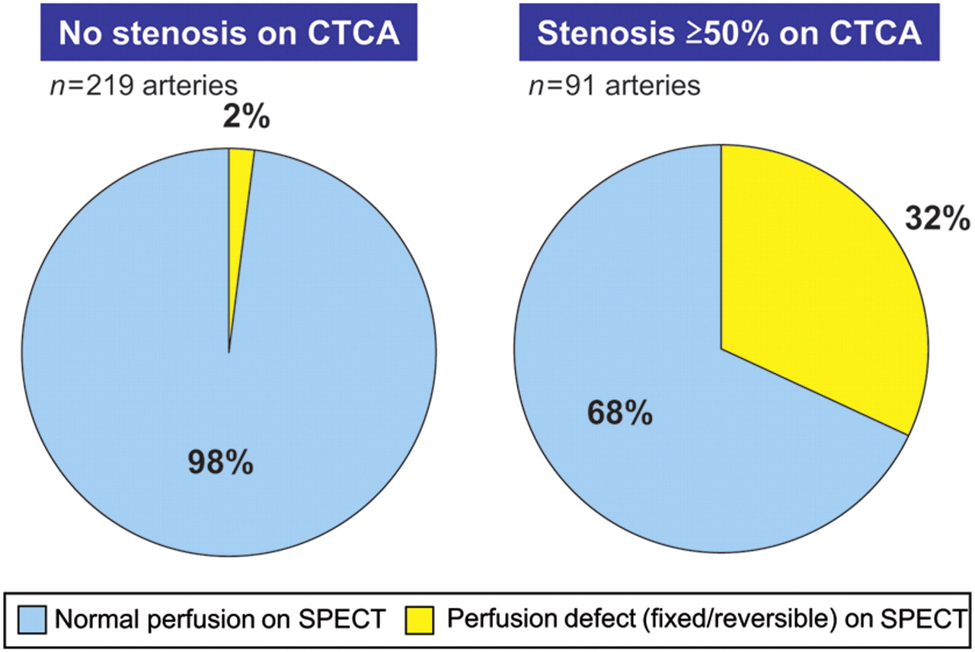
Functionally relevant coronary artery disease: comparison of 64-slice computed tomography coronary angiography with myocardial perfusion single photon emission computed tomography.
Gaemperli O et al. Eur Heart J 2011;32:2100-2108
Gaemperli O et al. Radiology 2008;248:414-423.
Notes:
Functionally relevant coronary artery disease: comparison of 64-slice computed tomography coronary angiography with myocardial perfusion single photon emission computed tomography. While almost all coronary arteries without obstructive lesions were associated with a normal perfusion (left pie chart), only 32% of significant coronary stenoses (≥50%) induced a perfusion defect on single photon emission computed tomography (right pie chart). Adapted from Gaemperli et al.7

Slide 10
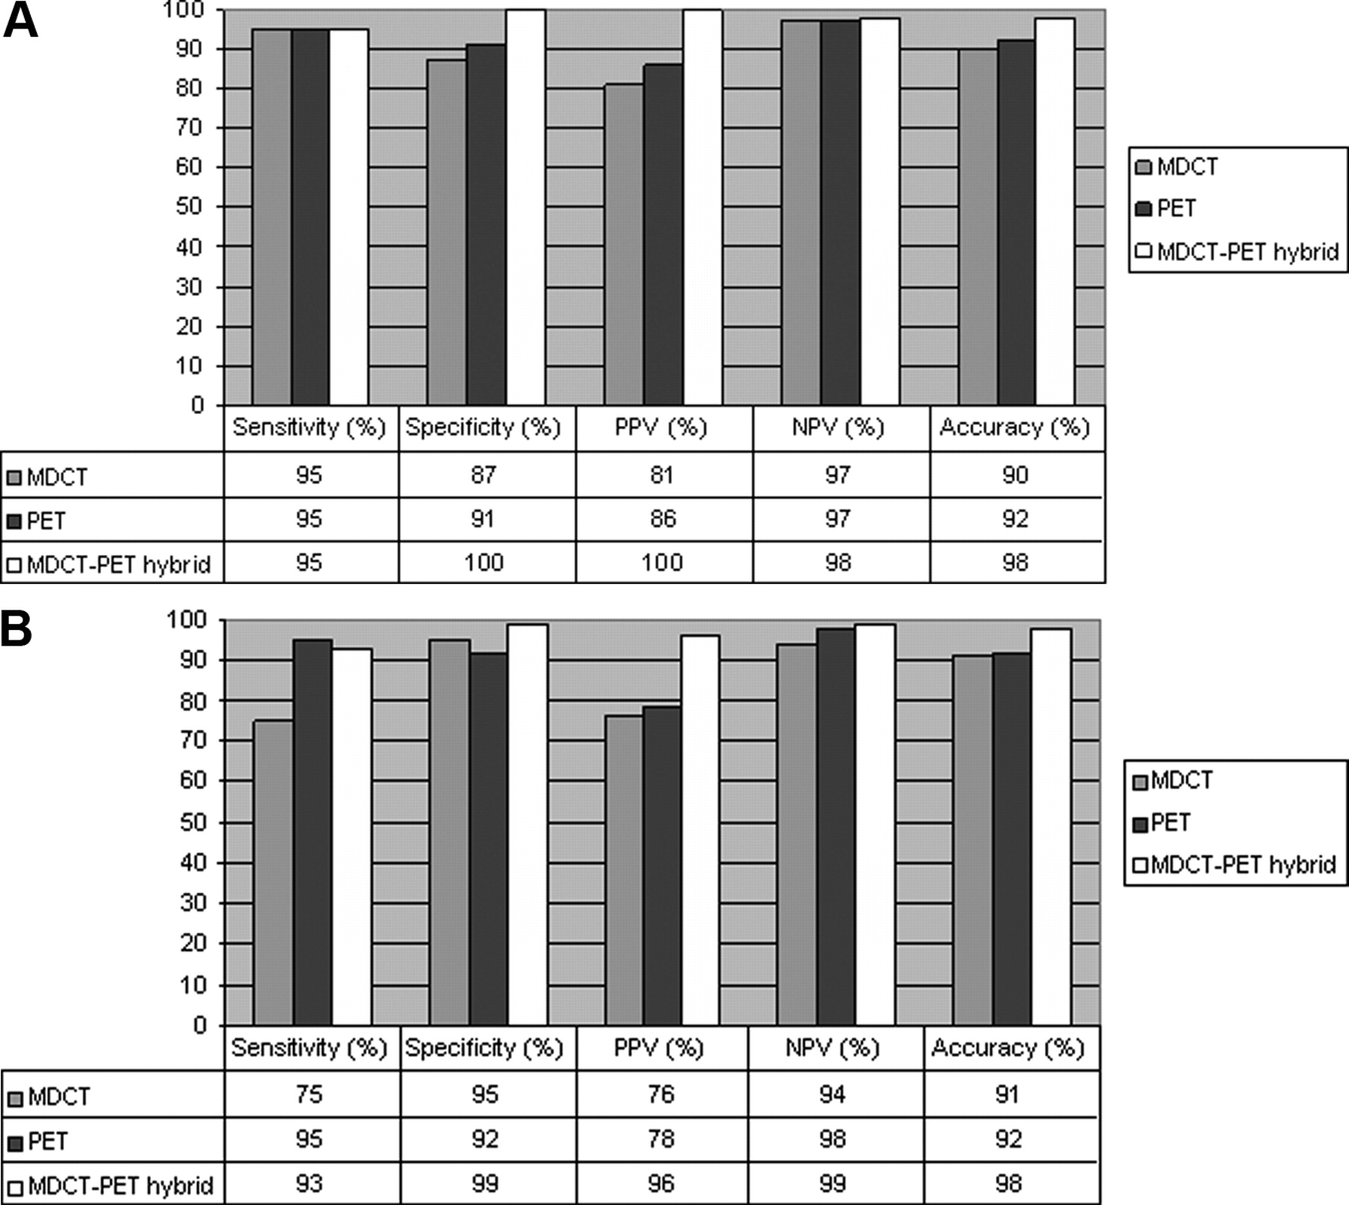
Figure 2. Sensitivity, specificity, PPV, NPV, and accuracy of stand-alone CT and PET and hybrid imaging against combined ICA and FFR. A, Analysis per patient.
Kajander S et al. Circulation 2010;122:603-613
Notes:
Figure 2. Sensitivity, specificity, PPV, NPV, and accuracy of stand-alone CT and PET and hybrid imaging against combined ICA and FFR. A, Analysis per patient. Hybrid imaging was more accurate than either CTA alone (P=0.0039) or PET alone (P=0.014). The difference between CTA and PET was not significant (P=0.32). B, Analysis per vessel. Hybrid imaging was more accurate than either CTA (P<0.0001) or PET (P<0.0001). The difference between CTA and PET was not significant (P=0.08).

Slide 11
Performance Indexes of CTCA and SPECT/CTCA for Detection of Hemodynamically Significant Coronary Lesions in 170 Segments in 44 Patients
 | CTCA | SPECT/CTCA
True positive | 24 | 24
True negative | 92 | 138
False positive | 53 | 7
False negative | 1 | 1
Sensitivity | 96% | 96%
Specificity | 63% | 95%⁎
PPV | 31% | 77%⁎
NPV | 99% | 99%
Rispler S et al. J Am Coll Cardiol 2007;49:1059-1067

Slide 12
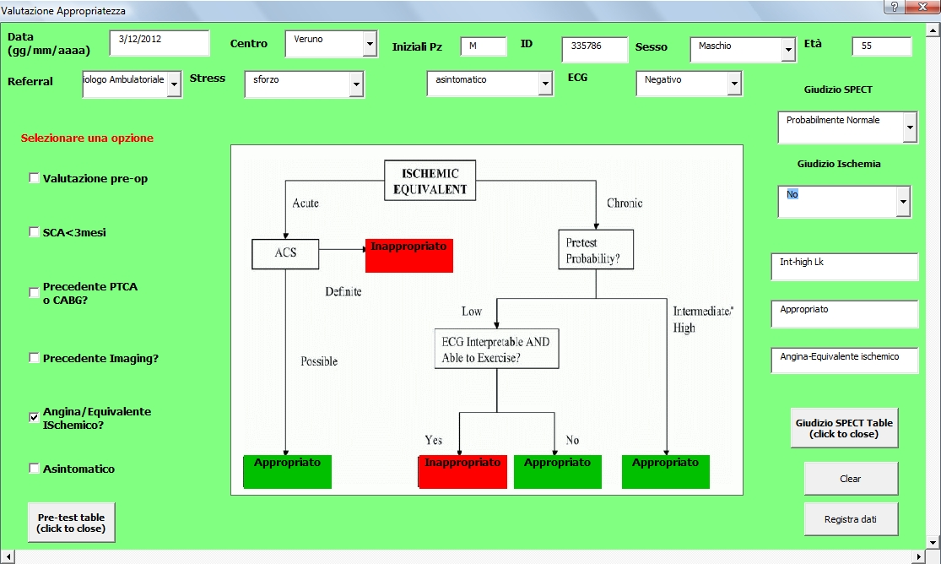

Slide 13
