Slide 1
BRESCIA, LA MEDICINA CHE CAMBIA:
INTEGRAZIONE OSPEDALE-TERRITORIO.
Prendersi cura della cronicità
Lo Scompenso cardiaco
Cosa ci dice la letteratura: standard epidemiologici e gestionali
Dr. Marco Metra
Cardiologia. Università e Spedali Civili di Brescia

Slide 2
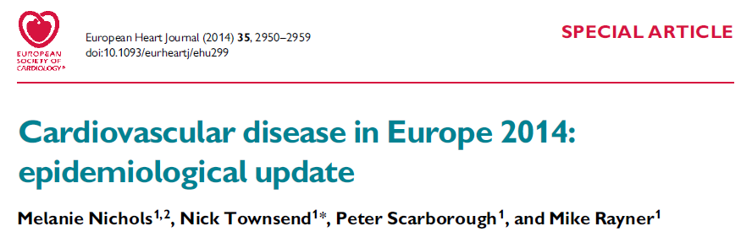
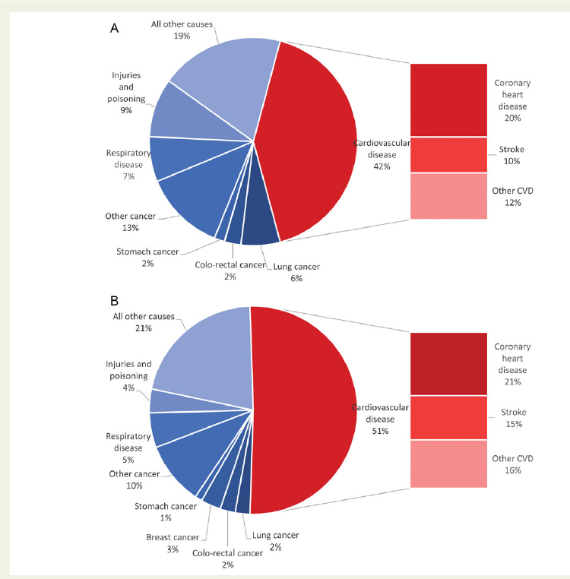
Proportion of all deaths due to major causes in men
Source: WHO Mortality database

Slide 3
Proportion of all deaths due to major causes in women
Source: WHO Mortality database

Slide 4
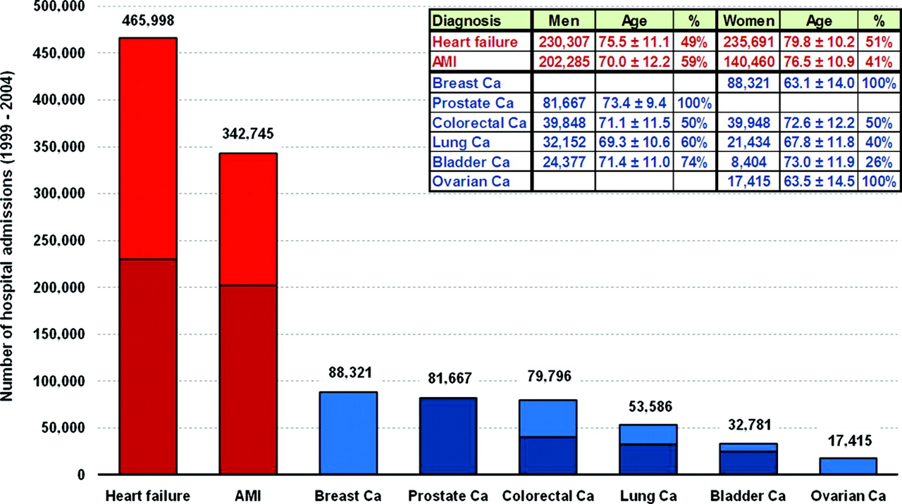
Distribution of 1,162,309 hospital admissions associated with a first-time diagnosis of HF, AMI, and common forms of cancer in Sweden during 1988 to 2004.
Stewart S et al. Circ Cardiovasc Qual Outcomes 2010;3:573-580
Notes:
Distribution of 1 162 309 hospital admissions associated with a first-time diagnosis of HF, AMI, and common forms of cancer in Sweden during 1988 to 2004. Ca indicates cancer.

Slide 5
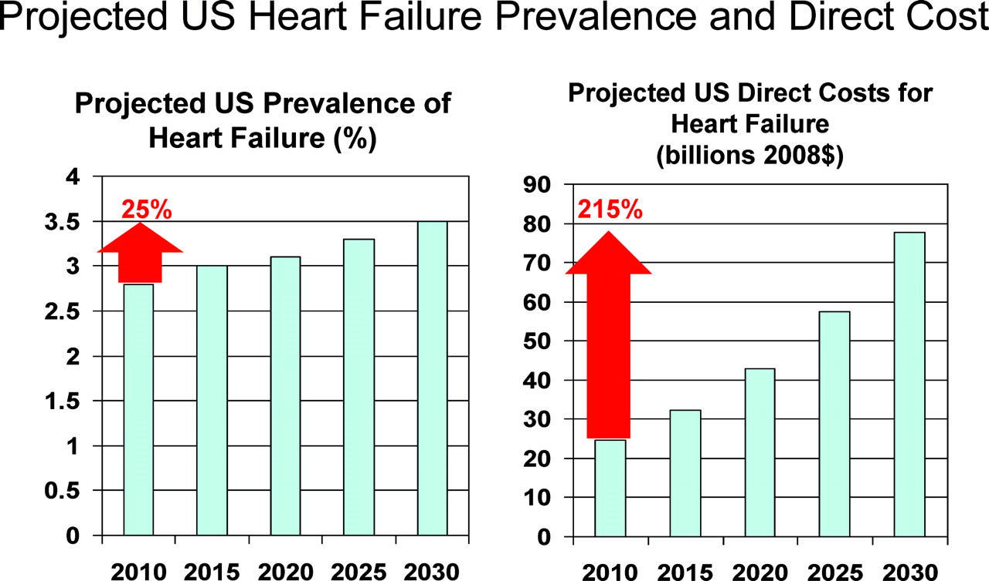
Twenty-year projections for U.S. heart failure prevalence and associated direct medical costs based on current trends.
Konstam M A Circulation 2012;125:820-827
Notes:
Twenty-year projections for United States heart failure prevalence and associated direct medical costs based on current trends. Adapted from Heidenreich et al1 with permission of the publisher.

Slide 6
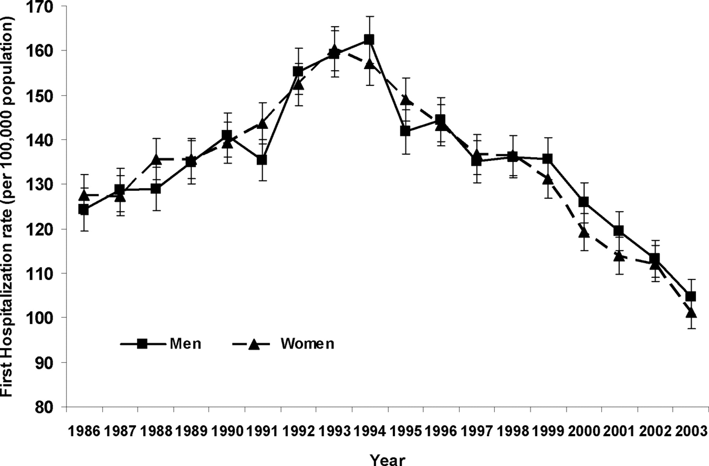
Age-adjusted trends in discharges for a first hospitalization for HF according to sex
Jhund, P. S. et al. Circulation 2009;119:515-523

Slide 7
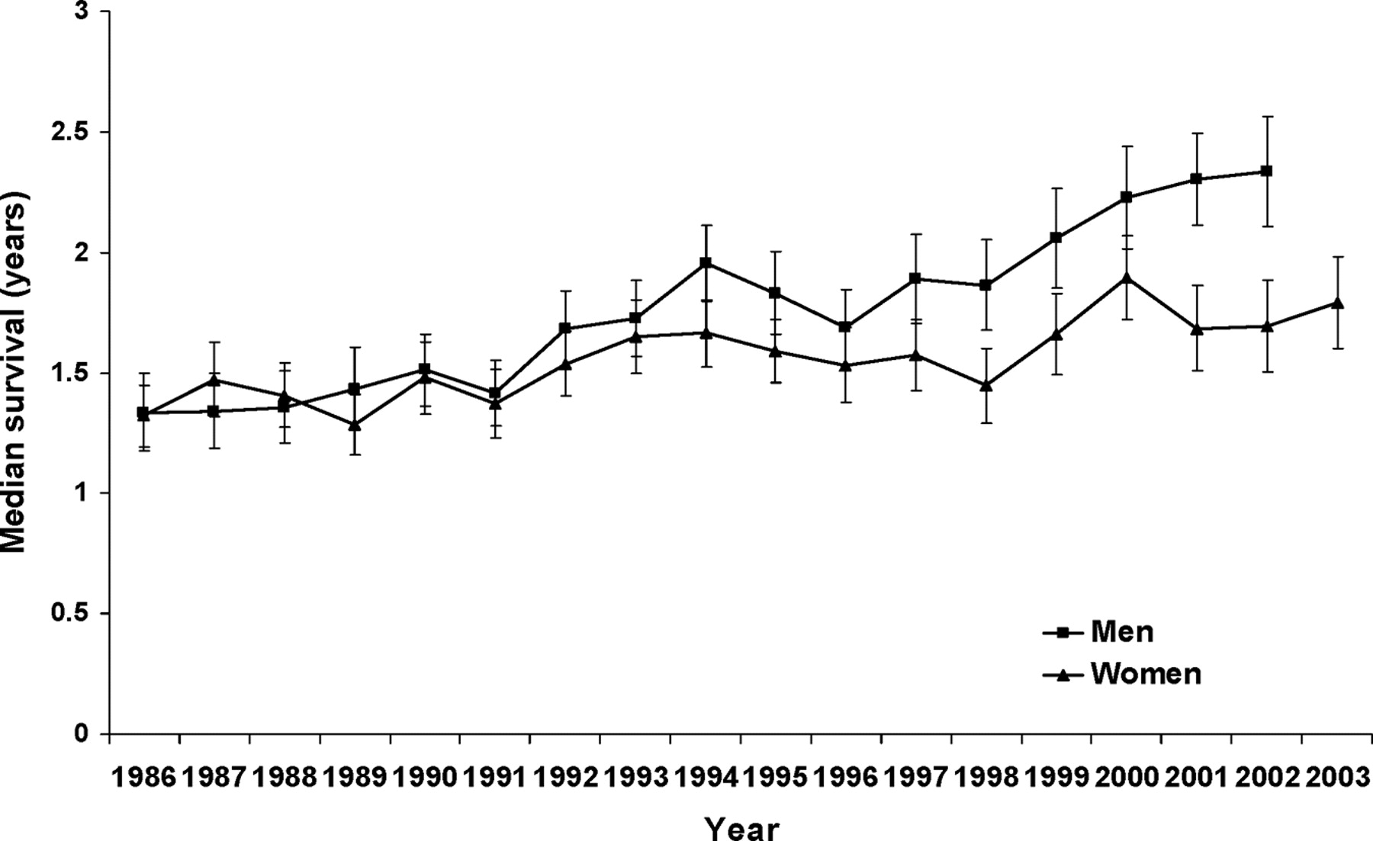
Trends in median survival (excluding deaths within 30 days) according to sex and year of admission
Jhund, P. S. et al. Circulation 2009;119:515-523

Slide 8
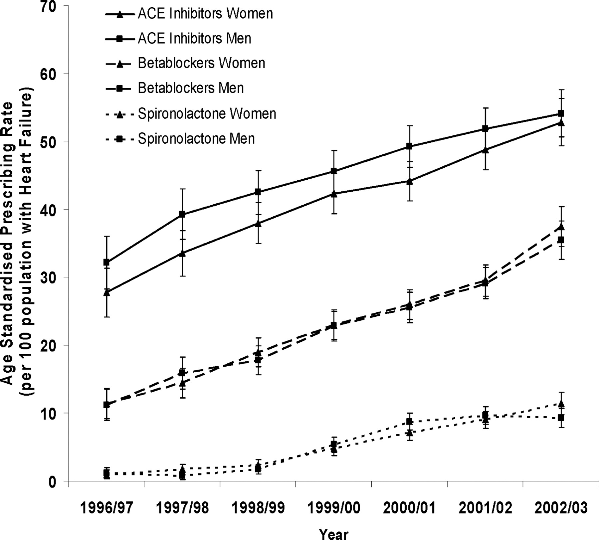
Age-adjusted trends in prescribing rates for ACE inhibitors, beta-blockers, and spironolactone in patients with HF in primary care
Jhund, P. S. et al. Circulation 2009;119:515-523

Slide 9
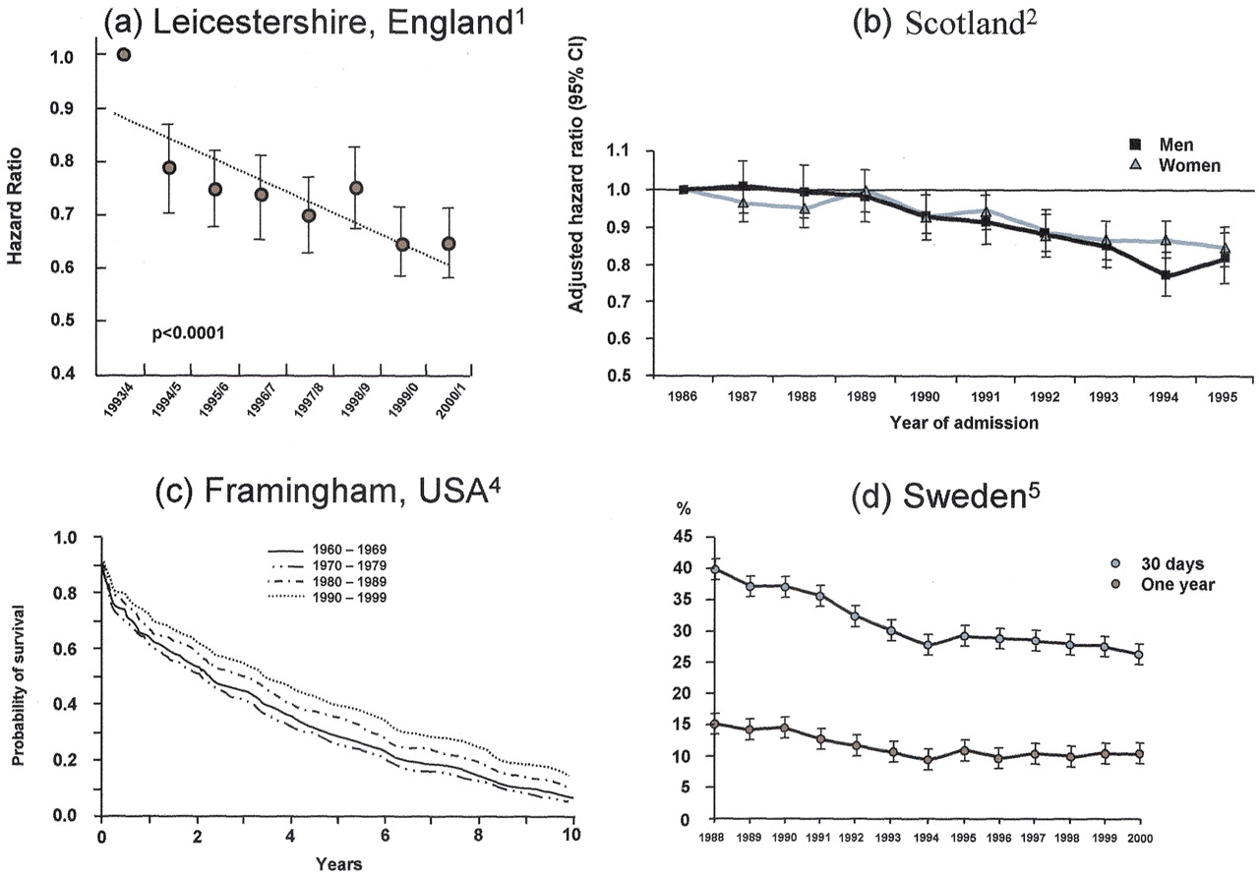
Evidence of improving survival from heart failure in the general population
¹Blackledge et al., Heart 2003; 89:615; ²MacIntyre et al., Circulation 2000;102:1126; ³Levy et al., NEJM 2002; 347:1397; ⁴Scahufelberger et al., EHJ 2004; 25:300; McMurray, J. J.V. et al. J Am Coll Cardiol 2004;44:2398-2405

Slide 10
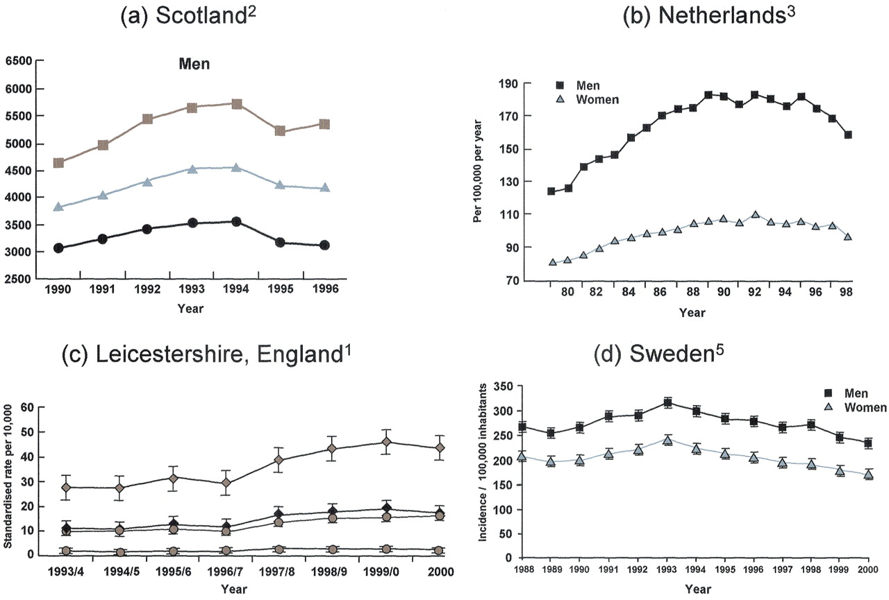
Recent trends in hospital admissions for heart failure demonstrating recent plateau or decline
1Blackledge et al., Heart 2003; 89:615; 2MacIntyre et al., Circulation 2000;102:1126; 3Levy et al., NEJM 2002; 347:1397; 4Scahufelberger et al., EHJ 2004; 25:300; McMurray, J. J.V. et al. J Am Coll Cardiol 2004;44:2398-2405

Slide 11
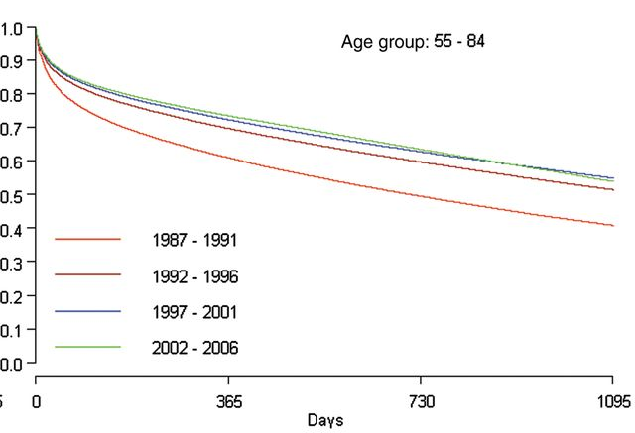
Survival after a first hospitalization for heart failure in Sweden
Barasa et al. Eur Heart J. 2014 Jan;35(1):25-32.

Slide 12
Epidemiologia dello scompenso cardiaco
Aumento di prevalenza ed incidenza
  Invecchiamento della popolazione generale
  Miglioramento delle cure delle cardiopatie acute
Riduzione della mortalità e delle riospedalizzazioni
  Utilizzo delle terapie basate sull’evidenza

Slide 13
Epidemiologia dello scompenso cardiaco
Aumento di prevalenza ed incidenza
  Invecchiamento della popolazione generale
  Miglioramento delle cure delle cardiopatie acute
Riduzione della mortalità e delle riospedalizzazioni
  Utilizzo delle terapie basate sull’evidenza
Problemi ancora aperti
  Scompenso cardiaco a frazione d’eiezione conservata
  Paziente ospedalizzato o recentemente ospedalizzato

Slide 14
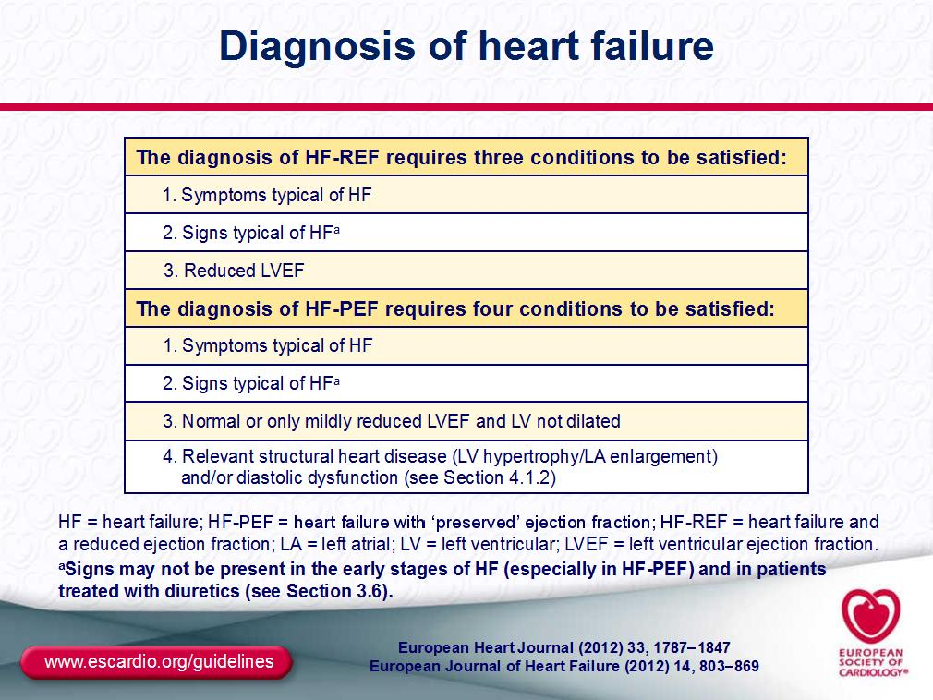

Slide 15
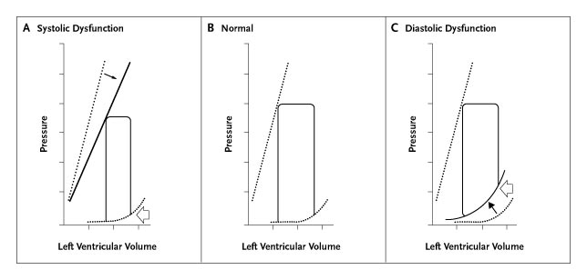
Left Ventricular Pressure-Volume Loops in Systolic and Diastolic Dysfunction
Aurigemma G and Gaasch W. N Engl J Med 2004;351:1097-1105
Notes:
Figure 2. Left Ventricular Pressure-Volume Loops in Systolic and Diastolic Dysfunction. In systolic dysfunction, left ventricular contractility is depressed, and the end-systolic pressure-volume line is displaced downward and to the right (Panel A, black arrow); as a result, there is a diminished capacity to eject blood into the high-pressure aorta. In diastolic dysfunction, the diastolic pressure-volume line is displaced upward and to the left (Panel C, black arrow); there is diminished capacity to fill at low left-atrial pressures. In systolic dysfunction, the ejection fraction is depressed, and the end-diastolic pressure is normal (Panel A, open arrow); in diastolic dysfunction, the ejection fraction is normal and the end-diastolic pressure is elevated (Panel C, open arrow).

Slide 16
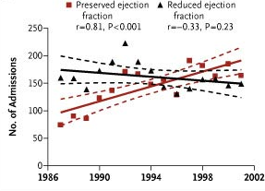
Secular Trends in the Prevalence of Heart Failure with Preserved Ejection Fraction
Owan T et al. N Engl J Med 2006;355:251-259

Slide 17
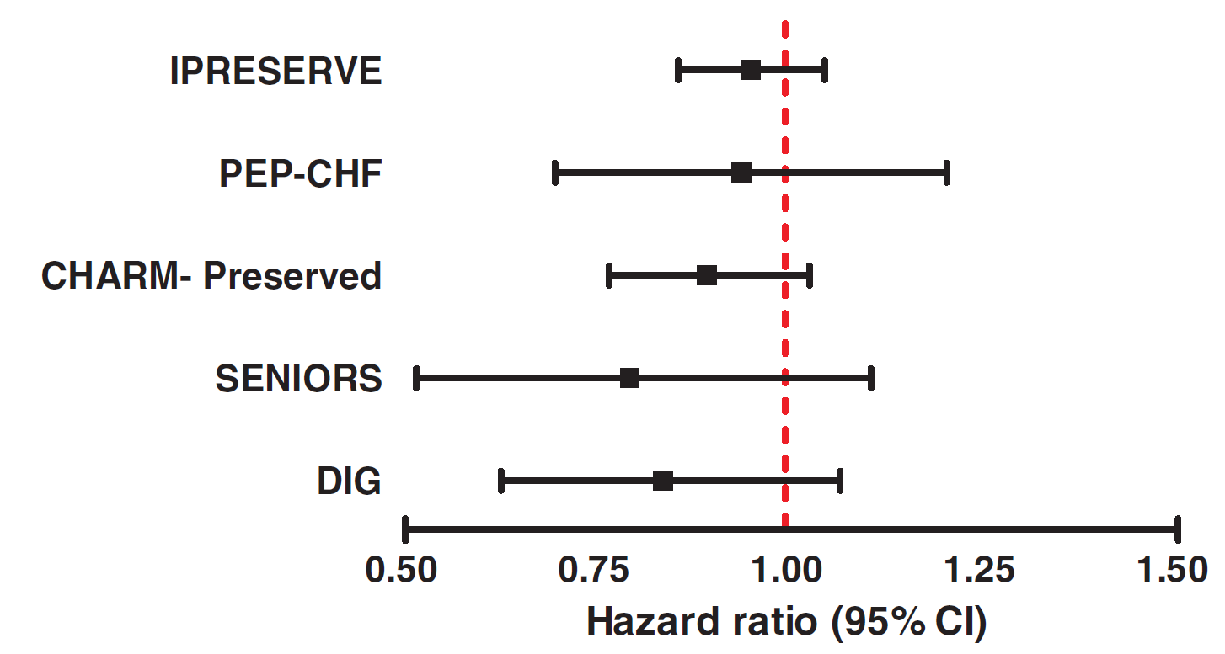
Large trials in HFpEF – no clear benefit
CI=confidence interval
Redfield MM, et al. Circ Heart Fail 2012;5;653–9

Slide 18
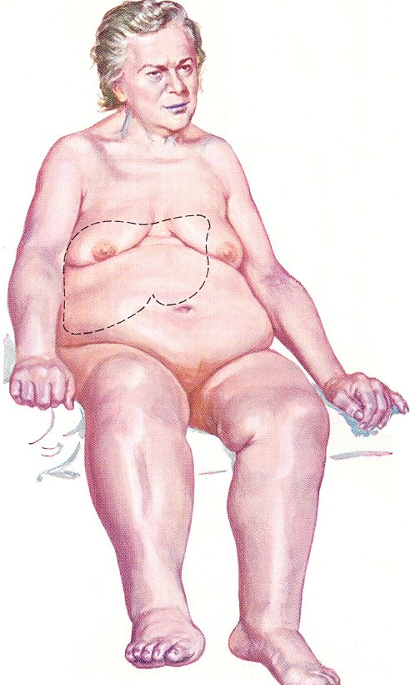

Spectrum of AHF clinical presentations

Slide 19
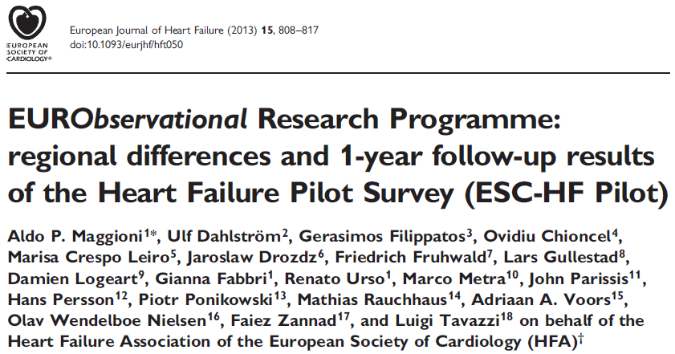
All-cause mortality
0.50
0.45
Type of patient
Hospital
Outpatient
0.40
0.35
0.30
0.25
Failure
0.20
17.4%
0.15
0.10
0.05
7.2%
0
0
30
60
90
120
150
180
210
240
270
300
330
360
Days from enrolment

Slide 20
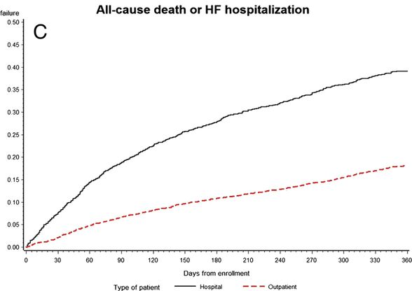
One year Deaths or HF hospitalizations in patients hospitalized patients with acute HF and ambulatory with chronic HF (dotted line). ESC-HF Pilot (n=5118)
All-cause deaths or HF hospitalizations
35.8%
17.8%
Maggioni A P et al. Eur J Heart Fail 2013;15:808-817
Notes:
Kaplan–Meier curves for all-cause death (A), admission to hospital for heart failure (HF) (B), and all-cause death or admission to hospital for HF (C), divided into hospitalized patients with acute HF (continuous line) and ambulatory patients with chronic HF (dotted line).

Slide 21
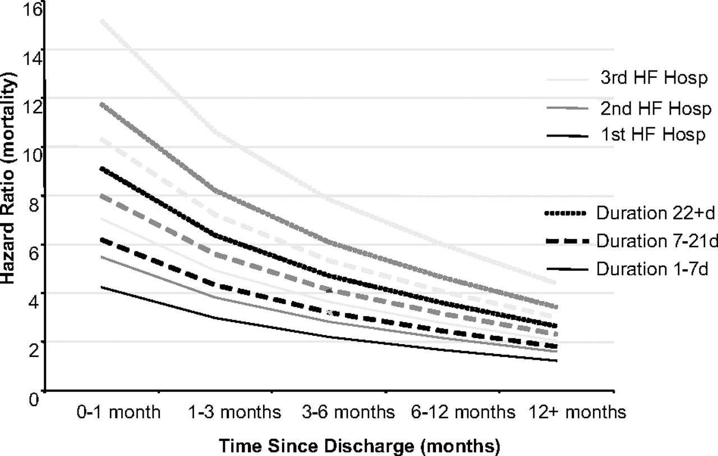
Hazard ratio for mortality based on time since latest discharge, longest duration of HF hospitalization and HF hospitalization number in CHARM
Solomon S D et al. Circulation. 2007;116:1482-1487
Notes:
Figure 5. Hazard ratio for mortality based on time since latest discharge, longest duration of HF hospitalization (solid, dashed, and dotted lines), and HF hospitalization number (black, dark gray, and light gray lines).

Slide 22
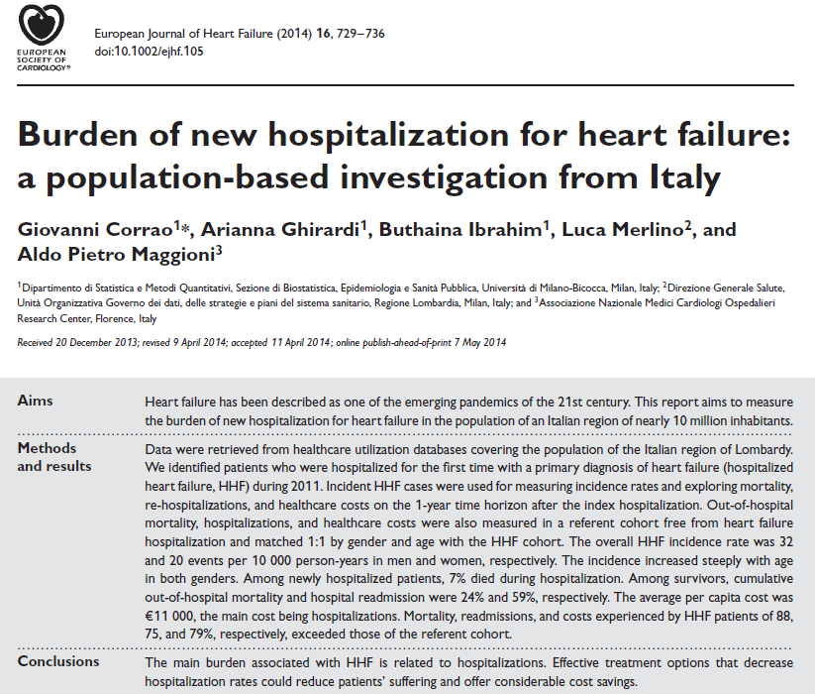

Slide 23
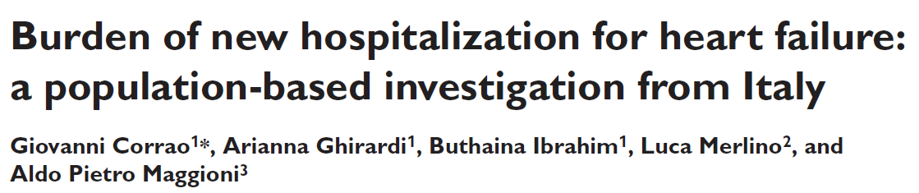
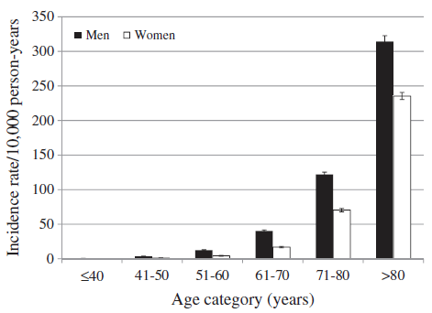
Corrao et al. Eur J Heart Fail 2014; 16, 729–736

Slide 24
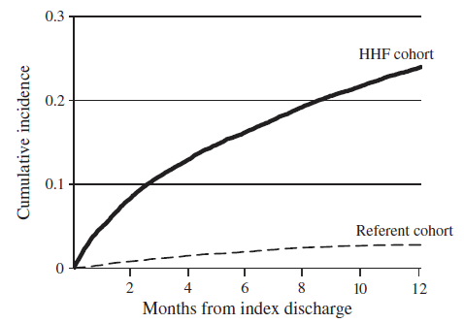
Cumulative incidence of all-cause mortality
Corrao et al. Eur J Heart Fail 2014; 16, 729–736

Slide 25
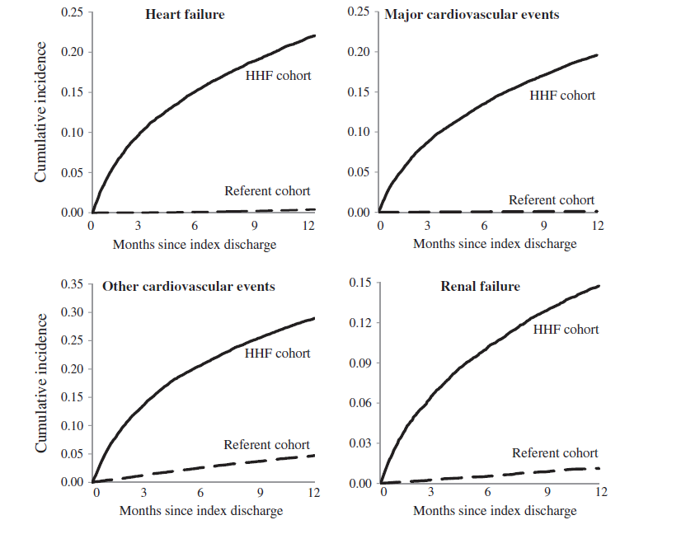
Incidence of hospitalizations, Lombardy 2011
Corrao et al. Eur J Heart Fail 2014; 16, 729–736

Slide 26
Corrao et al. Eur J Heart Fail 2014; 16, 729–736

Slide 27
Corrao et al. Eur J Heart Fail 2014; 16, 729–736

Slide 29
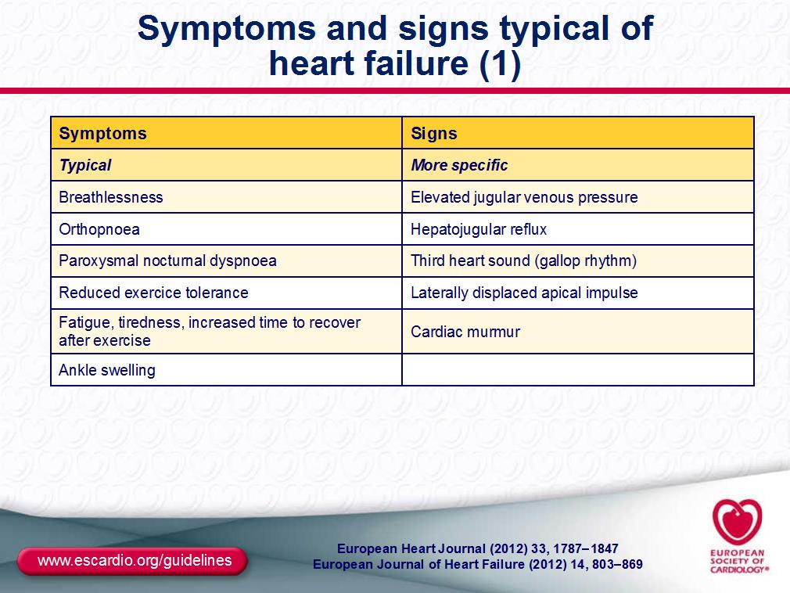

Slide 30
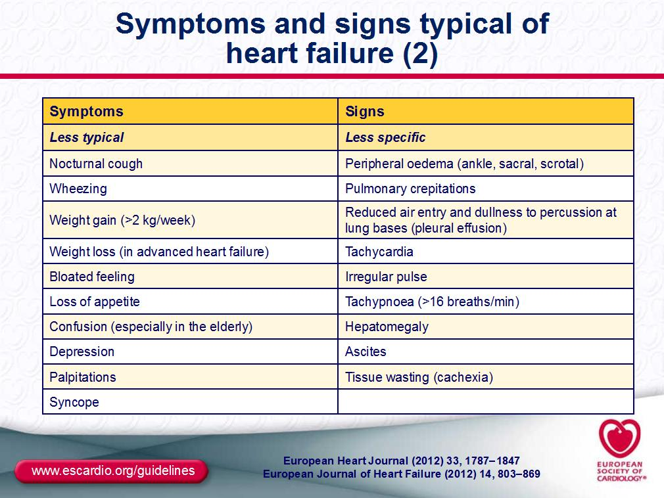

Slide 31
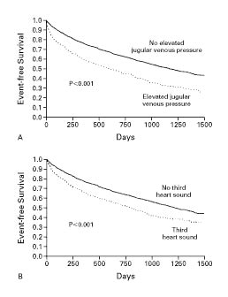
Drazner MH et al. N Engl J Med 2001;345:574-581.
Event-free Survival According to the Presence or Absence of Elevated Jugular Venous Pressure and a Third Heart Sound. Data from SOLVD Trial
Notes:
Figure 1. Kaplan–Meier Analysis of Event-free Survival According to the Presence or Absence of Elevated Jugular Venous Pressure (Panel A) and a Third Heart Sound (Panel B). The end point was a composite of death or hospitalization for heart failure. In Panel A, the 280 patients with elevated jugular venous pressure were significantly more likely than the 2199 patients without elevated jugular venous pressure to reach the composite end point (P<0.001 by the log-rank test). In Panel B, the 597 patients with a third heart sound were significantly more likely than the 1882 patients without a third heart sound to reach the composite end point (P<0.001 by the log-rank test).

Slide 32
Freedom from congestion predicts good survival also in patients with advanced HF
146 pts with NYHA IV
4-6 weeks after discharge re-evaluated for congestion
2-year survival
(%)
80
Criteria:
High-risk group
60
Orthopnoea
↑ JVP
Oedema
Weight gain
↑ baseline diuretics
40
20
0 crit
(n=80)
1-2 crit
(n=40)
≥3 crit
(n=26)
Orth+
(n=33)
Lucas et al., Am Heart J 2000;140:840

Slide 33
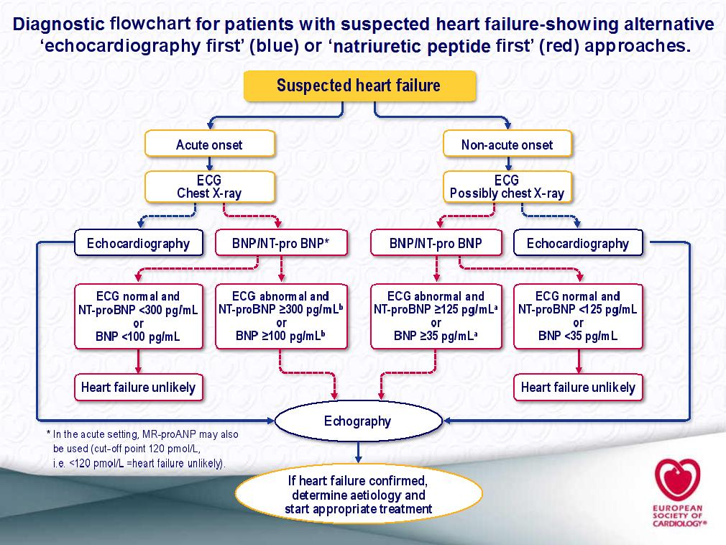

Slide 34
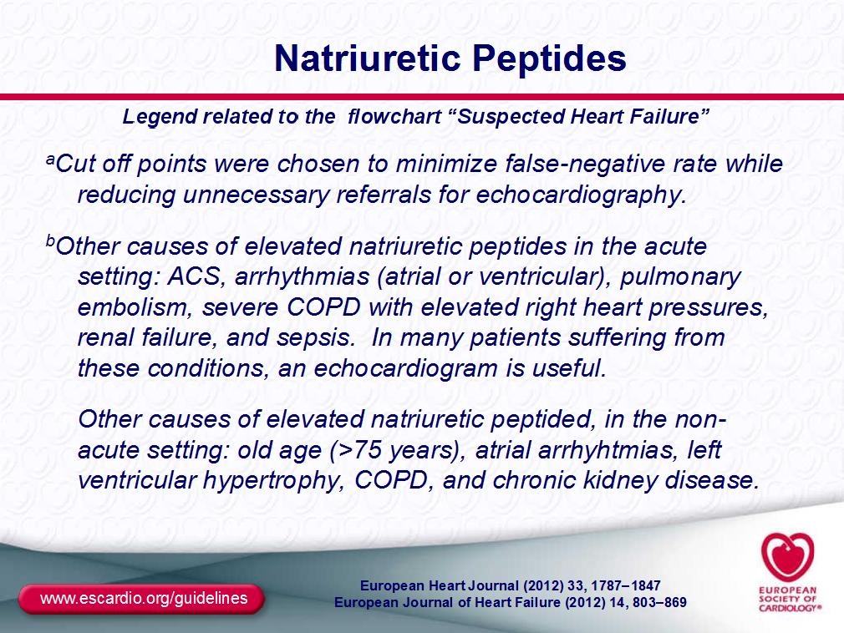

Slide 35
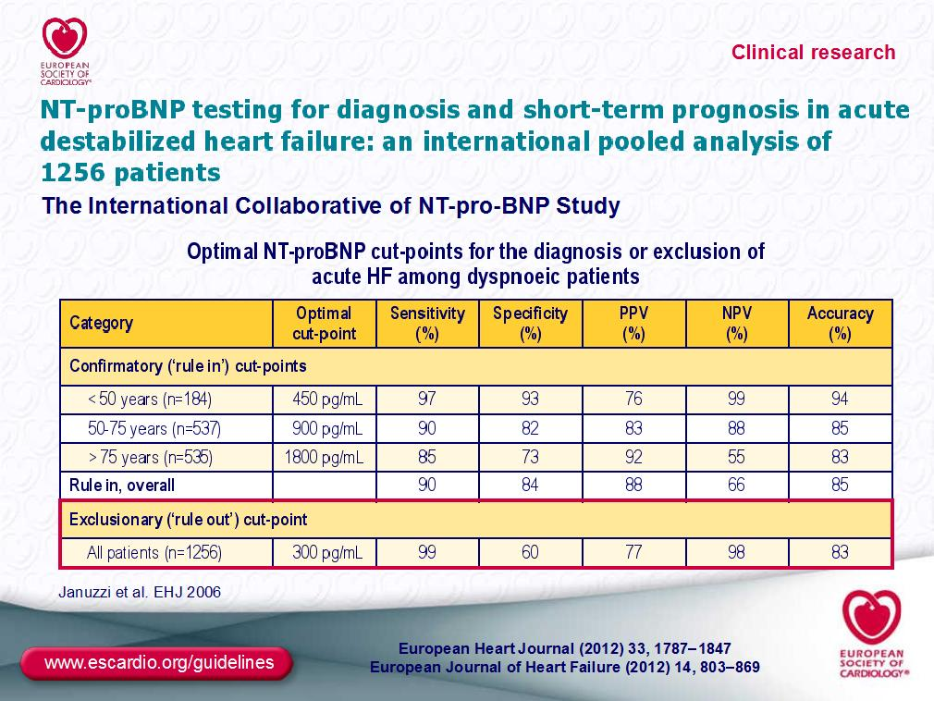

Slide 36
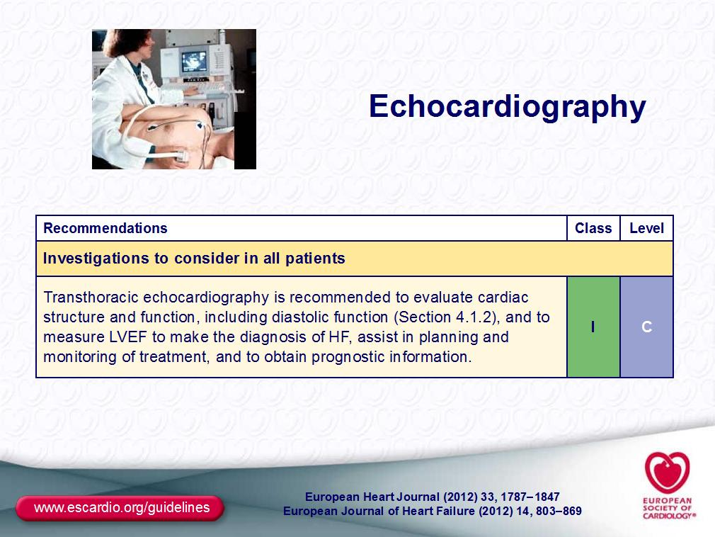

Slide 37
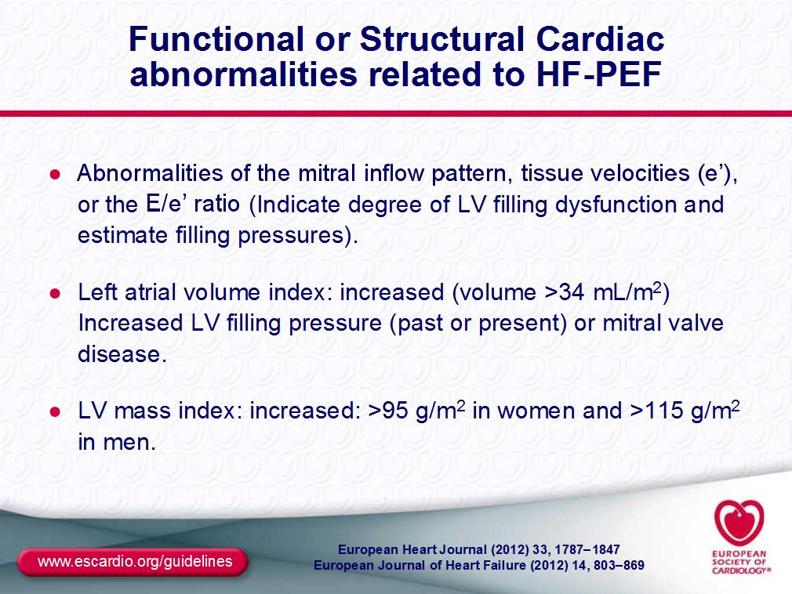

Slide 38
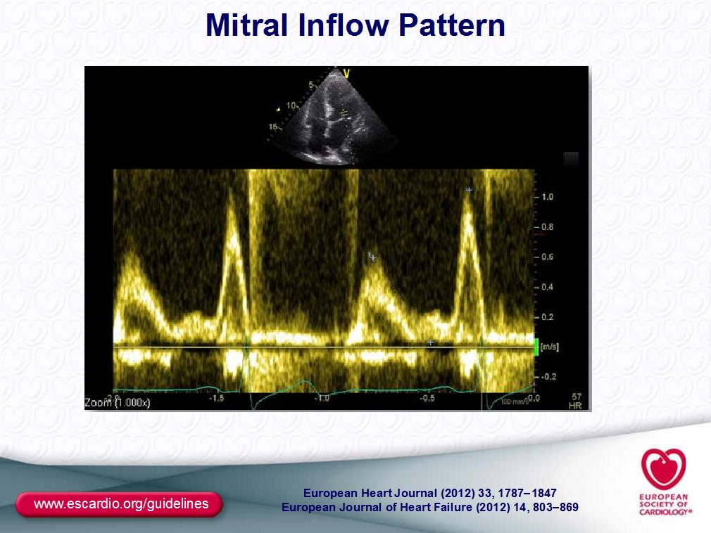

Slide 39
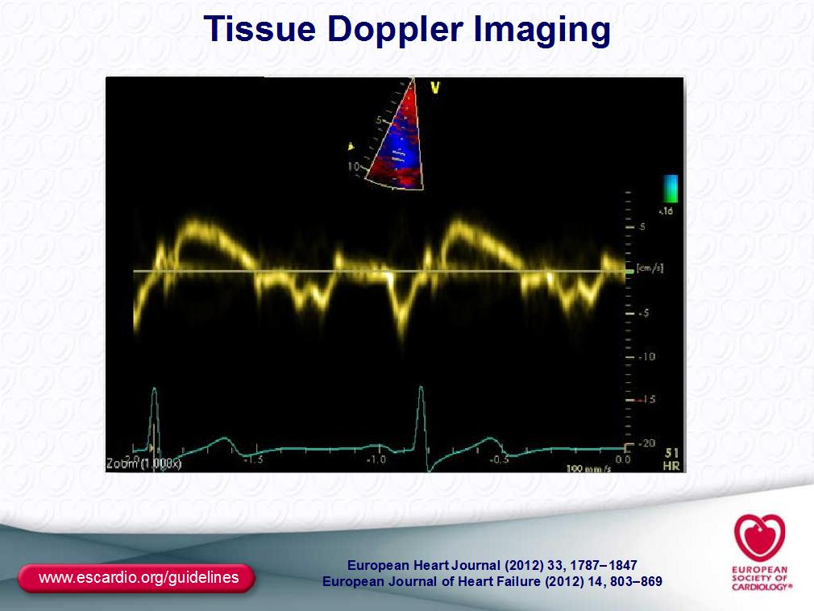

Slide 40
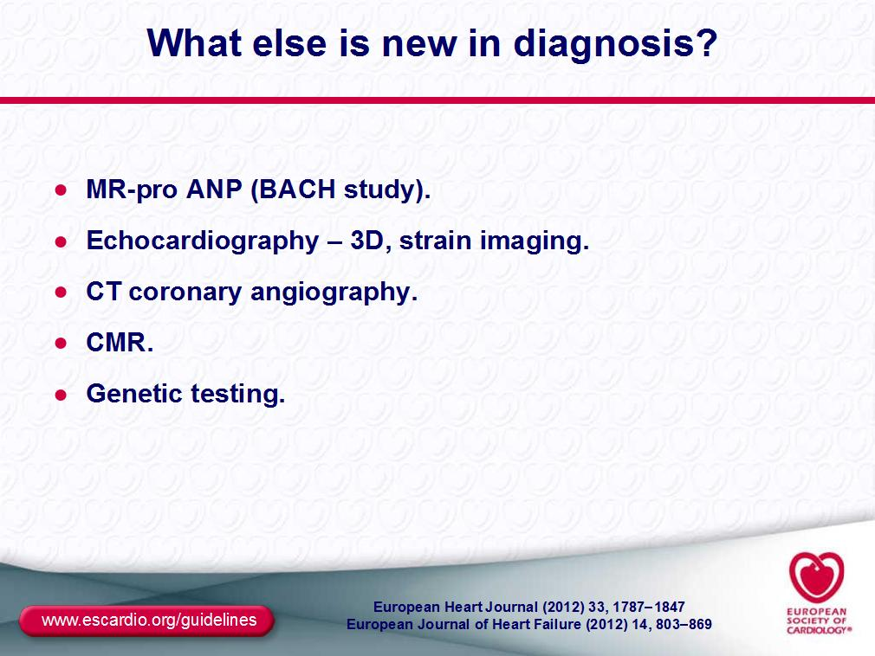

Slide 41
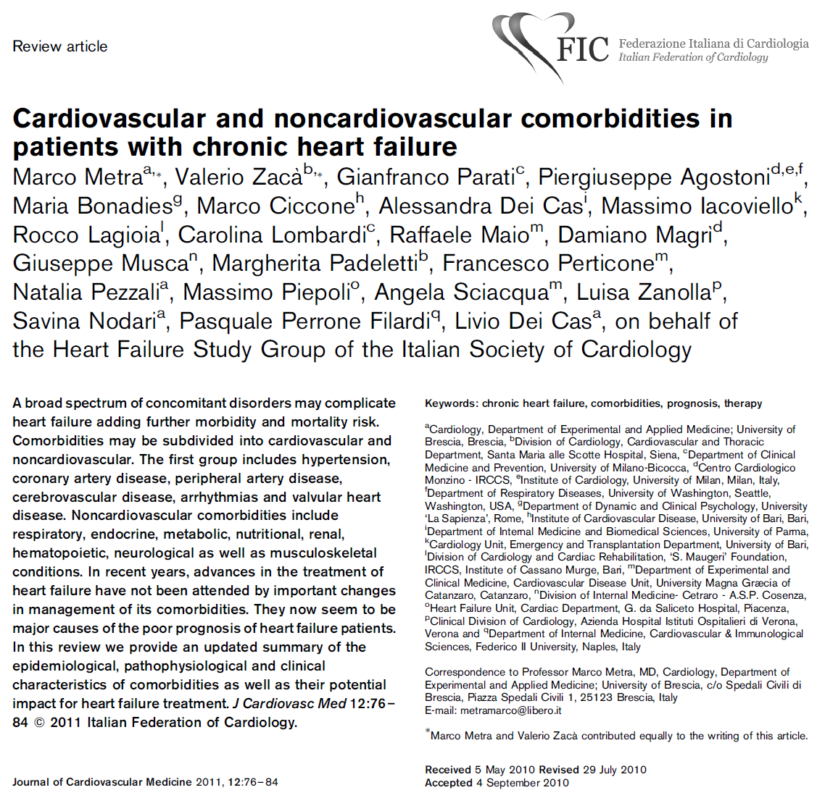

Slide 42
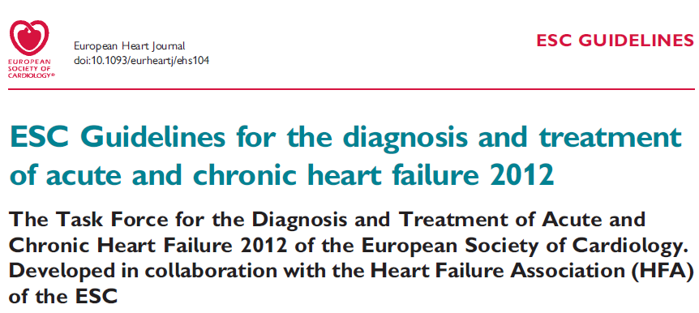
ESC 2012 guidelines

Slide 43
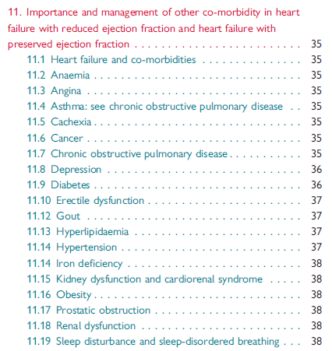
ESC 2012 guidelines

Slide 44
Non-cardiac comorbidities in acute heart failure patients
COPD | Renal disease | Diabetes | Anaemia | Liver abnormalities
Symptom overlap Diagnostic difficulty Misapplication of therapy Beta-blocker underuse Bronchodilator interaction (?) | Complicates diuresis Potassium balance ACE-I and MRA underuse Balance of decongestion and worsening renal function (?) | Different presenting signs/symptoms Other linked comorbidities Pharmacology implications of obesity Diabetes management in HF patients (?) | Multiple potential aetiologies Association with renal disease Impact of HF medications on worsening anaemia Prognostic marker or mediator of risk Optimal management (?) | Correlation with haemodynamics and hypoperfusion Marker vs. Mediator Variable association with outcomes
Notes:
The acute heart failure population represents a heterogeneous cohort with multiple interrelated non-cardiovascular comorbidities. Chronic obstructive pulmonary disease, renal disease, diabetes, anaemia and liver abnormalities impact the clinical characteristics and outcomes of patients with acute heart failure and complicate in-hospital management. Attention to the diagnosis and management of comorbidities in patients with AHF may improve patient outcomes.
Reference:
Mentz RJ, Felker GM. Noncardiac comorbidities and acute heart failure patients. Heart Fail Clin. 2013;9:359-67.

Slide 45
Prognostic determinants in heart failure
Demographic
  Age
  Male gender
Clinical
  Frequent rehospitalisations
  Advanced NYHA class
  Intolerance to neurohormonal antagonists
  Persistent/relapsing signs of pulmonary or peripheral congestion
  Hypotension
  Comorbidities
    Diabetes
    Renal failure
    Hepatic failure
    Anaemia
    COPD,
    Depression...
Electrocardiography
  Resting tachycardia
  Wide QRS complex
Laboratory
  Hyponatraemia
  Blood urea nitrogen/serum creatinine
  Anaemia
  Hepatic insufficiency
  Neurohormones
  Troponins
  Inflammatory markers
Doppler-echocardiography
  Signs of increased LV filling pressure
  Low RVEF
Functional capacity
Metra M, et al. Eur J Heart Fail. 2007;9:684–94.
Notes:
Useful prognostic indicators are outlined here. These include demographic and clinical determinants, functional capacity, as well as ECG and laboratory results. Signs of increased left ventricular filling pressure and/or of right ventricular dysfunction, assessed by Doppler-echocardiography or cardiac catheterisation, are more important in advanced heart failure with a greater predictive power when these data are collected after optimisation of therapy. Risk stratification models have been developed and validated both in patients referred for heart transplant and in those hospitalised for heart failure. Comorbidities, blood pressure and renal function are often amongst the most important independent prognostic variables. These results can also be applied to patients with advanced heart failure.
Reference:
Metra M, Ponikowski P, Dickstein K, et al. Advanced chronic heart failure: A position statement from the Study Group on Advanced Heart Failure of the Heart Failure Association of the European Society of Cardiology. Eur J Heart Fail. 2007;9:684-94.

Slide 46
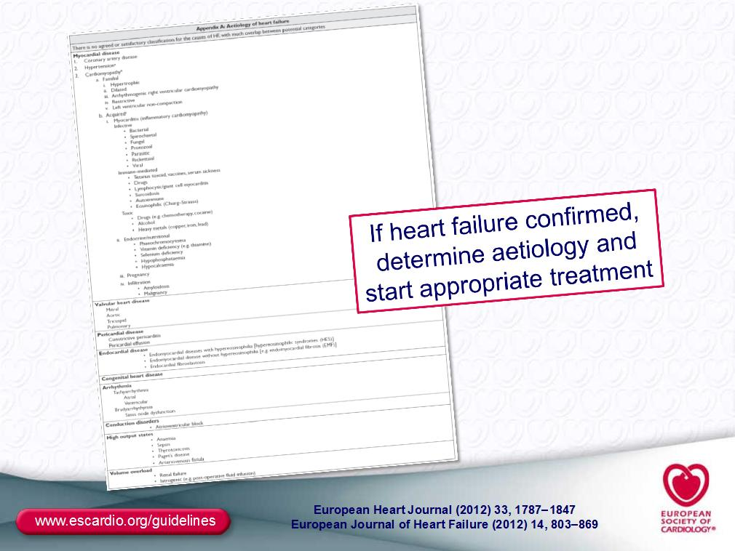

Slide 47
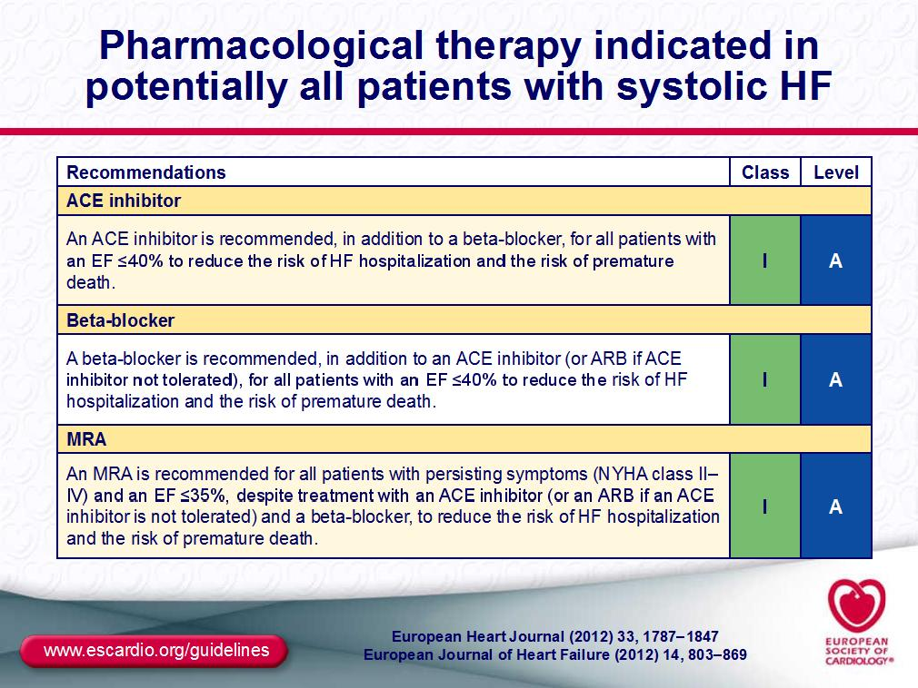

Slide 48
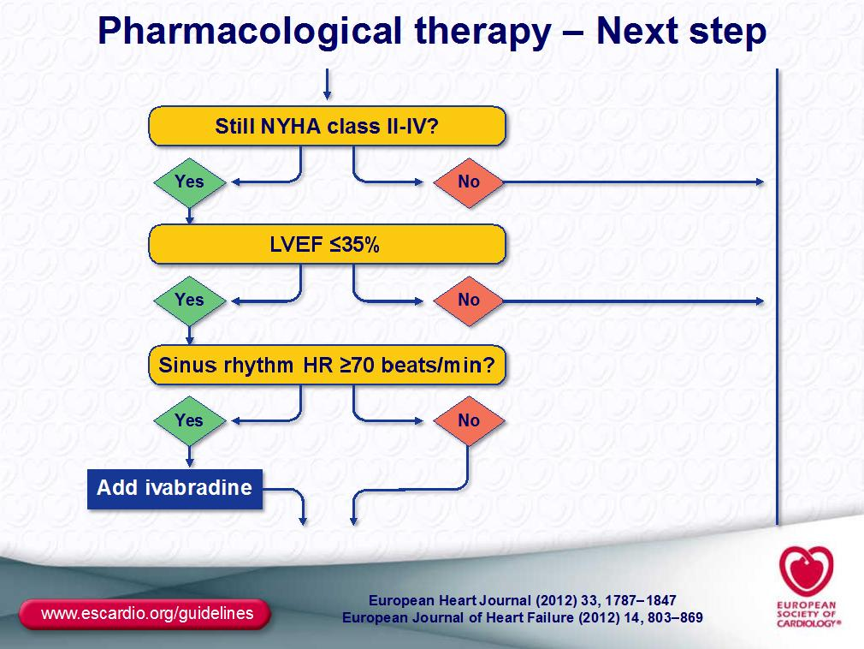

Slide 49
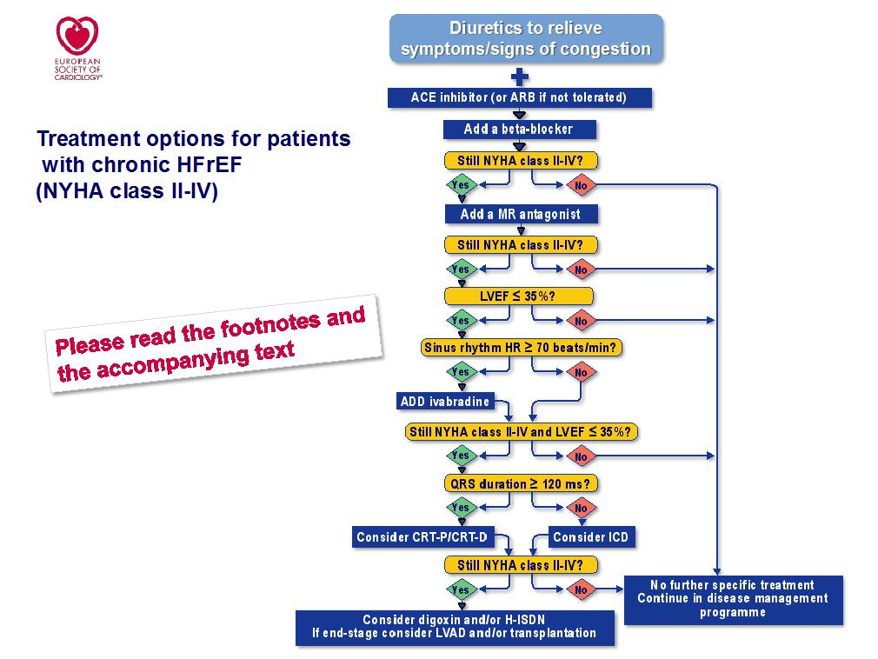

Slide 50
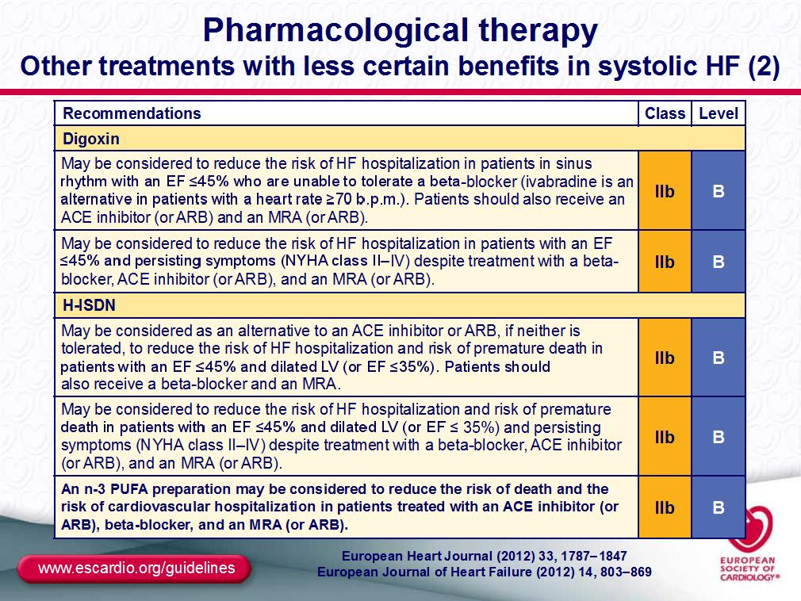

Slide 51
Heart failure: a state of “neurohumoral imbalance”?
Vasoconstrictor/
anti-natriuretic
/pro-hypertrophic
Vasodilator/
natriuretic/
anti-hypertrophic

Slide 52
Heart failure: a state of “neurohumoral imbalance”?
Vasodilator/
natriuretic/
anti-hypertrophic
Vasoconstrictor/
anti-natriuretic
/pro-hypertrophic

Slide 53
Molecular structure of LCZ696
Angiotensin receptor neprilysin inhibitor (ARNI)
LCZ696 active ingredient
PLASMA
AHU377
pro-drug
LBQ657
active NEPi
O
HN
O
HN
Esterase
O
O
O
OH
NaO
HO
Ingestion of LCZ696 leads to plasma exposure of the NEPi pro-drug AHU 377, the active NEP inhibitor LBQ657 and valsartan
O
O
Highly selective NEP inhibitor: IC50 for human NEP = 7.3 nM
Less selective for
ACE - APP
O
O
N
OH
Molecular complex of:
An ARB - valsartan
A NEP inhibitor – LBQ 657
Valsartan
ARB
N
Novartis Data on file
N
NH
N
NEP=neprilysin; NEPi=neprilysin inhibitor; ARB=angiotensin receptor blocker
ACE=angiotensin-converting enzyme; APP=aminopeptidase P

Slide 54
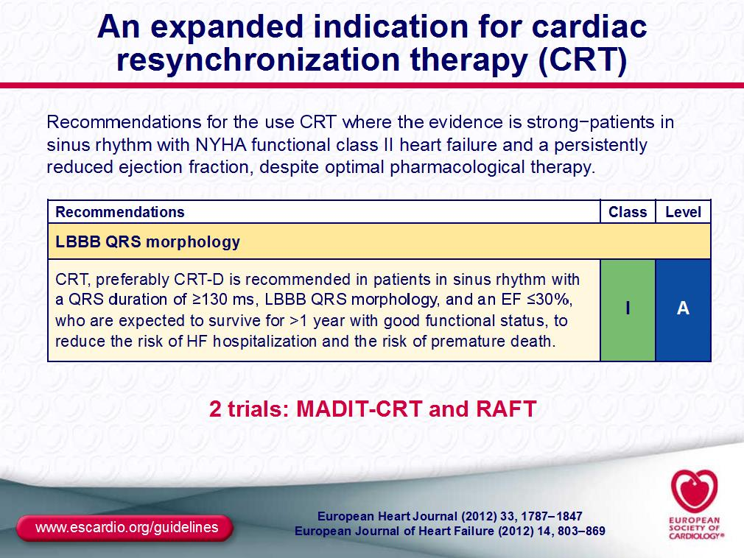

Slide 55
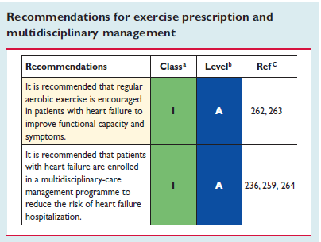

Slide 56
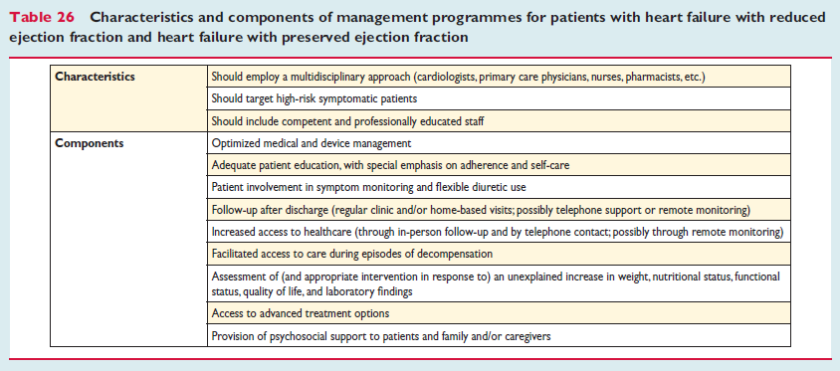

Slide 57
