Slide 1


Scompenso Cardiaco
Cosa ci dice la letteratura: standard epidemiologici e gestionali
Dott.ssa D. Raccagni
U.O. Cardiologia
Responsabile Ambulatorio Scompenso Cardiaco
A. O. Mellino Mellini - Chiari -

Slide 2
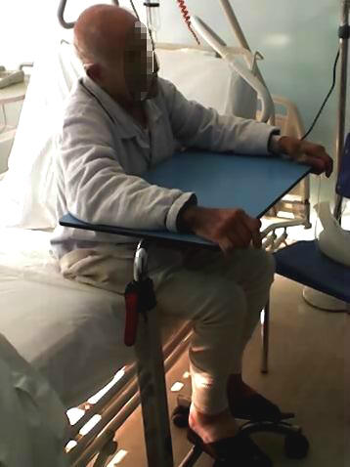
Scompenso cardiaco cronico
E’ una patologia:
Comune: 2% della popolazione
Pericolosa: elevata mortalità
Invalidante: elevata morbilità
Costosa: 2% spesa sanitaria
Trattabile: con terapie efficaci

Slide 4
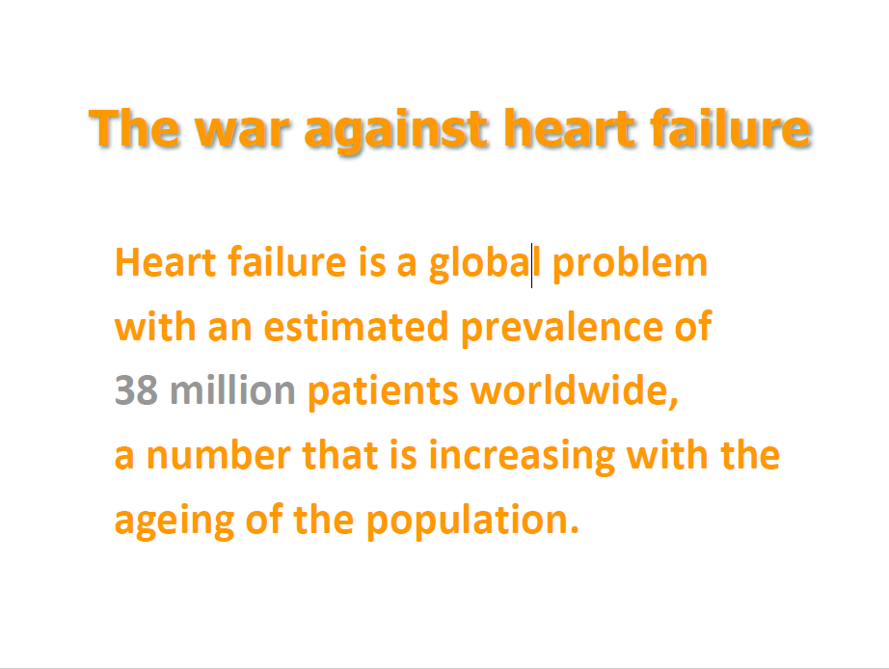

Slide 5
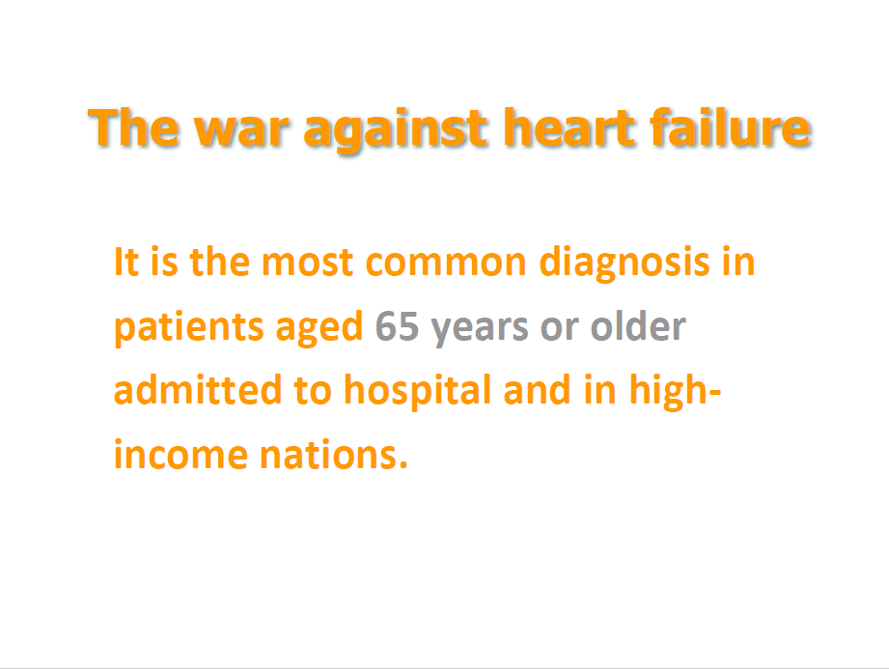

Slide 6
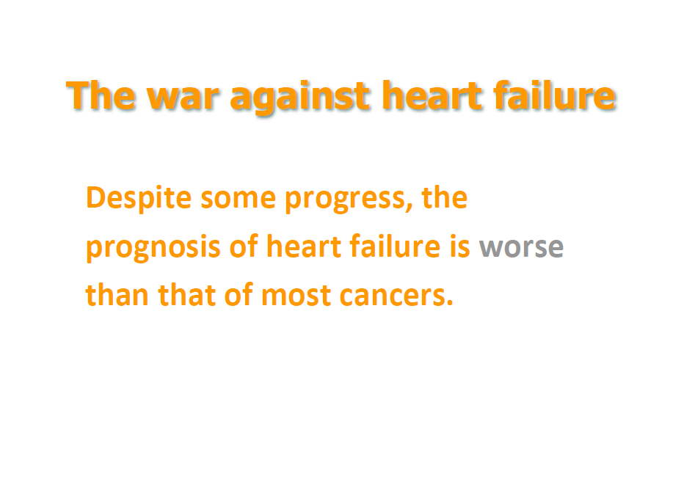

Slide 7
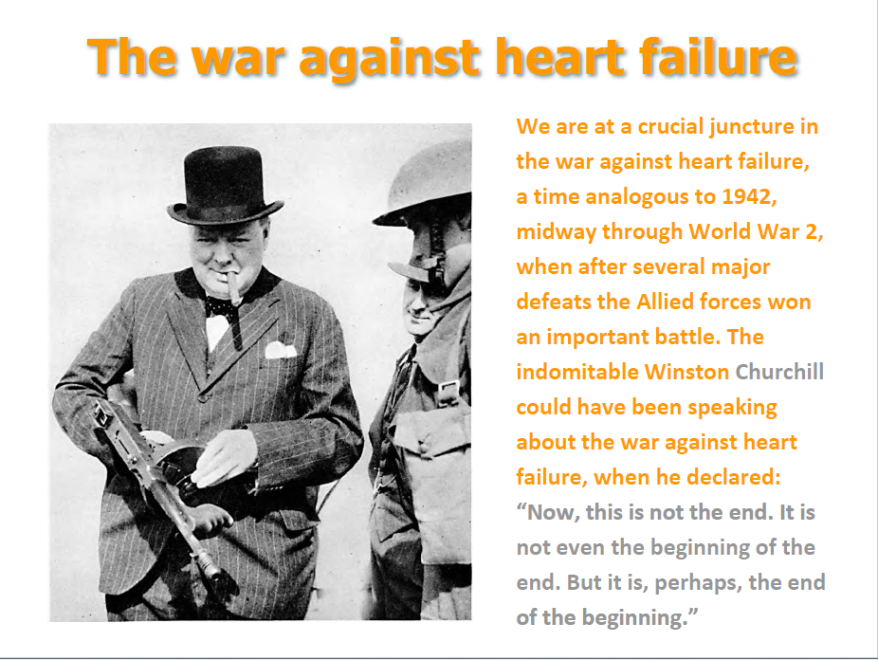

Slide 8
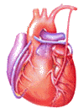
Heart Failure
The most common reason for hospitalization in adults >65 years old.

Slide 9
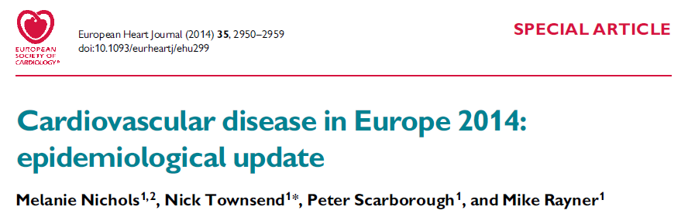
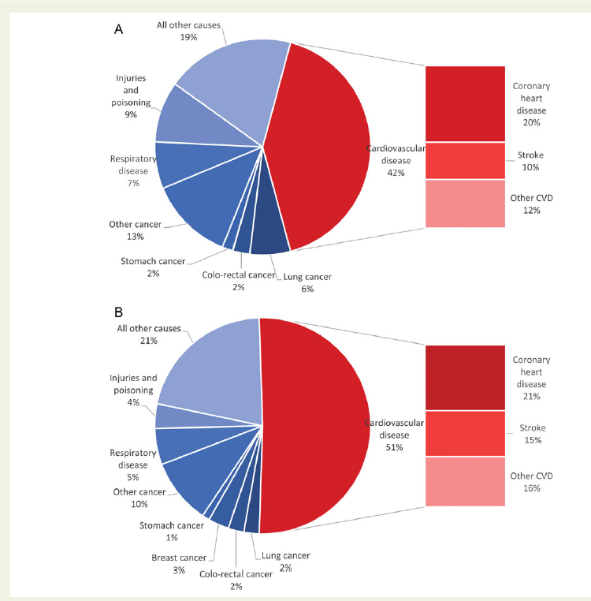
Proportion of all deaths due to major causes in men
Source: WHO Mortality database

Slide 10
Proportion of all deaths due to major causes in women
Source: WHO Mortality database

Slide 11
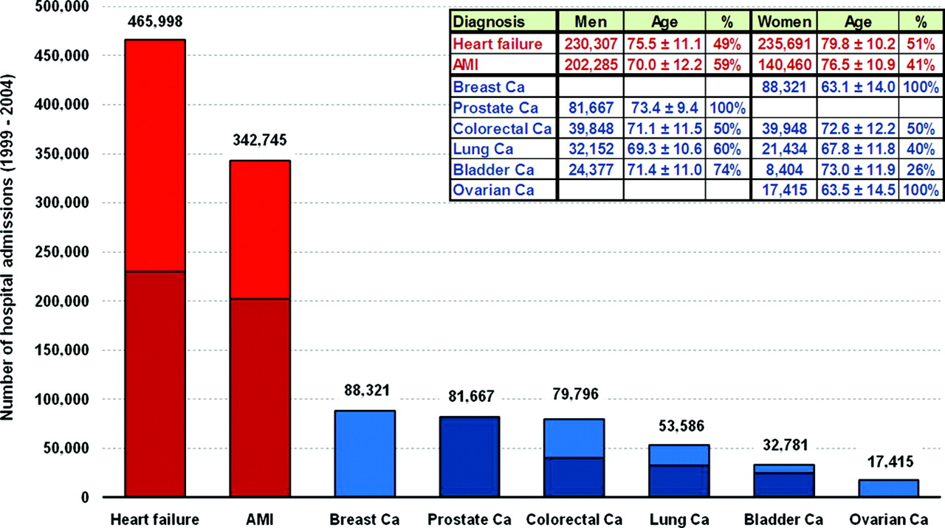
Distribution of 1,162,309 hospital admissions associated with a first-time diagnosis of HF, AMI, and common forms of cancer in Sweden during 1988 to 2004.
Stewart S et al. Circ Cardiovasc Qual Outcomes 2010;3:573-580
Notes:
Distribution of 1 162 309 hospital admissions associated with a first-time diagnosis of HF, AMI, and common forms of cancer in Sweden during 1988 to 2004. Ca indicates cancer.

Slide 12
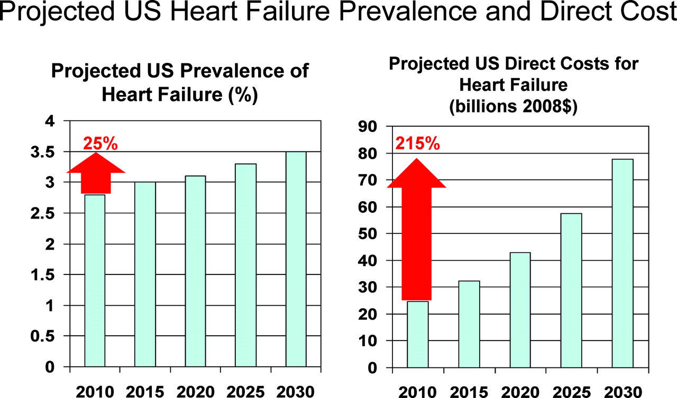
Twenty-year projections for U.S. heart failure prevalence and associated direct medical costs based on current trends.
Konstam M A Circulation 2012;125:820-827
Notes:
Twenty-year projections for United States heart failure prevalence and associated direct medical costs based on current trends. Adapted from Heidenreich et al1 with permission of the publisher.

Slide 13
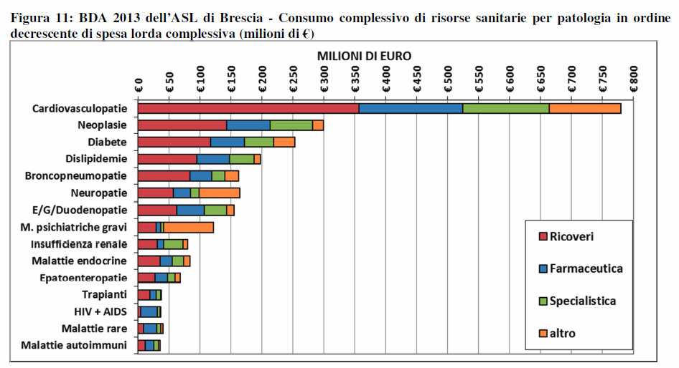
Prevalenza patologie croniche ASL di Brescia
2003-2013

Slide 14
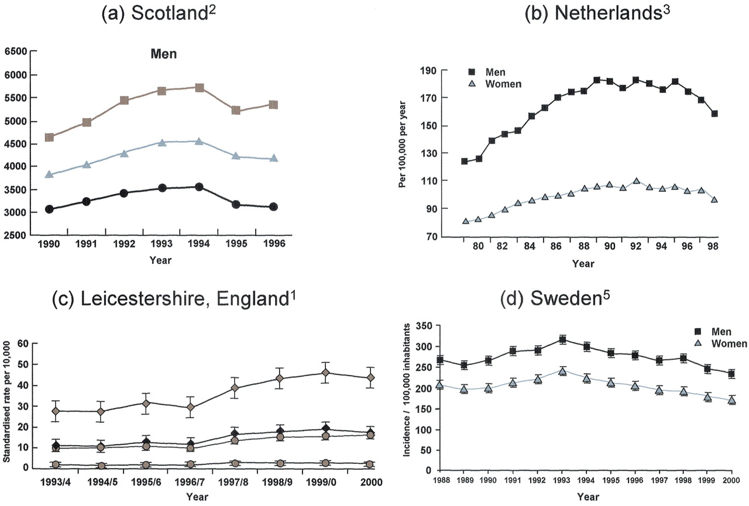
L’andamento delle ospedalizzazioni per scompenso cardiaco recentemente mostra un plateau o una riduzione
1Blackledge et al., Heart 2003; 89:615; 2MacIntyre et al., Circulation 2000;102:1126; 3Levy et al., NEJM 2002; 347:1397; 4Scahufelberger et al., EHJ 2004; 25:300; McMurray, J. J.V. et al. J Am Coll Cardiol 2004;44:2398-2405

Slide 15
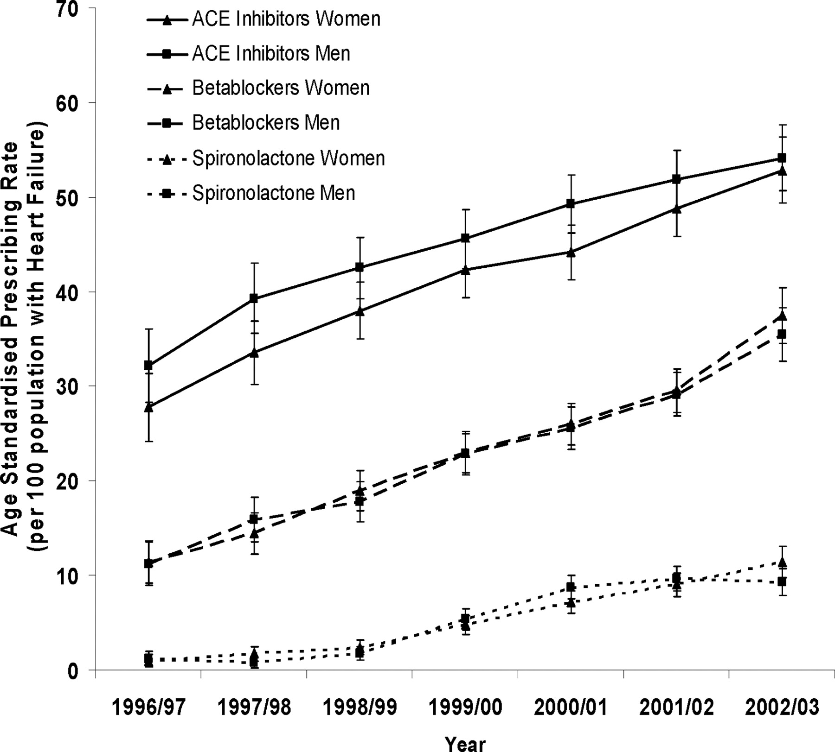
Prescrizione di ACE-inibitori, beta-bloccanti e spironolattone in pazienti con HF di primo riscontro
Jhund, P. S. et al. Circulation 2009;119:515-523

Slide 16
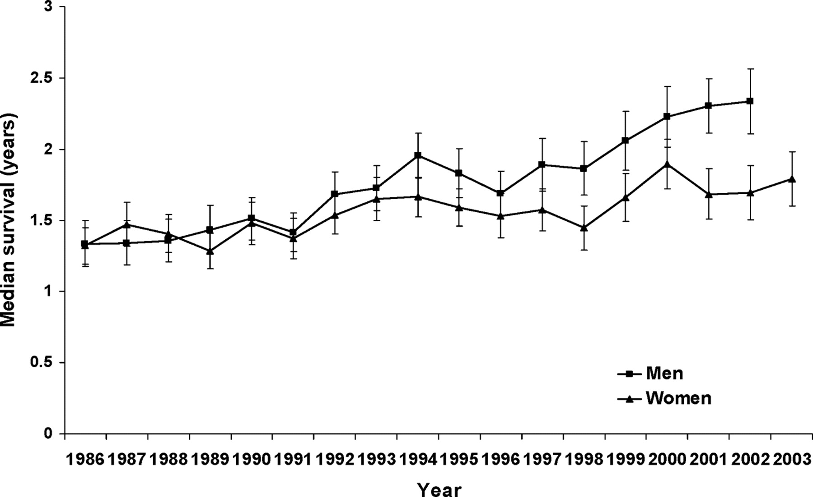
Trends di sopravvivenza (esclusa la mortalità entro 30 giorni) in relazione a sesso e anno di ricovero
Jhund, P. S. et al. Circulation 2009;119:515-523

Slide 17
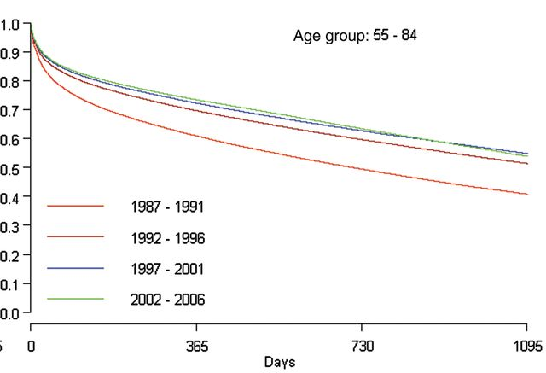
Sopravvivenza dopo la prima ospedalizzazione per scompenso cardiaco in Svezia
Barasa et al. Eur Heart J. 2014 Jan;35(1):25-32.

Slide 18
Epidemiologia dello scompenso cardiaco
Aumento di prevalenza ed incidenza
  Invecchiamento della popolazione generale
  Miglioramento delle cure delle cardiopatie acute
  Incremento delle diagnosi precoci di disfunzione ventricolare sinistra asintomatica
Riduzione della mortalità e delle riospedalizzazioni
  Utilizzo delle terapie basate sull’evidenza

Slide 19
Epidemiologia dello scompenso cardiaco
Aumento di prevalenza ed incidenza
  Invecchiamento della popolazione generale
  Miglioramento delle cure delle cardiopatie acute
  Incremento delle diagnosi precoci di disfunzione ventricolare sinistra asintomatica
Riduzione della mortalità e delle riospedalizzazioni
  Utilizzo delle terapie basate sull’evidenza
Problemi ancora aperti
  Scompenso cardiaco a frazione d’eiezione conservata
  Paziente ospedalizzato o recentemente ospedalizzato
  Le comorbilità

Slide 20
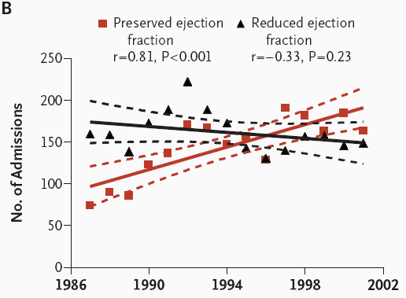
Secular Trends in the Prevalence of Heart Failure with Preserved Ejection Fraction
Owan T et al. N Engl J Med 2006;355:251-259

Slide 21
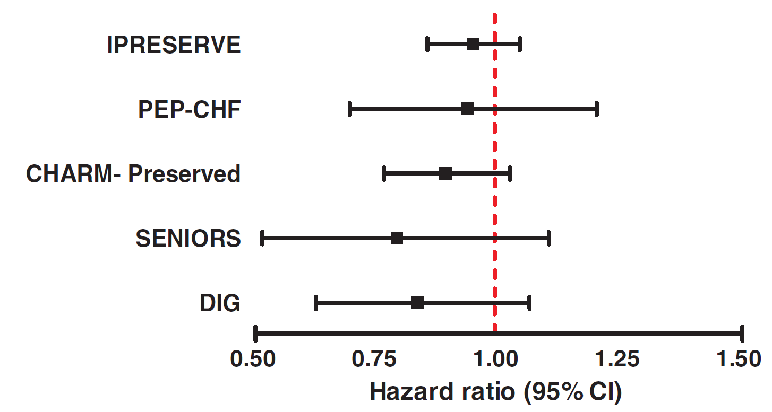
Large trials in HFpEF – no clear benefit
CI=confidence interval
Redfield MM, et al. Circ Heart Fail 2012;5;653–9

Slide 22
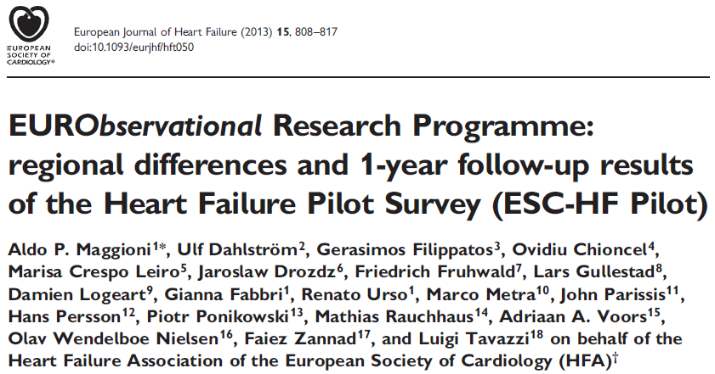
All-cause mortality
0.50
0.45
Type of patient
Hospital
Outpatient
0.40
0.35
0.30
0.25
Failure
0.20
17.4%
0.15
0.10
0.05
7.2%
0
0
30
60
90
120
150
180
210
240
270
300
330
360
Days from enrolment

Slide 23
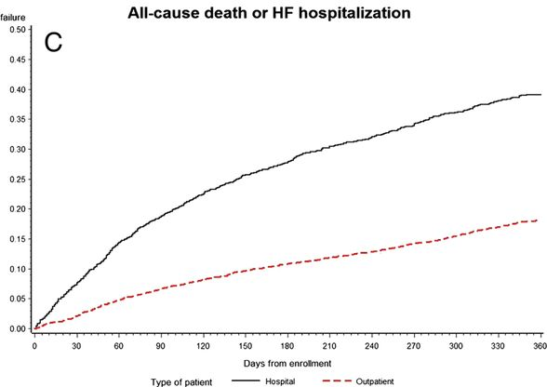
One year Deaths or HF hospitalizations in patients hospitalized patients with acute HF and ambulatory with chronic HF (dotted line). ESC-HF Pilot (n=5118)
All-cause deaths or HF hospitalizations
35.8%
17.8%
Maggioni A P et al. Eur J Heart Fail 2013;15:808-817
Notes:
Kaplan–Meier curves for all-cause death (A), admission to hospital for heart failure (HF) (B), and all-cause death or admission to hospital for HF (C), divided into hospitalized patients with acute HF (continuous line) and ambulatory patients with chronic HF (dotted line).

Slide 24
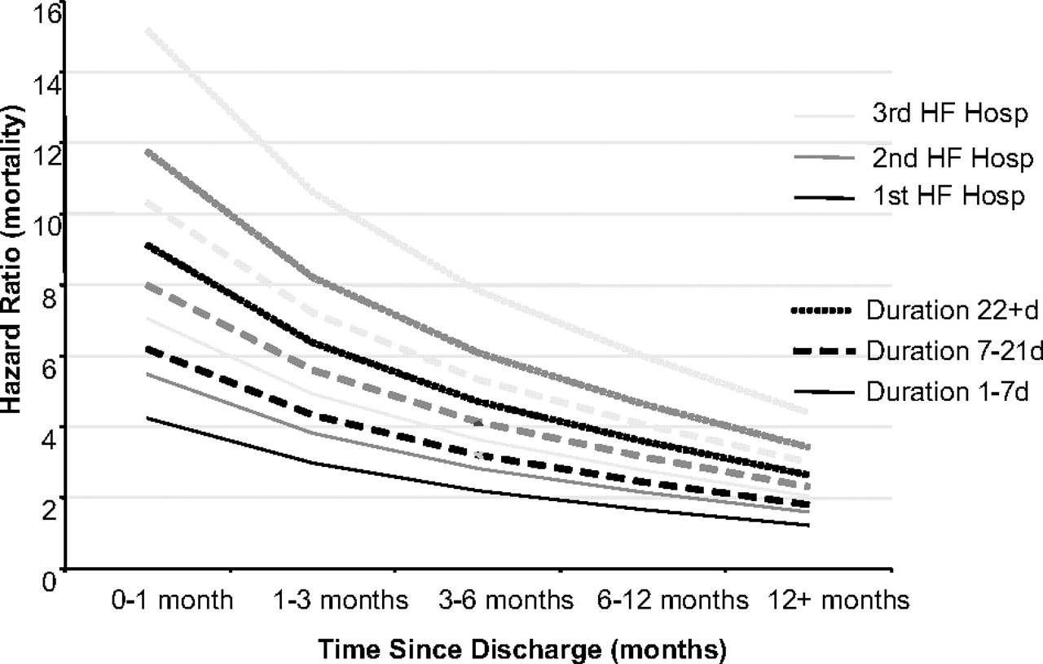
Hazard ratio for mortality based on time since latest discharge, longest duration of HF hospitalization and HF hospitalization number in CHARM
Solomon S D et al. Circulation. 2007;116:1482-1487
Notes:
Figure 5. Hazard ratio for mortality based on time since latest discharge, longest duration of HF hospitalization (solid, dashed, and dotted lines), and HF hospitalization number (black, dark gray, and light gray lines).

Slide 25
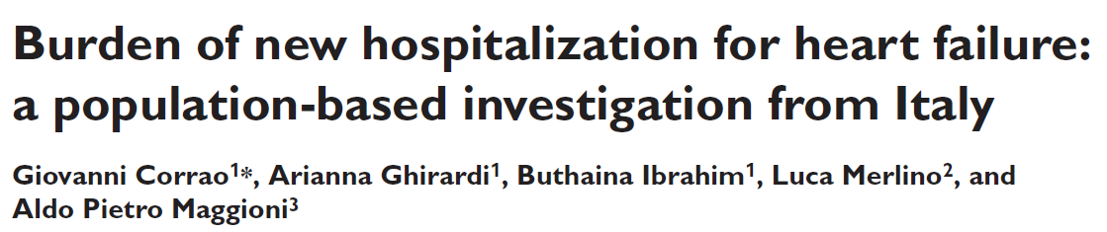
Corrao et al. Eur J Heart Fail 2014; 16, 729–736

Slide 26
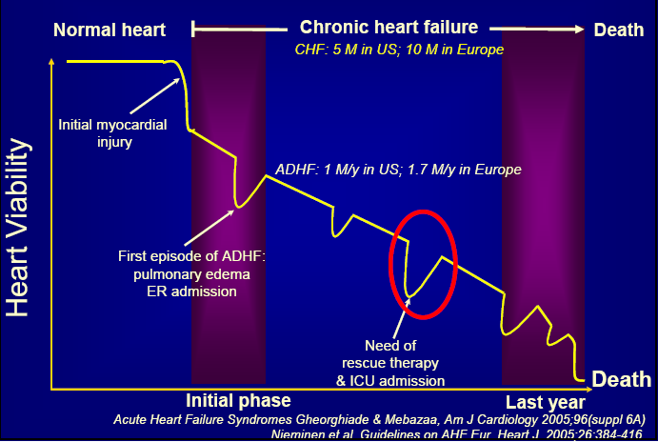
Prognosi
Notes:
HF is a a waxing and waning disease with many readmissions and a general decline.

Slide 27
Stages, Phenotypes and Treatment of HF

Slide 28
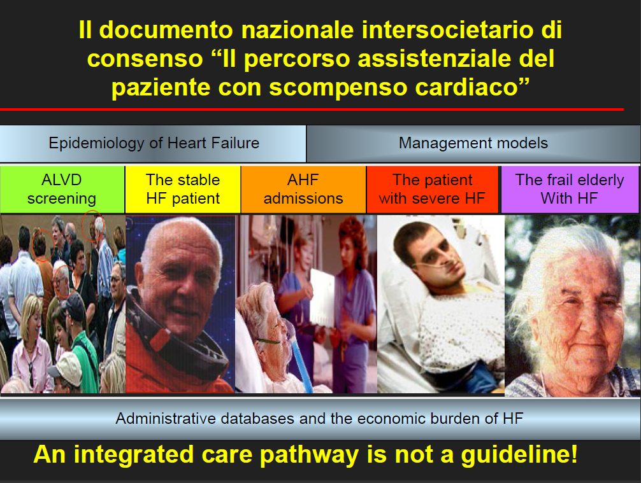

Slide 29
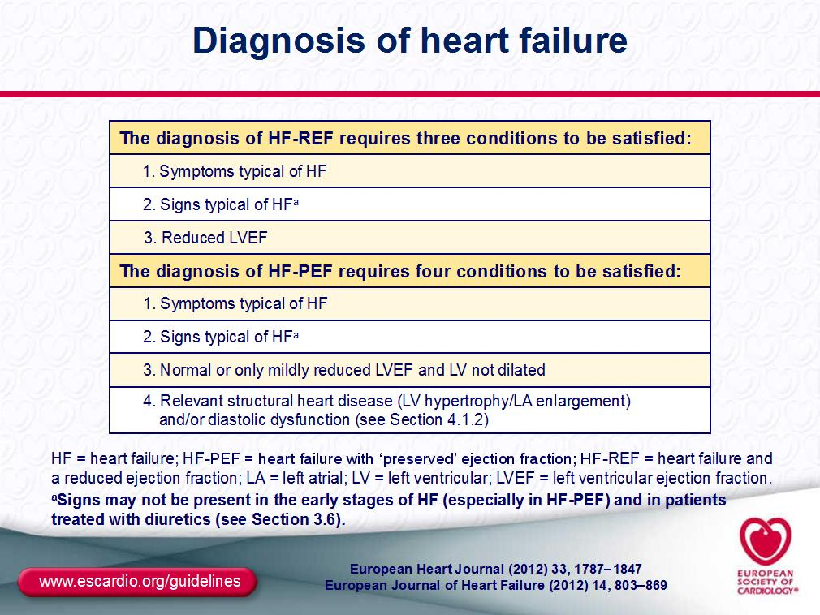

Slide 30
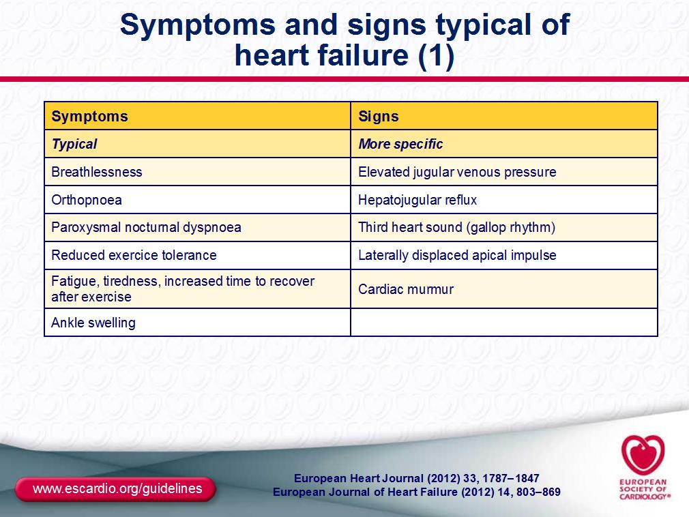

Slide 31
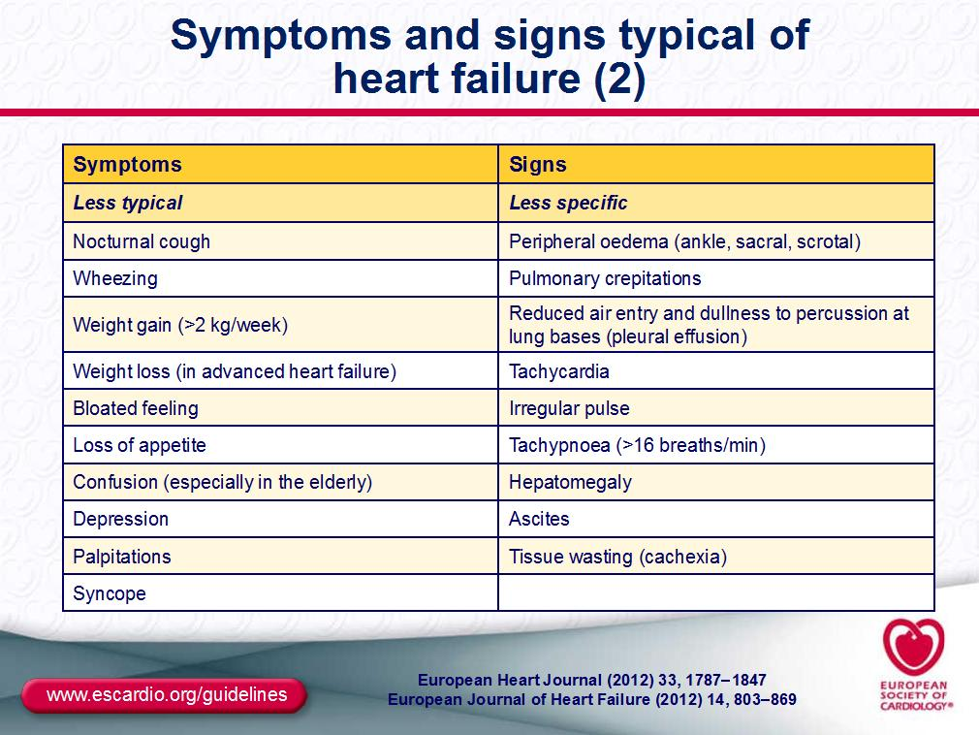

Slide 32
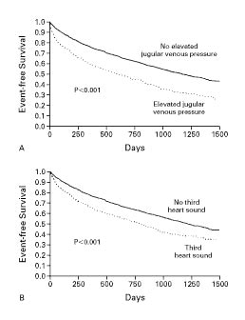
Drazner MH et al. N Engl J Med 2001;345:574-581.
La presenza di terzo tono o di turgore giugulare correla con la sopravvivenza
Data from SOLVD Trial
Notes:
Figure 1. Kaplan–Meier Analysis of Event-free Survival According to the Presence or Absence of Elevated Jugular Venous Pressure (Panel A) and a Third Heart Sound (Panel B). The end point was a composite of death or hospitalization for heart failure. In Panel A, the 280 patients with elevated jugular venous pressure were significantly more likely than the 2199 patients without elevated jugular venous pressure to reach the composite end point (P<0.001 by the log-rank test). In Panel B, the 597 patients with a third heart sound were significantly more likely than the 1882 patients without a third heart sound to reach the composite end point (P<0.001 by the log-rank test).

Slide 33
L’assenza di congestione predice una buona sopravvivenza anche in pazienti con HF avanzato
146 pts with NYHA IV
4-6 weeks after discharge re-evaluated for congestion
2-year survival
(%)
80
Criteria:
High-risk group
60
Orthopnoea
↑ JVP
Oedema
Weight gain
↑ baseline diuretics
40
20
0 crit
(n=80)
1-2 crit
(n=40)
≥3 crit
(n=26)
Orth+
(n=33)
Lucas et al., Am Heart J 2000;140:840

Slide 34
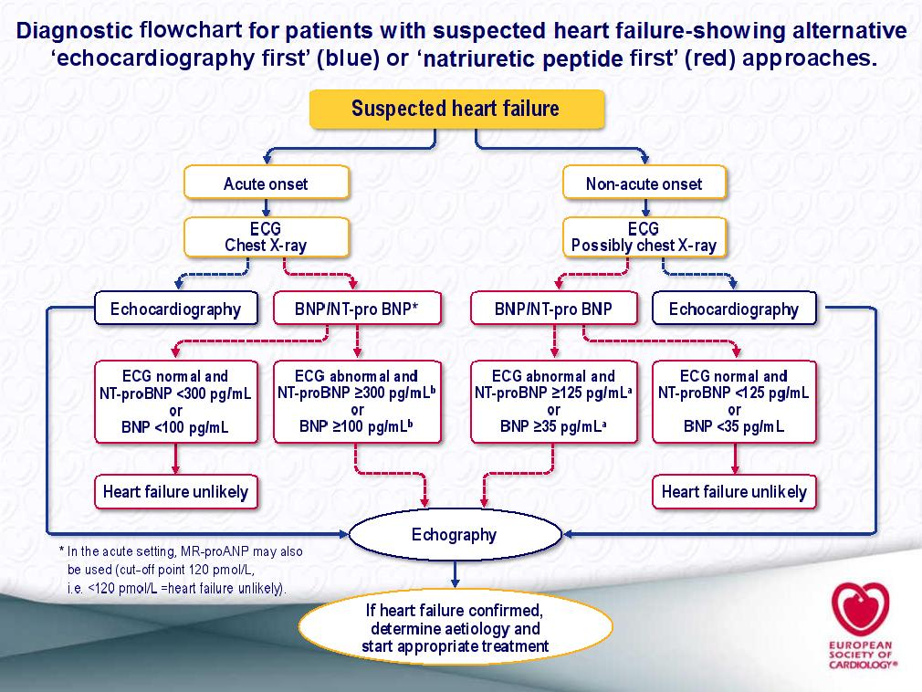

Slide 35
Causes for Elevated Natriuretic Peptide Levels
Cardiac
Noncardiac
Heart failure, including RV syndromes
Acute coronary syndrome
Heart muscle disease, including LVH
Valvular heart disease
Pericardial disease
Atrial fibrillation
Myocarditis
Cardiac surgery
Cardioversion
Advancing age
Anemia
Renal failure
Pulmonary causes: obstructive sleep apnea, severe pneumonia, pulmonary hypertension
Critical illness
Bacterial sepsis
Severe burns
Toxic-metabolic insults, including cancer chemotherapy and envenomation

Slide 36
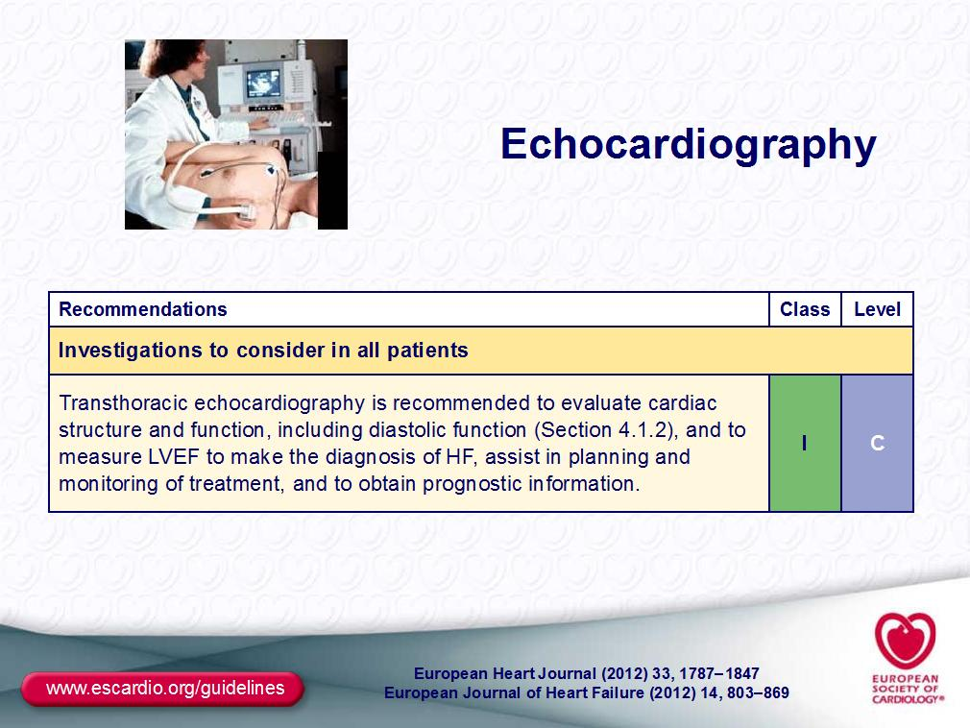

Slide 37
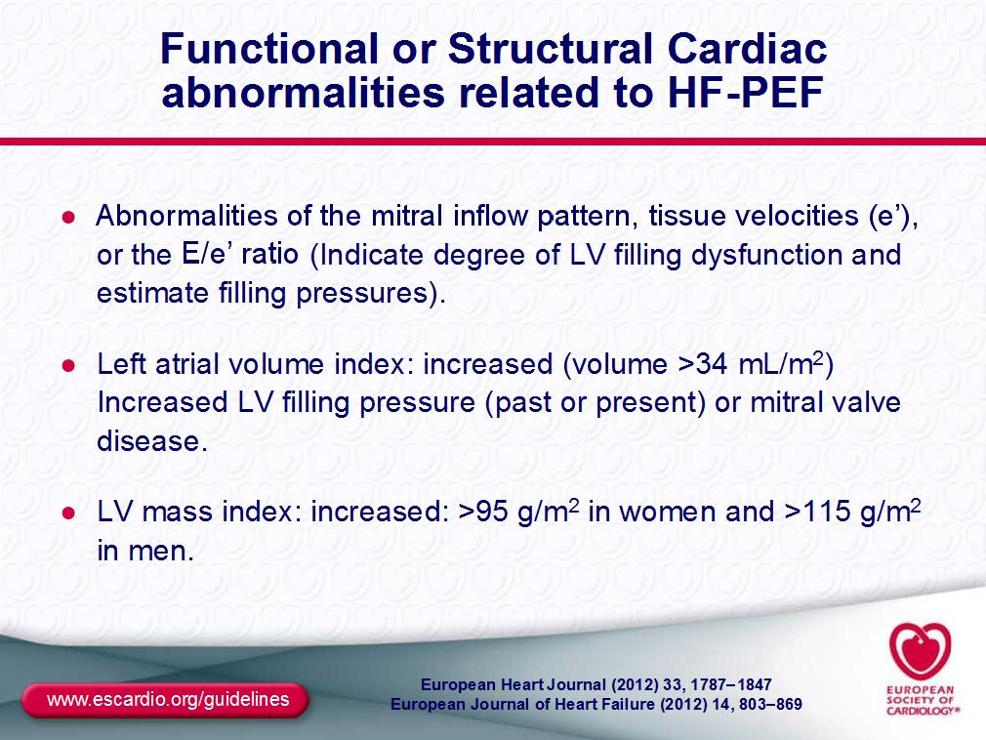

Slide 38
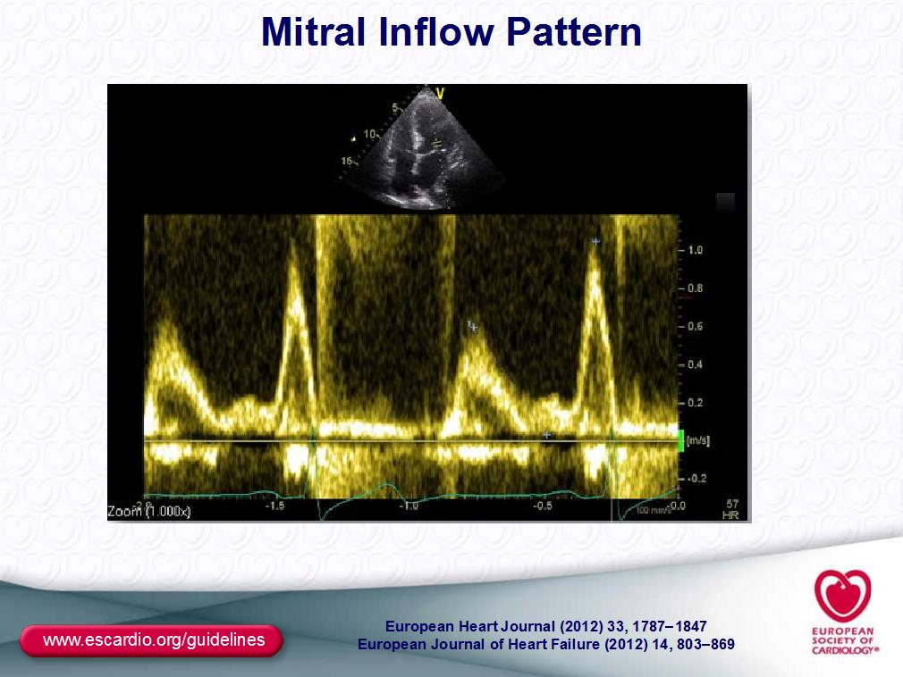

Slide 39
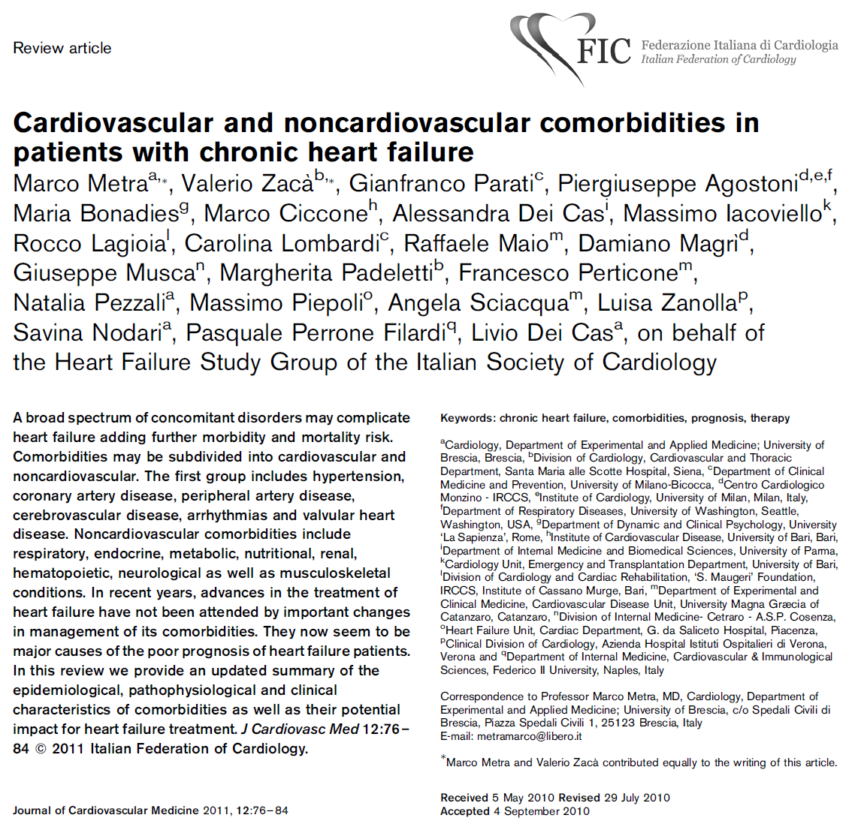

Slide 40
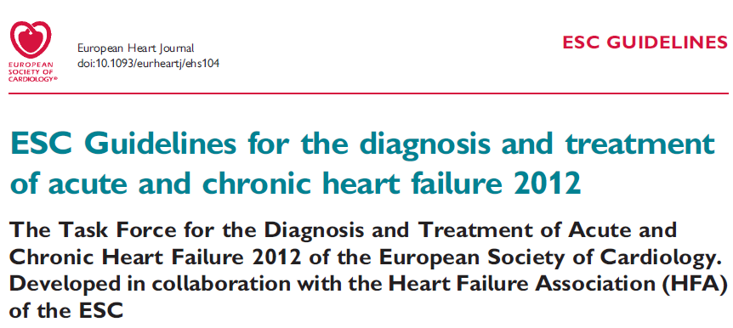
ESC 2012 guidelines

Slide 41
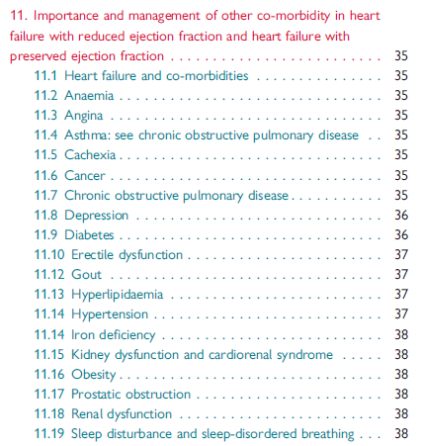
ESC 2012 guidelines

Slide 42
Non-cardiac comorbidities in acute heart failure patients
COPD | Renal disease | Diabetes | Anaemia | Liver abnormalities
Symptom overlap Diagnostic difficulty Misapplication of therapy Beta-blocker underuse Bronchodilator interaction (?) | Complicates diuresis Potassium balance ACE-I and MRA underuse Balance of decongestion and worsening renal function (?) | Different presenting signs/symptoms Other linked comorbidities Pharmacology implications of obesity Diabetes management in HF patients (?) | Multiple potential aetiologies Association with renal disease Impact of HF medications on worsening anaemia Prognostic marker or mediator of risk Optimal management (?) | Correlation with haemodynamics and hypoperfusion Marker vs. Mediator Variable association with outcomes
Notes:
The acute heart failure population represents a heterogeneous cohort with multiple interrelated non-cardiovascular comorbidities. Chronic obstructive pulmonary disease, renal disease, diabetes, anaemia and liver abnormalities impact the clinical characteristics and outcomes of patients with acute heart failure and complicate in-hospital management. Attention to the diagnosis and management of comorbidities in patients with AHF may improve patient outcomes.
Reference:
Mentz RJ, Felker GM. Noncardiac comorbidities and acute heart failure patients. Heart Fail Clin. 2013;9:359-67.

Slide 43
Prognostic determinants in heart failure
Demographic
  Age
  Male gender
Clinical
  Frequent rehospitalisations
  Advanced NYHA class
  Intolerance to neurohormonal antagonists
  Persistent/relapsing signs of pulmonary or peripheral congestion
  Hypotension
  Comorbidities
    Diabetes
    Renal failure
    Hepatic failure
    Anaemia
    COPD,
    Depression...
Electrocardiography
  Resting tachycardia
  Wide QRS complex
Laboratory
  Hyponatraemia
  Blood urea nitrogen/serum creatinine
  Anaemia
  Hepatic insufficiency
  Neurohormones
  Troponins
  Inflammatory markers
Doppler-echocardiography
  Signs of increased LV filling pressure
  Low RVEF
Functional capacity
Metra M, et al. Eur J Heart Fail. 2007;9:684–94.
Notes:
Useful prognostic indicators are outlined here. These include demographic and clinical determinants, functional capacity, as well as ECG and laboratory results. Signs of increased left ventricular filling pressure and/or of right ventricular dysfunction, assessed by Doppler-echocardiography or cardiac catheterisation, are more important in advanced heart failure with a greater predictive power when these data are collected after optimisation of therapy. Risk stratification models have been developed and validated both in patients referred for heart transplant and in those hospitalised for heart failure. Comorbidities, blood pressure and renal function are often amongst the most important independent prognostic variables. These results can also be applied to patients with advanced heart failure.
Reference:
Metra M, Ponikowski P, Dickstein K, et al. Advanced chronic heart failure: A position statement from the Study Group on Advanced Heart Failure of the Heart Failure Association of the European Society of Cardiology. Eur J Heart Fail. 2007;9:684-94.

Slide 44
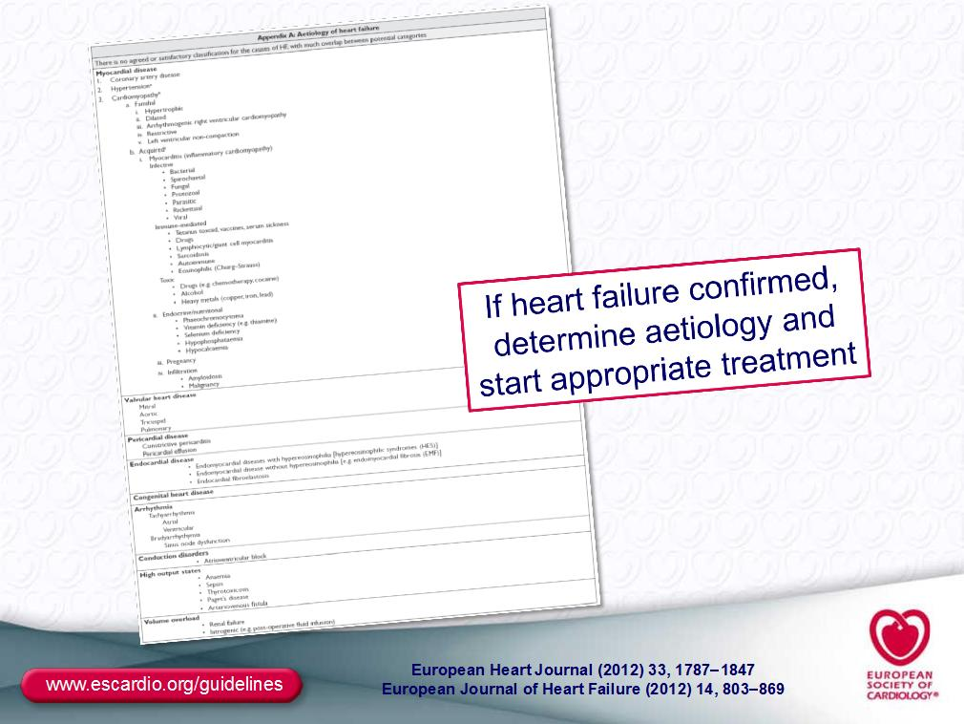

Slide 45
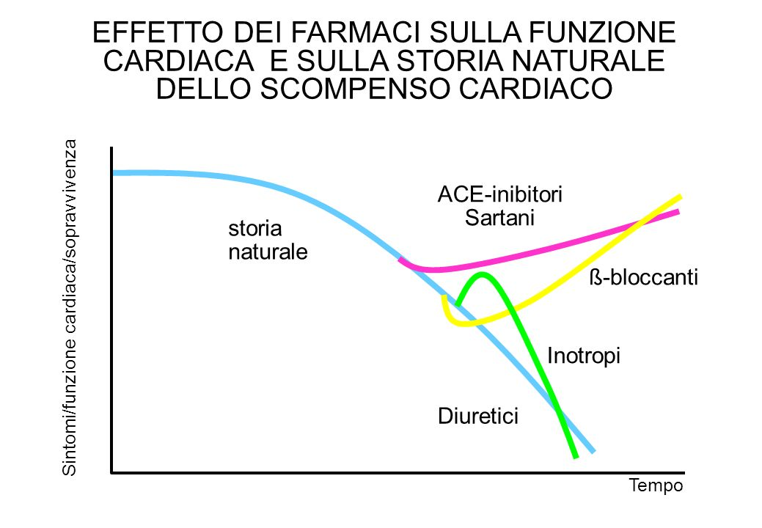

Slide 46
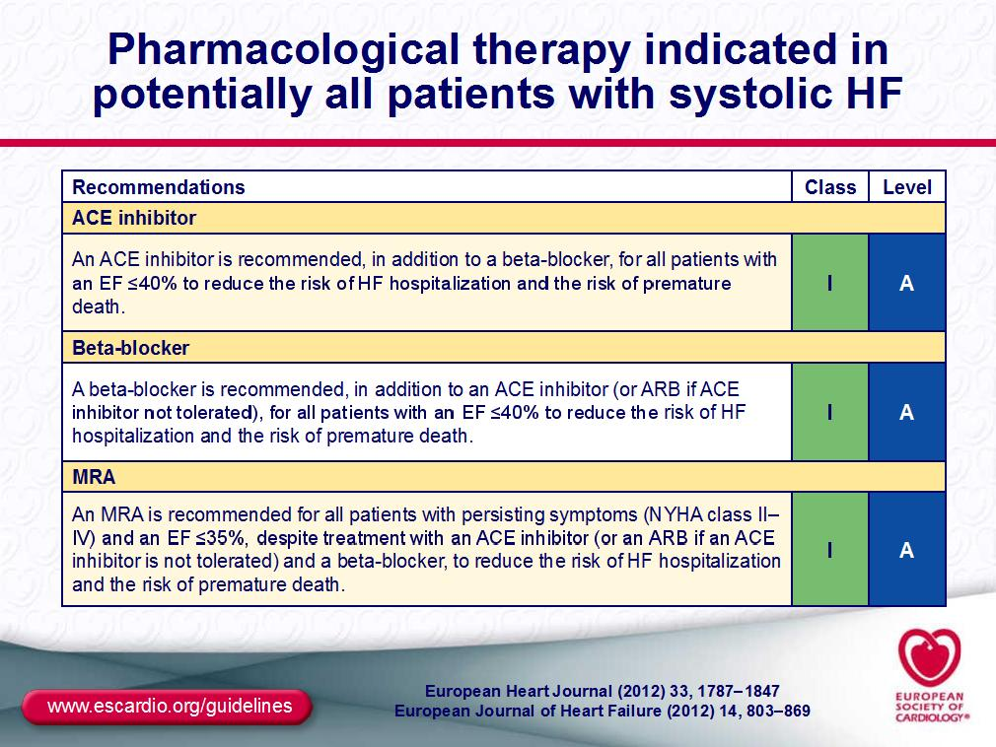

Slide 47
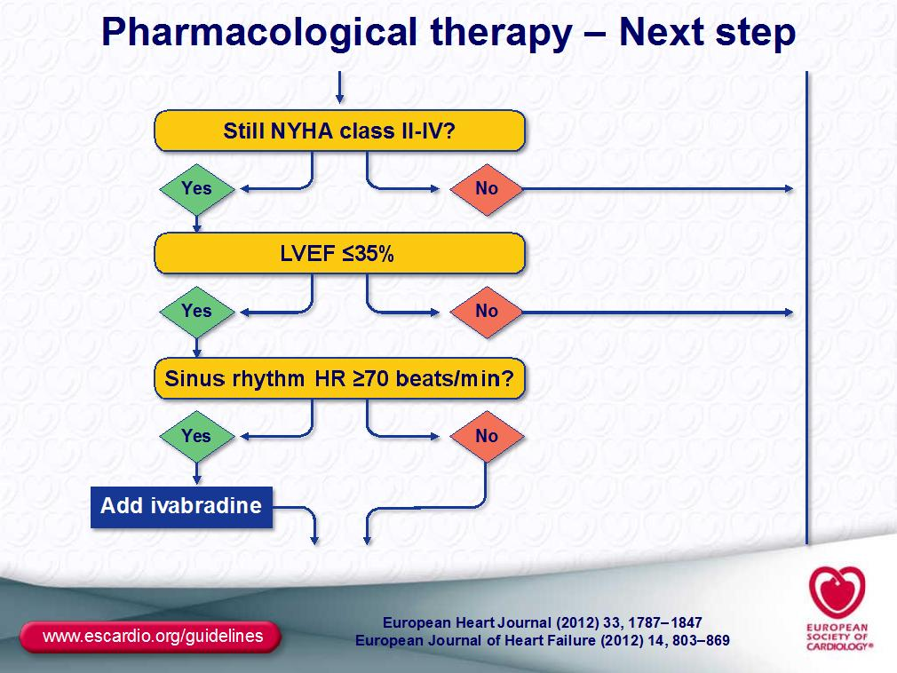

Slide 48
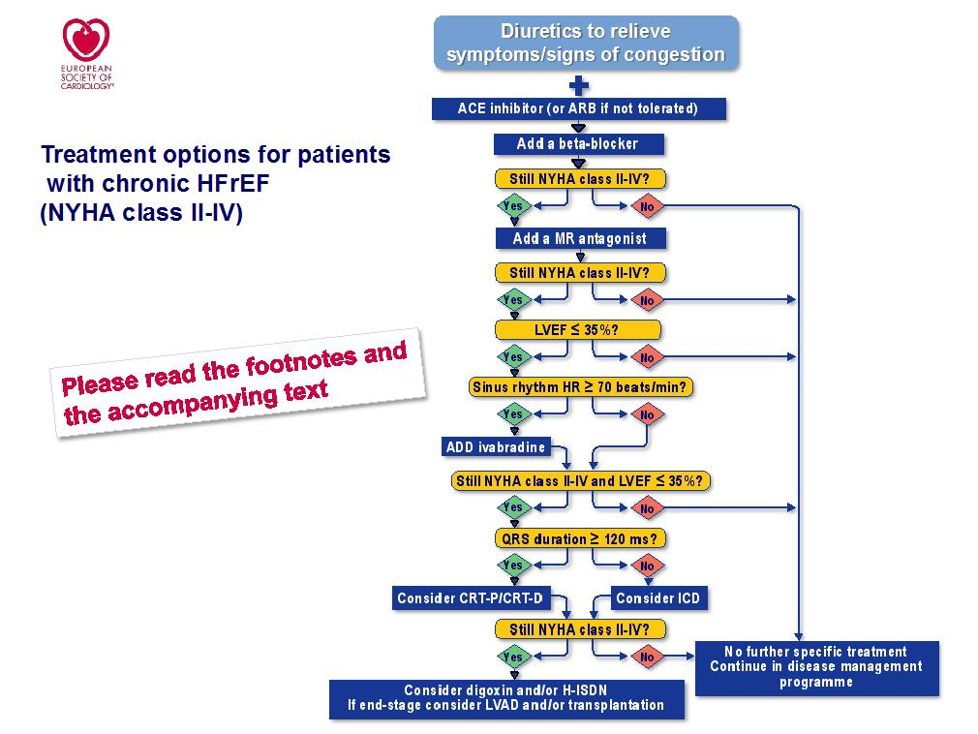

Slide 49
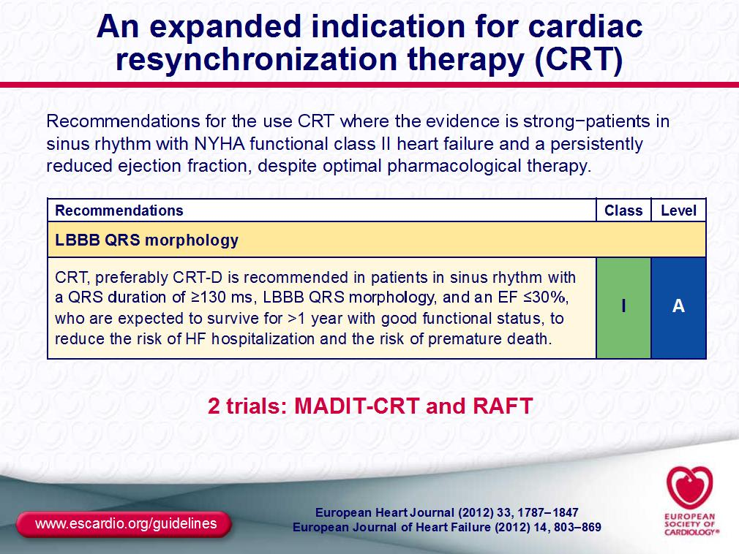

Slide 50
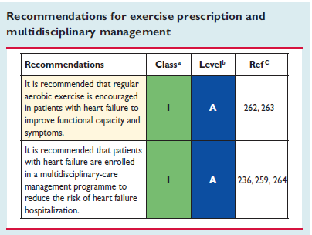

Slide 51
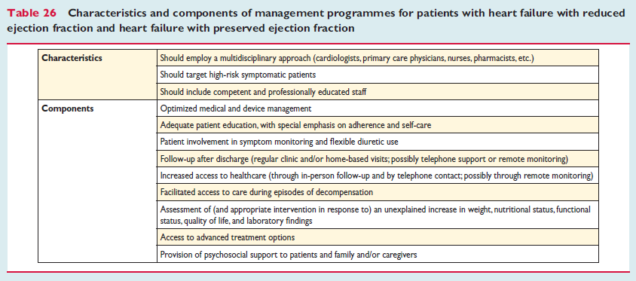

Slide 52
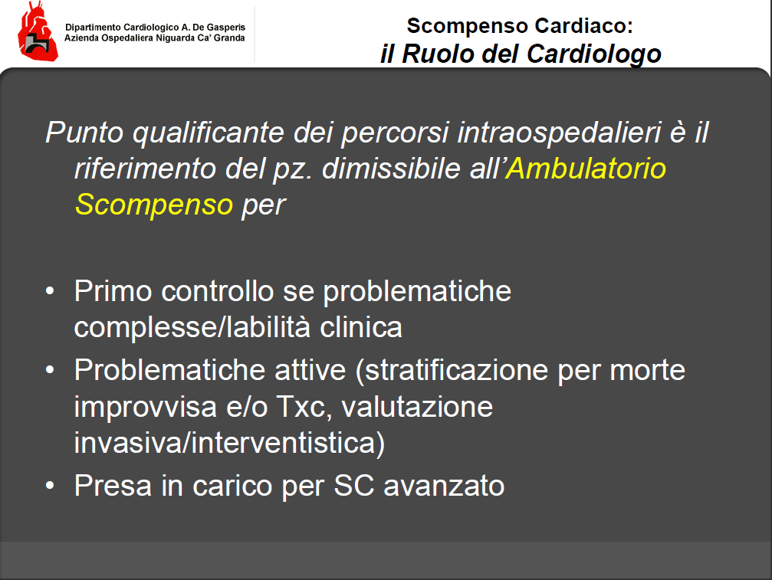

Slide 53

Conclusioni
Rete ospedale-territorio
Ambulatorio dello scompenso cardiaco tel. 0307102895
(lunedì, mercoledì, venerdì mattina)
Counseling infermieristico (nuove reti sanitarie): martedì mattina
Mail: raccagni.domenica@aochiari.it
turelli.annalisa@aochiari.it

Slide 54


