Slide 1
LE MEDICINE COMPLEMENTARI E NON ALTERNATIVE
Evidence based medicine,
precision medicine
e medicine integrative
GF Gensini
Brescia, 30 gennaio 2016

Slide 2
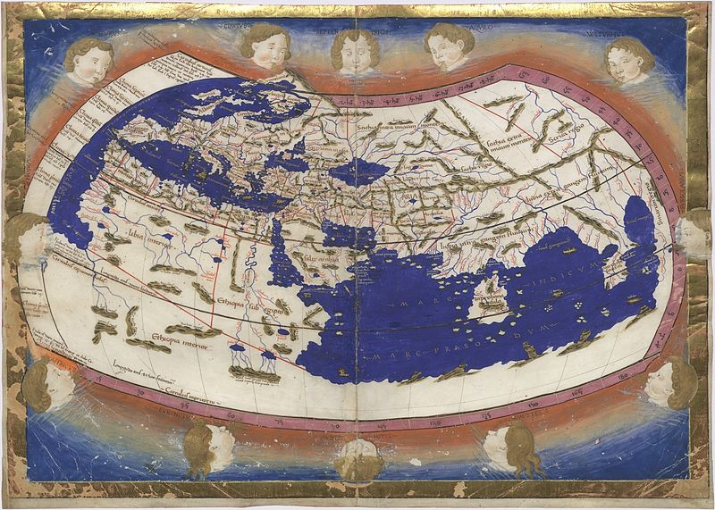
The world before 1492

Slide 3
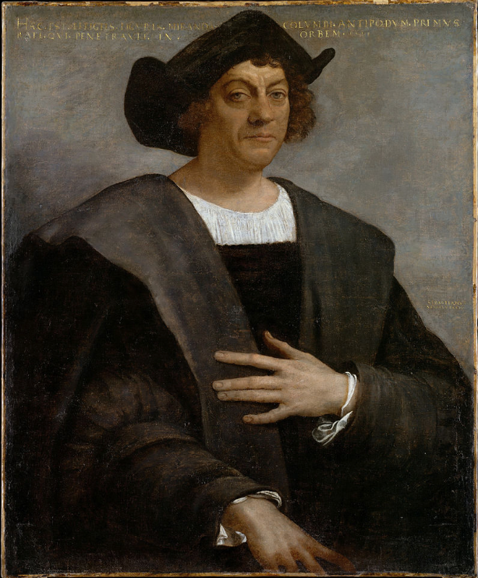

Slide 4
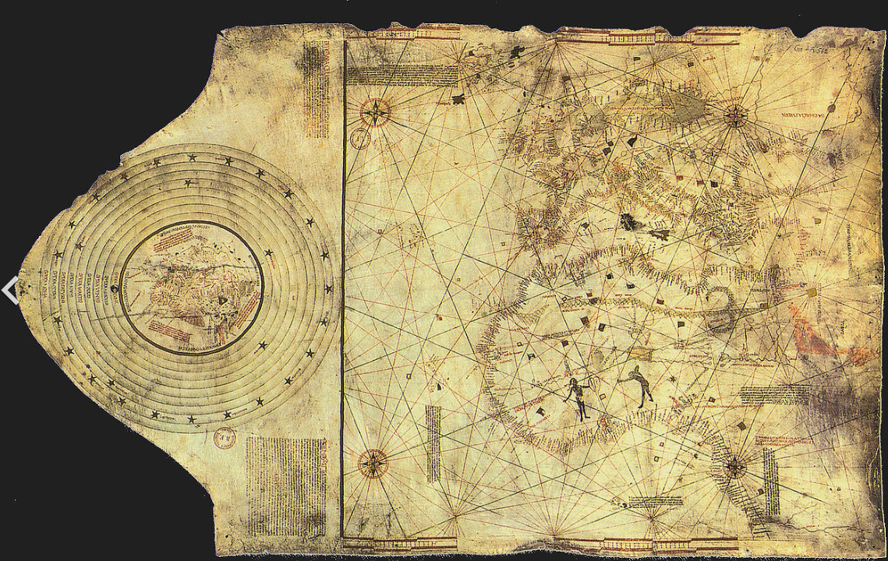

Slide 5
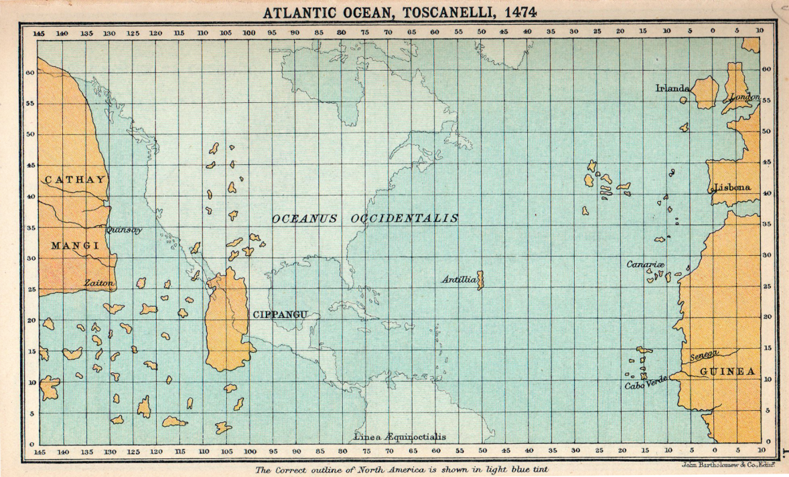
Il Nuovo Mondo

Slide 6
Il Nuovo Mondo

Slide 7
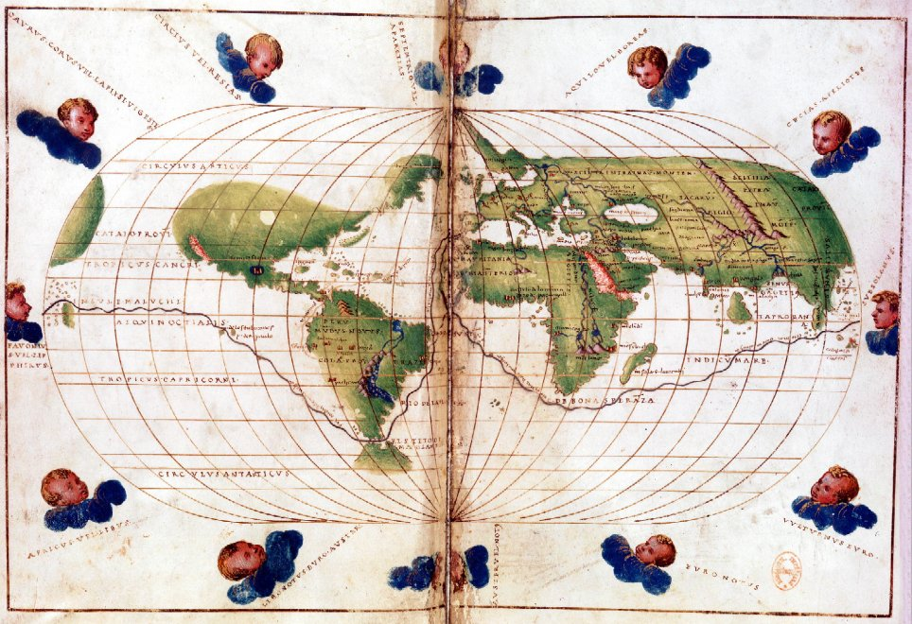
The world soon after 1492

Slide 8


2013

Slide 9

The world, today

Slide 10
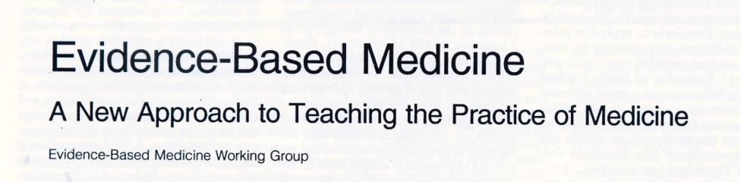

1992: Evidence Based Medicine
D. Sackett et al
10

Slide 11

http://ktclearinghouse.ca/cebm/
EBM is the integration of
best research evidence with
clinical expertise and
patient values.

Slide 12
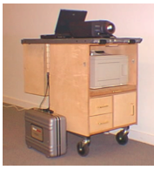

Slide 13
EVIDENCE KART

Slide 14
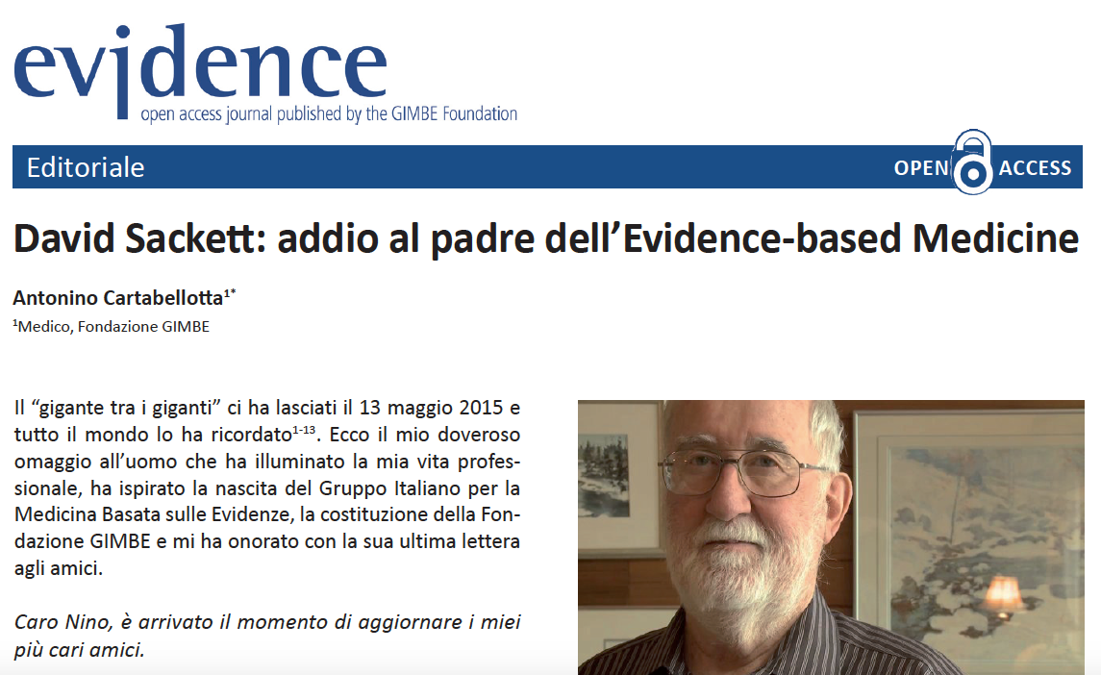

Slide 15
Evidence based medicine quickly became an energetic intellectual community committed to making clinical practice more scientific and empirically grounded and thereby achieving safer, more consistent, and more cost effective care.
Greenhalgh, BMJ 2014
British Thoracic Society’s 1990 asthma guidelines
UK National Institute for Health and Care Excellence guidelines for prevention of venous thromboembolism after surgery
Prescription of inhaled steroids for asthma increased and morbidity and mortality fell
Significant reduction in thromboembolic
complications

Slide 16
http://ktclearinghouse.ca/cebm/
What kind of evidence?.
Simple, disease-related evidence

Slide 17
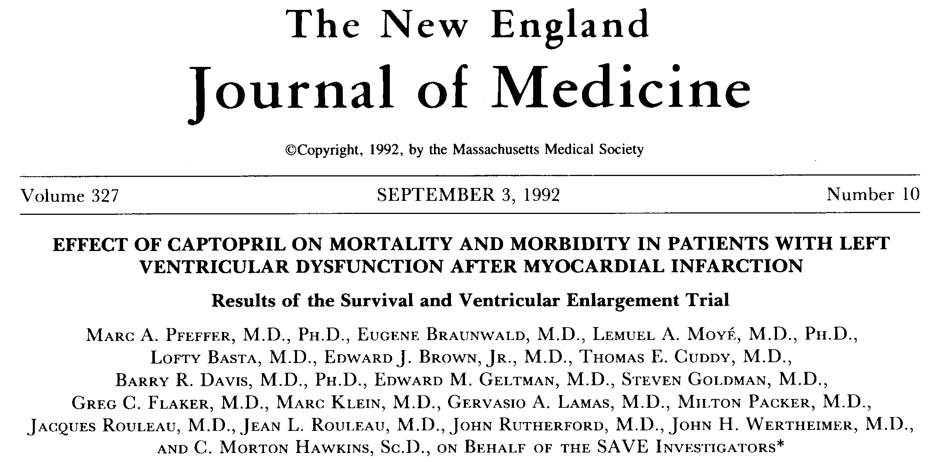
1992: an example of simple Evidence

Slide 18
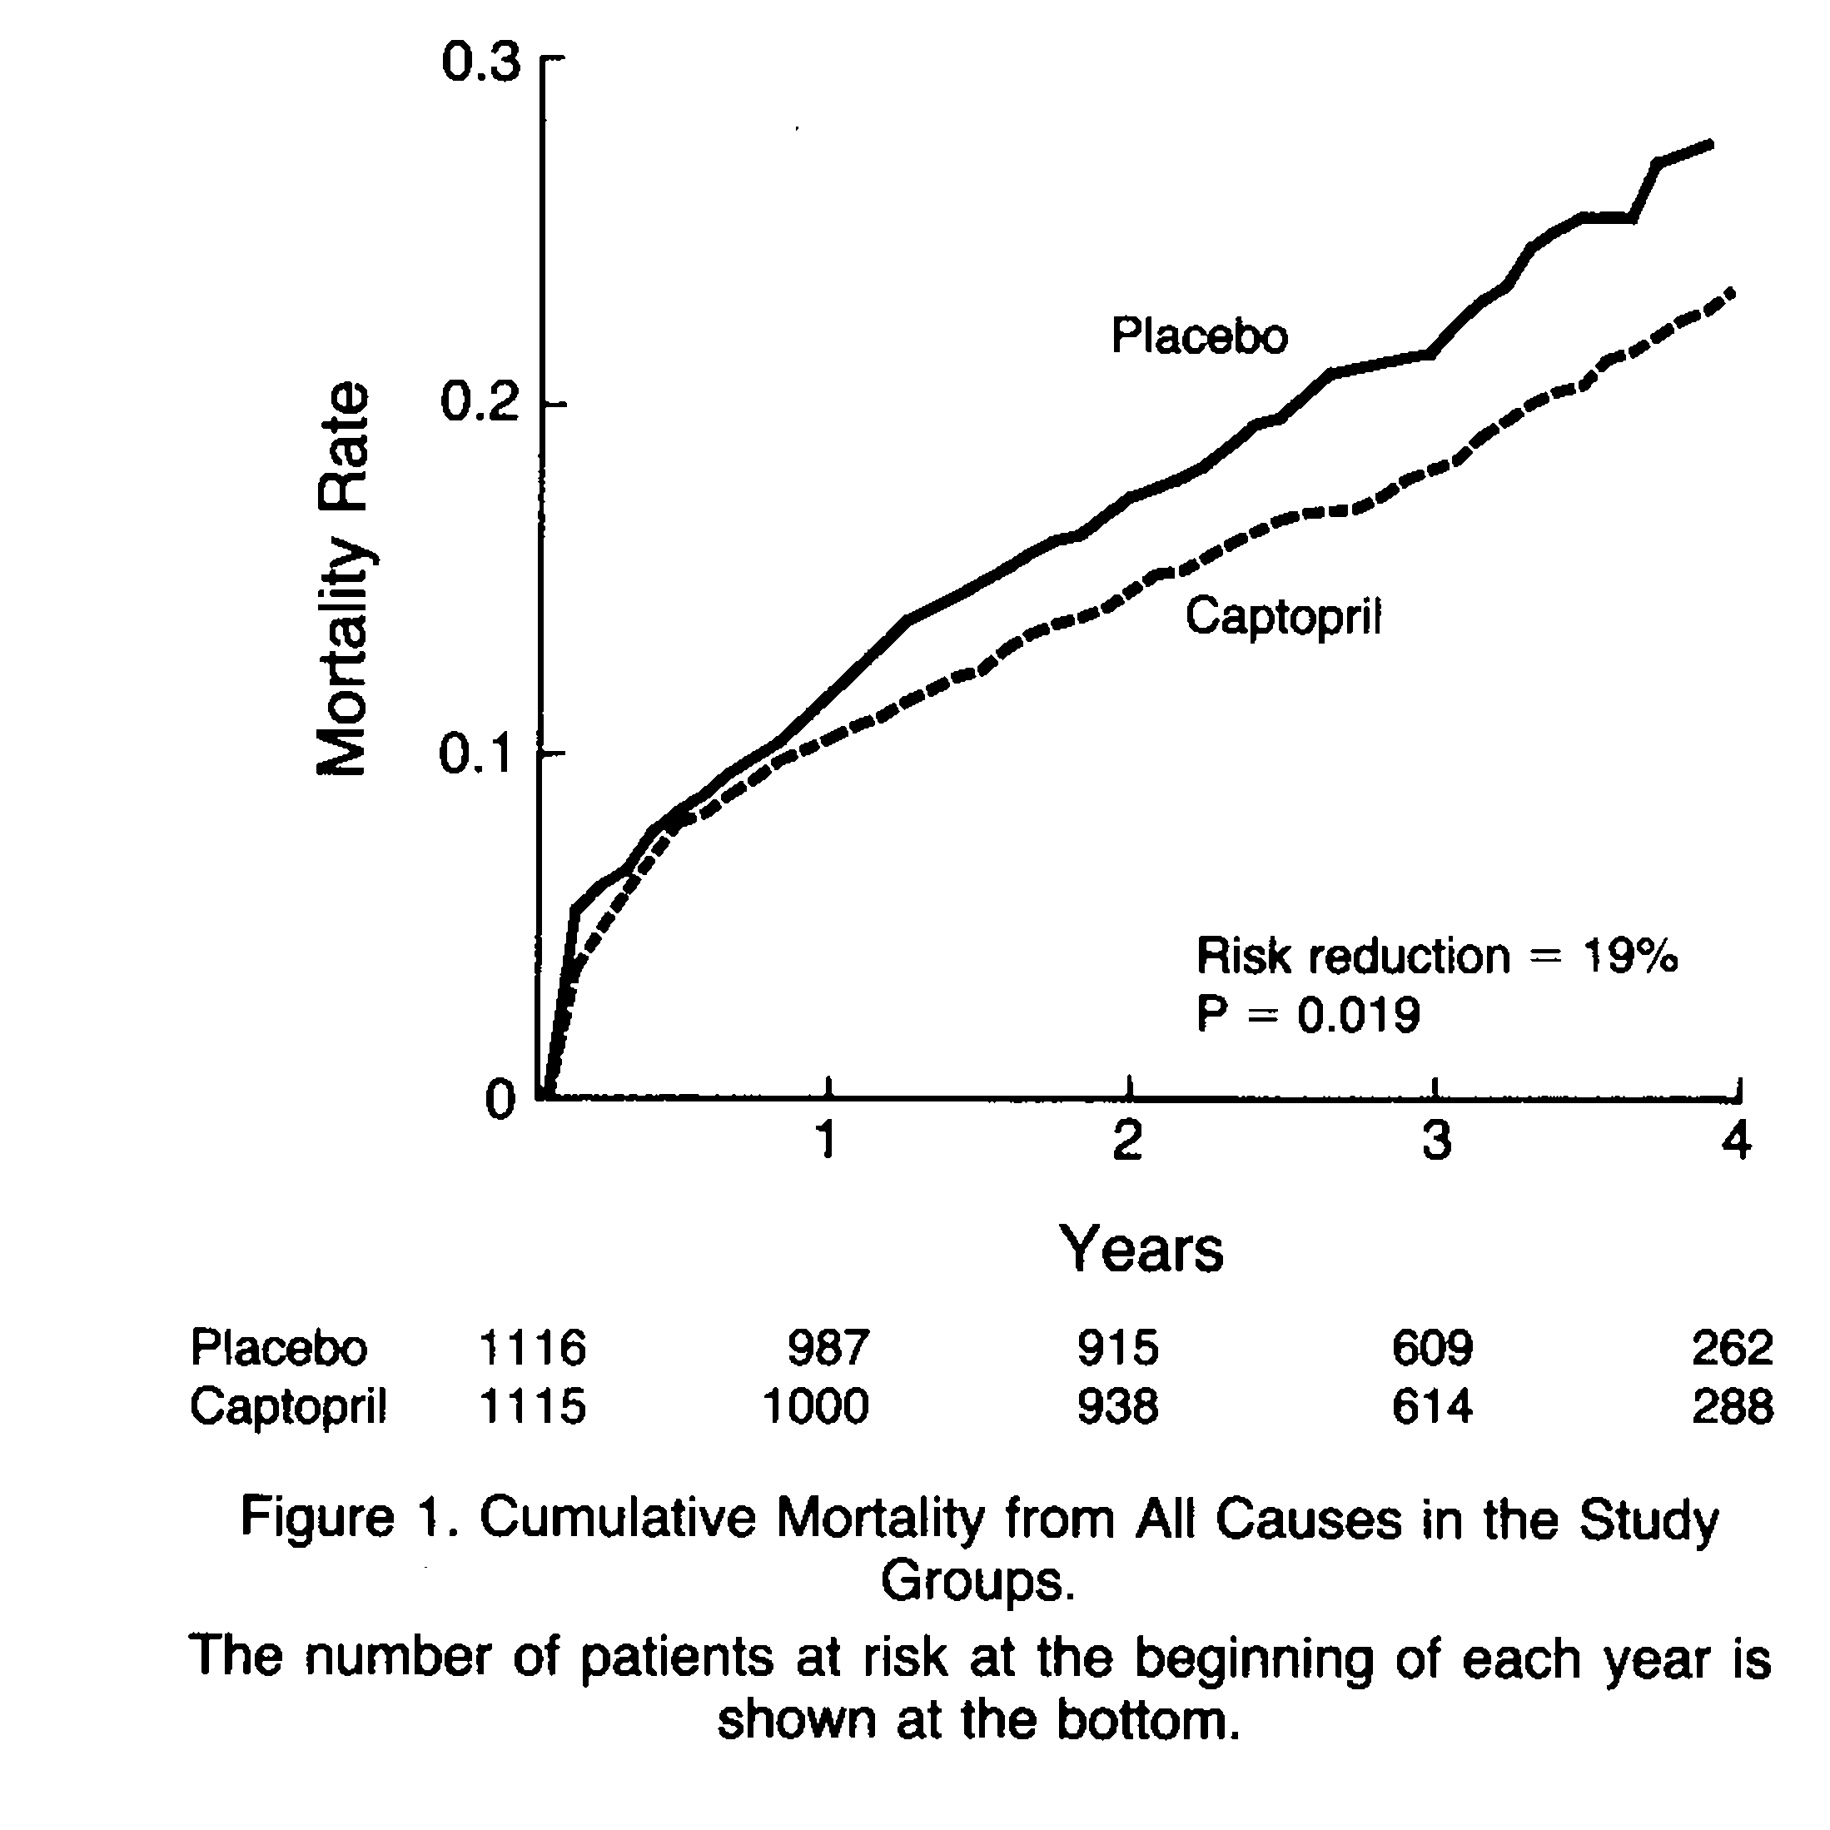

Slide 19
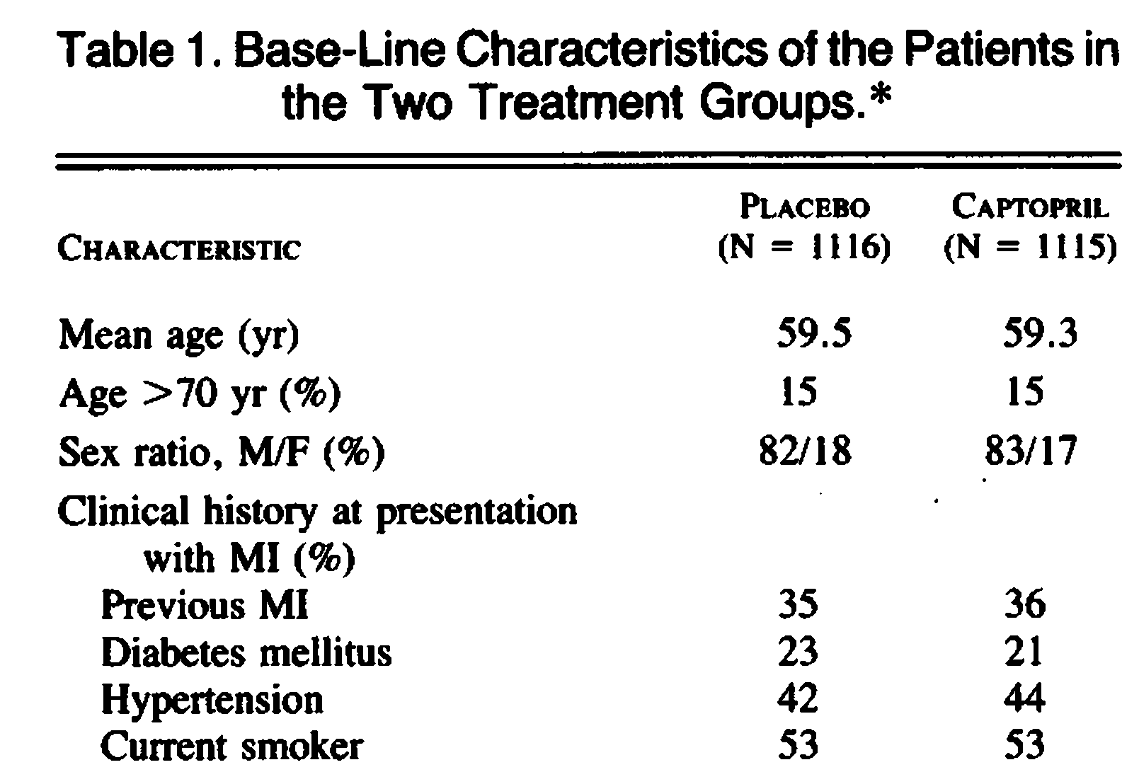

Slide 20
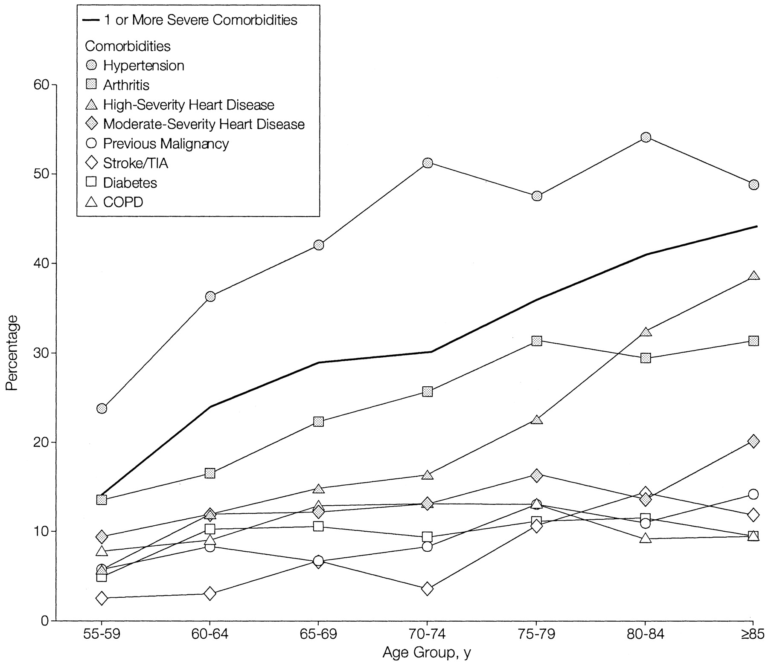
Importance of co-morbidity
Prevalence and age trends for selected co-morbidities
Holmes 2003

Slide 21
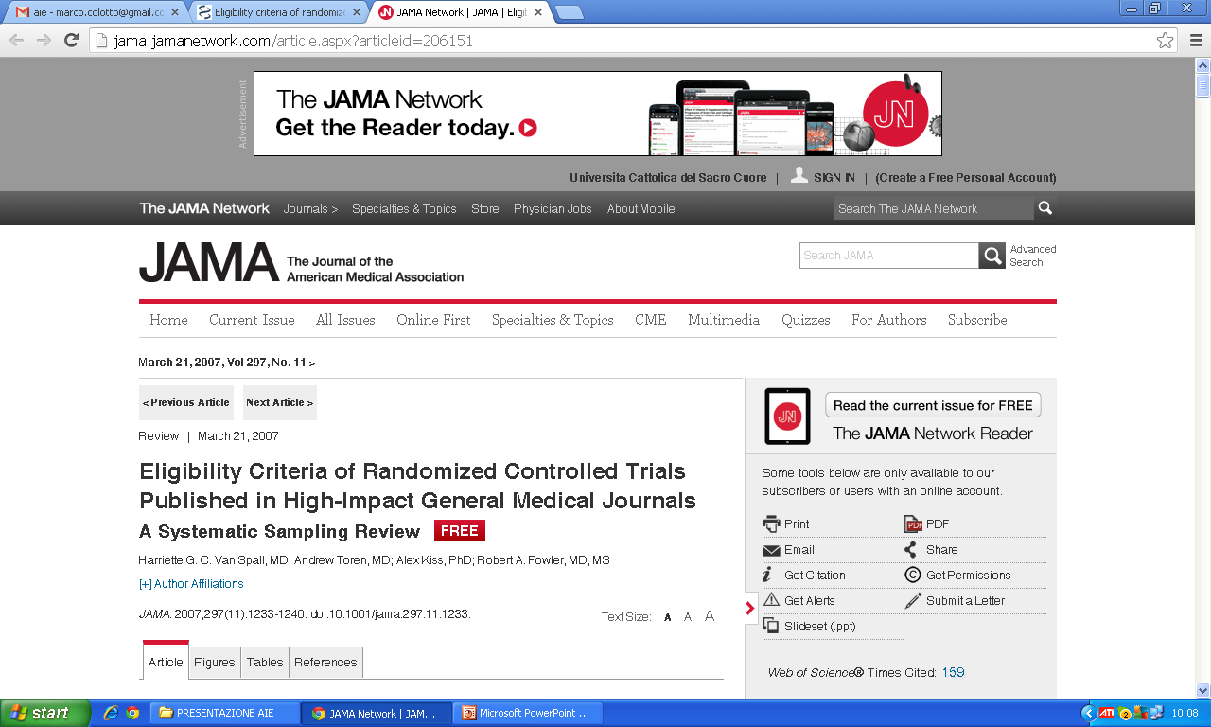
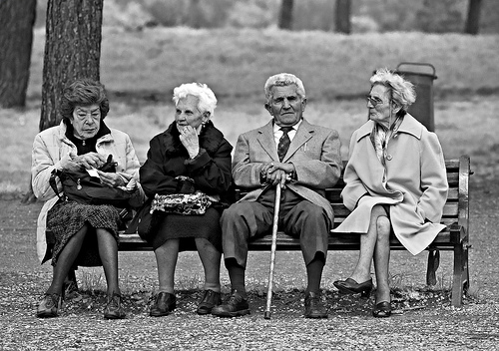
The “new” patients
The unknown
“new” patients
Age >75 (72.1%)
Comorbidities (81.3%)
Polypharmacotherapy (54.1%)
Causes of failure to enrol in the trial
Van Spall HG, 2007
Notes:
3 out of 4 of the exclusion elements are characteristics of the “new” patient”

Slide 22
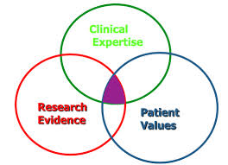
EVIDENCE BASED MEDICINE

Slide 23
An Evolving Scenario
Integrated Care supported by ICT
ICT as enabler of a new model of care
4P medicine
Predictive
Preventive
Participatory
Personalized
Leroy Hood 2010

Slide 24
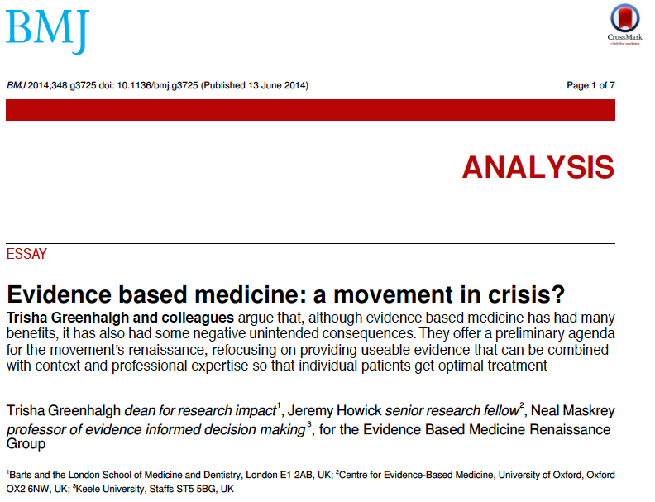
Evidence Based Medicine Renaissance

Slide 25
A real case:
Mrs Patel, age 83 “feels unwell”
Quinine 300 mg at night “for my cramps”
Cholecalciferol 1 capsule daily “for my bones”
Ramipril 5 mg daily “for my blood pressure”
Simvastatin 40 mg daily “for my cholesterol”
Aspirin / clopidogrel 75+100 mg daily “for my blood”
Bisoprolol 10 mg daily “after my heart attack”
Metformin 1g twice daily “for my diabetes”

Slide 26
Mrs Patel: Questions
What are her (many) diagnoses?
In Asian women over 80 with condition X, what is the benefit of drug Y and what are the harms?
In Asian women over 80 with multi-morbidity, how does the benefit-harm balance change as each additional drug gets added?
How do I go about de-prescribing?
How can I share decisions with Mrs Patel?

Slide 27
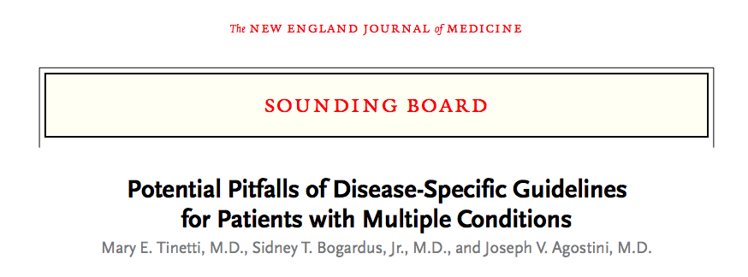

Slide 28
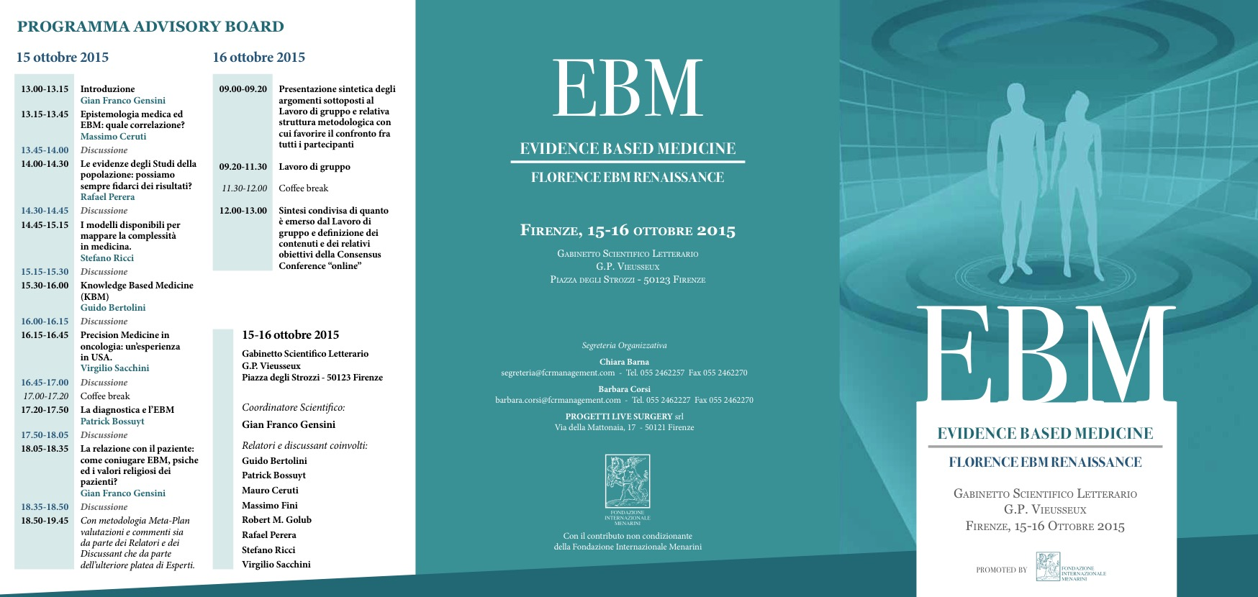

Slide 30
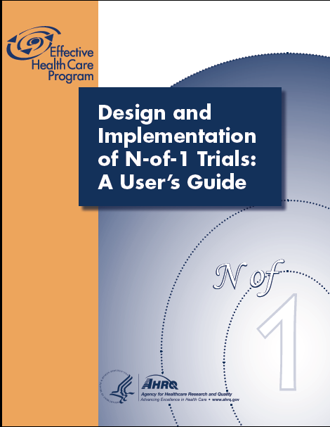

Slide 31
…a seemingly clear disease entity like myocardial infarction is a continuum in:
space (location of infarct related artery),
time (critical relevance of timing of reopening of occluded artery),
severity,
  individual factors:
                degree of subclinical atherosclerosis not related to the event,
  variability of coagulation system and platelet response to drugs.
Hunziker: Knowledge-based (personalized) medicine Eur. J. Nanomed. 2012;4(1):5–6

Slide 32
An Evolving Scenario
Integrated Care supported by ICT
ICT as enabler of a new model of care
4P medicine
Predictive
Personalized
Preventive
Participatory
Efficient patient management
Modulation of disease progress

Slide 33
Reducing Uncertainty:
A fifth P : PRECISION MEDICINE
Researchers and health-care providers must have access to vary large sets of health and disease-related data linked to individual patients.
These data are also critical for the development of the Information Commons, the Knowledge Network of Disease, and the development and validation of the New Taxonomy, different from the usual Disease-based Taxonomy.
Toward Precision Medicine NCR 2011

Slide 34

WATSON
HTL High Threshold Logic - NLP Natural Language Processing

Slide 35
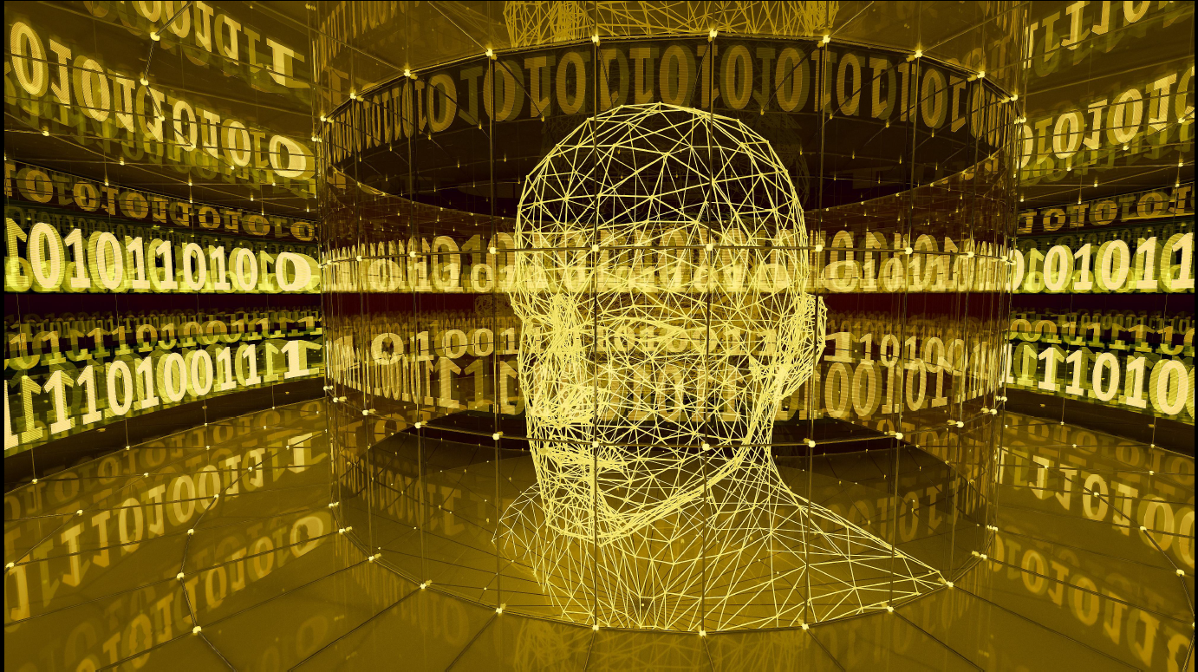
WATSON
HTL High Threshold Logic - NLP Natural Language Processing

Slide 36
Watson integrates on a large scale:
Clinical data,
Research data,
Medical guidelines and
Personal Clinical Wisdom.
Watson is a deep question answering natural-language computer system, a very complex and sophisticated, healthcare oriented, software, it is in an advanced stage of development. Its developers have chosen oncology as a medical area for the starting of their efforts. They have started with few specific subfields of cancer diagnosis and therapy:
(i) Lung adeno-carcinomas; Breast cancer; Prostate cancer (Memorial Sloan-Kettering).
(ii) Leukemias (MD Anderson).

Slide 37
The supercomputer has incorporated (and made manageable in an integrated way) thousands of sources, including scientific journal articles, national guidelines, individual-hospital best practices, clinical trials, and even textbooks.
Watson interfaces with electronic medical records, it has the capability to read and “comprehend” case notes (natural language processing).

Slide 38
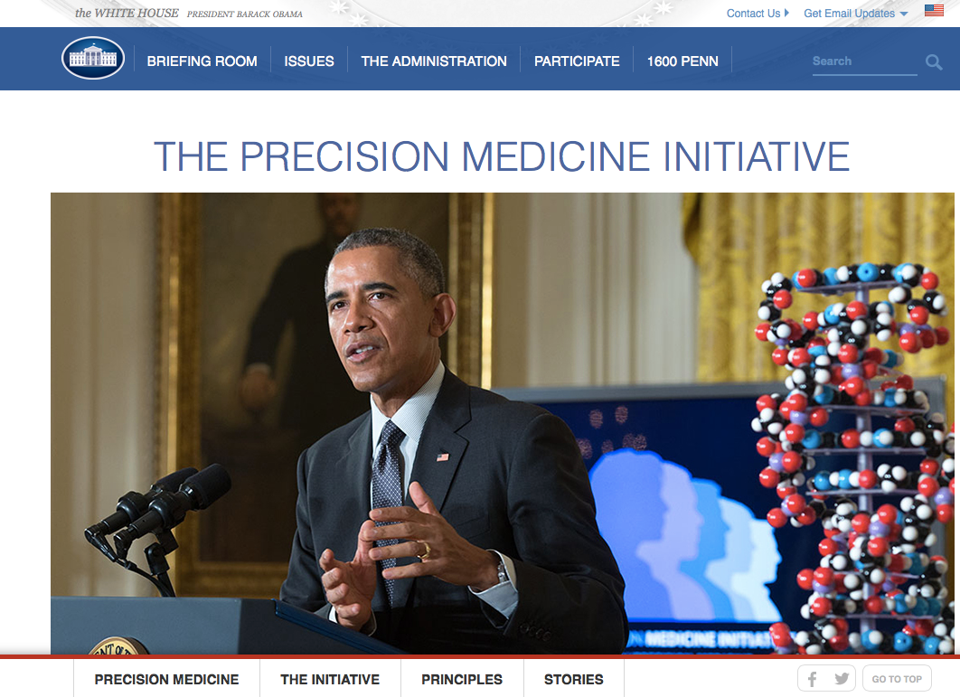

Slide 39

“Tonight, I'm launching a new Precision Medicine Initiative to bring us closer to curing diseases like cancer and diabetes — and to give all of us access to the personalized information we need to keep ourselves and our families healthier.”
President Barack Obama, State of the Union Address, January 20, 2015

Slide 40
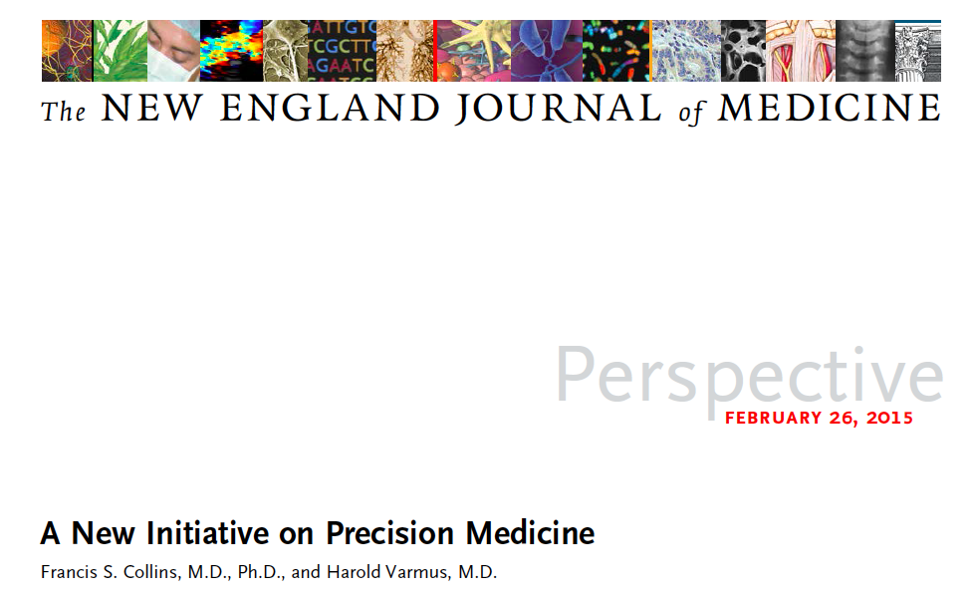
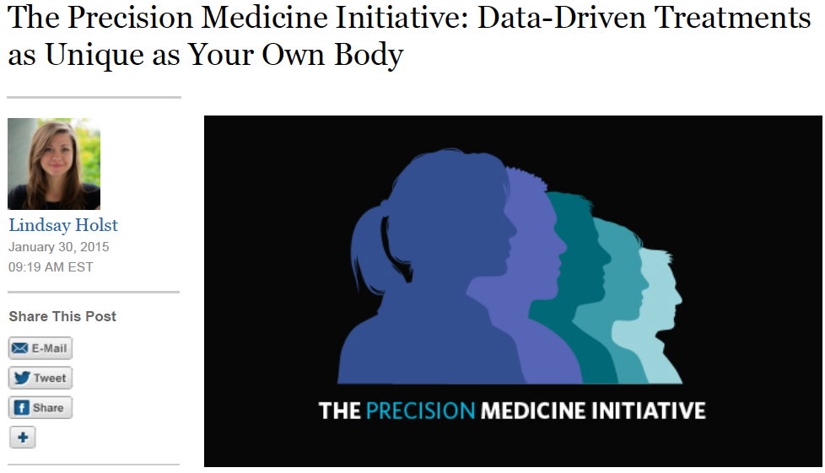
right drug
at the right dose
to the right patient.

Slide 41
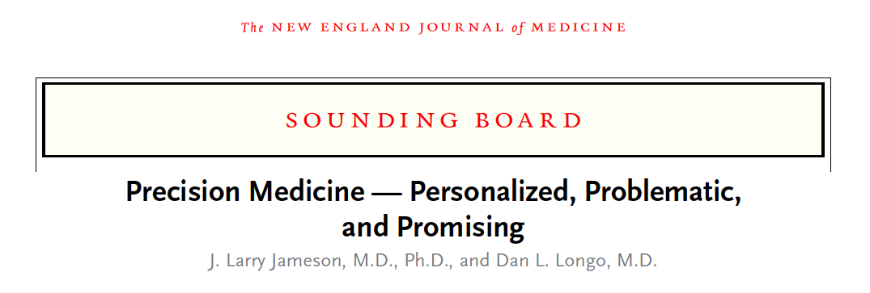

Slide 42
Precision medicine
should be viewed as a means of providing the best available health care for a population by
identifying the needs and
improving the outcomes of individual patients.

Slide 43
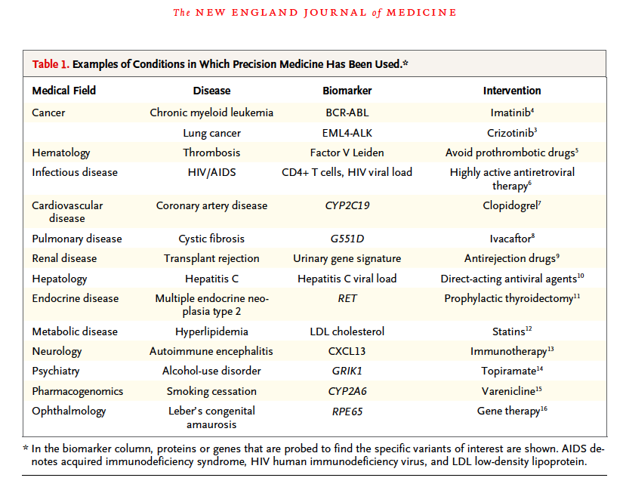

Slide 44
Crisis in evidence based medicine?
• The volume of evidence, especially clinical guidelines, has become unmanageable
• Statistically significant benefits may be marginal in clinical practice
• Inflexible rules and technology driven prompts may produce care that is management driven rather than patient centred
• Evidence based guidelines often map poorly to complex multimorbidity

Slide 45
Actions to deliver real evidence based medicine
• Patients must demand better evidence, better presented, better explained, and applied in a more personalised way;
• Clinical training must go beyond searching and critical appraisal to hone expert judgment and shared decision making skills;
• Producers of evidence summaries, clinical guidelines, and decision support tools must take account of who will use them, for what purposes, and under what constraints;

Slide 46
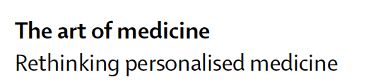
…the key to personalised medicine for chronic diseases is to put the patient at the heart of the treatment programme. This will require reconsidering four major assumptions that underlie personalised medicine:
what comprises the intervention;
who provides it;
where is it provided; and
who is the target of the intervention.
Public health approaches to chronic diseases have innovative approaches for re-engineering each of these assumptions. For many chronic diseases, the approach favoured by current practitioners of personalised medicine is to treat the specific diagnostic syndrome, which leads to fragmentation of the patient’s problems into the domains of the myriad organ-based specialties, with the consequence that the patient him/herself is lost from the picture.

Slide 47
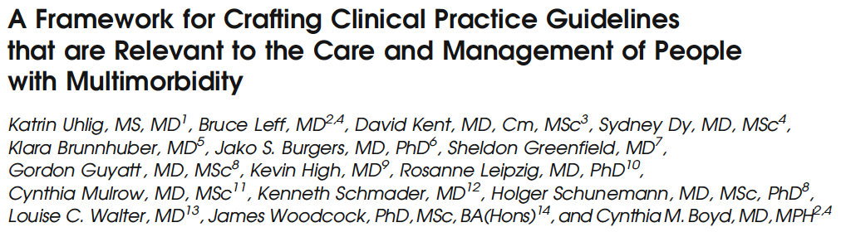
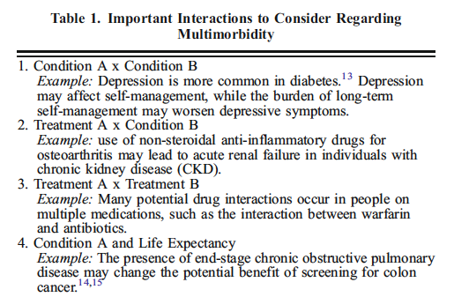
J Gen Intern Med. 2014 Apr;29(4):670-9.

Slide 48
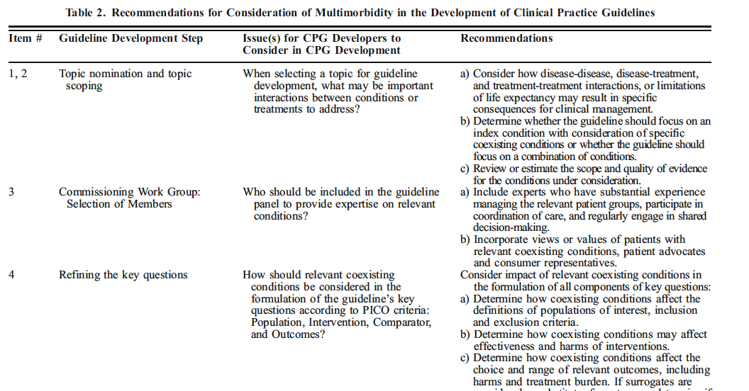

Slide 49
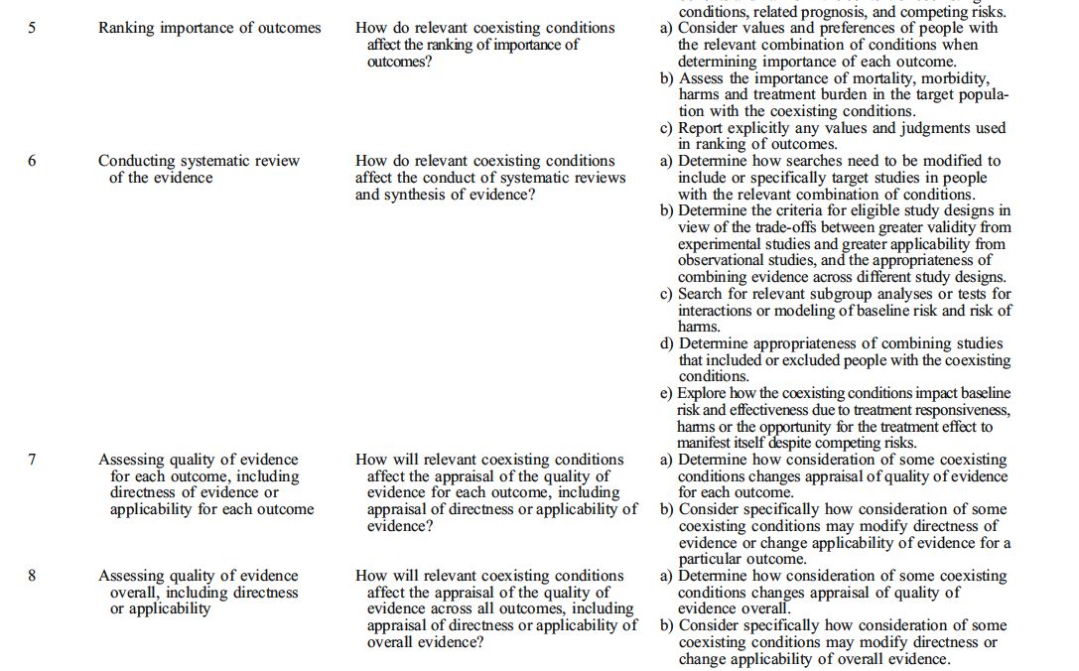

Slide 50
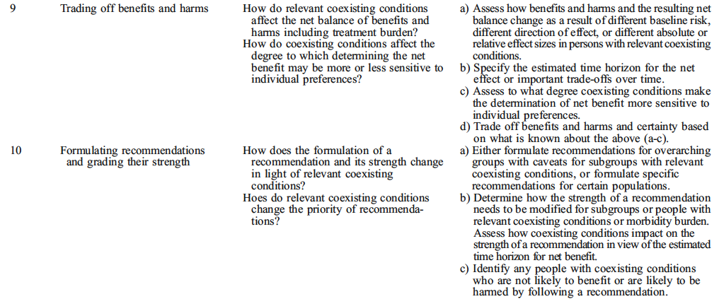

Slide 51
Evidence Based Medicine Renaissance

Slide 52
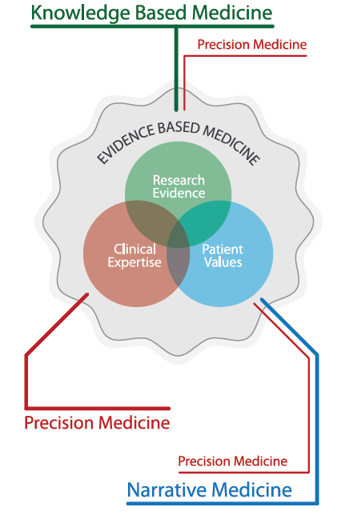


Slide 54
Integrative Medicine
requires a paradigm shift from
the disease-centered approach of conventional biomedicine
to
an approach in which patient values and participation of patients are central.
Maizes 1999

Slide 55
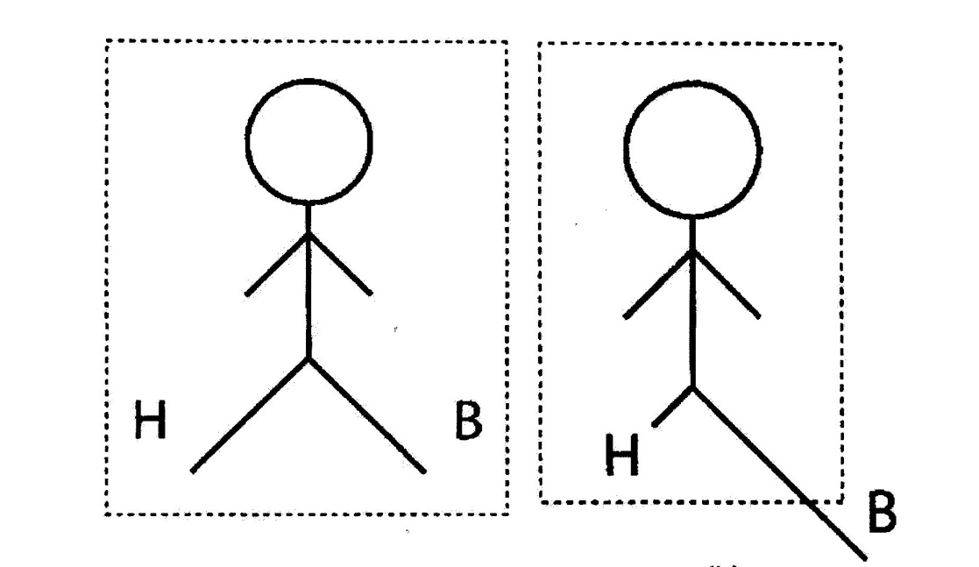
The patient as a person
Today’s medicine
B: Biomedical model; H: Humanistic model
Hetlevik I. Evidence-based medicine in general practice: a hindrance to optimal medical care? Scand J Prim Health Care 2004; 22: 136-40
55

Slide 56
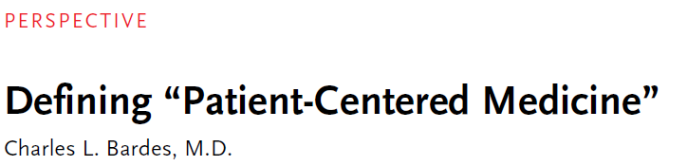
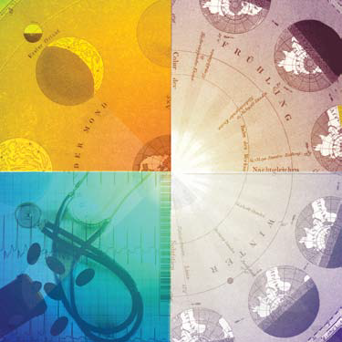
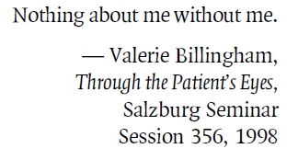
…..The growing demands for quality and safety in health care have refocused attention on patient outcomes, even if efforts to ensure more consistently positive outcomes sometimes reduce the physician’s prized autonomy

Slide 58
Dalla medicina delle malattie a quella degli individui (le 4 P)
  predictive
  preventive
  personalized (superconvergenza)
  partecipatory
Uno spostamento dell’enfasi dai “silos” disciplinari (specialismi) alla ibridazione dei saperi (la struttura delle risposte deve riconfigurarsi in relazione ai problemi)
Modificazioni nell’estensione (vastità), intensificazione (iperspecialismo), tassi di rinnovamento delle basi di conoscenza

Slide 59

June 8, 2010,
9:00 PM The Human Phenome Project
By OLIVIA JUDSON
In 1884, a man called Francis Galton opened the doors of his “Anthropometric Laboratory.” This was “for the use of those who desire to be accurately measured in many ways, either to obtain timely warning of remediable faults in development, or to learn their powers.” The many ways included height, hand strength, acuity of sight and hearing, lung capacity and the power of a blow with the fist.

Slide 60
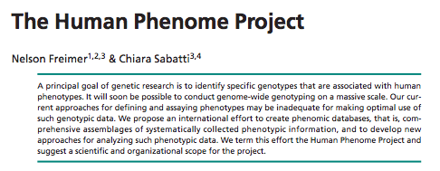
The Human Phenome Project

Slide 61
A primary task for the new field of phenomics will be to clarify
what, in practical terms, constitutes a phenotype and then to
delineate the different phenotypic components that compose the
phenome. The term ‘phenotype’ can refer to any morphologic,
biochemical, physiological or behavioral characteristic of an
organism.

Slide 62
“Phenomics approaches require
collecting phenotypic information, in
any given individual, at a series of
different levels of resolution
(molecules, cells, tissues and whole
organisms) and then determining
how these features can profitably be
studied together.”

Slide 63
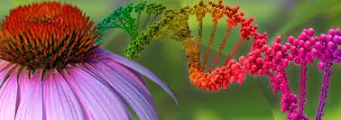
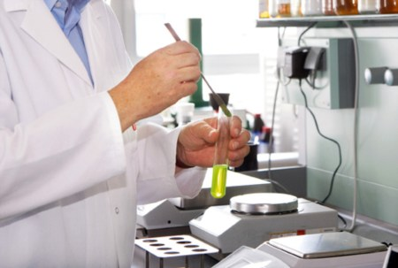
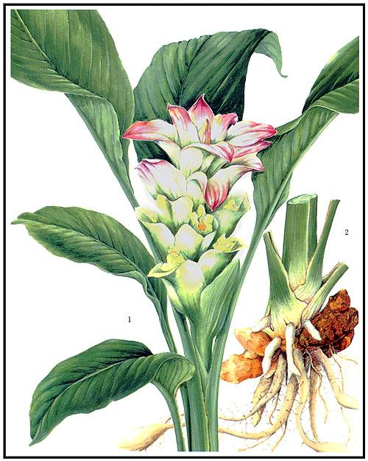
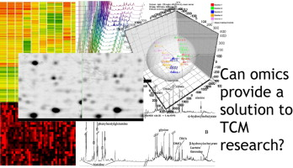

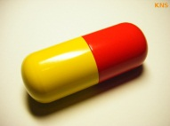
HERBAL GENOMIC
Novel analytical procedure for understanding the therapeutic effect and toxicity of herbal medicine preparation on certain disease progression through a profiling of the affected genomic alteration, therefore, providing mechanistic insights into that action of a particular herbal medicine preparation and developing new therapeutic strategies.
Curcuma longa

Slide 64
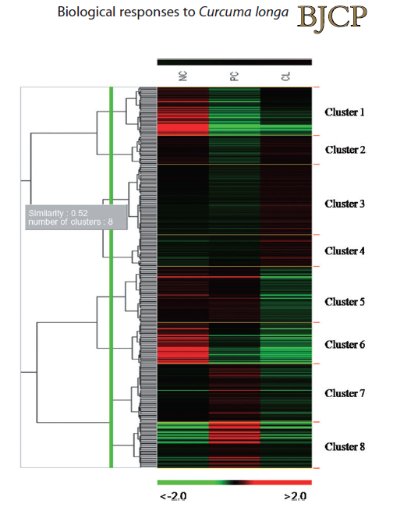
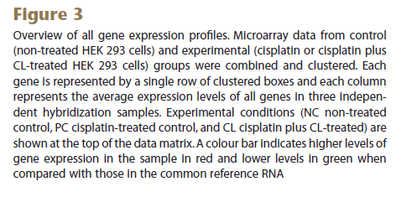


Curcuma longa (CL) and cisplatin

Slide 65

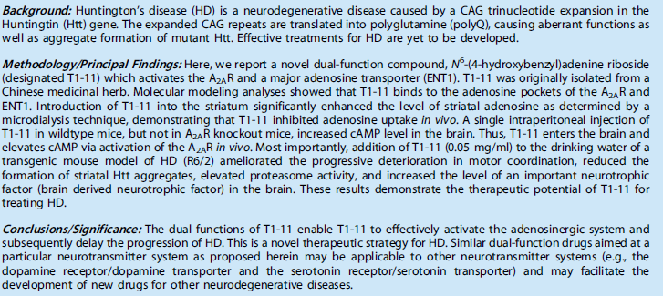


Chinese medicinal herbs

Slide 66
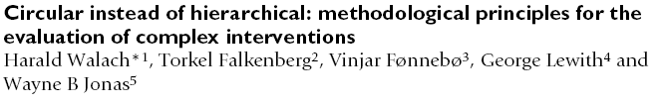
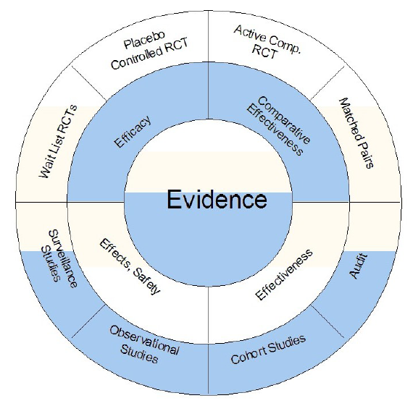
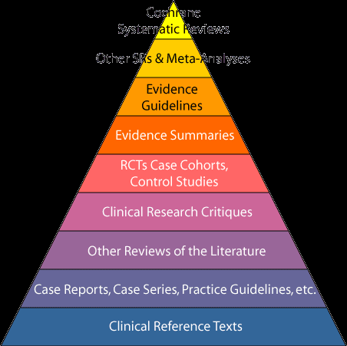

EVIDENCE

Slide 67
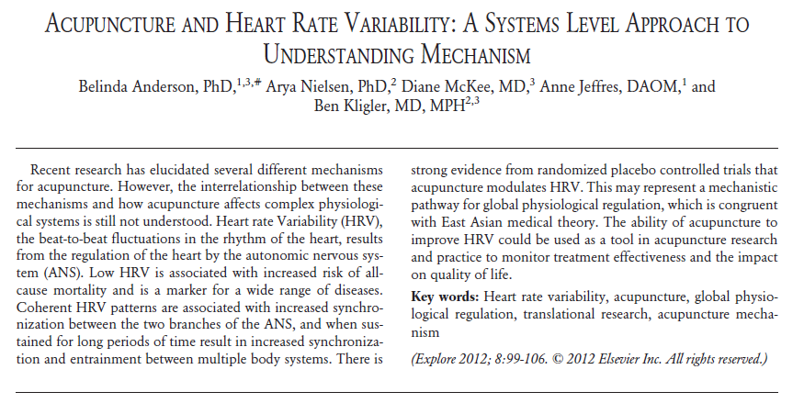
Integrative Medicine and Systems Medicine

Slide 68
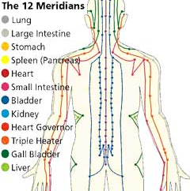

Slide 69







Slide 70

Integrative Medicine and Systems Medicine
Systems biology offers cutting-edge tools for the study of complementary and alternative medicine (CAM). The advent of ‘omics’ techniques and the resulting avalanche of scientific data have introduced an unprecedented level of complexity and heterogeneous data to biomedical research, leading to the development of novel research approaches. Statistical averaging has its limitations and is unsuitable for the analysis of heterogeneity, as it masks diversity by homogenizing otherwise heterogeneous populations. Unfortunately, most researchers are unaware of alternative methods of analysis capable of accounting for individual variability. This paper describes a systems biology solution to data complexity through the application of parsimony phylogenetic analysis.

Slide 71

Integrative Medicine and Systems Medicine
This paper presents state space grids (SSGs) as a mathematically less intensive methodology for process-oriented research beyond traditional qualitative and quantitative approaches in whole systems of complementary and alternative medicine, able to answer to the questions:
Is change during treatment gradual and incremental or does it involve sudden extreme gains (or symptom spikes), extreme worsenings, and plateaus? When does the improvement begin? How do relationships with practitioners and significant others interact with other components of the treatment? Does the pattern of change matter for clinical outcomes? By what process do novel structures (e.g., engaged clinical interaction and alliance) or patient skills (e.g., coping, mobility, pain regulation) emerge during the treatment?

Slide 72


Sept 12, 2012
The homeopathic doctors I know are caring people, disillusioned with the crudeness of conventional medicine […] They listen, spend time, and offer some explanation for the unexplainable—and their patients like them.
The effect of homeopathy is the positive effect of a therapeutic relationship that is reassuring, accepting, and supportive. Society should never underestimate the healing effect of a kind word or the value of a holistic approach. These consultations genuinely improve wellbeing.
Homeopathic pills are placebos, but the placebo response is great, maybe even as high as 80%.
There is no hard evidence for homeopathy. But likewise the more you understand of research evidence the more you understand it is mere modern marketing quackery.
Modern medicine has real capacity to do harm but often minimal good; homeopathy has minimal capacity to do harm but real capacity to do good.
Homeopathy is bad science but good medicine.

Slide 73
Integrative Medicine
Integrative Medicine is healing-oriented medicine that takes account of the whole person (body, mind, and spirit), including all aspects of lifestyle.
It emphasizes the therapeutic relationship and makes use of all appropriate therapies, both conventional and alternative.
www.integrativemedicine.ariazona.edu
PIM – U of Arizona

Slide 74
The Future of Integrative Medicine
Definition of Integrative Medicine From the CAHCIM
“Integrative medicine is the practice of medicine that reaffirms the importance of the relationship between practitioner and patient, focuses on the whole person, is informed by evidence, and makes use of all appropriate therapeutic approaches to achieve optimal health and healing.”
Consortium of Academic Health Centers for Integrative Medicine
Notes:
Acupuncture Consult in the HTU

Slide 75


Slide 76



Slide 77


Slide 78


Slide 79
Evidence based medicine: one for all?
EVIDENCE BASED MEDICINE

Slide 81

INTEGRATIVE
MEDICINE

