Slide 1
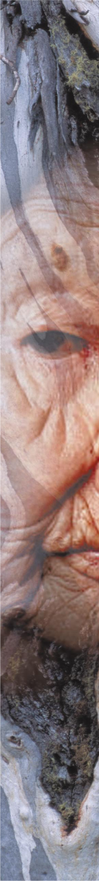




Dal nutraceutico all’integratore alimentare,
al novel-food, al farmaco fitoterapico
Giovanni Scapagnini, MD, PhD

Slide 2

The term “Nutraceutical” was coined in 1989 by Stephen De Felice, MD, Founder and Chairman of the Foundation for Innovation in Medicine (FIM).
Nutraceutical can be defined as
“ A food or part of food or nutrient, that provides health benefits, including the prevention and treatment of a disease.”

Slide 3
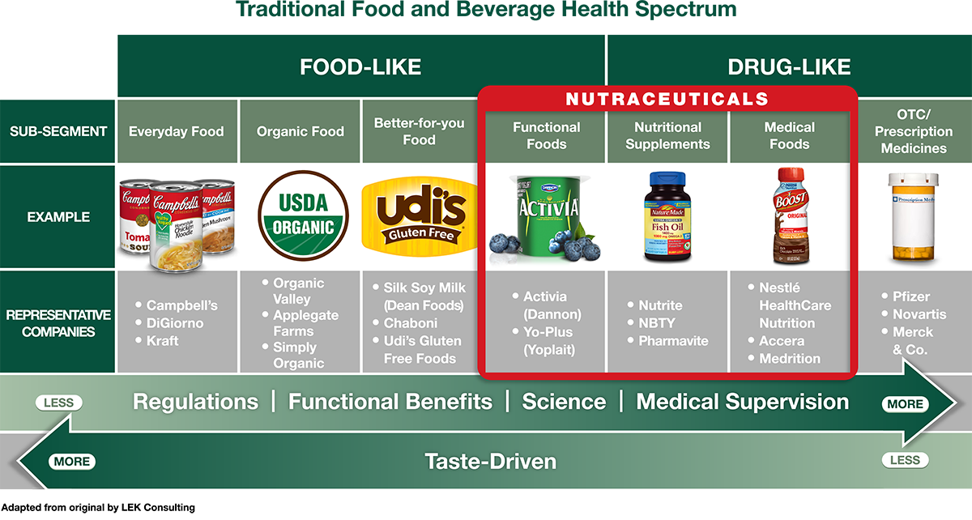
Il termine "nutraceutico" è spesso usato in maniera intercambiabile con “alimento funzionale”
Total global nutraceuticals market reached $142.1 billion in 2011. Expected to reach $204.8 billion by 2017
PR Newswire (http://www.prnewswire.com/news-releases/nutraceutical-ingredient-market-worth-336-billion-by-2018-242365841.html), January 2014.

Slide 4
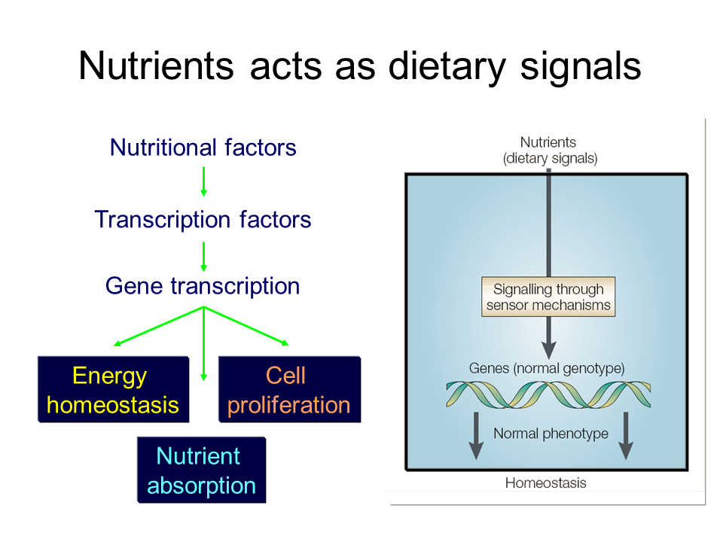

Slide 5
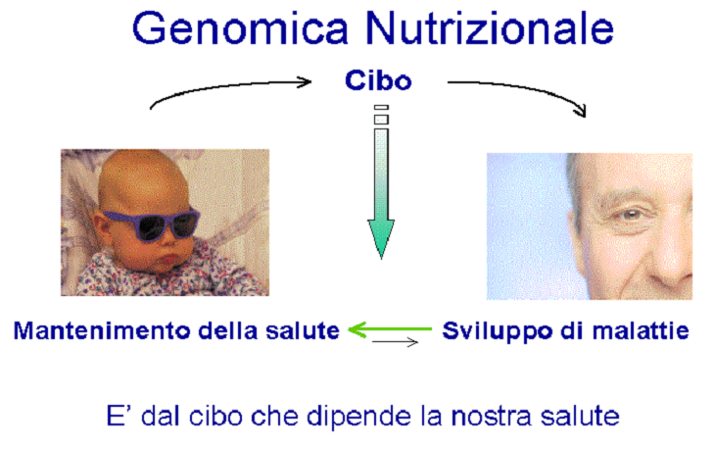

Slide 6
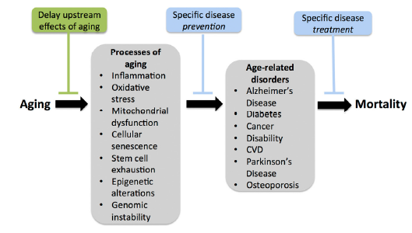
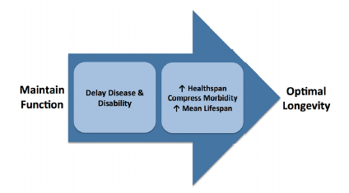
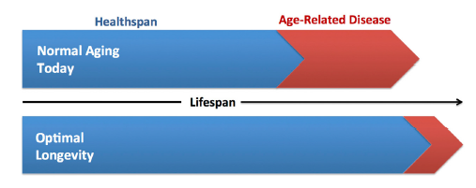
Seals DR and Melov S. Translational Geroscience: Emphasizing function to achieve optimal longevity. Aging 2014, 6: 718-730

Slide 7


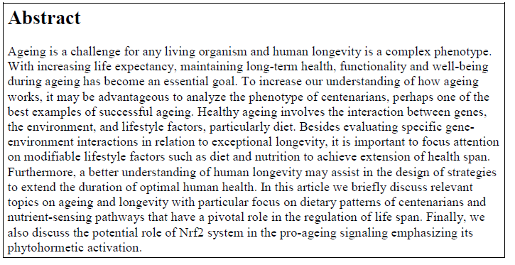
Sergio Davinelli¹, D Craig Willcox², Giovanni Scapagnini¹*
1 Department of Health Sciences, University of Molise, Campobasso, Italy
2 Department of Human Welfare, Okinawa International University, Ginowan, Japan
* Corresponding author
Davinelli et al. Immunity & Ageing 2012

Slide 8
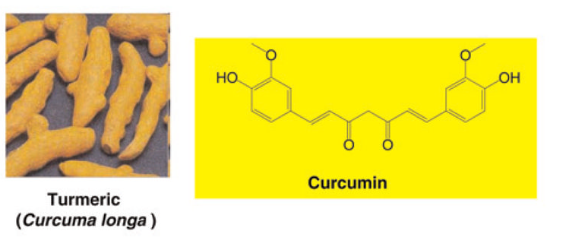
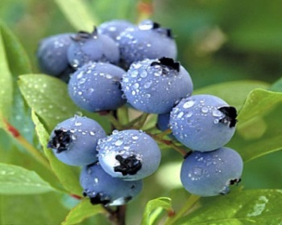
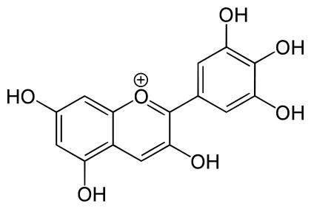
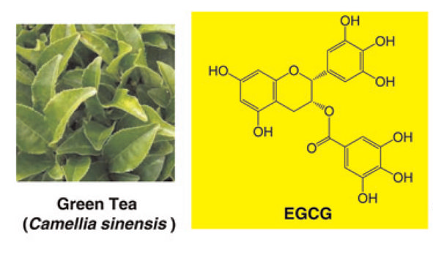
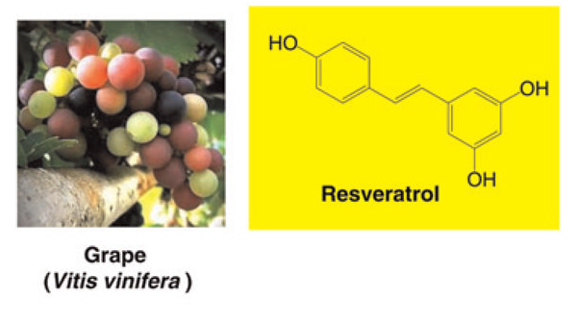
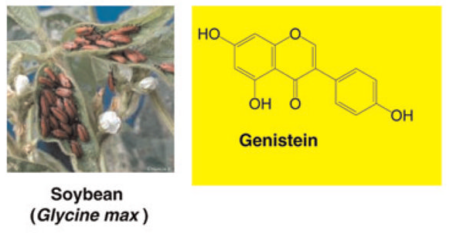
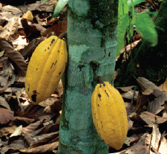
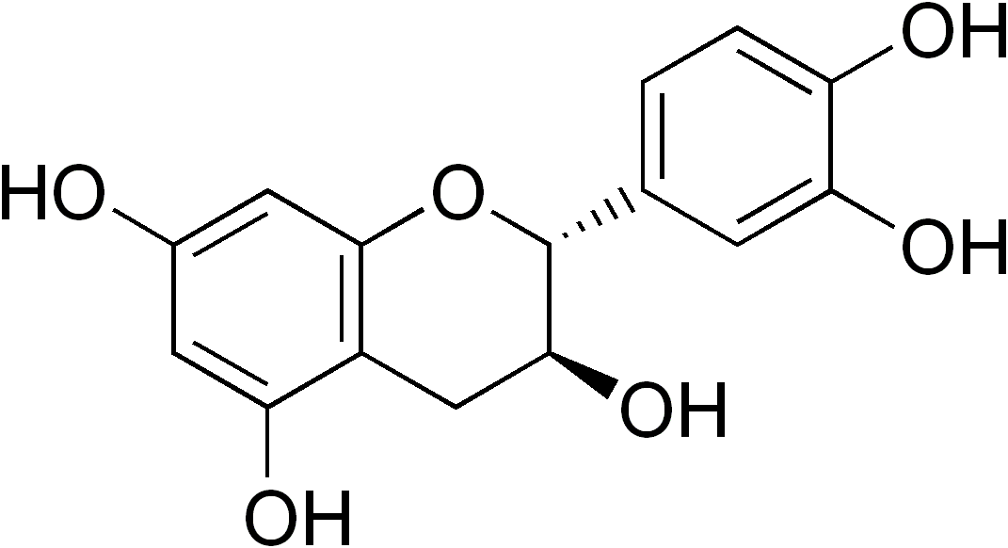
Bioactive Natural Polyphenols
from Food Sources
Delphinidin
Blueberry
Epicatechin
Cocoa
(Theobroma cacao)

Slide 9
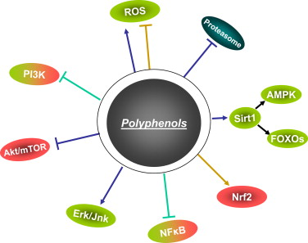
Major pathways activated by polyphenols

Slide 10

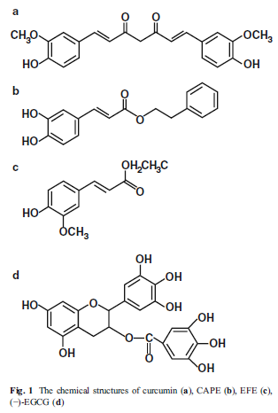
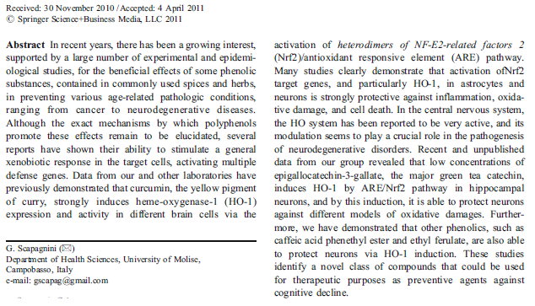
Modulation of Nrf2/ARE pathway by food polyphenols: a nutritional neuroprotective strategy for cognitive and neurodegenerative disorders.
Scapagnini G, Vasto S, Abraham NG, Caruso C, Zella D, Galvano F.
Mol Neurobiol. 2011 Oct;44(2):192-201.

Slide 11
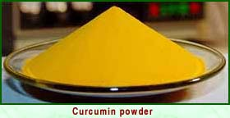
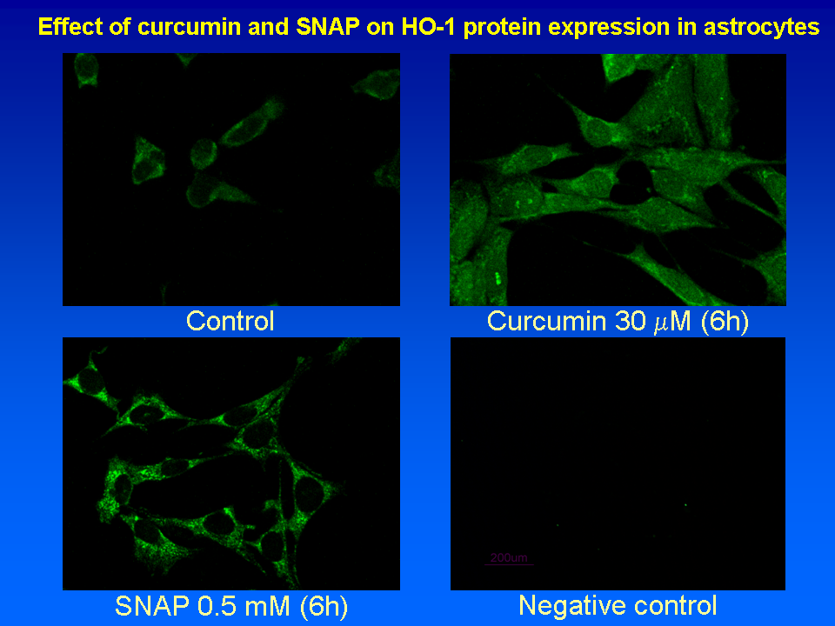
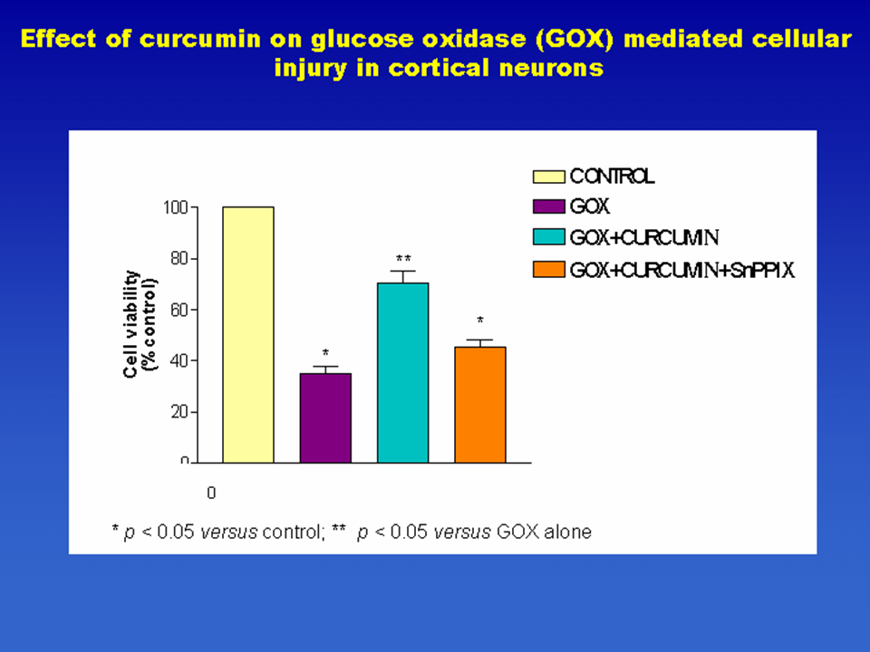
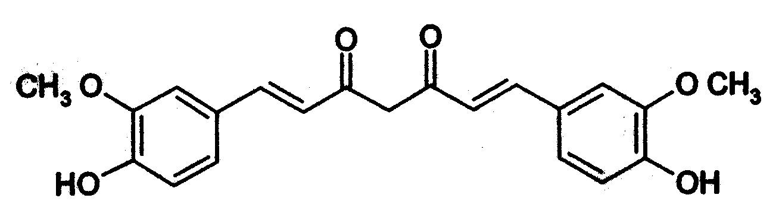
Scapagnini G, Colombrita C, Amadio M, D'Agata V, Arcelli E, Sapienza M, Quattrone A, Calabrese V.
Curcumin activates defensive genes and protects neurons against oxidative stress.
Antioxid Redox Signal. 2006 Mar-Apr;8(3-4):395-403.
Institute of Neurological Sciences, National Research Council (CNR), Catania, Italy.,
Blanchette Rockefeller Neurosciences Institute, West Virginia University, Rockville, Maryland.
CURCUMIN

Slide 12
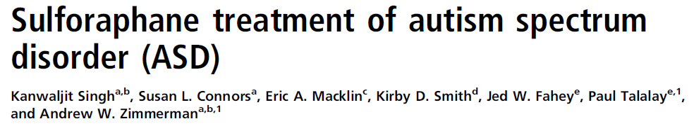
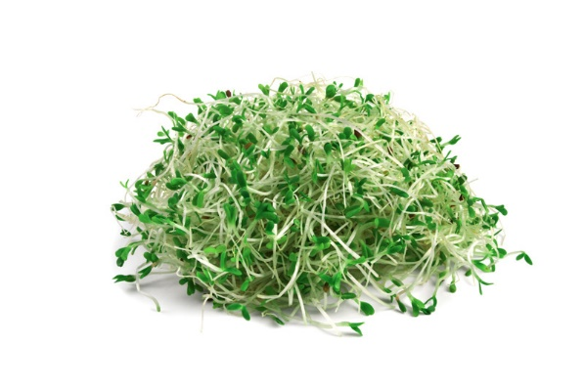

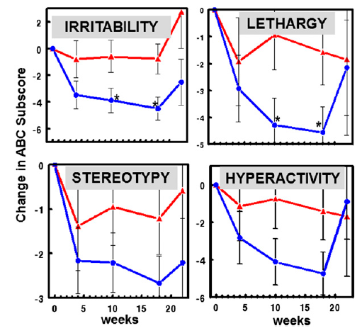
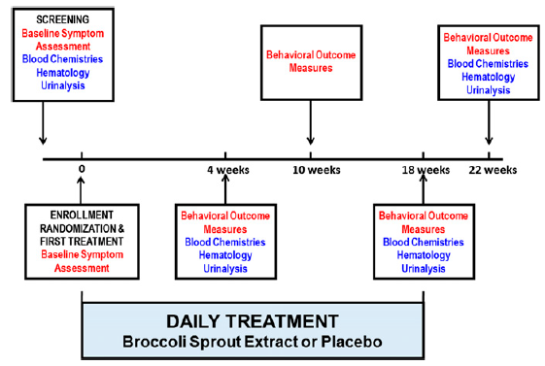

Slide 13

SOSTANZE E PREPARATI VEGETALI (BOTANICALS)
Premesso che la dizione “sostanza e preparato vegetale” include non solo piante ma anche alghe, funghi e licheni, per “botanical” generalmente si intende:
un ingrediente vegetale, ovvero la “droga vegetale” ovvero la pianta in toto o sue parti (intere, a pezzi o tagliate) in forma non trattata, generalmente essiccati;
un preparato vegetale ottenuto sottoponendo l’ingrediente vegetale a vari trattamenti (ad esempio: estrazione, distillazione, spremitura, frazionamento, purificazione, concentrazione, fermentazione, triturazione e polverizzazione).
Per la corretta identificazione botanica delle piante si può fare riferimento ai seguenti data base, consultabili gratuitamente: www.theplantlist.org www.ars-grin.gov www.algaebase.org www.indexfungorum.org www.lichens.ie
Linee guida sulla valutazione della sicurezza dei botanicals: Compendium of botanicals reported to contain naturally occurring substances of possible concern for human health when used in food and food supplements.

Slide 14
Modalità di registrazione e di immissione in commercio di prodotti vegetali con azione su salute/benessere possono seguire:
la normativa del farmaco (2001/83/CE) per specialità ad uso ben consolidato
la normativa 2004/24/CE per la registrazione semplificata di farmaci vegetali tradizionali.
La normativa 2002/46/CE per la notifica di integratore alimentare
Regolamento 1223/2009 per notifica di prodotto cosmetico
La Direttiva 93/42/CE per registrazione di Dispositivo Medico
La direttiva 99/21/CE, per registrazione di Alimento a Fini Medici Speciali
Regolamento (CE) 258/97 per approvazione di Novel Food

Slide 15
I prodotti vegetali che in Italia hanno lo status di farmaco sono classificabili in:
Specialità medicinali registrate con AIC (Well Estabilished Use)
La registrazione segue la esigente normativa 2001/83/CE che impone tutta la procedura di test clinici e tossicologici che garantiscono sicurezza e affidabilità.
Tali fitoterapici sono caratterizzati, quindi, da un livello di provata efficacia e sicurezza, ed immessi in commercio (AIC), con o senza obbligo di ricetta, seguendo lo stesso iter di tutti i farmaci complessi e monomolecolari.
I farmaci vegetali tradizionali
Sono prodotti vegetali utilizzati in terapia da 30 anni nel mondo e da 15 anni nell’Unione Europea e sono classificati come fitoterapici con livello di efficacia non provato dalla letteratura scientifica, qualità dimostrata e sicurezza garantita. La registrazione avviene tramite l’Agenzia Europea per il Farmaco (EMA), seguendo una normativa semplificata (2004/24/CE), senza eseguire trial clinici e tossicologici di grande portata. I prodotti che hanno i requisiti per essere registrati come farmaci vegetali tradizionali sono tutti monografati dal Comitato specifico dell’EMA che si occupa di prodotti vegetali, l’HMPC (Committee on Herbal Medicinal Products).

Slide 16
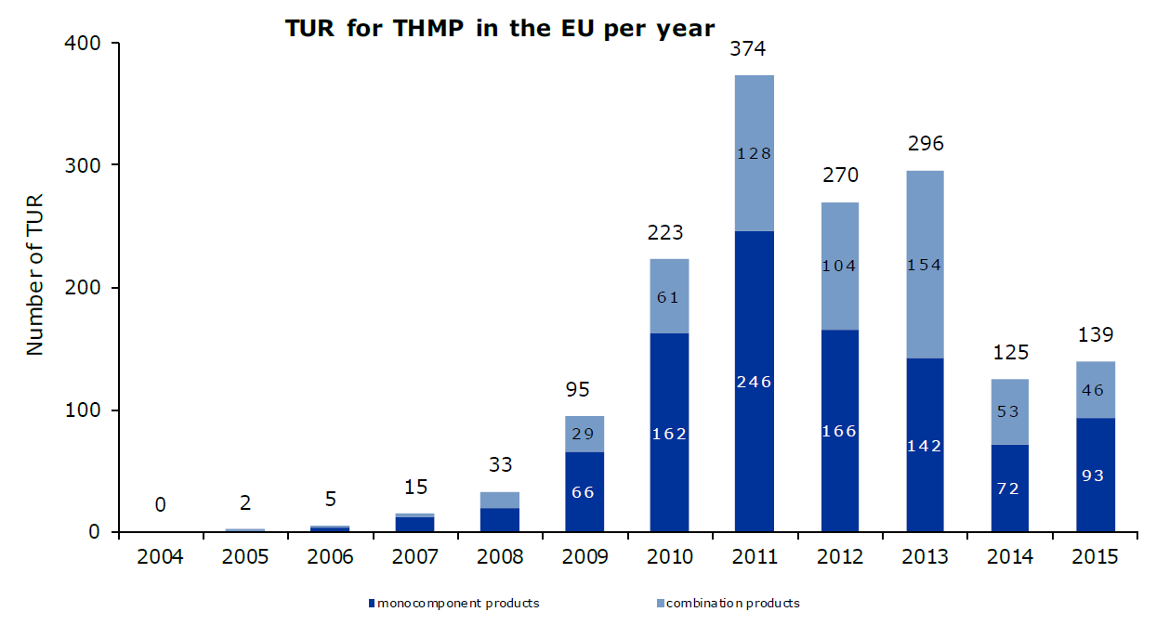
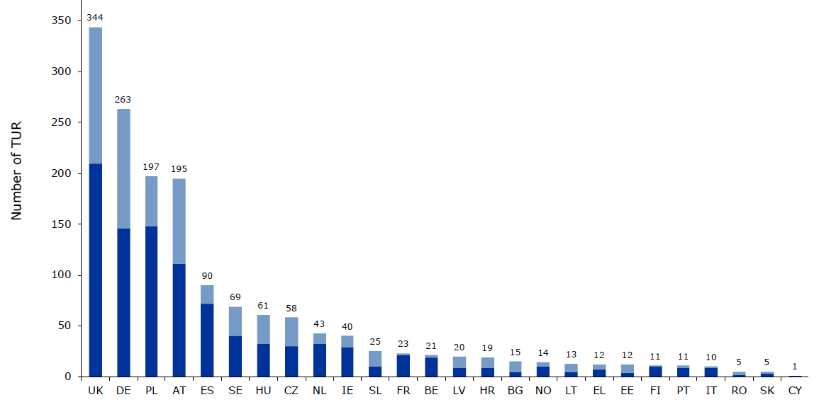
Number of traditional use registrations (TUR) for traditional herbal medicinal products (THMP) in the EU

Slide 17
Alimenti a Fini Medici Speciali
Il Regolamento (UE) 609/2013 (art. 2.2.g) ne ripropone la definizione: “un prodotto alimentare espressamente elaborato o formulato e destinato alla gestione dietetica di pazienti, compresi i lattanti, da utilizzare sotto controllo medico; è destinato all’alimentazione completa di o parziale di pazienti con capacità limitata, disturbata o alterata di assumere, digerire, assorbire, metabolizzare o eliminare alimenti comuni o determinate sostanze nutrienti in essi contenute o metaboliti, oppure con altre esigenze nutrizionali determinate da condizioni cliniche e la cui gestione dietetica non può essere effettuata esclusivamente con la modifica della normale dieta.”
In definitiva si tratta di prodotti che sono volti al trattamento dietetico di soggetti affetti da turbe, malattie o condizioni mediche che determinano una vulnerabilità nutrizionale, cioè l’impossibilità o la forte difficoltà ad alimentarsi utilizzando i comuni alimenti, integratori alimentari compresi, per sodisfare il loro fabbisogno nutritivo.
Per quanto concerne la composizione, gli AFMS vengono catalogati dalla direttiva 99/21/CE nelle tre seguenti categorie:
prodotti completi dal punto di vista nutrizionale con una formulazione standard dei nutrienti
prodotti completi dal punto di vista nutrizionale con una formulazione in nutrienti adattata ad una specifica malattia, un disturbo o uno stato patologico
prodotti incompleti dal punto di vista nutrizionale con una formulazione standard o adattata ad una specifica malattia, un disturbo o uno stato patologico, che non rappresentano l’unica fonte alimentare giornaliera

Slide 18

Integratori Alimentari
Gli integratori vengono considerati come prodotti appartenenti all’area alimentare, a base di vitamine, minerali e altre sostanze di interesse nutrizionale e fisiologico. Per quanto concerne i livelli di assunzione massima giornaliera di tali nutrienti l’orientamento è quello di assumere come riferimento generale livelli entro limiti di sicurezza (upper safe level:UL), pur tenendo in considerazione le RDA (recommended dietary allowances).
Nel settore degli integratori alimentari sono sempre più presenti prodotti diretti a favorire lo stato di benessere e non solo a colmare carenze alimentari, come quelli che accanto a una componente nutrizionale presentano una componente vegetale.
Le “erbe” impiegate devono essere in ogni caso idonee all’uso alimentare, non sono ammesse quelle che per la loro natura possono essere commercializzate solo attraverso il canale delle farmacie.
Il loro impiego ha lo scopo di ottimizzare gli apporti nutrizionali, fornire sostanze di interesse nutrizionale ad effetto protettivo o trofico e migliorare il metabolismo e le funzioni fisiologiche dell’organismo.
Attualmente, in mancanza di una norma specifica, la loro commercializzazione è subordinata alla procedura di notifica, cioè alla trasmissione al Ministero della Salute del modello di etichetta impiegato per la commercializzazione, ai sensi dell’art.7 del decreto legislativo 27 gennaio 1992 n.111.
DIRETTIVA 2002/46/CE DEL PARLAMENTO EUROPEO E DEL CONSIGLIO del 10 giugno 2002
DECRETO LEGISLATIVO 21 maggio 2004 n. 169

Slide 19
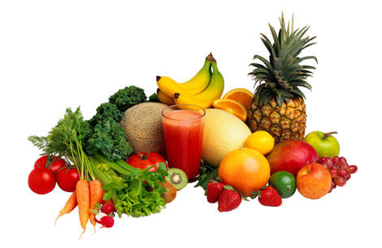
L’evoluzione del concetto di Integratore Alimentare
tra norme e bisogni
Ieri
Integrazione = carenza o aumentato fabbisogno
mancanza di vitamine = mangiare più frutta e verdura
2002
Oggi
Azione fisiologica per sostenere gli organi e le loro funzioni
Vera attività di prevenzione
Forte effetto salutistico
PER VIVERE MEGLIO E IN SALUTE
anche in ASSENZA DI CARENZE
anche seguendo una DIETA NORMALE

Slide 20
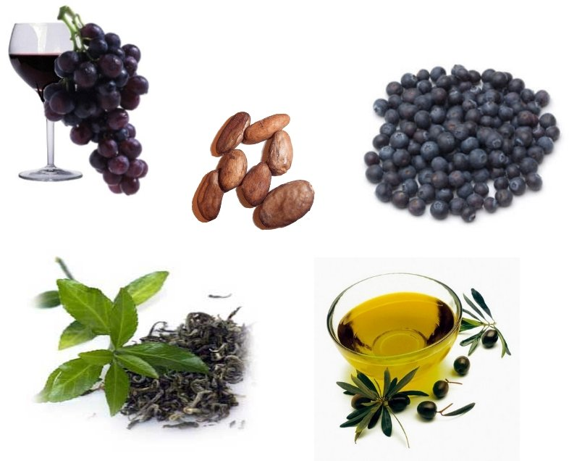
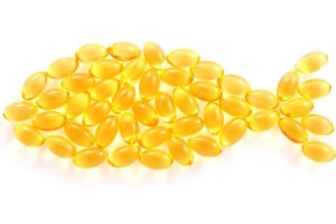
Cosa troviamo all’interno degli integratori
VITAMINE
MINERALI
AMINOACIDI
ACIDI GRASSI ESSENZIALI
FIBRE BETA SISTOSTEROLO
GAMMA ORIZANOLO
OCTACOSANOLO
ACIDO LIPOICO
L-TEANINA
OMOTAURINA
GLUCOSAMINA
CONDROITINSOLFATO
POLIFENOLI
ISOFLAVONI
ESTRATTI VEGETALI

Slide 21
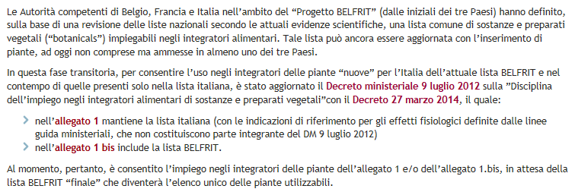
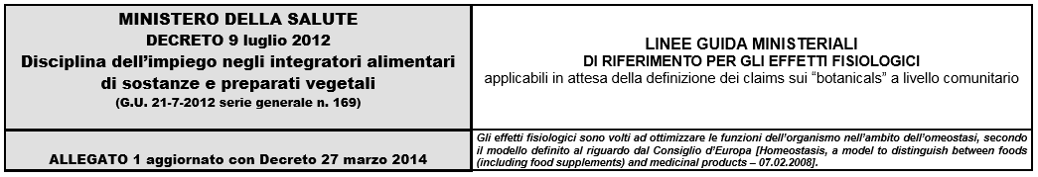
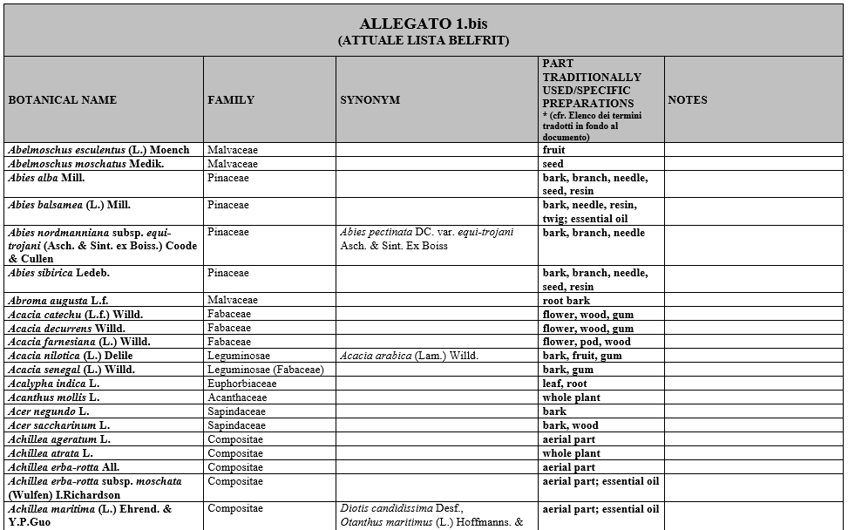
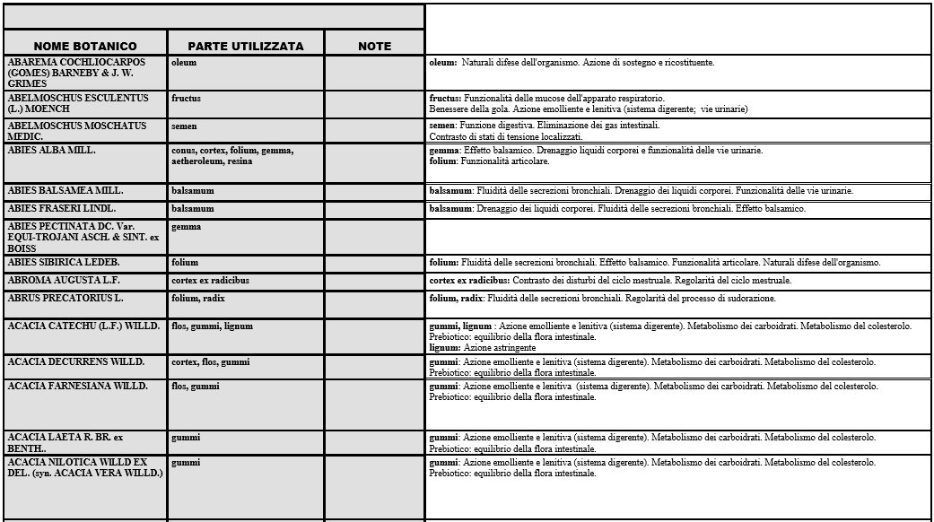

Slide 22


Slide 23
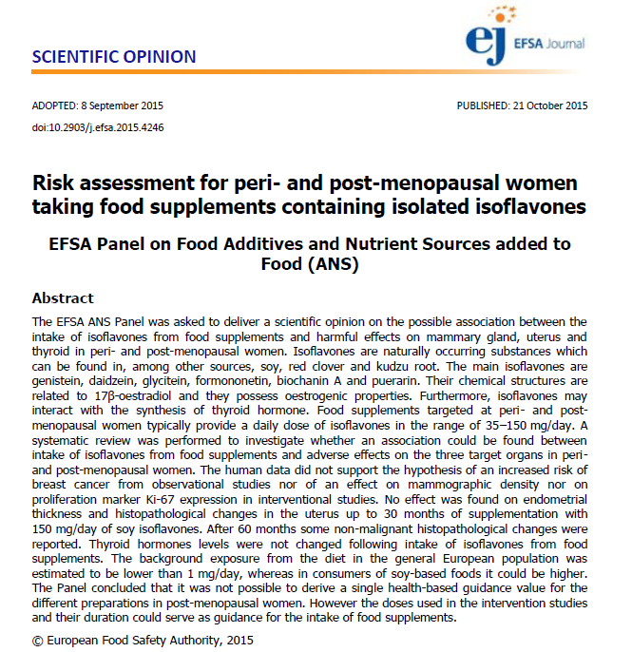
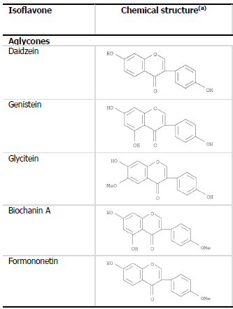

Slide 24
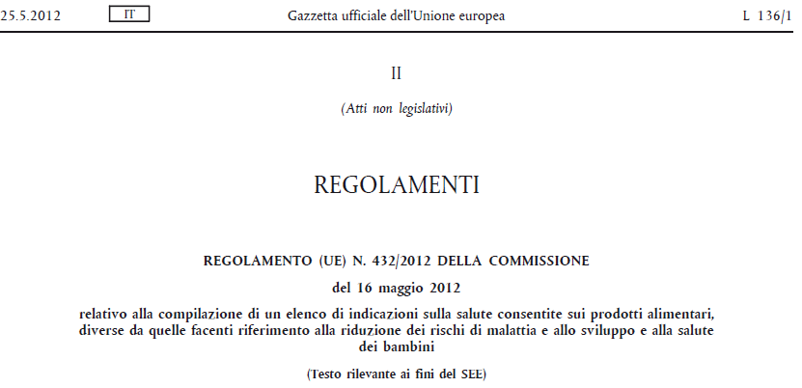
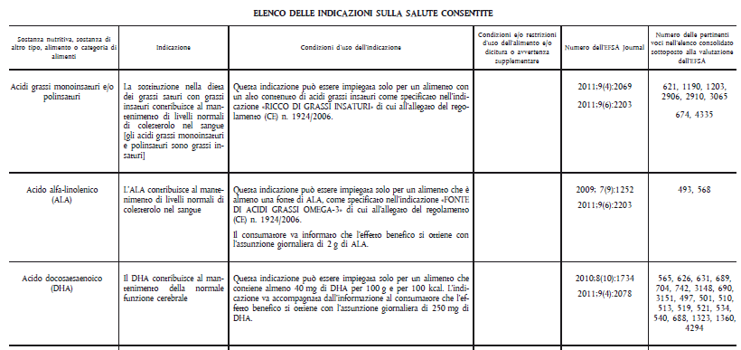

Slide 25
Specific guidance on the scientific requirements for health claims
the immune system, the gastrointestinal tract and defense against pathogenic microorganisms;
antioxidants, oxidative damage and cardiovascular health;
appetite ratings, weight management and blood glucose concentrations;
bone, joints, skin and oral health;
physical performance;
functions of the nervous system, including psychological functions.

Slide 26

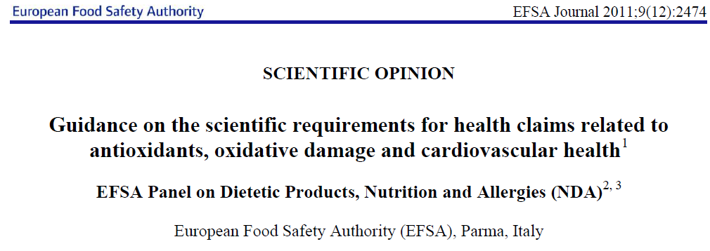

Slide 27
What is an antioxidant ?
In vitro and in vivo definitions
An antioxidant is any substance that is present in low concentrations compared to those of an oxidizable substrate and significantly delays or prevents oxidation of that substance.
Halliwell B, Gutteridge JMC (2007)
Claims made on the antioxidant capacity/content or properties of foods/constituents based on their capability of scavenging free radicals in vitro refer to a property of the foods/constituents measured in model systems, and it is not established that this capability exerts a beneficial physiological effect in humans.
The scientific substantiation of health claims on the protection of molecules from oxidative damage requires at least one appropriate marker of oxidative modification of the target molecule assessed in human studies.
EFSA Panel on Dietetic Products, Nutrition and Allergies (NDA)

Slide 28
Mortality in Randomized Trials of Antioxidant Supplements for Primary and Secondary Prevention. Systematic Review and Meta-analysis
G. Bjelakovic, D Nikolova, LL Gluud, RG Simonetti, C Gluud,
JAMA, February 28, 2007—Vol 297, No. 8
Context Antioxidant supplements are used for prevention of several diseases.
Objective To assess the effect of antioxidant supplements on mortality in randomized primary and secondary prevention trials.
Data Sources and Trial Selection We searched electronic databases and bibliographies published by October 2005. All randomized trials involving adults comparing beta carotene, vitamin A, vitamin C (ascorbic acid), vitamin E, and selenium either singly or combined vs placebo or vs no intervention were included in our analysis. Randomization, blinding, and follow-up were considered markers of bias in the included trials. The effect of antioxidant supplements on all-cause mortality was analyzed with random-effects meta-analyses and reported as relative risk (RR) with 95% confidence intervals (CIs). Meta-regression was used to assess the effect of covariates across the trials.
Data Extraction We included 68 randomized trials with 232 606 participants (385
publications).
Conclusions Treatment with beta carotene, vitamin A, and vitamin E may increase mortality. The potential roles of vitamin C and selenium on mortality need further study.

Slide 29

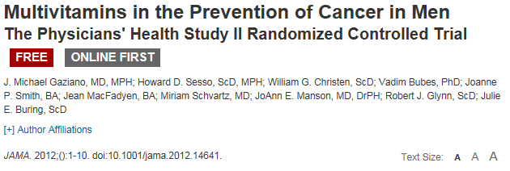
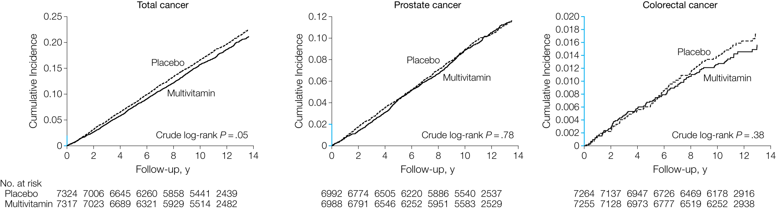
In this large prevention trial of male physicians, daily multivitamin supplementation modestly but significantly reduced the risk of total cancer.

Slide 30
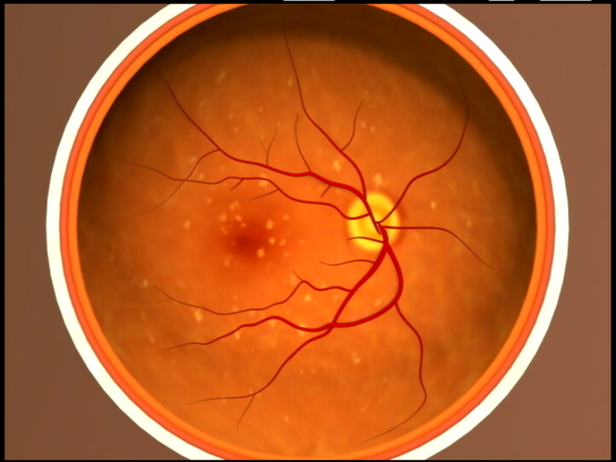
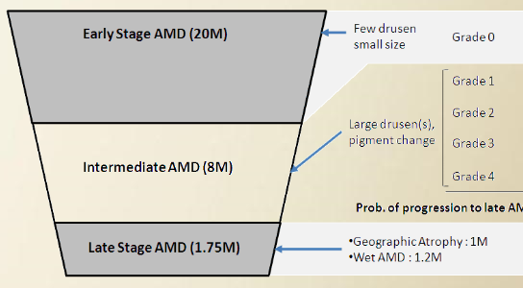


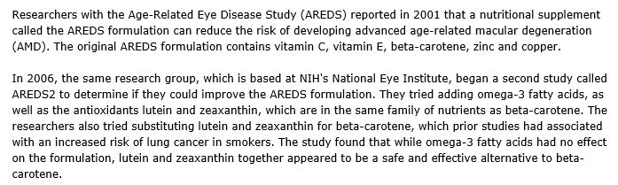
lutein/zeaxanthin (10 milligrams/2 milligrams)
500 milligrams vitamin C, 400 international units of vitamin E Zinc 25 mg

Slide 31
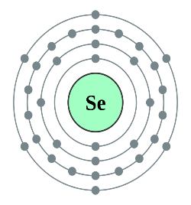
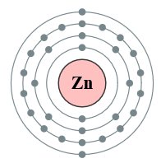
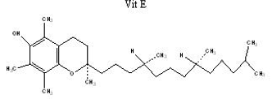
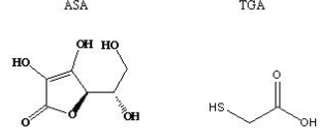




Antioxidants: an heterogeneous family of compounds
Beta carotene
Glutathione
Elements, Hydro soluble vitamins, Lipid Vitamins, Polyphenols, Terpenes, Peptides….

Slide 32
Claims on the protection of body cells and molecules (i.e. DNA, proteins and lipids) from oxidative damage, including photo-oxidative (UV-induced) damage
4.1.1 Oxidative damage to proteins
Direct measurements of oxidative damage to proteins in vivo (e.g. measurement of oxidative changes of amino acids in proteins) could be obtained by means of HPLC-MS and other methods, as long as identification and separation of such molecules in plasma from other substances is successfully achieved (e.g. from protein tyrosine nitration products). Measures of protein oxidation by-products (e.g. protein carbonyls) using conventional assays (e.g. colorimetric procedure which involves dinitrophenylhydrazine (DNPH) derivatisation of carbonyl groups) or ELISA methods (either directly or after DNPH derivatisation) are usually susceptible to interferences by molecules other than proteins, and could only be used in combination with at least one direct marker of oxidative damage to proteins in vivo if assessed directly in blood or target tissue (e.g. skin).

Slide 33
4.1.2 Oxidative damage to lipids
Direct measurements of oxidative damage to lipids (i.e. lipid peroxidation) could be obtained in vivo by measuring changes in F2-isoprostanes in 24-h urine samples, which is a better matrix than plasma for this measurement, using gas-chromatography techniques with various detection modes, of which mass spectrometry is preferred. F2-isoprostanes can also be measured using immunoassays. However, lack of specificity owing to possible cross reactions with other prostanoids needs to be taken into account.
Measurements of oxidative damage to lipids (i.e. lipid peroxidation) could also be obtained in vivo by measuring oxidised LDL particles in blood using immunological methods (i.e. antibodies) with appropriate specificity.
Phosphatidylcholine hydroperoxides (PCOOH) measured in blood or tissue by high-performance liquid chromatography (HPLC) is also an acceptable marker of lipid peroxidation.
Other methods proposed are not reliable in vivo markers of lipid peroxidation (e.g. thiobarbituric acid reactive substances (TBARS), malondialdehyde (MDA), lipid peroxides, HDL-associated paraoxonases, conjugated dienes, breath hydrocarbons, auto-antibodies against LDL particles, and ex vivo LDL resistance to oxidation). However, concentrations of MDA or lipid peroxides in blood or tissue could be used as supportive evidence (i.e. in addition to measurements of F2-isoprostanes and in vivo LDL oxidation) if appropriate techniques are used for analysis (e.g. HPLC).

Slide 34
4.1.3 Oxidative damage to DNA
Direct measurements of oxidative damage to DNA may be obtained in vivo by using modifications of the comet assay, which allow the detection of oxidised DNA bases (e.g. use of endonuclease III to detect oxidised pyrimidines). Although the assay provides no absolute values, it allows quantitative comparison with an appropriate control. This assay directly reflects DNA oxidative damage within cells when assessed, for example, in circulating lymphocytes.
Measures of DNA damage using the traditional comet assay (single-cell microgel electrophoresis, SCGE) detect DNA strand breaks by the appearance of tailing, and are not specific for oxidative damage. Other variants of the comet assay determine resistance against oxidative modification using ex vivo pro-oxidant challenges. Neither of these measurements is appropriate for assessing in vivo oxidative damage to DNA.
Analyses of 8-hydroxy-2-deoxy-guanosin (8-OHdG) in blood (e.g. lymphocytes), tissue (e.g. skin) and urine have been used to assess oxidative damage to DNA. Free 8-OHdG results from oxidative damage and excision-repair; it may also result from oxidation of free bases or nucleotides, from oxidation of other nucleic acids, and from artefacts during sample work up. Urinary 8-OHdG does not directly reflect DNA oxidation within cells, but could be used in combination with direct measurements of oxidative damage to DNA if appropriate techniques are used for analysis (e.g. HPLC).

Slide 35

Classification of Antioxidants
Direct Antioxidants
  Free radical scavengers (SOD/O₂^{-.})
  Non radical scavengers (Catalase/H₂O₂)
Indirect Antioxidants
  Inhibitors of cellular sources of oxidants (chelators/metals, apocynin/Nox)
  Inducers of cellular antioxidants (sulforaphane/Nrf2 targets-GSH)

Slide 36


EFSA has rejected all the claims related to Q10 healthy effects
On the basis of the data presented, the Panel concludes that a cause and effect relationship has not been established between the consumption of coenzyme Q10 (ubiquinone) and any of the overall health claims

Slide 37





Consumption of olive oil polyphenols helps protect blood lipids against oxidative stress.
The European Food Safety Agency (EFSA) has issued a positive opinion on the use of a Health Claim for olive polyphenols: "Scientific Opinion on the substantiation of health claims related to polyphenols in olive and protection of LDL particles from oxidative damage." EFSA Journal 2011;9(4):2033, which indicates that the panel concludes that there is a relationship of cause and effect between the consumption of olive polyphenols (mainly hydroxytyrosol and its derivatives) and the protection of the cholesterol LDL particles from oxidative damage.

Slide 38





Design of the PREDIMED (Prevención con Dieta Mediterránea) study.
CVD, cardiovascular disease; EVOO, extravirgin olive oil; MeDiet, Mediterranean diet.
Incidence of cardiovascular disease by intervention group in the PREDIMED (Prevención con Dieta Mediterránea) study.

Slide 39


JAMA Internal Medicine Published onlineMay 11, 2015
INTERVENTIONS
Participants were randomly assigned to a Mediterranean diet supplemented with extravirgin olive oil (1 L/wk), a Mediterranean diet supplemented with mixed nuts (30 g/d), or a control diet (advice to reduce dietary fat).
CONCLUSIONS AND RELEVANCE
In an older population, a Mediterranean diet supplemented with olive oil or nuts is associated with improved cognitive function.

Slide 40




Cocoa phytochemicals, a story of positive biology

Slide 41




Methylxanthines in Plants, and cocoa
Coffea arabica
Paullinia cupana
Camellia sinensis
Theobroma cacao

Slide 42



Chemical structures of cocoa flavanols
Monomers
Procyanidins

Slide 43






EU Cocoa Health Claims

Slide 44





EU Cocoa Health Claims

Slide 45


Psychopharmacology (2015) 232:3227–3234
Axial slices showing regions of significantly greater regional perfusion 2 h post-consumption of the high flavanol drink relative to the low flavanol drink using arterial spin labelling. Significantly greater change in blood perfusion occurred following the high flavanol drink compared to the low flavanol drink in two clusters; the ACC and the central opercular cortex of the left parietal lobe down to a sub-cluster in the temporal pole.

Slide 46



USA - EU Cocoa Health Claims – What next?
In a controlled randomized trial, healthy 50–69-year-old subjects consumed either a high or low cocoa flavanol–containing diet for 3 months. A high-flavanol intervention was found to enhance DG function, as measured by fMRI and by cognitive testing.

Slide 47








Flaviola European Project

Slide 48



USA, COcoa Supplement and Multivitamin Outcomes Study (COSMOS)
COSMOS will enroll 18,000 women and men nationwide, making it the largest dietary intervention study to evaluate the health benefits of cocoa flavanols and a multivitamin.

Slide 49







Mediterranean Fashion: a treasure of functional food

Slide 50
I «Novel food», cioè i nuovi alimenti o i nuovi ingredienti alimentari, sono disciplinati dalla legislazione alimentare comunitaria con il Regolamento (CE) 258/97. Rientrano in questa categoria tutti quei prodotti e sostanze alimentari per i quali non è dimostrabile un consumo “significativo” al 15 maggio 1997 all’interno dell’Unione Europea (UE), data di entrata in vigore del regolamento medesimo.
I “novel food” devono ricadere in una delle seguenti categorie:
1. prodotti o ingredienti alimentari con una struttura molecolare primaria nuova o volutamente modificata;
2. prodotti o ingredienti alimentari costituiti o isolati a partire da microrganismi, funghi o alghe;
3. prodotti o ingredienti alimentari costituiti da vegetali o isolati a partire da vegetali e ingredienti alimentari isolati a partire da animali;
4. prodotti e ingredienti alimentari sottoposti ad un processo di produzione non generalmente utilizzato, che comporta nella composizione o nella struttura dei prodotti o degli ingredienti alimentari cambiamenti significativi del valore nutritivo, del loro metabolismo o del tenore di sostanze indesiderabili.

Slide 51












Applications under Regulation (EC) N° 258/97 of the European Parliament and of the Council

Slide 52






