Slide 1
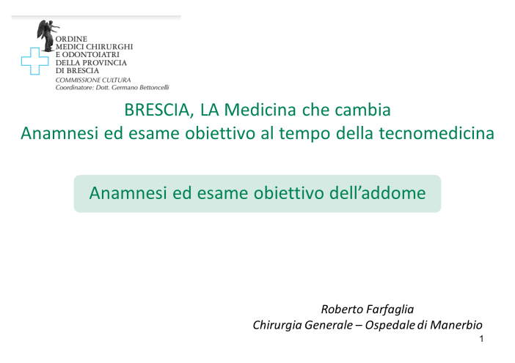

Slide 2
Luigi Condorelli - 1968
«…oggi un altro grave pericolo minaccia la sana educazione delle nuove generazioni di medici. E’ la pericolosa penetrazione del pragmatismo anglosassone, che minaccia di svisare e denaturare la sublime elevatezza del classico tradizionale indirizzo clinico. Questa nuova incarnazione del pragmatismo porta a sostituire la tecnica (soprattutto strumentale) alla metodologia …. e ad annichilire la personalità del medico, rivolgendo il dramma clinico in una pedestre quanto scialba e slegata ricomposizione di frammenti di mosaico, rappresentati dai risultati delle ricerche, spesso strumentali, eseguite sui diversi organi, quasi sempre da più osservatori, cioè dai cosiddetti specialisti degli infiniti frammenti del corpo umano

Slide 3
Dolore addominale acuto non traumatico
Disturbo comune ma insidioso, che richiede diagnosi differenziale fra malattie non gravi e malattie serie che necessitano di approccio medico o chirurgico urgente
La sensibilità e la specificità dell’anamnesi e dell’ esame obiettivo nel diagnosticare le diverse cause di dolore addominale sono piuttosto basse per le forme benigne , ma accettabili per le forme più serie (occlusione, colecistite, appendicite, peritonite...)

Slide 4

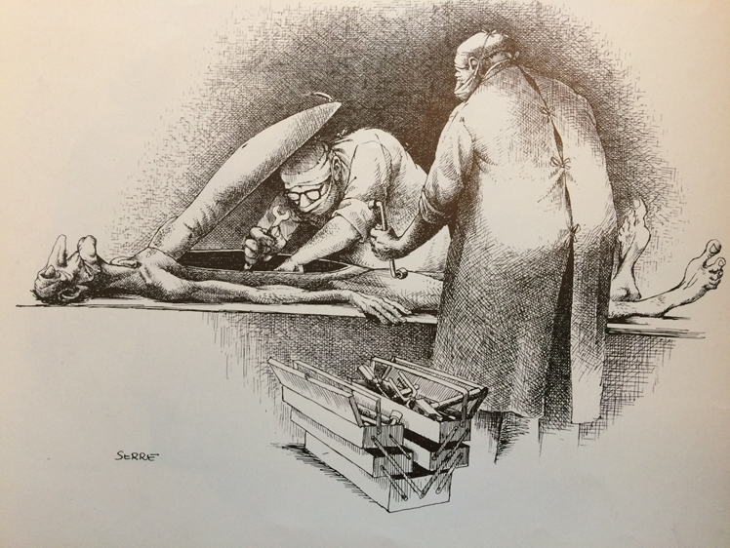
Vantaggio del chirurgo

Slide 5
Anamnesi
Nato a termine da parto eutocico, allattamento materno,
sviluppo psico-somatico normale, abile alla visita di leva………..
Familiare (oncologica…)
Fisiologica (fumo, alcool, stili di vita…)
Patologica remota (interventi, diabete, allergie, malattie cardiovascolari…)
Farmacologica (steroidi, psicofarmaci, fans, antibiotici…)
Sociale
«Geografica» (migrazioni, turismo)
Scale di automonia e mobilità (conley, braden, barthel…)

Slide 6
Il dolore addominale
Localizzazione ed irradiazione (diffusa, quadrante…)
Elementi temporali (esordio, durata, colico/costante…)
Tipo
Intensità (nps 1-10)
Fattori scatenanti od attenuanti
Sintomi associati (g.I., Uro, gine, cardio, pneumo, neuro)
Sintomi d’allarme (febbre, calo ponderale, sanguinamenti, astenia, anoressia)
Interferenze farmacologiche
Aspetti epidemiologici

Slide 7
Esame obiettivo
Segni vitali e segni di sepsi
Ispezione (posizione, gestualità, mobilità, escursioni respiratorie, cicatrici, ernie…)
Percussione (ascite, globo vescicale, distensione intestinale, masse…)
Auscultazione ( peristalsi e rumori intestinali per ileo meccanico o paralitico)
Palpazione

Slide 8
Palpazione
      definire la presenza o l’assenza di peritonismo e’ un obiettivo primario dell’esame obiettivo addominale
      la dolorabilità orienta sulla localizzazione del focus patologico
      La contrattura di difesa, cioè l’aumentato tono (focale o diffuso) della muscolatura addominale, esprime l’involontario riflesso di protezione dal movimento del contenuto addominale.
      La contrattura di rimbalzo (Blumberg positivo) è segno di peritonismo (sensibilità dell’80% e specificità del 50%).
      L’addome a tavola è l’esempio estremo di una contrattura di difesa.

Slide 9
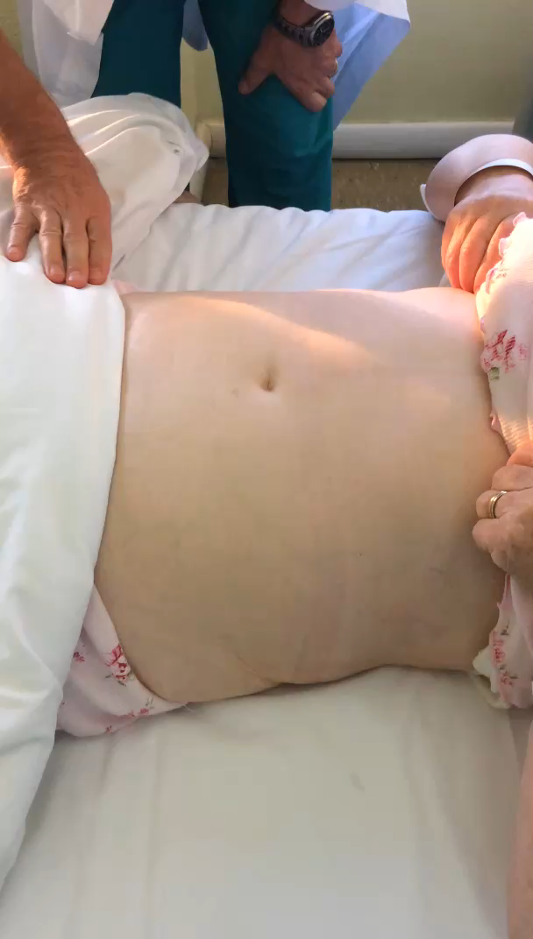
Palpazione
Reazione di difesa in FIS con contrattura riflessa e Blumberg = PERITONISMO

Slide 10
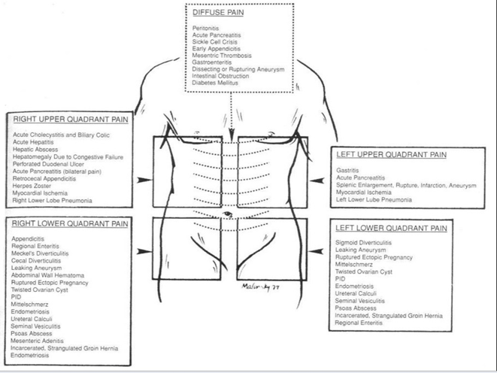

Slide 11
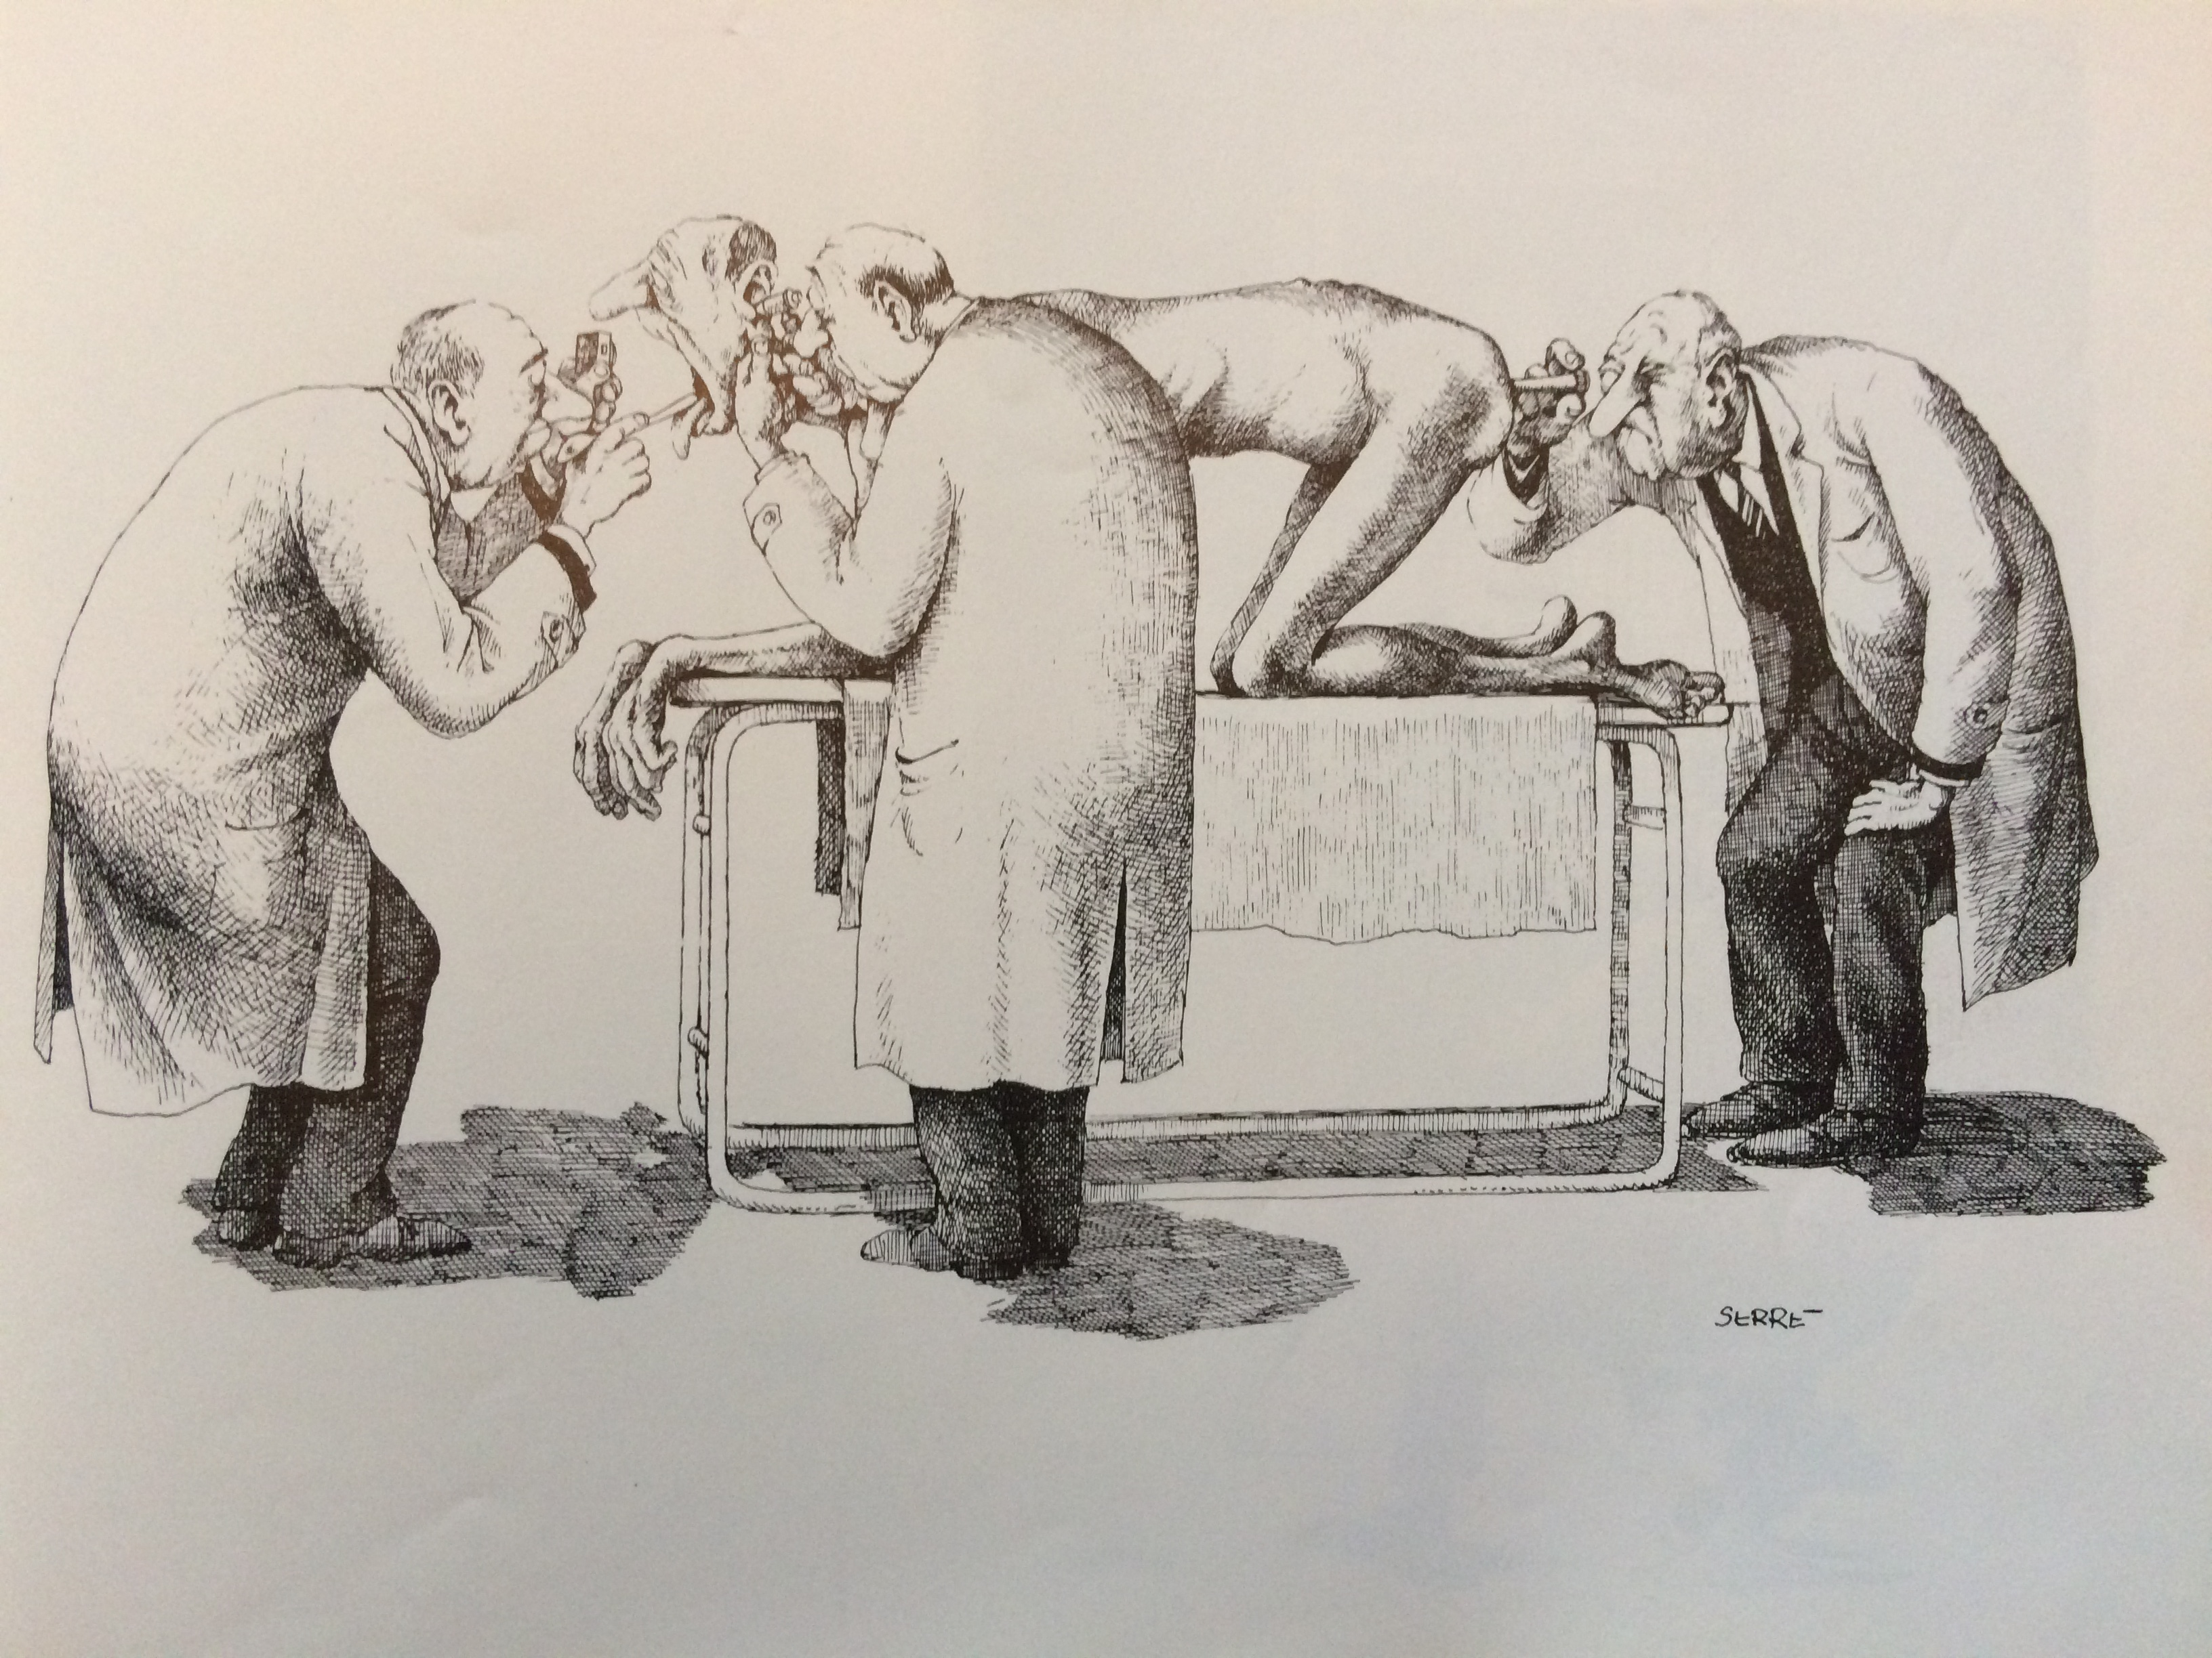
Esplorazione rettale
Posizione di sims
sanguinamenti digestivi (colore?)
Dolorabilità scavo pelvico
Lesioni, masse, fecalomi…..

Slide 12
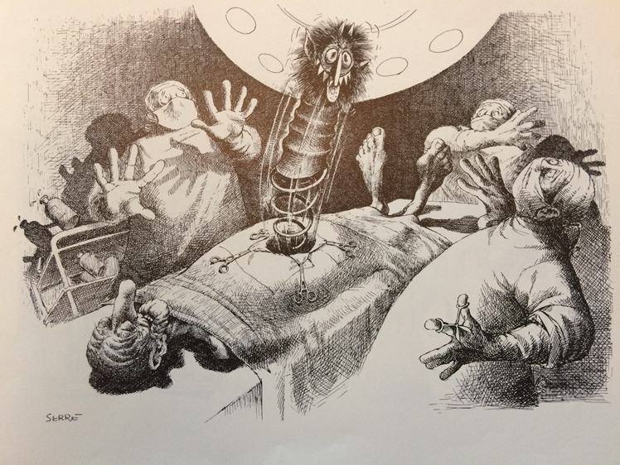
Elementi di cautela

Slide 13
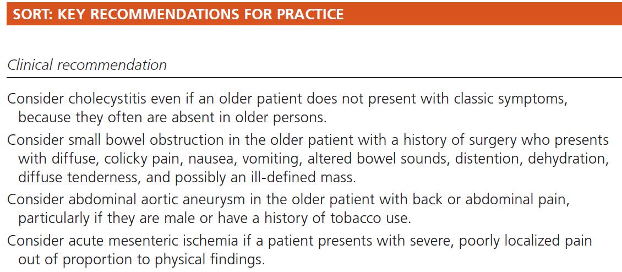
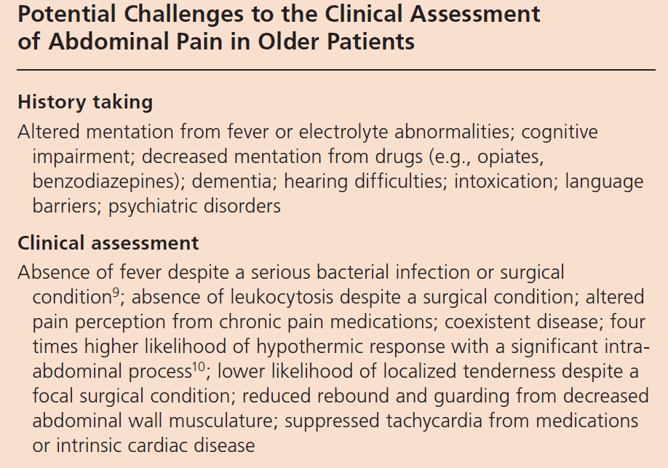
Acute Abdominal Pain in Older Patients

Slide 14
Dolore addominale ginecologico

Slide 15
Appendicite: Sistemi di score clinico

Slide 16
Appendicite acuta

Slide 17
Dolore addominale non specifico (nsap)
PS
1411 NSAP (34% degli accessi per dolore addominale)
8% rientro in PS a 12 mesi
76% NSAP
24% SAP (30% litiasi biliare, 20% appendicite, 7% cancro G.I.)
Gunnarsson O.S. BMJ 2011

Slide 18
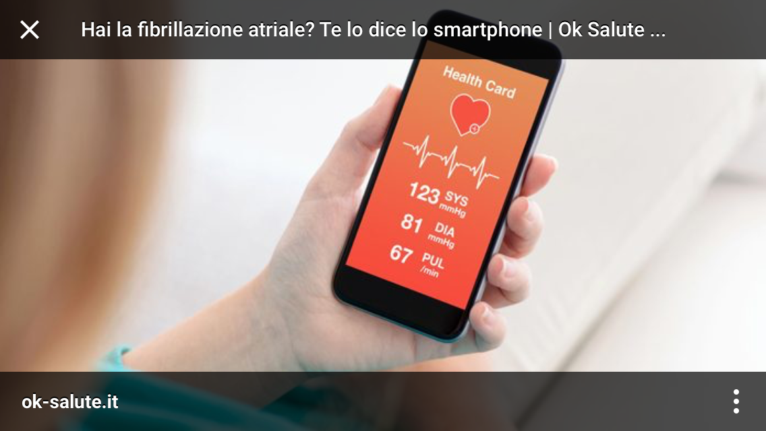
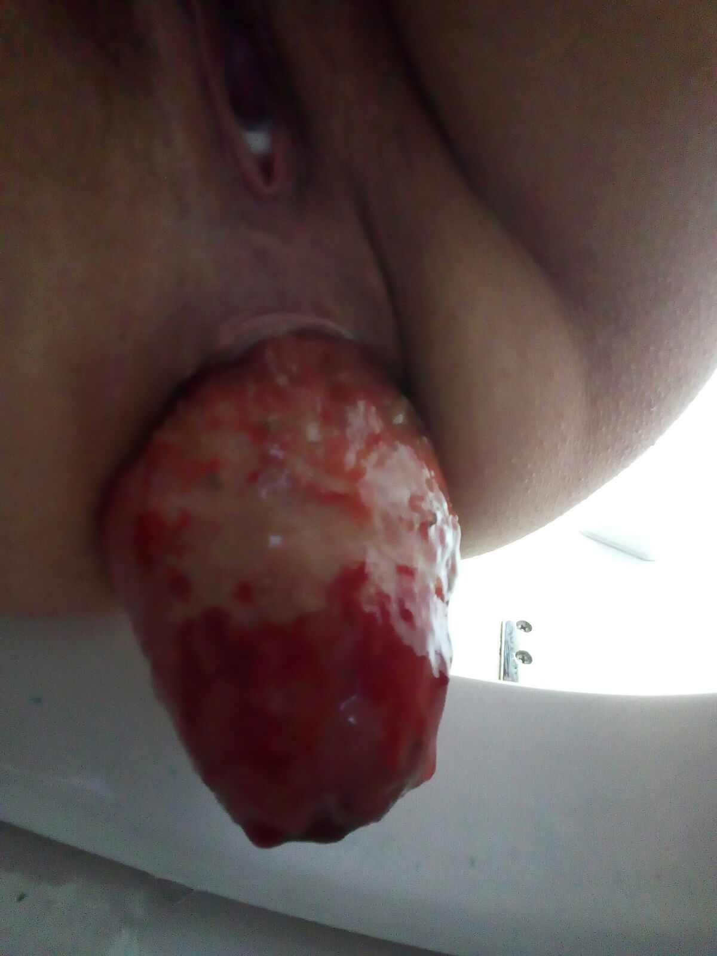
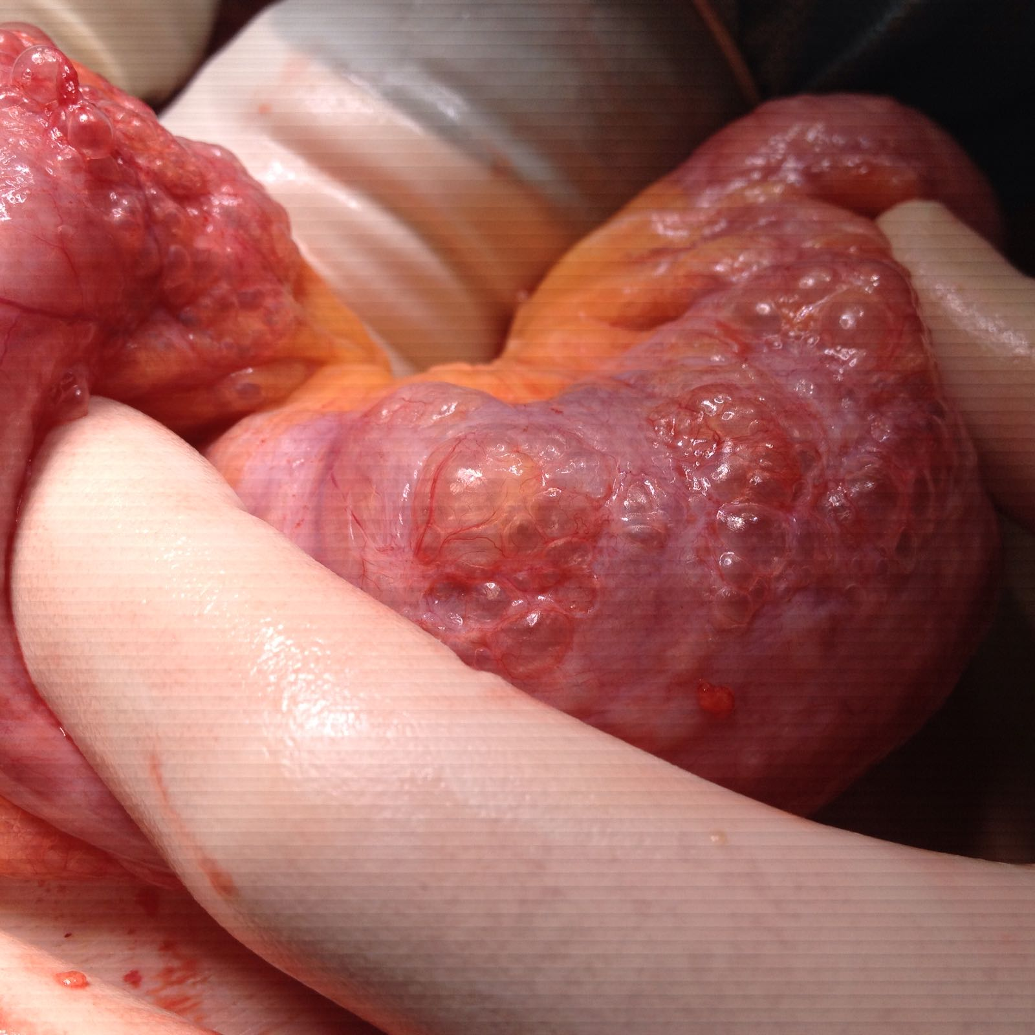
smartphone
EO virtuale

Slide 19
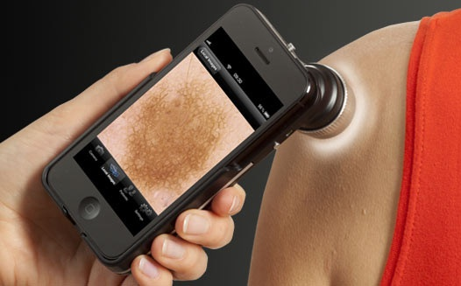
CAMBRIDGE Molemate system
Dermatoscopio per smartphone abbinato ad un algoritmo specifico non equivale (ancora) ad una valutazione di un pool di esperti dermatologi ma ….
J.H.Walters, BMJ 2012

Slide 20

I.A. will redesign healthcare

Slide 21

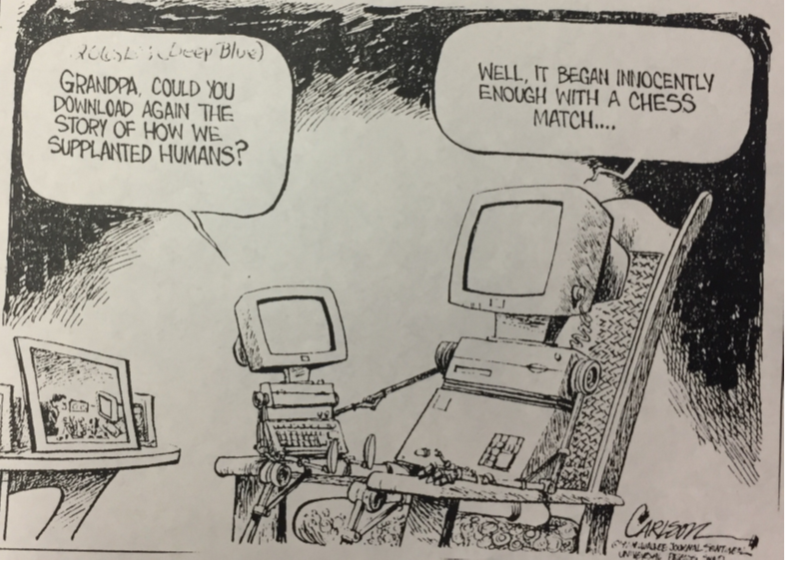

KASPAROV VS DEEP BLUE (maggio 1997)

Slide 22

IBM Watson (febbraio 2011)
Watson Oncology MSKCC:
90% concordance with a board of 15 oncology specialists for breast and lung cancer

Slide 23

826 Aziende

Slide 24
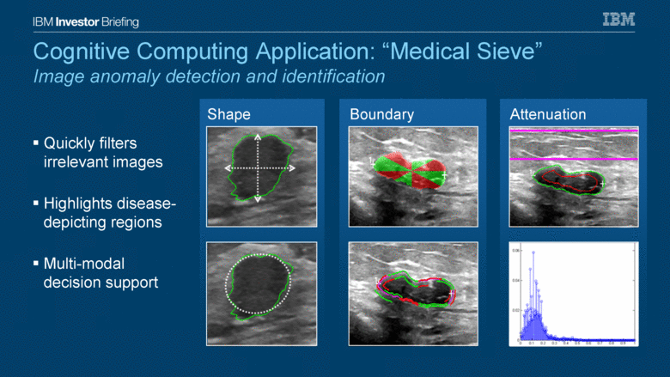
Il futuro dei radiologi…….

Slide 25

Doctors on demand.
Health Tap.
The World Health Organization estimates that there is a worldwide shortage of around 4.3 million physicians, nurses, and allied health workers.
The telehealth service established in 2010 already answered 6.3 billion health-related queries, employs 108,000 medical professionals and saved 24,489 lives.

Slide 26
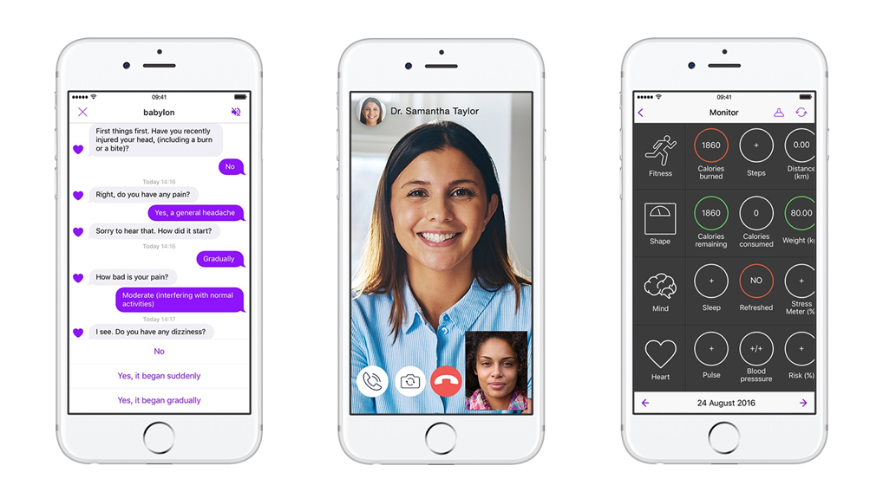
Babylon
London 2013
Virtual GP by subscription
Tested as an alternative to NIH 111 tel.

Slide 27

Because it’s time the doctor come to you

Slide 28
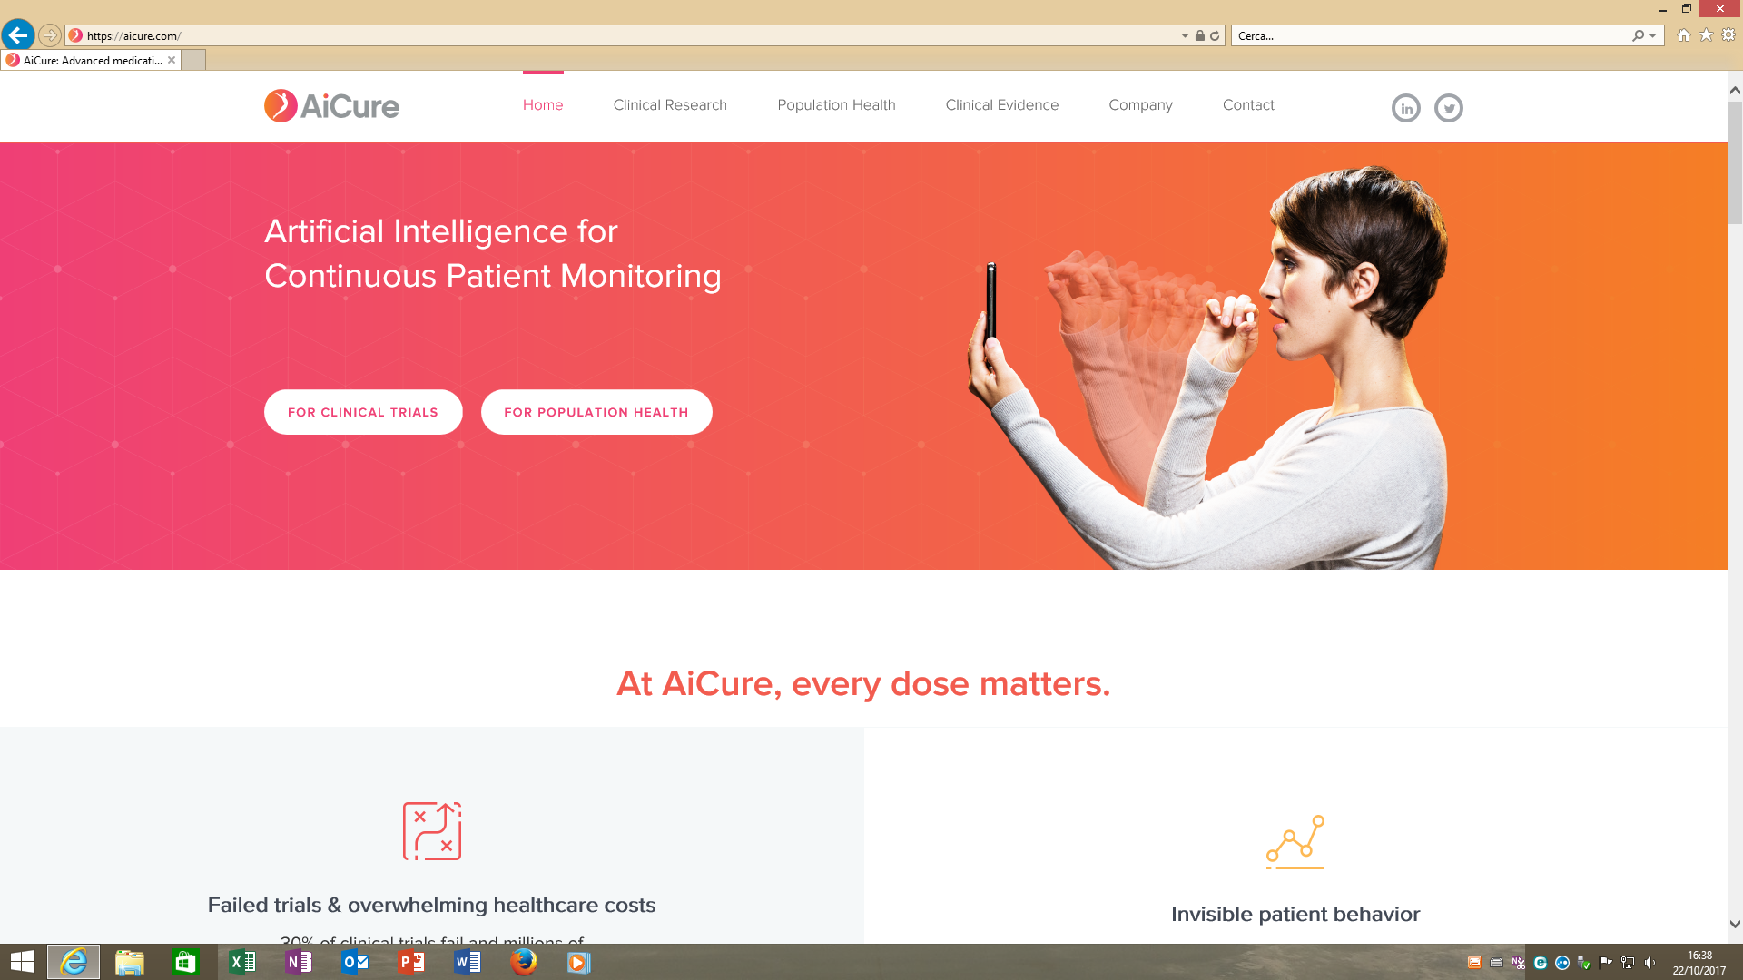
APP per smartphones
Ha ridotto del 50% il rischio di
non-aderenza alla terapia
anticoagulante, ma anche per la terapia di epatite C, tubercolosi schizofrenia

Slide 29

SFIDA Uomo vs macchina

Slide 30
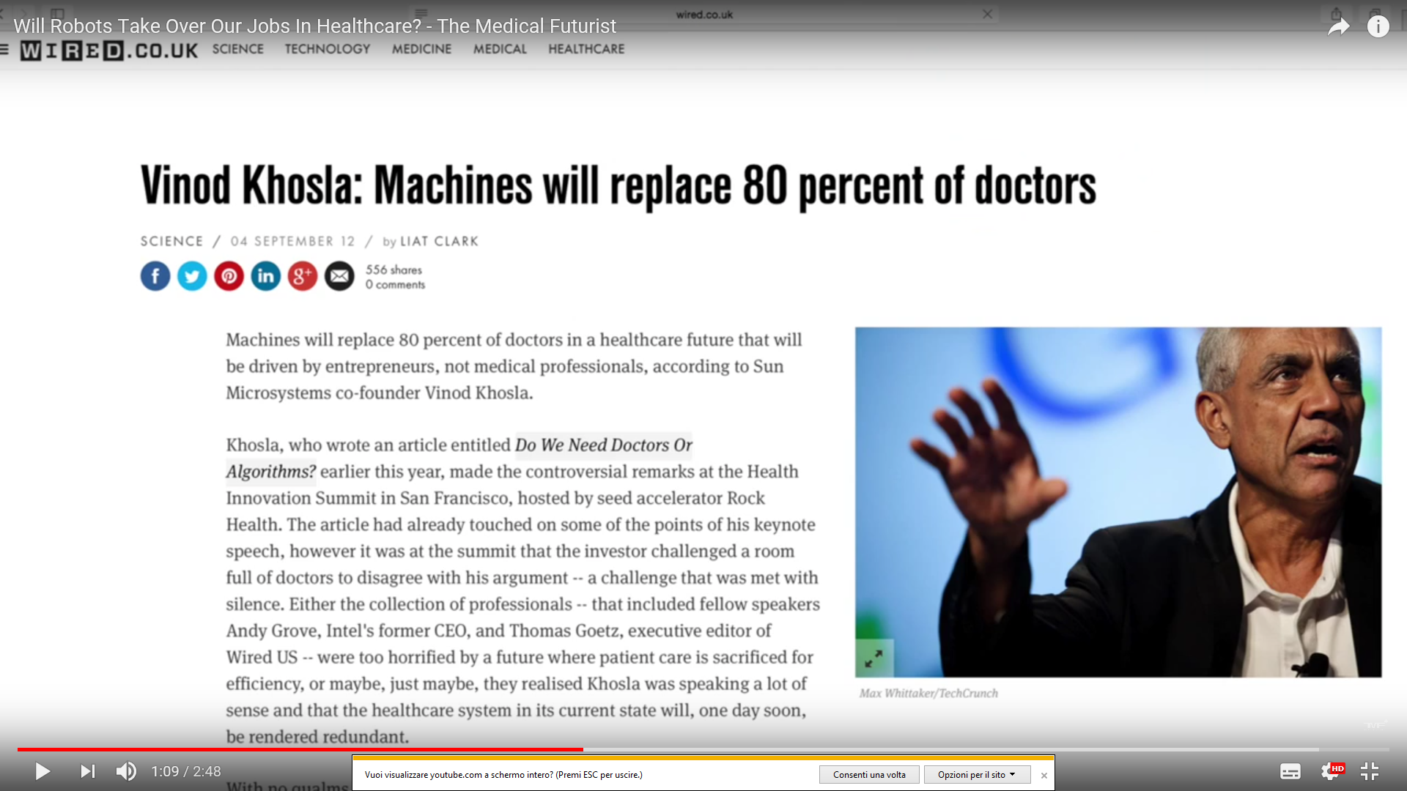
Do we need doctors or algorithms

Slide 31


…with disruptive technologies physicians would finally have time to focus on the
patient, deal with challenging decisions and enjoy their profession again !

Slide 32
Where could humans have a chance?
At the so-called soft skills: creativity, empathy, compassion and paying attention to each other. Although artificial intelligence will perform diagnostic tasks or robots might be able to do surgeries, but could they talk to a patient with empathy about the risks and consequences of an operation?
Non tutto quello che si può contare conta
E non tutto quello che conta si può contare

Slide 33

Algoritmi o soft skills?

Slide 34


Slide 35
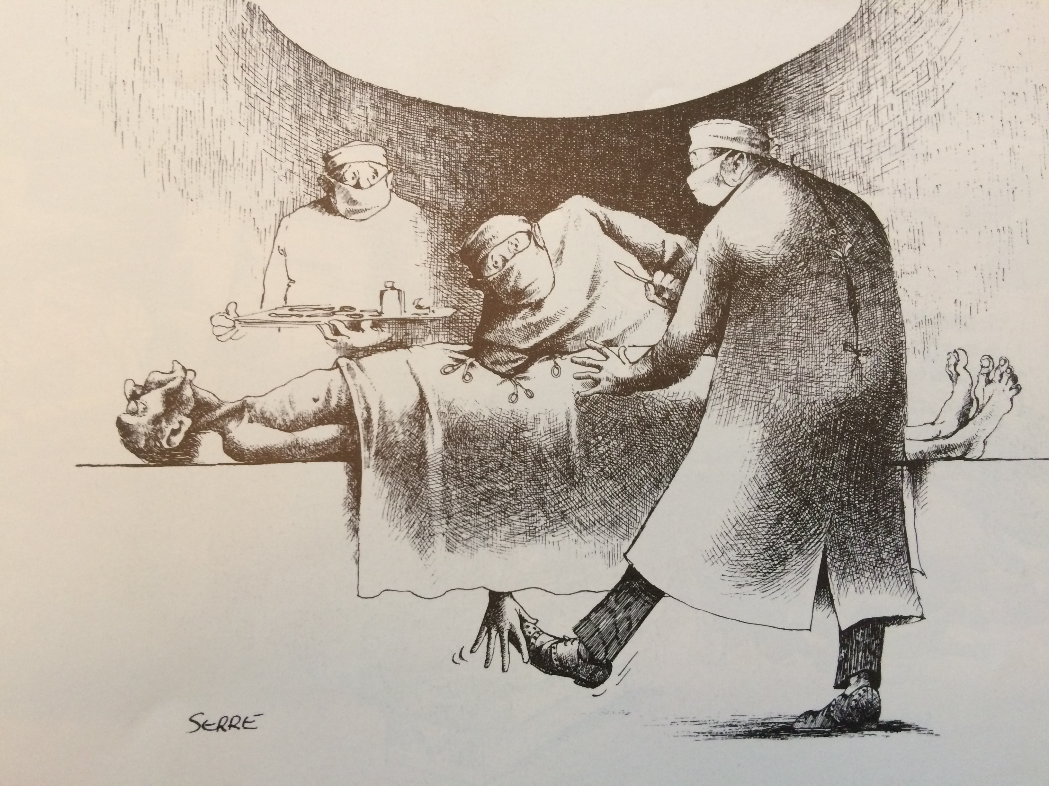

Slide 36


Slide 37
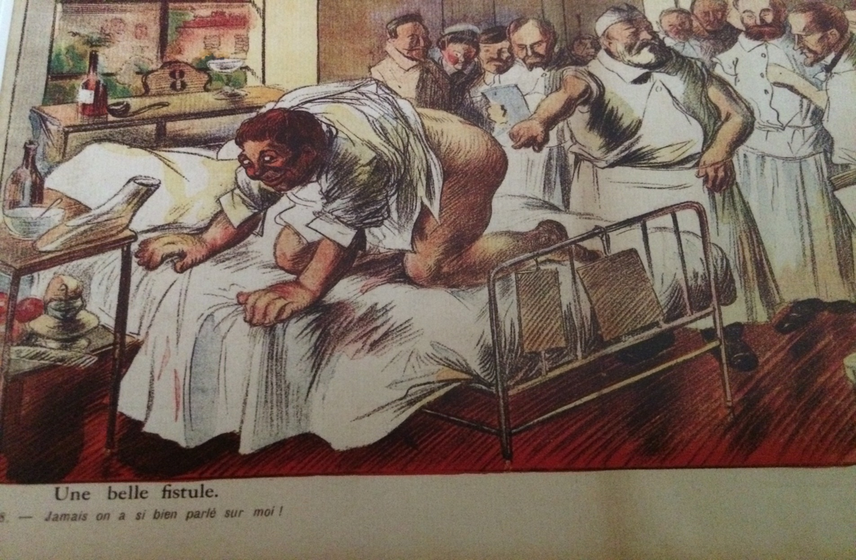

Slide 38


Slide 39
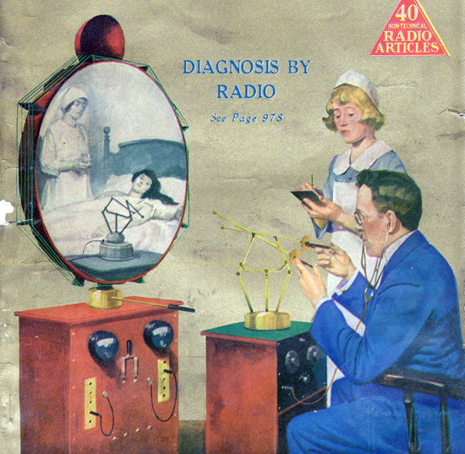
HUGO GERNSBACK TELEDACTYL (1925)

Slide 40

Intelligenza artificiale

Slide 41
Acute Abdominal Pain (AAP)
  Pain location
    generally perceived in midline (afferent impulses from visceral organs are poorly localized)
    Distention, stretch, vigorous contraction, and ischemia
    foregut structures - localized to the epigastric region.
    midgut structures - periumbilical region
    hindgut structures - suprapubic region
    retroperitoneal structures – in the back
  Character
    Visceral - dull, poorly localized, aching, or gnawing
    Somatic - “sharp”, more defined and localized (inflammatory or chemical irritation of the parietal peritoneum)
  Onset
    Acute-onset, severe, - potential intra-abdominal catastrophe (ruptured abdominal aortic aneurysm or aortic dissection;
    perforated ulcer, volvulus, mesenteric ischemia, and torsion)
    only 47% of elderly patients with a proven perforated ulcer report the acute onset of pain.
    Serious vascular issues such as mesenteric ischemia may present with a gradual onset of pain
    Pain that awakens the patient from sleep should be considered serious until proven otherwise.
  Intensity
    severe pain - concern for a serious underlying cause
  Radiation and referral of pain
    shoulder pain - diaphragmatic irritation, from free intraperitoneal blood, or by biliary disease.
  Duration and progression
    migration of pain in appendicitis
    “colic” gallbladder pain - not paroxysmal, almost never lasts less than 1 hour, average of 5–16 hours’ duration
    Small bowel obstruction from an intermittent (“colicky”) pain to more constant pain (distention). Late somatic pain (transmural ischemia or perforation contiguous to parietal peritoneum)

Slide 42
Acute Abdominal Pain (AAP)
  Provocative and palliating factors
    jarring motions (coughing or walking) exacerbate the pain - peritoneal irritation.
  Previous episodes
    Recurrent episodes generally point to a medical cause, with the exceptions of mesenteric ischemia (intestinal angina), gallstones, or partial bowel obstruction.
  Vomiting
    Pain generally precedes vomiting in surgical conditions, with the important exception of esophageal rupture from forceful emesis.
    Other serious entities including large bowel obstruction frequently present without vomiting.
    Massive hematemesis in a patient with a prior abdominal aortic aneurysm repair may be due to aorto-enteric fistula.
  Bowel symptoms
    Diarrhea - frequent accompaniment of benign abdominal conditions
    Absence of flatus - bowel obstruction
    Bloody stool and abdominal pain - mucosal compromise from ischemia
    Melena - upper source of bleeding Frank blood - lower source or a massive upper bleed
    Urge to defecate in AAP - serious disease (ruptured aneurysm or ruptured ectopic pregnancy)
  Other symptoms
    Any inflammatory process contiguous to the genitourinary tract may result in pyuria and dysuria.
    Testicular torsion may present as abdominal pain, nausea, and vomiting.

Slide 43
Approach to patient with intense AAP
Step 1. Differentiate clinical condition and life-threatening diseases.
  Confirm patient vital signs, airway (A), breathing (B), circulation (C), and consciousness.
  Emergency treatment required if any abnormality identified during ABCD assessment.
  Differentiate super emergent disease and emergent disease while stabilizing the physiologic state of the ABC of patients with abdominal pain and abnormal ABCD.
Step 2. Evaluation of clinical condition and physical examination
  If vital signs stable, determine whether the cause of the abdominal pain requires surgical intervention according to history, physical examination, and laboratory findings.
  In patients with sudden onset or increasing pain, emergency surgery is often required
  Patients exposure from the processus xiphoideus to groin
Inspection
  detect abdominal surgery scars, herpes zoster infection, stigmata of cirrhosis, hernia, respiratory fluctuations, skin changes (ecchymosis)
Gentle percussion and palpation
  Percussion - detecting acute peritonitis - presence of ascites - size of liver, bladder, and spleen.
  Tympanic sounds on percussion - expanded bowel
  Dullness - presence of ascites or abdominal masses.
  Tenderness - Muscle guarding - early peritoneal stimulation sign
  Organ hypertrophy and presence of masses
Auscultation
  Peristaltic movements

Slide 44
Common causes of AAP
  Acute cholecystitis
    Biliary tract disease – most common indication for surgery in older patients with abdominal pain 1/3 patients > 55 years presenting to ED with AAP. right upper quadrant pain and Murphy’s sign in 50% of older patients with cholecystitis Pts > 65 years with acute cholecystitis: 60 % no back or flank pain 5 % no pain at all 40 % no nausea, > 50% afebrile, 41% normal white blood cell count
  Acute appendicitis
    generalized pain, longer duration of pain, distention, rigidity, decreased bowel sounds, and a mass (delay in presentation?) fever alone poor predictor of acute appendicitis in older patients; 23% > 37.7°.
  Acute pancreatitis
    nausea, vomiting, dehydration, and midepigastric pain with radiation to the back. Serum amylase levels of five times the upper limit of normal, used as a diagnostic indicator, have a specificity of 70-100% sensitivity 79-95%. Lipase more specific (80 -100 %), because mild elevations in amylase can be associated with other processes such as mesenteric ischemia or peptic ulcer and bowel perforation.
  Peptic ulcer perforation
    Nonsteroidal anti-inflammatory drugs (NSAIDs) and HP infection - most important risk factors
    30% > 60 years with confirmed peptic ulcer disease no abdominal pain. Abdominal pain with a perforation - abrupt onset, epigastrium, absent bowel sounds, abdominal rigidity. 50 % no free air
  Diverticular disease
    5% general population - 2/3 pt 90 years 10-30% painful diverticular disease or diverticulitis. Sigmoid colon most commonly affected - left lower quadrant pain and signs of inflammation.

Slide 45
Common causes of AAP
  Small bowel obstruction
    most commonly by adhesions from previous surgery (50 to 70 percent) and hernias (15 to 30 percent).
    diffuse, colicky pain, nausea, and vomiting. Altered bowel sounds, distention, dehydration, diffuse tenderness, and possibly an ill-defined mass. Peritoneal signs if perforation
  Large bowel obstruction
    Malignancy - common cause of large bowel obstruction - Diverticulitis and colonic volvulus. Laxative use, sedatives, anticholinergics, and antiparkinson medicines predispose patients to a volvulus. Chronic distention, elongation, and increased mobility of the colon allow parts of the colon to twist on itself. Symptoms of large bowel obstruction tend to be insidious in onset, and presentation is similar to small bowel obstruction
  Abdominal aortic aneurysms (AAAs)
    highest risk for AAA are older men who use tobacco and have hypertension, peripheral vascular disease, and a family history of AAA. Smoking – strongest independent risk factor; 90% of patients with AAA have used tobacco.
    When symptoms - usually nonspecific, abdominal pain, backache, or claudication.
    Signs and symptoms of AAA rupture - severe abdominal pain, back or flank pain, hypotension, and a pulsatile mass on examination. Present in 25 to 50 %
  Acute mesenteric ischemia
    uncommon but often fatal cause of acute abdominal pain. 0.1% of all hospital admissions and 1 percent of admissions for acute
    abdominal pain. ½ patients > 45 years. SMA most commonly implicated in acute mesenteric ischemia.
    Arterial embolism, arterial thrombosis, nonocclusive ischemia, and mesenteric venous thrombosis.
    Severe, poorly localized abdominal pain out of proportion to physical findings. 1/3 nausea, vomiting, or diarrhea, often
    mimicking gastroenteritis. Distention, shock, and peritoneal irritation late findings signaling infarction and perforation
  Atypical causes
    urinary tract infection, pyelonephritis, myocardial infarction (inferior wall), pulmonary embolism, congestive heart failure with hepatic congestion, pneumonia, constipation, urinary retention, abdominal muscle injury.

Slide 46
«Se consideriamo che una gran parte delle affezioni addominali decorre con una vistosa sintomatologia subiettiva ma con obiettività scarsa o nulla, comprendiamo facilmente tutta l’importanza che nella patologia dell’addome riveste il raccogliere un’anamnesi corretta e minuziosa».
G.M. Rasario
Manuale di semeiotica medica 1979

